Slide 1
2023 National Conservation Foundation - Envirothon
Aquatics Study Guide

Slide 2
1. The Hydrologic Cycle
http://www.jcscience.ie/es-5.html

Slide 3
Watersheds
A watershed or catchment area is the area of land in which all water flows to the same point.
A watershed can be as small as the area around your neighborhood that flows into a single stream
Or as large as the Mississippi River watershed, which comprises about 40% of the lower 48 states of the United States. It covers parts of 32 states and two Canadian provinces.

Slide 4
17. Watersheds and catchment areas
https://www.erosionpollution.com/watershed-protection.html

Slide 5
14. Aquatic food web
https://www.biologyonline.com/dictionary/biotic-factor

Slide 6
15. Energy and Trophic Levels
https://texasaquaticscience.org/habitats-aquatic-science-texas/

Slide 7
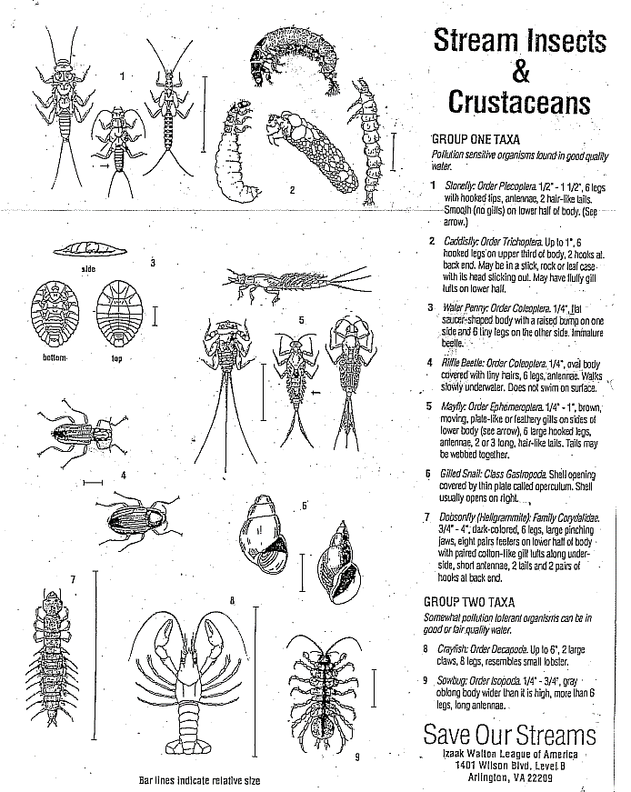
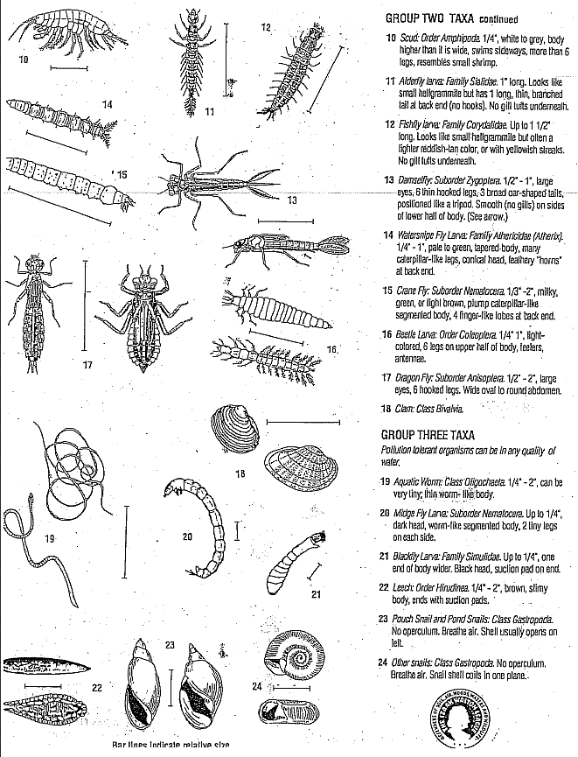
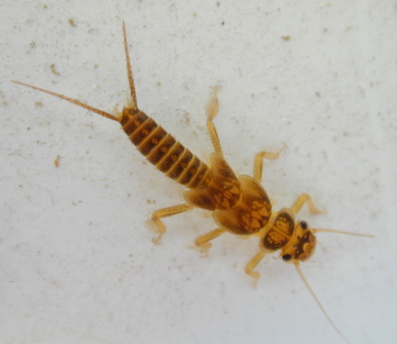
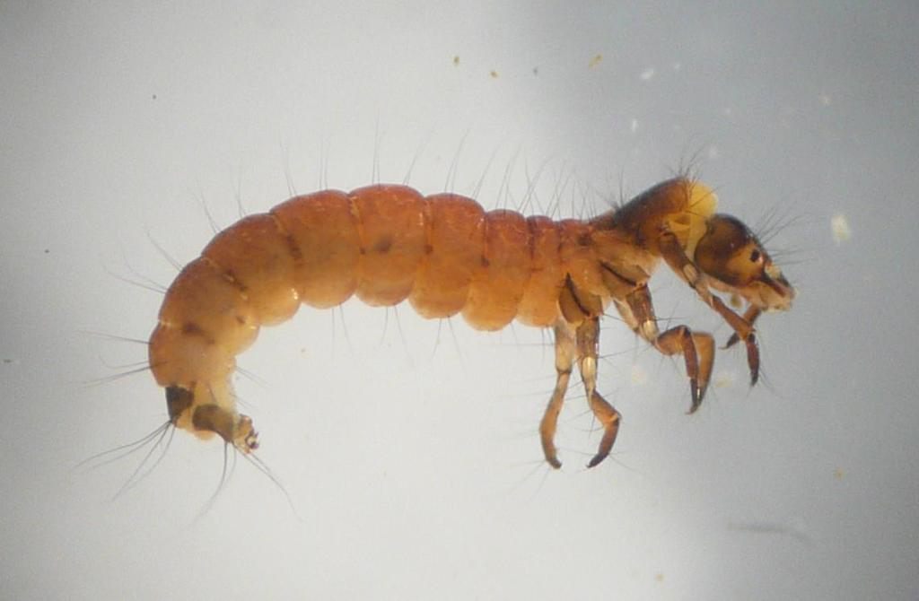
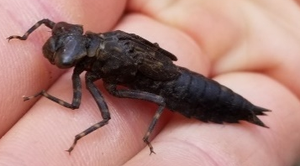
52. Common macroinvertebrates of Louisiana
https://www.inaturalist.org/photos/4192
Stonefly larva (Order Plecoptera)
https://www.inaturalist.org/observations/72101327
Caddisfly larva (Order Trichoptera)
https://www.inaturalist.org/observations/11277225
Predaceous diving beetle larva –
Beetle larva (Order Coleoptera)
https://www.inaturalist.org/observations/85213645
Dragonfly larva – dragonflies and damselflies (Order Odonata)
https://www.deq.louisiana.gov/assets/docs/Envirothon/Aquaticmacroinvertebratedocuments.pdf

Slide 8
Wetland Types
Freshwater – no saltwater; < 2 ppt salinity
Brackish – intermediate salt content; between 3 and 15 ppt
Saline – higher salt content; > 16 ppt
Forested Wetlands – have trees like cypress, tupelo, buttonbush and willow
Marsh Wetlands – have mostly grass like species
Vernal Pools
small but important form of wetland
only holds water for short periods of time
many animals like frogs, toads, salamanders, and insects can rapidly locate the pool, breed, hatch, and grow into adults before once again dispersing into the surrounding areas when the pool dries up.

Slide 9
Estuaries, a Special Type of Wetland
In between freshwater and saltwater systems is an area known as brackish systems. These are often found in what are known as estuaries or estuarine systems. Estuaries are areas where freshwater from the land mixes with saltwater from the ocean. They create an area with a vast mixture of plants and animals adapted to the gradations from fresh to saline marshes, with different plants and animals occupying different salinity ranges or niches. Salinity in brackish systems ranges from about 2 parts per thousand to about 10 parts per thousand.

Slide 10
5. Brackish water systems or estuaries
Illustration by Al Hindrichs

Slide 11
Estuarine Plants
Typical freshwater marsh vegetation includes: cattail (Typha angustifolia), bulltongue (Sagittaria spp.), maiden cane (Panicum hemitomon), water hyacinth (Eichhornia crassipes), pickerelweed (Pontederia cordata), alligator weed (Alternanthera philoxeroides), and pennywort (Hydrocotyle spp.).
Brackish marshes have: bulltongue (Sagittaria spp.), wild millet (Echinochloa walteri), bullwhip (Scirpus californicus), sawgrass (Cladium jamaicense), wiregrass (Spartina patens), three-cornered grass (Scirpus olneyi), and widgeongrass (Ruppia maritima).
At the upper end of an estuaries salinity gradient, salt or saline marshes have: oystergrass (Spartina alterniflora), glasswort (Salicomia spp.), black rush (Juncus roemerianus), saltwort (Batis maritima), black mangrove (Avicennia germinans), and saltgrass (Distichlis spicata).

Slide 12
10. Aquifers
http://coastgis.marsci.uga.edu/summit/k12-groundwater.htm

Slide 13
Potable (drinkable) Water in the World
About 71 % of the earth’s surface is covered with water. There is an estimated 332 million cubic miles of water on earth. But of that huge amount, some 97% is unfit to drink because it is too salty. This salty water can be desalinated, but the process is expensive and only currently used in extremely arid (and wealthy) regions of the world.
Of this remaining water, about 80% is frozen at the poles and not readily available for consumption. Out of the remaining portion, about 99.5% is too far underground to be of use, is trapped in soil, or is too polluted to be drinkable. Another way to look at it is that only 0.003% of all the water in the world is potable (drinkable) water.

Slide 14
Dissolved Oxygen
Factors affecting the level of DO in water:
DO in good water quality water bodies is generally between 3 and 12 parts per million
Many things can affect DO concentrations:
Temperature (warmer water contains less oxygen)
Velocity (rapidly flowing water absorbs more oxygen)
Turbulence (higher turbulence = higher oxygen content)
Plants in the water (photosynthesis releases oxygen)
Decaying materials in the water (decomposition of dead algae, leaf matter, and wastes uses up oxygen)
Shading of a stream (affects temperature and photosynthesis, thus oxygen level)
Depth (deeper water = lower oxygen content)

Slide 15
Fecal Coliform Bacteria
The second most significant form of water pollution in Louisiana is sewage.
Can cause dissolved oxygen problems
Sewage can cause health problems for humans swimming in the water.
Sewage frequently contains high levels of what are known as fecal coliforms.
Fecal coliform are naturally found in the intestines of warm blooded animals, where they contribute to the digestion of food.
Found in animal intestines they naturally end up in the waste product of those animals.
Not normally harmful by themselves but the presence of fecal coliforms may indicate the possible presence of harmful bacteria, viruses, and parasites that may be coming along for the ride.

Slide 16
Nutrients: Nitrogen
The sources of nitrogen in water include the air, sewage, animal wastes, artificial fertilizers, and plant and animal matter.
The concentration of inorganic nitrogen in relatively unpolluted streams in Louisiana ranges from 0.03 to 0.18 parts per million, and in polluted streams it can be as high as 0.50 parts per million.
Louisiana has not yet established numerical water quality standards for nutrients.

Slide 17
Metals
Metals are natural elements of the earth, but they also enter surface waters from anthropogenic (human-caused) activities
In elevated concentrations, these metals can be harmful to fish and other aquatic organisms
Commonly measured metals include:
Arsenic
Cadmium
Copper
Lead
Mercury
Nickel
Zinc

Slide 18
44. Point Source vs. Non-point Source Pollution
https://pubs.usgs.gov/circ/circ1225/html/sources.html

Slide 19
LDEQ Water Quality Discharge Permits
Point source discharges are releases of wastewater from an identified location.
Wastewater may originate from large industrial or petrochemical facilities. It may also be discharged from large municipal sewage treatment plants or small neighborhood or business wastewater facilities.
In each case the discharger must have a permit from the LDEQ to ensure that the discharge will not harm or impair the water quality of the water body receiving the discharge.
Permitting regulations and implementation plans establish procedures to effectively incorporate the water quality standards into wastewater discharge permits.

Slide 20
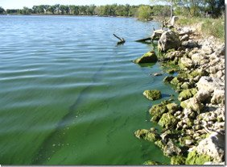
24. Cyanobacteria and harmful algal blooms
https://www.deq.louisiana.gov/page/harmful-algal-blooms-habs https://www.epa.gov/cyanohabs/learn-about-cyanobacteria-and-cyanotoxins

Slide 21
Ocean Acidification
Burning of fossil fuels releases carbon dioxide, CO₂
CO₂ is absorbed into the oceans
CO₂ in seawater produces bicarbonate (HCO₃⁻) and carbonate (CO₃²⁻)which makes the ocean more acidic
Since the industrial revolution, the ocean’s pH has dropped from 8.21 to 8.10, which is equivalent to ten times greater acidity.
Acid wears on and weakens calcium structures like the shells of crustaceans, including commercially harvested crabs, and makes it harder for them to thrive.

Slide 22
47. Ocean Acidification
https://www.climate.gov/news-features/understanding-climate/climate-change-atmospheric-carbon-dioxide

Slide 23
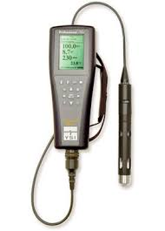
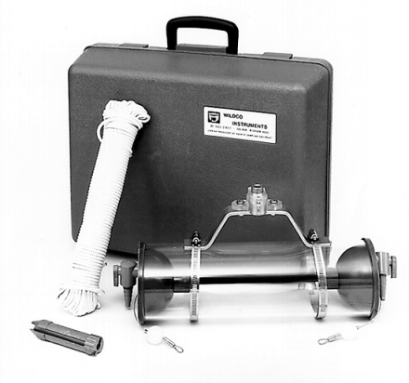
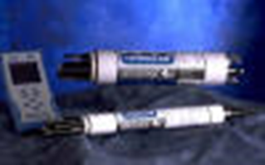
56. Equipment: Electronic & Water Sampling Devices
YSI electronic
water meter
Van Dorn horizontal
water grab sample bottle
Hydrolab electronic
water meter
Kemmerer water
grab sample bottle
https://www.hydrolab.com/
https://www.ysi.com/
https://envcoglobal.com/catalog/water/limnology/water-quality-sampling/water-sampling-bottle/surface-water-sampling/kemmerer
http://envcoglobal.com/catalog/term/water/limnology/water-quality-sampling/water-sampling-bottle/surface-water-sampling/van

Slide 24
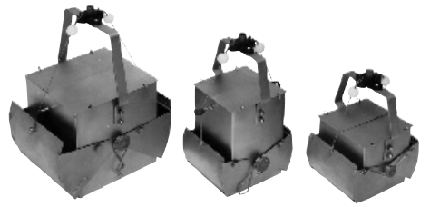
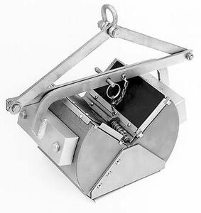
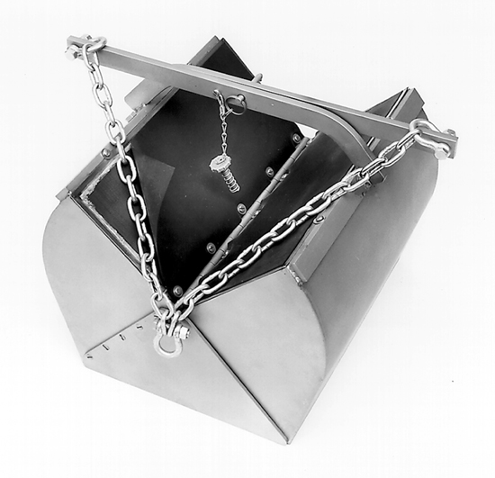
56. Equipment: Sediment Sampling Devices
Ekman bottom grab samplers
Ponar bottom
grab sampler
Van Veen bottom
grab sampler
http://envcoglobal.com/catalog/water/sediments-and-sludge-samplers/bottom-grabs/ekman-bottom-grabs
https://www.pine-environmental.com/products/ponar_grab_sampler
https://www.generaloceanics.com/sampler-grab-van-veen-small-602-021.html

Slide 25
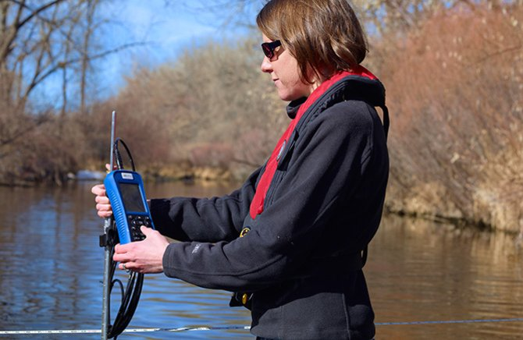
56. Equipment: Flow meters
Wading rod
flow meter
https://www.phametechnology.com/wp-content/uploads/2014/12/Current-Meter-1.jpg
https://www.fondriest.com/usgs-top-setting-wading-rods.htm
http://www.geoscientific.com/flowcurrent/AA_Current_Meter.html
http://envcoglobal.com/catalog/water/liquid-flow/current-meters-and-discharge-monitoring/river-gauging-equipment/hydro

Slide 26
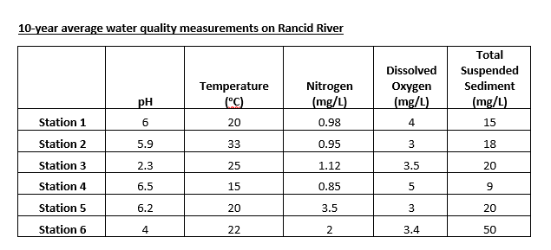
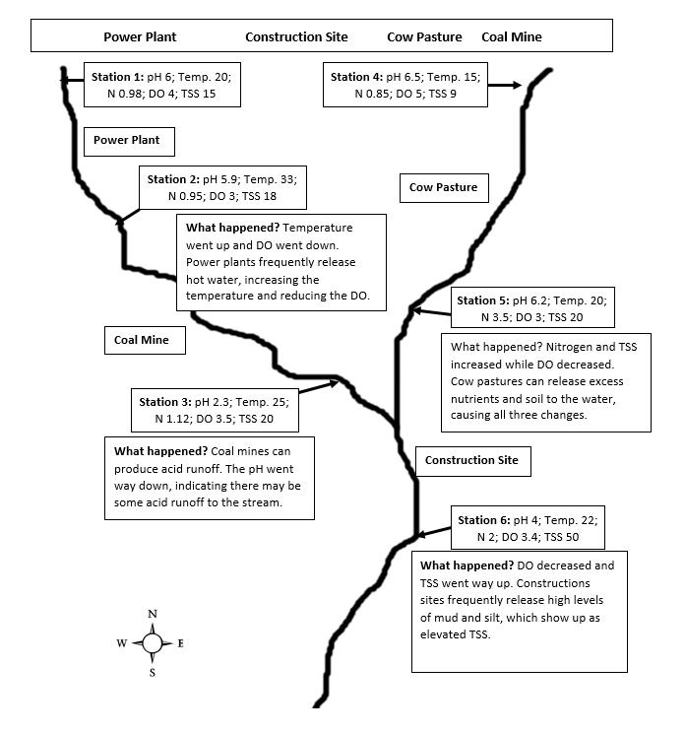
57. Interpreting Water Quality Data

Slide 27
Thank You

