Slide 1
Air Permits 101:
Understanding the Process &
Permits 101: Understanding the Basics
Jada Lewis and Dustin Duhon
Air Permits Division
Gary Aydell
Water Permits Division
Jason Meyers
Waste Permits Division
Louisiana Department of Environmental Quality

Slide 2
Air Permits 101:
Understanding the Process
Jada Lewis and Dustin Duhon
Air Permits Division
Louisiana Department of Environmental Quality

Slide 3
Office Organizational Chart
ENVIRONMENTAL
SERVICES
ENVIRONMENTAL
COMPLIANCE
ENVIRONMENTAL
ASSESSMENT
MANAGEMENT &
FINANCE
Waste Permits
Air Permits
Permits Support Division
Water Permits
Enforcement
Emergency Response & Radiological Services
Surveillance
Water Quality Assessment
Technology
Remediation
Air Quality Assessment
Laboratory Services
Underground Storage Tank
Information Services
General Services
Human Resources
Financial Services

Slide 4
Organization
Office of Environmental Services
Air Permits Division
Writes and Issues Air permits
Petrochem
Writes air permits for petroleum facilities, chemical manufacturing facilities, and oil and gas production facilities
Manufacturing
Writes air permits for power plants, saw mills, painting and sandblasting, asphalt plants, and miscellaneous facilities
Regulates pollution by issuing multi-media permits consistent with laws and regulations

Slide 5
Louisiana Department of
Environmental Quality
Mission Statement
The Department's mission is to provide service to the people of Louisiana through comprehensive environmental protection in order to promote and protect health, safety and welfare while considering sound policies regarding employment and economic development.
Vision
To be a respected steward of the State‘s environment.

Slide 6
LDEQ’s Role and EPA
EPA provides oversight of LDEQ’s air quality program.
LDEQ is federally authorized to administer the federal Part 70 (Title V) and New Source Review (NSR) programs.

Slide 7
Air Permits Role
Issue air permits
  Shows all applicable operations limits
  Basis for Surveillance Division’s inspections
  Basis for Enforcement Division’s work
Issue other permitting actions
  Variances
  Exemptions

Slide 8
Air Permits Role
Provide technical guidance for permit applications
  Industry
  Community
Work with public and community on permitting activities
  Public comments
  Public hearings

Slide 9
Basics of
Air Permits

Slide 10
The Basics of Air Permits
Clean Air Act (CAA) and
Clean Air Act Amendments (CAAA)
  Permitting Authority
  Subdivided into “titles”, i.e., Title IV, Title V, etc.
Purpose:
  Legally limit the amount of air pollutants released into the air by controlling and limiting releases at the individual source
  Required when businesses and industries are capable of reaching or exceeding certain established thresholds of pollutant release

Slide 11
The Basics of Air Permits
The final permit usually contains:
A description of the facility
Specific enforceable standards that apply
Specific limits that apply
Specific monitoring and recordkeeping requirements
Specific reporting requirements

Slide 12
The Basics of Air Permits
The type of permit issued to a facility will depend on three things:
1. The facility’s potential-to-emit (PTE)
2. The type of emissions emitted by the facility
3. The status of the area in which the facility is located

Slide 13
Who needs An air permit?

Slide 14
Who Needs An
Air Permit?
Activities that do NOT need an air permit include:
activities conducted on residential property (unless it constitutes a Part 70 source);
distribution or use of pesticides;
mobile sources such as automobiles, trucks and aircraft;

Slide 15
Who Needs An
Air Permit?
Activities that do NOT need an air permit include (cont.):
air pollution that does not leave the boundaries of the commercial or industrial plant from which it is emitted;
controlled burning of agricultural by-products in the field or cotton gin agricultural waste; or
controlled burning of timberland, pastureland, or marshlands in connection with timber management or trapping or livestock production;

Slide 16
Who Needs An
Air Permit?
Facilities that do NOT need an air permit include those regulated solely because of:
NESHAP for Asbestos Demolition and Renovation (40 CFR 61.145);
Standards of Performance for New Residential Wood Heaters (40 CFR Part 60 AAA); and
Regulations promulgated pursuant to the federal Clean Air Act under 112(r), Prevention of Accidental Releases (e.g., 40 CFR 68)

Slide 17
Who Needs An
Air Permit?
Facilities that do NOT need an air permit include those regulated solely because of:
Act 547 of the 2008 Louisiana Legislature
  Less than 5 tons per year (TPY) of any criteria pollutant
  Less than a total of 15 TPY of all criteria pollutants
  Less than Minimum Emission Rate (MER) of any TAP
  Not otherwise required to obtain a permit
More information: http://www.deq.louisiana.gov/portal/tabid/2619/Default.aspx

Slide 18
Air Permit Application
Download appropriate application from LDEQ website:
http://www.deq.louisiana.gov/portal/tabid/2619/Default.aspx
Application for Approval of Emissions of Air Pollutants from Part 70 Sources
Application for Approval of Emissions of Air Pollutants from Minor Sources

Slide 19
Major AIR regulations

Slide 20
Major Regulations That Govern
Louisiana Air Quality Regulations [LAC 33:III]
New Source Performance Standards [40 CFR 60]
National Emissions Standards for Hazardous Air Pollutants [40 CFR 61 and 40 CFR 63]
Acid Rain Regulations [40 CFR 72-78]
National Ambient Air Quality Standards (NAAQS)
Prevention of Significant Deterioration [40 CFR 52]

Slide 21
Louisiana Air Quality Regulations [LAC 33:III]
State administers its own air quality program
Regulates emissions of criteria pollutants and surrogates (PM₁₀, NO_{x}, CO, VOC, SO₂, Lead)
Regulates emissions of Toxic Air Pollutants (LAC 33:III.Chapter 51)

Slide 22
New Source Performance Standards
[40 CFR 60]
Typically applies to
  New Sources
  Reconstructed Sources
  Modified Sources
Technology-based limitations
Other federal regulations are generally more stringent

Slide 23
New Source Performance Standards
[40 CFR 60] (cont.)
Examples
  40,000 gallon gasoline tank constructed in 1994 must:
    Install an internal floating roof;
    Install an external floating roof; or
    Install a closed vent system that vents to a control device.
    Required by 40 CFR 60 Subpart Kb
  Lime Kiln at a paper mill combusting natural gas must:
    Control PM emissions to 0.15 g/dscm @ 10% oxygen
    Required by 40 CFR 60 Subpart BB

Slide 24
National Emissions Standards for Hazardous Air Pollutants [40 CFR 61 and 40 CFR 63]
Applies to sources that emit Hazardous Air Pollutants (HAP)
Incorporates Maximum Achievable Control Technology (MACT)
Typically applies to major sources of HAP
Two varieties:
  Pollutant Specific NESHAP (40 CFR 61)
  Source Category NESHAP (40 CFR 63)

Slide 25
National Emissions Standards for Hazardous Air Pollutants [40 CFR 61 and 40 CFR 63] (cont.)
Examples:
  Shipyard that paints vessels must:
    Comply with VOHAP limits (in grams/liter) for each painting application
    Required by 40 CFR 63 Subpart II
  Incinerator that processes beryllium-containing waste must:
    Not emit more than 10 grams/24 hr. period of Beryllium
    Required by 40 CFR 61 Subpart C

Slide 26
Acid Rain Regulations
[40 CFR 72-78]
Fossil fuel-fired power plants
Affects SO₂ emissions (cap and trade)
Affects NO_{x} emissions (no cap and trade)
LDEQ issues permits, but EPA administers cap and trade program

Slide 27
National Ambient Air Quality
Standards (NAAQS)
LDEQ can never permit any activity that violates NAAQS
Primary Standards set to protect public health
Secondary Standards set to protect public welfare

Slide 28
National Ambient Air Quality
Standards (NAAQS)

Slide 29
Prevention of Significant Deterioration [40 CFR 52]
Prevents deterioration of air quality
More stringent regulatory program
Incorporates Best Available Control Technology (BACT)
Requires sources to control operations at least as well as the best performing similar source, within reason

Slide 30
Prevention of Significant Deterioration [40 CFR 52]
Source is compared to other similar sources using RACT/BACT/LAER Clearinghouse (RBLC): http://cfpub.epa.gov/rblc/cfm/basicsearch.cfm
Source is allowed to take credit for certain decreases in emissions
Source can use economic, technical, or environmental feasibility studies to suggest alternate BACT

Slide 31
internal AIR permit process

Slide 32
Air Permit Process
Permit Processing
Technical Review & Drafting
Internal Review of
Draft Permit
Public Notice
(minimum 30 days)
Final Decision w/ Basis for Decision and Response to Comments, if applicable
Internal Review of
Revised Draft

Slide 33
Permit Process
Application is received and reviewed for technical deficiencies, enforcement history, and environmental reputation
Permit Writer obtains any necessary additional information from applicant
“Give and take” to draft permit
Applicant is more likely to alter original request than to let LDEQ deny permit

Slide 34
Community involvement

Slide 35
Community Involvement
Submit comments during Public Notice Period
Participate in Public Hearings
Coordinate with environmental advocacy groups
Contact LDEQ staff with questions

Slide 36
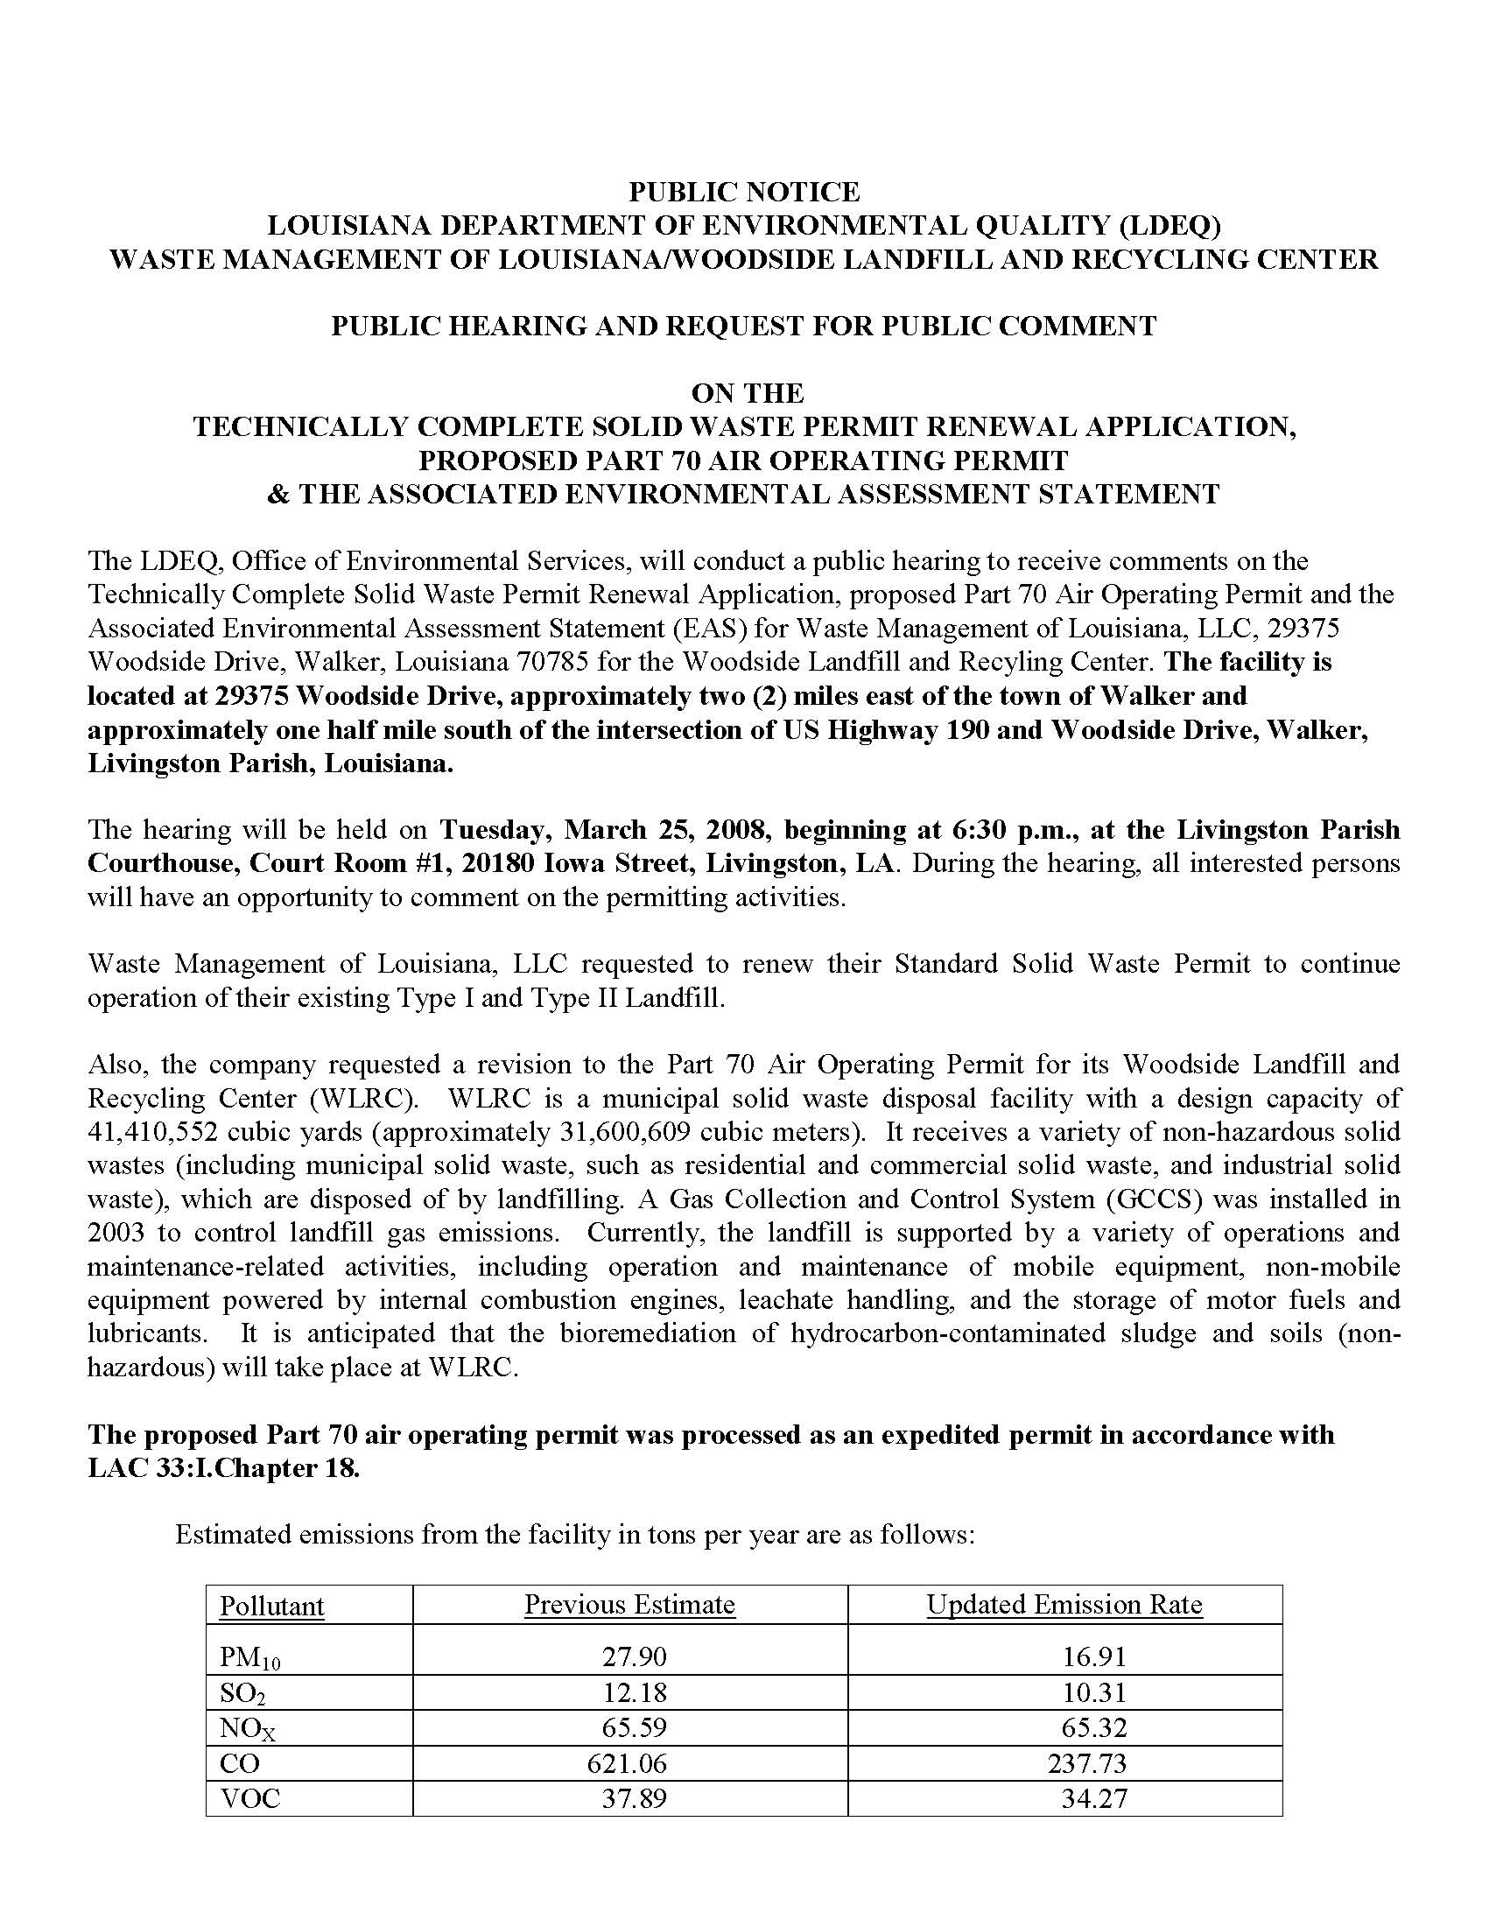
Title

Slide 37

Title

Slide 38
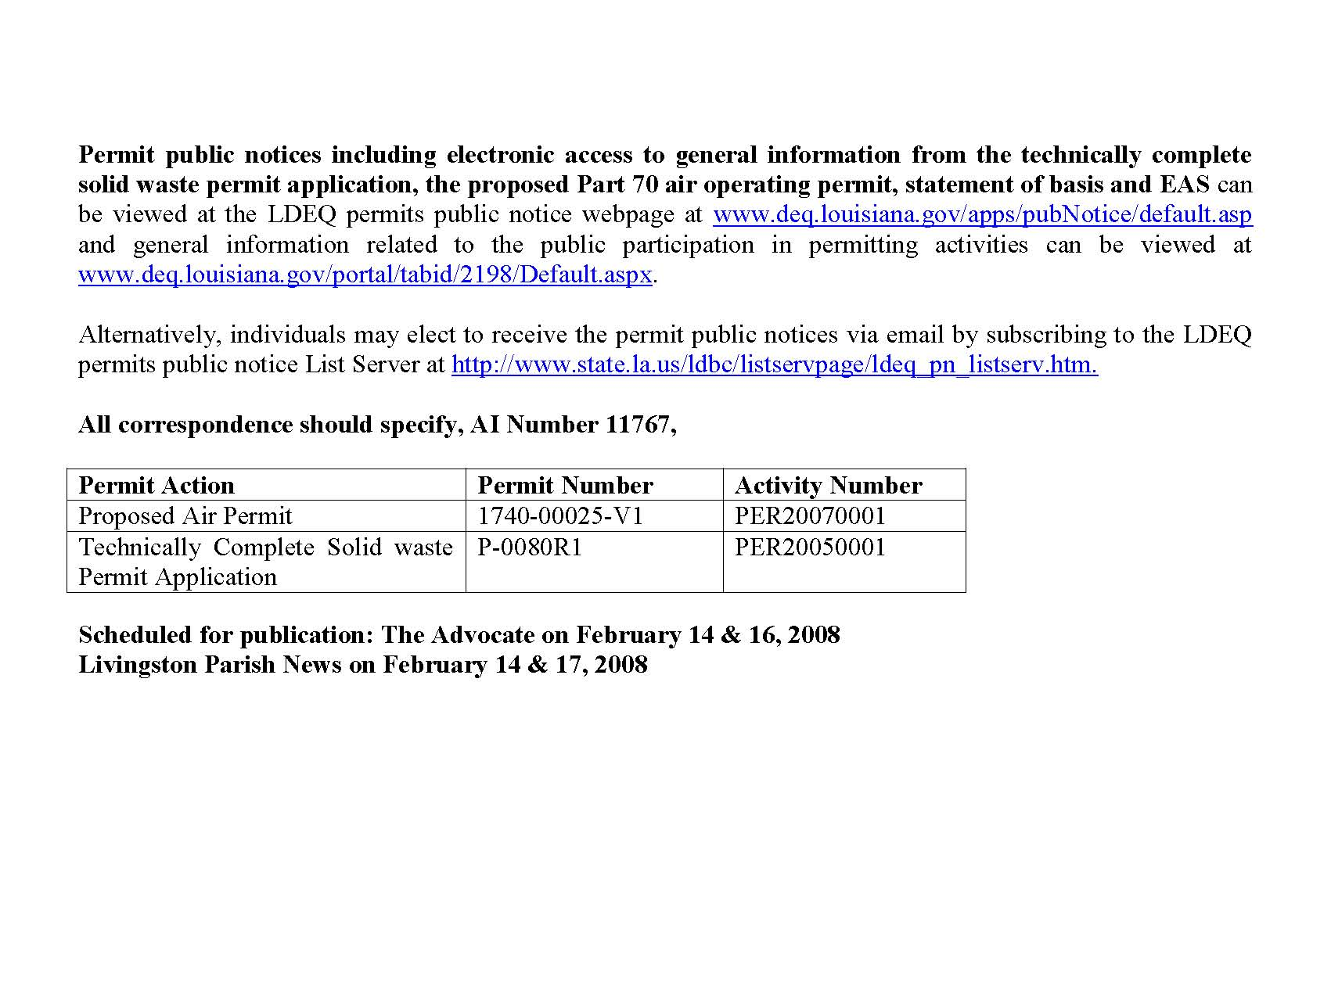
Title

Slide 39
Community Involvement
Materials made available for review during Public Notice period:
  Draft permit
  Permit application and any additional information submitted
  Statement of Basis (if required)
  Environmental Assessment Statement (for new facilities and PSD projects)
Materials can be viewed via:
  Local Library
  Electronic Document Management System (EDMS): http://edms.deq.louisiana.gov

Slide 40
Resources, definitions, and acronyms

Slide 41
Resources
Louisiana Environmental Regulatory Code (LAC)
Title 33 :Part III.Air
Part I. Office of the Secretary
http://www.deq.louisiana.gov/portal/tabid/96/Default.aspx
The Code of Federal Regulation (CFR)
NSPS (40 CFR 60)
NESHAP (40 CFR 61)
  http://www.gpoaccess.gov/cfr/retrieve.html
The Clean Air Act (CAA)
The Clean Air Act Amendments (CAAA)
http://www.epa.gov/air/caa/peg/

Slide 42
Resources
DEQ Website
http://www.deq.louisiana.gov/portal/tabid/36/Default.aspx
A weekly list of permit applications received http://www.deq.louisiana.gov/portal/tabid/2824/Default.aspx
A list of permits on public notice http://www.deq.louisiana.gov/apps/pubNotice/default.asp
EDMS – Can be accessed on-line
http://www.deq.louisiana.gov/portal/tabid/2604/Default.aspx
Public Participation Group
http://www.deq.louisiana.gov/portal/tabid/2198/Default.aspx

Slide 43
Definitions and Acronyms
APD Air Permits Division
BACT Best Achievable Control Technology
BART Best Available Retrofit Technology
BMP Best Management Practices (Plan)
CAA Clean Air Act
CAAA Clean Air Act Amendments
CEMS Continuous Emission Monitoring System
CFR Code of Federal Regulations
CMS Continuous Monitoring System
CO Carbon monoxide
Criteria Pollutants These are nitrogen oxide (NOx), sulfur dioxide (SO2), Particulate Matter (PM), Carbon Monoxide (CO), Volatile Organic Compounds (VOC), and Lead (Pb).
DEQ Department of Environmental Quality
EPA Environmental Protection Agency
EDMS Electronic Documents Management System : The repository for all official records created or received by the Department

Slide 44
Definitions and Acronyms
HAP Hazardous Air Pollutant
HON Hazardous Organic NESHAPS
LAC Louisiana Administrative Code
LAER Lowest Achievable Emission Rate
Major Source Facilities with emissions of criteria emissions that equal or exceed 100 tons per year (TPY) or emissions of any one federally-regulated HAP that equals or exceeds 10 TPY or if total HAP emissions for the facility equal or exceed 25 TPY. Lower emission thresholds for a criteria pollutant may apply in nonattainment areas. A facility which has emissions of one or more criteria pollutants above 100 tpy.
MACT Maximum Achievable Control Technology
MER Minimum Emission Rate
Minor Source Facilities with emissions of criteria emissions that are less than 100 tons per year (TPY) or emissions of any one federally-regulated HAP is less than 10 TPY or if total HAP emissions for the facility are less than 25 TPY.
MM Million
MMBTU Millions of British thermal units

Slide 45
Definitions and Acronyms
NAA Nonattainment area
NAAQS National Ambient Air Quality Standards
PM2.5 Particulate Matter of 2.5 microns or less aerodynamic diameter
PM-10 Particulate matter, 10 microns or less in size
NESHAP National Emission Standards for Hazardous Air Pollutants
NSPS New Source Performance Standards
NSR New Source Review
NNSR Non-attainment New Source Review
Pb Lead
PPB Parts per Billion
PPM Parts Per Million
PSD Prevention of Significant Deterioration
PTE Potential To Emit is the emissions from a facility if it is run at maximum all year long.
SCF Standard Cubic Foot
SCFH Standard Cubic Feet per Hour
SCFM Standard Cubic Feet per Minute

Slide 46
Definitions and Acronyms
SCM Standard Cubic Meter
SIC Standard Industrial Classification
SIP State Implementation Plan
SO₂ Sulfur dioxide
SOCMI Synthetic Organic Chemical Manufacturing Industry
SOP Standard Operating Procedures
Synthetic minor source A facility that would be major source except that the emissions are being controlled below the major source emission level. The facility is permitted as a minor source.
Title V Operating Permit Program authorized by Title V of the Clean Air Act
TPY Tons per year
VOC Volatile Organic Compound
TEMPO Tools for Environmental Management and Protection Organizations.: The Department’s official database into which all data for every facility is entered.

Slide 47
Office & Division
Contact Information
Air Permits Division
602 N. Fifth Street
Baton Rouge, LA 70802
225.219.3181
Customer Service Center
225-219-LDEQ (5337)
Toll Free 1-866-896-LDEQ (5337)
Hours 8-4:30 M-F

Slide 48
Speakers’ Contact Information
Jada Lewis
Environmental Chemical Specialist
225.219.0034
Jada.Lewis@la.gov
Dustin Duhon
Environmental Chemical Specialist
225.219.3057
Dustin.Duhon@la.gov

Slide 49
Permits 101:
UNDERSTANDING THE BASICS
Gary Aydell
WATER PERMITS DIVISION
Louisiana Department of Environmental Quality

Slide 50

WATER PERMITTING OVERVIEW

Slide 51
LPDES PERMITS PROGRAM
The state water discharge permit program is called the Louisiana Pollutant Discharge Elimination System (LPDES)
LA has authority to implement the Federal (EPA) water permit program called the National Pollutant Discharge Elimination System (NPDES)

Slide 52
WHO NEEDS A WATER DISCHARGE PERMIT?
Any one who discharges pollutants from a point source to waters of the state.
Key definitions:
  Pollutants
  Point Source
  Waters of the State
Must have an effective water discharge permit at the time you start discharging.

Slide 53
TYPES OF PERMITS
Individual Permits - Public notice for each permit
Facility types (examples):
  Chemical plants
  Refineries
  Power plants
  Oil field service companies
  Solid waste landfills
  Sanitary waste water treatment plants with a capacity greater than 100,000 gallons per day
  Barge cleaning/ship building
  Seafood processing

Slide 54
TYPES OF PERMITS (cont.)
(2) General Permits
LDEQ issues ‘Master’ general permit and this ‘Master’ is public noticed.
Normally, a separate public notice is not required when facilities are authorized to discharge under general permit.
Facility types (examples):
  Small sanitary
  Car washes
  Hydrostatic testing
  Potable water treatment plants
  Storm water associated with construction and industrial activities

Slide 55
ISSUANCE PROCESS for
INDIVIDUAL PERMITS
Application – available electronically on LDEQ web page
Application completeness determination
Application assigned to permit writer (PW)
  PW may contact applicant to verify information in application
  PW may ask for additional information
  PW may conduct site visit
PW prepares Statement of Basis or Fact Sheet and Draft Permit
Draft Permit public noticed – 30-day public comment period
May have a public hearing – depending on comments
Final Permit issued

Slide 56

The Application Process
Applications for renewal of existing NPDES/LPDES permits must be submitted anytime between 180 and 0 days prior to the expiration date in order to be administratively continued.
Where can I find permit applications?
www.deq.louisiana.gov
Applications are available for download in Adobe Acrobat or Microsoft Word
To request an application by phone please call the Permits Division at (225) 219-3181

Slide 57

Public Notices
During the public notice comment period, which lasts 30 days, the permittee and public are afforded the opportunity to comment on the draft permit.
All LDEQ, Permits Division, Public Notices can be found on our public web site at:
http://www.deq.louisiana.gov
If there is significant public response to the draft permit action, a public hearing or public meeting may be held.

Slide 58
AUTHORIZATION PROCESS for
COVERAGE
UNDER A GENERAL PERMIT
LDEQ public notices and issues ‘Master’ general permit
EPA has 90 days to review/approve ‘master” general permits
Applicant submits Notice of Intent (NOI) – available electronically on LDEQ web page
Authorization may be automatic or require specific authorization by LDEQ
  If automatic, authorization is effective within 2 days of submittal of a complete NOI
  Specific authorization normally takes 2-4 weeks after submittal of a complete NOI

Slide 59
INFORMATION ABOUT
THE PERMIT
Fees – annual and new permit (no new permit fee for general permit coverage)
Title page
Limits page
  Outfall description
  Parameters
  Discharge limits
  Monitoring frequency
  Monitoring location

Slide 60
PERMIT INFO (cont.)
Other conditions
  Reopener language
  Requirements to submit Discharge Monitoring Reports (DMRs)
  Storm water pollution prevention requirements
Standard conditions – some basic regulatory requirements
  Duty to re-apply – 180 days before expiration date (5 yr permit)
  Inspections by LDEQ – right of entry
  Enforcement – penalties
  Monitoring procedures – must use approved analytical methods

Slide 61
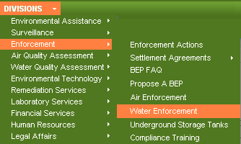
Discharge Monitoring Reports
Blank DMR’s and Sample DMR’s for general LPDES permits can be found on our public web site at: http://www.deq.louisiana.gov:
Minor dischargers are required to submit DMR’s quarterly.
Major dischargers are required to submit DMR’s by the 15th of the following month.

Slide 62
PERMIT INFO (cont.)
Standard conditions (cont.)
  Bypass and upset
  Record keeping
  Proper operation and maintenance
  Reporting requirements
    Changes
    Non-compliance
    Emergency situations
  Signature requirements

Slide 63
IMPAIRED WATER BODIES
Water bodies not in compliance with water quality standards
Related terms
  Total Maximum Daily Load (TMDL)
  303(d) List
May result in more stringent discharge limitations
Common problem – beware!
  Authorization under the construction general permit
  Water quality problems related to issuance of a water discharge permit for the operation of the facility after construction. (i.e., construction of a subdivision and discharge from the sewer treatment plant for the subdivision)

Slide 64
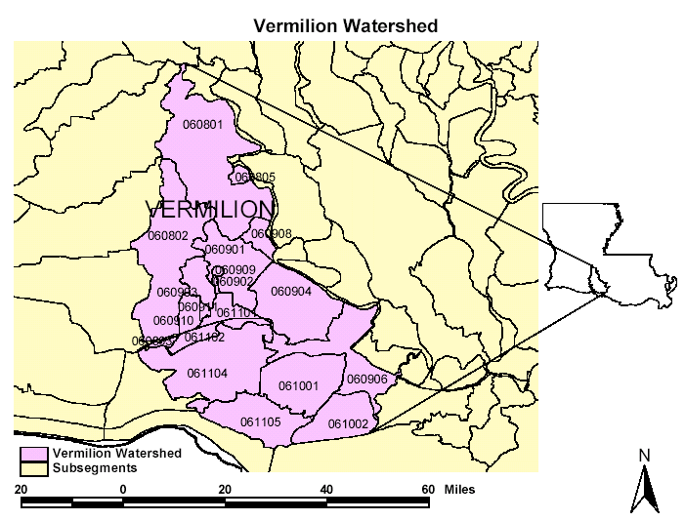
What is a TMDL
Total amount of a pollutant that a waterbody can receive and still meet applicable water quality standards.
Watershed studies are necessary to establish an acceptable pollutant load for an impaired waterbody with individual load allocations to dischargers.

Slide 65
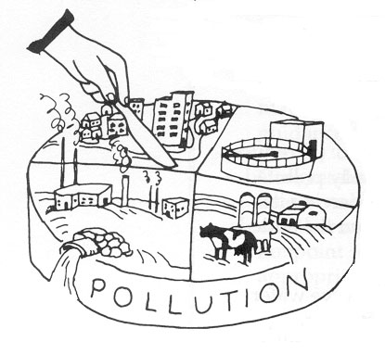
TMDL Definition & Elements
TMDL = WLA + LA + MOS
WLA = Waste Load Allocation to Point Sources
LA = Load Allocation to Non-Point Sources and Natural Background
MOS = Margin of Safety – extra measure of protection due to uncertainty – explicit or implicit

Slide 66
Federal TMDL Regulations
Clean Water Act Section 303(d)
EPA Implementing Regulations at 40 CFR Part 130.7
Upon final EPA approval TMDLs become part of the State Water Quality Management Plan (WQMP) where they are implemented into LPDES permits.

Slide 67
CONTACT INFORMATION
LDEQ web page - http://www.deq.louisiana.gov/portal/
Most general permits, pretreatment, and biomonitoring:
  Jan Cedars (225) 219-3074 jan.cedars@la.gov
Sanitary permits, landfills, and centralized waste treaters:
  Ronnie Bean (225) 219-3119 ronnie.bean@la.gov
Power plants and most minor industrial individual permits:
  Cheryl Lejeune (225) 219-3122 cheryl.lejeune@la.gov
Most major industrial and oil & gas permits:
  Scott Guilliams (225) 219-3072 scott.guilliams@la.gov

Slide 68
Municipal & General Water
Permits Section
Facility Type and Assignments
General Permit Group – Jan Cedars
Stormwater General Permits
Non-Stormwater General Permits (Sanitary, Industrial, Commercial)
Potable Water Treatment Plants
CAFOs (Concentrated Animal Feeding Operations)
17 Non-Stormwater General Permits
4 Stormwater General Permits

Slide 69
Municipal & General Water
Permits Section (cont.)
Facility Type and Assignments
Municipal Permit Group – Ronnie Bean
POTWs – Publicly Operated Treatment Works
Private Sanitary Treatment Plants
Landfills
CWTs – Centralized Waste Treaters
Commercial Metal Reclaimers

Slide 70
Industrial Water
Permits Section
Facility Type and Assignments
Group 1 – Scott Guilliams
Organic and Inorganic Chemicals
Refineries
Oil & Gas Exploration, Production and Development
Paper Mills
Shipbuilding and Repairs
Mining Operations

Slide 71
Industrial Water
Permits Section (cont.)
Facility Type and Assignments
Group 2 – Cheryl Lejeune
Coke Calcining
Food Processing and Preparation
Bulk Material Blending and Packaging
Bulk Storage Terminal/Warehouse
Fabricated Metal Products
Marine Cargo Handling/Stevedoring
Oilfield Service Facilities
Truck Terminal, Industrial Laundry, Grain Elevator, etc.

Slide 72
Speaker Contact
Information
Gary Aydell
Environmental Scientist Senior
Office of Environmental Services
Water Permits Division
(225)219-3002
gary.aydell@la.gov
Customer Service Center
225-219-LDEQ (5337)
Toll Free 1-866-896-LDEQ (5337)
Hours 8-4:30 M-F

Slide 73
Permits 101:
UNDERSTANDING THE BASICS
Jason Meyers, P.E.
Engineer Supervisor
Waste Permits Division
Louisiana Department of Environmental Quality

Slide 74
Waste Permits Overview

Slide 75
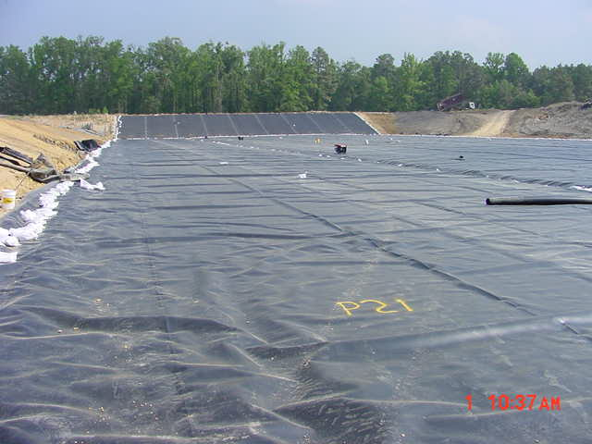
Waste Permits Division
The Waste Permits Division authorizes permits administered under the Solid Waste and Hazardous Waste Regulations
  Is responsible for all activities pertaining to the permitting of existing and proposed solid waste processing and disposal facilities.
Facilities include, but are not limited to:
  sanitary landfills
  industrial landfills
  Hazardous waste landfills
  surface impoundments
  Landfarms
  Incinerators
  transfer stations
  resource recovery facilities
  refuse-derived fuel facilities

Slide 76
Waste Permits Division
Administrator
Solid and Hazardous Waste Permits
Hazardous Waste Engineers
Geology Support
Solid Waste Engineers

Slide 77
Waste Permits Division
  Solid and Hazardous Waste Permits Section
    Perform technical review of applications
    Route documents for review
  Solid Waste Engineers
    Perform engineering and geotechnical review of solid and hazardous waste applications
  Hazardous Waste Engineers
    Review tank design, BIF design, trial burn data
  Geology support
    Review monitoring well design and boring data

Slide 78
Facilities Needing a
Solid Waste Permit
LAC 33:VII.509.A.1—Any person who processes and/or disposes solid waste, with the exception of those listed in the regulations.
  Generators and transporters that are not processors or disposers of solid waste are not required to secure a permit.
  Collection facilities and non-processing transfer stations at which no solid waste is processed or disposed of are not required to secure a permit.

Slide 79
Types of Solid Waste Permits
Temporary Permits
  Allows continued operation of an existing facility but does not allow the expansion or modification of the facility without prior approval
    Duration: Not to exceed three years
Standard Permits
  Issued for solid waste processing and/or disposal facilities that have successfully completed the standard permit application process.
    Types: Type I, Type I-A, Type II, Type II-A, and Type III
    Duration: not to exceed ten years

Slide 80
Types of Solid Waste Facilities
Type I
  Industrial disposal facilities (e.g., landfills, surface impoundments, or landfarms);
Type I-A
  Industrial processing facilities (e.g., balers, shredders, transfer stations (processing), etc.);
Type II
  Non-industrial disposal facilities (e.g., landfills, surface impoundments, landfarms);
Type II-A
  Non-industrial processing facilities (e.g., composting municipal solid waste facilities, balers, shredders, transfer stations (processing), refuse-derived fuel facilities, autoclaves, etc.); or
Type III
  Construction/demolition-debris and woodwaste landfills, separation facilities, composting facilities, or other.

Slide 81
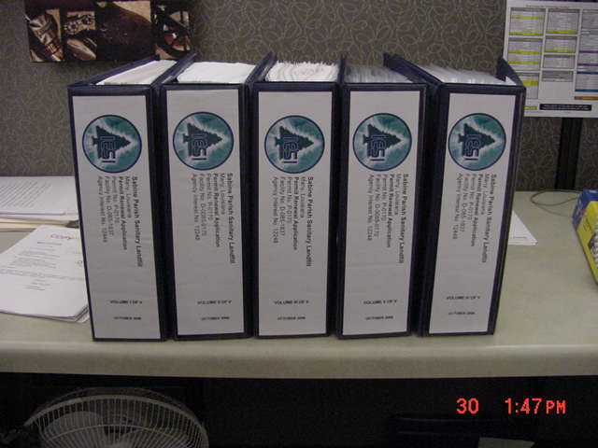
Permitting Process
Public notice of intent to submit an application
(No sooner than 45 days prior to submittal)
  State journal (The Advocate)
  Parish journal

Slide 82
Permitting Process (cont.)
Administrative completeness review
  Application Verification Group
    Verifies all parts of the application are included.
    Verifies fee has been included

Slide 83
Permitting Process (cont.)
Submittal of fees
  Type I, I-A, II, II-A--$3,300
  Type III--$660

Slide 84
Permitting Process (cont.)
General requirements of document submittal
  Five Sections:
  LAC 33:VII.519 (Part I)
    Simple fill-in-the blank checklist
  LAC 33:VII.520 (Compliance Information)
    Refers back to LAC 33:I.1701

Slide 85
Permitting Process (cont.)
General requirements of document submittal
  LAC 33:VII.521 (Part II)
    Facility specific information
    Includes applicable references from Chapter 7
  LAC 33:VII.522 (Geological responses)
    Boring requirements
    Monitoring well details
  LAC 33:VII.523 (Part III)
    IT Questions

Slide 86
Permitting Process (cont.)
Technical completeness review
  Copies of the application are routed for review to:
  Environmental Scientist
  Engineer
  Geologist

Slide 87
Permitting Process (cont.)
Deficiencies
  Notice of Deficiencies
    Items which require clarification or more information.
  Response to Notice of Deficiencies

Slide 88
Permitting Process (cont.)
Technical completeness determination
  All deficiencies have been addressed
    Applicant submits six updated copies of the application with all deficiencies included.
    We verify all deficiencies have been included and send out application for public review.

Slide 89
Permitting Process (cont.)
30-day public comment/review period
  Copies of the technically complete application are sent to and available for review at the following locations:
    DEQ Headquarters in Baton Rouge
    DEQ Regional Office
    Local Library
    Local Government Office

Slide 90
Permitting Process (cont.)
30-day public comment/review period
  Public is allowed to submit written comments in favor or in opposition of granting the standard permit (all reasonable comments will be addressed)
  Public is allowed to request a public hearing
  A summary and/or Basis for Decision is drafted and routed to the Assistant Secretary, and a permitting decision will be made

Slide 91
Permitting Process (cont.)
Permit granted
  Public notice by applicant within 10 days of issuance
  Start-up inspection
    Conducted after all construction and upgrade measures are completed
  Issuance of Order to Commence
    Facility may begin to operate

Slide 92
Hazardous Waste Permitting
Same basic permitting process:
  Public notice is placed prior to submittal
  Administrative completeness review

Slide 93
Hazardous Waste Permitting (cont)
General requirements for Hazardous Waste submittals:
  Everyone addresses Chapter 5
    Includes:
    Chapter 515 (Part I)
      (checklist)
    Chapter 517 (Part II)
      Site specific information

Slide 94
Hazardous Waste Permitting (cont)
General requirements for Hazardous Waste submittals:
  Everyone also addresses Chapters 15, 17, 33, 35, and 37.
    Chapter 15- Treatment, Storage, Disposal facilities
    Chapter 17- Air Emission Standards
    Chapter 33- Groundwater Protection
    Chapter 35- Closure and Post-closure
    Chapter 37- Financial Assurance

Slide 95
Hazardous Waste Permitting (cont)
Depending on type of facility may also need to address the facility specific standards in Chapters 18-32.

Slide 96
Hazardous Waste Permitting (cont)
Deficiencies
  Notice of Deficiencies
  Response to Notice of Deficiencies
Prepare draft permit
Public notice
  45 day public notice for Hazardous Waste

Slide 97
Hazardous Waste Permitting (cont)
  A responsiveness summary is drafted and routed to the Assistant Secretary, and a permitting decision will be made

Slide 98
Waste Terms & Definitions
Solid Waste
  Any garbage, refuse, or sludge from a waste treatment plant, water-supply treatment plant, or air pollution-control facility, and other discarded material including solid, liquid, semi-solid, or contained gaseous material resulting from industrial, commercial, mining, and agricultural operations, and from community activities.
Hazardous Waste
  Waste identified as hazardous in the current Louisiana hazardous waste regulations (LAC 33:V.Subpart 1) and/or by the federal government under the Resource Conservation & Recovery Act and subsequent amendments.

Slide 99
Waste Terms & Definitions
Generator: Any person whose act or process produces solid waste as defined in the regulations.
Transporter: Any person who moves industrial solid waste off-site and/or who moves solid waste of a commercial establishment or more than one household to a storage, processing, or disposal facility.
Type I Facility: A facility used for disposing of industrial solid waste. (If the facility is also used for disposing of residential or commercial solid waste, it is also a Type II facility).
Type I-A Facility: A facility used for processing industrial solid waste (e.g. transfer station, incinerator waste-handling facility, shredder, baler, or compactor). (If the facility is also used for processing residential or commercial solid waste, it is also a Type II-A facility).

Slide 100
Waste Terms & Definitions
Type II Facility: A facility used for processing residential or commercial solid waste (e.g. transfer station, incinerator waste-handling facility, refuse-derived fuel facility, shredder, baler, or compactor). (If the facility is also used for processing industrial solid waste , it is also a Type I-A facility).
Type II-A Facility: A facility used for processing residential or commercial solid waste (e.g. transfer station, incinerator waste-handling facility, refuse-derived fuel facility, shredder. baler. or compactor). (If the facility is also used for processing industrial solid waste, it is also a Type I-A facility).
Type III Facility: A facility used for: disposing of construction/demolition debris or woodwaste, composting organic waste to produce a usable material, or separating recyclable wastes (a separation facility). Residential, commercial, or industrial solid waste must not be disposed of in a type III facility.

Slide 101
Resources
LAC 33:VII (Solid Waste Regulations) or LAC 33:V (Hazardous Waste Regulations)
  http://www.deq.louisiana.gov/portal/tabid/1674/Default.aspx#Title33
Solid Waste Information and Guidance Document
  http://www.deq.louisiana.gov/portal/tabid/259/Default.aspx
  http://www.deq.louisiana.gov/portal/Default.aspx?tabid=247
Hazardous Waste Information and Guidance Document
  http://www.deq.louisiana.gov/portal/tabid/2267/Default.aspx
  http://www.deq.louisiana.gov/portal/Portals/0/permits/haz/General%20Guidelines%20H W%20App.pdf
  http://www.deq.louisiana.gov/portal/Portals/0/permits/haz/Statement%20of%20Acknowledgment%20and%20Non-ApplicabilityADD6.30.pdf

Slide 102
Division Contact Information
Office of Environmental Services
Waste Permits Division
PO Box 4313
Baton Rouge, LA 70821-4313
Phone: (225) 219-3462
Fax: (225) 219-3474

Slide 103
Speaker Contact Information
Questions:
Jason Meyers, P.E.
(225) 219-0791
jason.meyers@la.gov

