Slide 1
CAMx Ancillary Input Development
Chris Emery
ENVIRON International Corporation, Novato CA
November 14, 2012

Slide 2
Meteorological Processing
WRFCAMx v3.3 converts raw WRF output to CAMx formats
  Time-shift from UTC to CST
  Extract 27 vertical layers up to 11 km MSL
  Use every WRF layer up to 3 km, collapse layers above
  Diagnose sub-grid clouds in 36 & 12 km grids (not 4 km)
  Calculate vertical turbulent exchange coefficients (or “diffusivities”, Kv)
KVPATCH used to enhance Kv in specific cases
  Enhance minimum nighttime Kv in urban surface layer
  Extend diffusion through clouds that cap the daytime boundary layer

Slide 3
Development of Landuse/Landcover
Defines surface types for dry deposition calculations
  Prepared for the 36/12/4km grids
Gridded time-invariant fields for
  Landuse – 26 categories for Zhang dry deposition scheme
  Leaf area index (LAI)
2000 North America Land Cover (NALC) database
  Satellite derived data at 1 km resolution http://edc2.usgs.gov/glcc/nadoc2_0.php
  29 categories cross referenced to 26 CAMx categories

Slide 4
Development of Landuse/Landcover
LAI MEGAN biogenic model
  Global 30 second (~1 km) resolution
  2001 monthly averages http://acd.ucar.edu/~guenther/MEGAN/MEGAN.htm

Slide 5
Dominant Landcover on 4 km Grid

Slide 6
Column Albedo/Haze/Ozone
This file defines state of atmosphere for photolysis rate calculations
AHOMAP generates gridded CAMx input file containing
  Surface albedo (from landuse file)
  Total atmospheric column haze opacity (default, constant)
  Total atmospheric ozone column
Total Ozone Mapping Spectrometer (TOMS)
  Aboard OMI satellite platform in 2010
  Daily, 1 degree resolution http://ozoneaq.gsfc.nasa.gov/OMIOzone.md

Slide 7
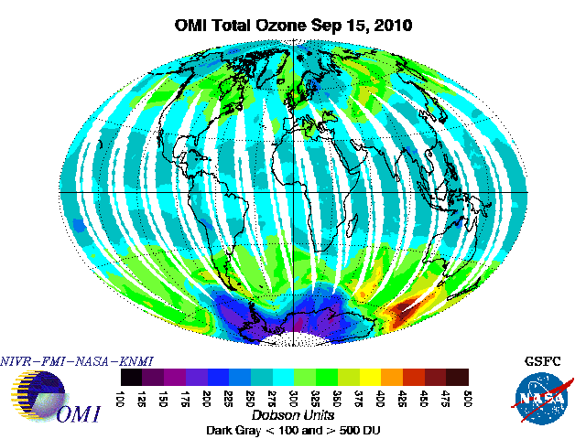

Slide 8
Photolysis Rates
TUV Version 4.8 (NCAR)
  Reads AHO file
  Creates lookup table of clear-sky photolysis rates
    Dimensions include: solar zenith angle, height above ground, surface albedo, haze column, ozone colum
  Photolysis reactions defined by the Carbon Bond version 6 (CB6) chemical mechanism
These rates are internally adjusted within CAMx for hourly gridded cloud conditions

Slide 9
Initial/Boundary Conditions
IC’s represent initial concentration pattern from which the simulation starts
BC’s represent concentration patterns outside of the outer CAMx modeling domain that are transported into the grid system
Derived from MOZART-4 (NCAR) output for 2010
  http://www.acd.ucar.edu/wrf-chem/mozart.shtml
  1.9 by 2.5 degree horizontal resolution, 56 vertical layers
  6-hour output intervals
  Horizontally and vertically interpolated to CAMx 36 km grid
  Mapped to CB6 chemical speciation
  Data were time shifted from UTC to CST

Slide 10
CAMx Configuration
Chemistry
  CB6 ozone only (no PM)
  In-line TUV cloud photolysis adjustment
  Wet removal (from WRF cloud+rain output)
  Zhang dry surface deposition
Standard advection/diffusion
  Sensitivity tests for Kv inputs, ACM2 treatment
Plume-in-Grid (PiG) for large NOx sources
  Sensitivity tests for PiG

