Slide 1
Development of Emissions for
Louisiana, Gulf, Biogenics, Fires
Chris Emery
ENVIRON International Corporation, Novato CA
November 14, 2012

Slide 2
Summary
Emissions Processing System, version 3 (EPS3)
  Generates hourly, chemically speciated, gridded formats needed by CAMx
  Needs raw annual/ozone season county/parish-level emission inventory files
  Needs support data
    Spatial surrogates, temporal and speciation profiles, cross-reference files
Products for this work
  Hourly point, area, on/non-road mobile
  CB6 compounds
  36/12/4 km grid system
  Sep-Oct 2010 representative weekday, Saturday, Sunday
  Day-specific for on-road, certain points, and fires

Slide 3
Summary
Other emission modeling tools
  MOVES/CONCEPT for on-road (LA only)
  NMIM/NONROAD for non-road sources (LA only)
  MEGAN for biogenics (all grids)
  FINN for wildfires and agricultural burning (all grids)
  Anthropogenic emissions outside LA by Alpine Geophysics
Emissions developed for
  2010 Actual (for model performance evaluation)
  2010 Typical (for projecting to future year)
  2017 Typical (for developing RRFs)

Slide 4
CB6 Speciation and Temporal Allocation
Criteria pollutants split to CB6 chemical mechanism
  Nitrogen oxides (NOx): NO, NO₂, HONO
  Volatile organic compounds (VOC): ACET, ALD2, ALDX, BENZ, ETH, ETHA, ETHY, ETOH, FORM, IOLE, ISOP, KET, MEOH, OLE, PAR, PRPA,TERP, TOL, XYL
Standard source-specific speciation profiles
  From EPA SPECIATE 4.3 database
  Profiles assigned to each source category
  We used default EPA cross-references
Standard source-specific temporal profiles for most categories
  Default EPA season, month, day-of-week, hour profiles
  We used default EPA cross-references

Slide 5
Spatial Allocation
Gridding surrogates on the 4 km modeling domain
  EPA Spatial Allocator tool http://www.cmascenter.org/index.cfm
  Typical surrogate types were created including:
    Population, various road types and other transportation networks, agriculture, residential, commercial and industrial land, retail, and water bodies
  Spatial Allocator creates surrogates formatted for the SMOKE emissions model
    Reformatted to EPS3
    67 individual spatial surrogates gridded to the modeling domains using GIS overlays

Slide 6
Louisiana Point Sources
LDEQ 2010 annual permitting database
  Temporally allocated to month, day of week, and hours
  Default EPA profiles & cross-references
EPA ARP/CAMD 2010 hourly point SOx/NOx database
  ARP facilities matched to LDEQ database
  ARP NOx used to scale LDEQ VOC & CO to hourly
  LDEQ sources removed to avoid double-counting
Speciated to CB6
  Default EPA profiles & cross-references
Located in grid according to stack coordinates

Slide 7
Louisiana Area Sources
Stationary sources not identified as individual points
  Many types, distributed over a large spatial extent (i.e. parish)
2009 data obtained from LDEQ
  Assume 2009 emissions representative of 2010 – no adjustment
Speciated to CB6
  Default EPA profiles & cross-references
Temporally allocated to month, day of week, and hours
  Default EPA profiles & cross-references
Spatially allocated to the CAMx grid system
  Source categories mapped to spatial surrogate codes
  Default EPA cross-references

Slide 8
Louisiana On-Road Mobile
Emissions during operation and non-operation
  Does not include refueling (area source)
Two models were used for Louisiana
  MOtor Vehicle Emission Simulator (MOVES);
  CONsolidated Community Emissions Processor Tool, Motor Vehicle (CONCEPT MV).

Slide 9
MOVES
MOVES2010a (model) and movesdb20100830 (database)
Run in “Emission Rate Calculation” mode by parish
  Outputs emission factor tables (g/mi or g/vehicle/hr)
  By process (start, running, evaporative)
  Run for range of conditions to produce lookup tables
Range of meteorological conditions calculated from WRF using MET2MOVES tool
Local data provided by LDEQ
  Age Distribution, Fuels and I/M programs, by parish
  2011 annual average day VMT by road type and parish
  2011 vehicle population by parish for four source types:
    Motorcycle
    Passenger Car
    Passenger Truck
    Light Commercial Truck

Slide 10
MOVES
3 parish groups identified for combinations of age distribution, fuel properties, and I/M programs

Slide 11
CONCEPT MV
Combines MOVES emission factors with VMT, vehicle population, and speed activity
  Gridded hourly meteorology from WRF
  Gridded activity and population using spatial surrogates according to road type or specific emissions type
    Surrogate assignments from EPA/SMOKE cross-references
  Daily average vehicle speeds by road type provided by Louisiana DOTD
  Temporal allocation of annual VMT by vehicle class from monthly, day-of-week, and hourly profiles
  Hourly fleet mix temporal profiles
    Weekday fleet mix from the previous Louisiana SIP
    Weekend fleet mix as daily average of weekday – constant all hours
  Outputs gridded, hourly model-ready files

Slide 12
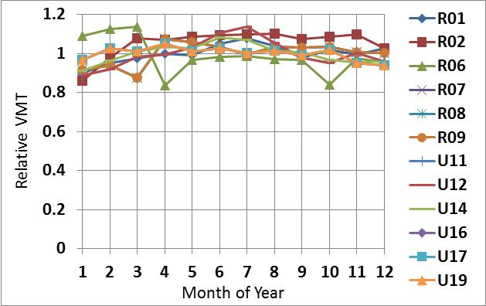
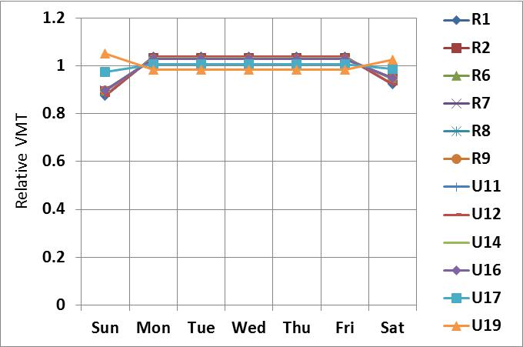
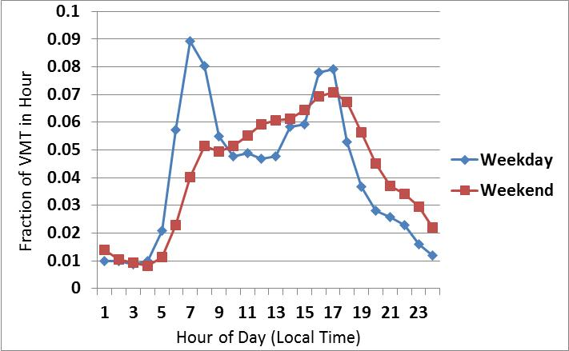
CONCEPT VMT Temporal Profiles

Slide 13
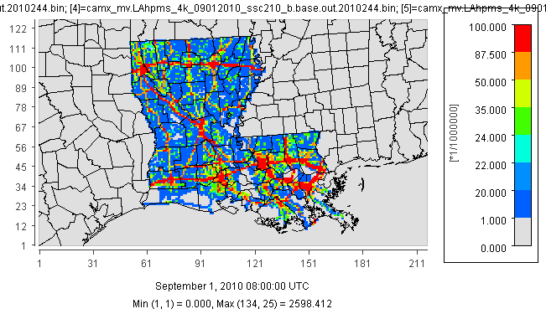
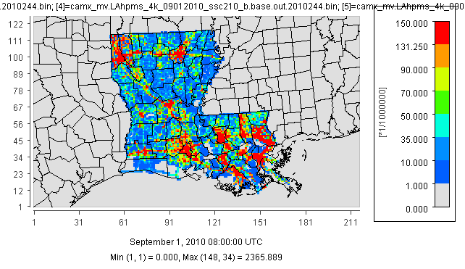
Louisiana On-Road Emissions, 8-9 AM, 9/1/10
NO (mol/hr)
PAR (mol/hr)

Slide 14
Louisiana Non-Road Mobile
EPA National Mobile Inventory Model (NMIM)
  NMIM20090504 and NONROAD2008a (models) with county database NCD20090531
Estimates emissions from the following equipment
  Agricultural equipment
  Airport ground support
  Construction equipment
  Industrial and commercial equipment
  Residential and commercial lawn and garden equipment
  Logging equipment
  Recreational equipment
  Recreational marine vessels

Slide 15
Louisiana Non-Road Mobile
Parish-level gasoline fuel parameters from LDEQ
  Consistent with on-road inventory
  All non-gasoline equipment used default parameters
EPS3 used to generate model-ready files
  Speciated to CB6 compounds
  Temporally allocated to day of week and hour of day
  Spatially allocated using EPA default categories and cross-references
NMIM/NONROAD do not include railroad locomotives, aircraft, and marine vessels
  Locomotive and aircraft extracted from the 2008 NEI
    Processed as area sources
  Marine vessels developed separately

Slide 16
Haynesville Shale O&G Development
Straddles border between Northeast TX and Northwest LA
  Focus of exploration and leasing activity
Study by Northeast Texas Air Care (NETAC)
  Investigate Haynesville Shale activity projections on future ozone
  Annual production for 2009-2020 estimated for three scenarios
    Aggressive, moderate, and limited development
  Used to develop multiple future emission inventories
2012 emission projections vs. 2010 actual activity
  Limited (low) scenario matched 2010 well sources
  Aggressive (high) scenario matched 2010 drill rigs
Spatial allocation based on LDNR Haynesville Shale wells data
  http://sonris-www.dnr.state.la.us/gis/agsweb/arcgisserver/arcgisoutput/extData/shp/Haynesville_wells.zip

Slide 17
Louisiana Ports and Shipping Lanes
ENVIRON project for LDEQ in 2010
  Based on 2002 EPA estimates for “Category 3” ocean-going vessels
  Projected to 2006 for past SIP modeling
  Emissions by port and transit mode in link-based format
    Five LA Ports
      Baton Rouge, Lake Charles, New Orleans, Port of Plaquemines, Port of South Louisiana
    Four transit modes
      Hoteling, maneuvering, reduced speed zone (RSZ), cruise mode (CM)

Slide 18
Louisiana Ports and Shipping Lanes
Reformatted to EPS3 PRESHP module
  Hoteling/maneuvering modeled as points located at port
  RSZ modeled as line sources
  CM not used to avoid double counting Gulf-wide emissions
2006 estimates projected to 2010
  Activity
    Annual total commodity tonnage summary http://www.ndc.iwr.usace.army.mil/data/datappor.htm
    Factor was estimated as 1.0035
  NOx emission reductions
    2020 EPA-estimated control factors for different engine/ship types
    2006-2010 interpolation was 0.9781
Emissions assumed to be constant in time

Slide 19
Port Fourchon
O&G support center
  Emission estimates may have been historically under estimated
Updates from Starcrest Consulting Group, LLC and Louisiana State University (2010)
  We ignored off-shore estimates
    Processed separately with Gulf-wide emissions
Data imported into EPS3 system
  Spatially allocated to two grid cells covering the port
  Processed as area sources
    CB6 speciation by source category, temporally constant

Slide 20
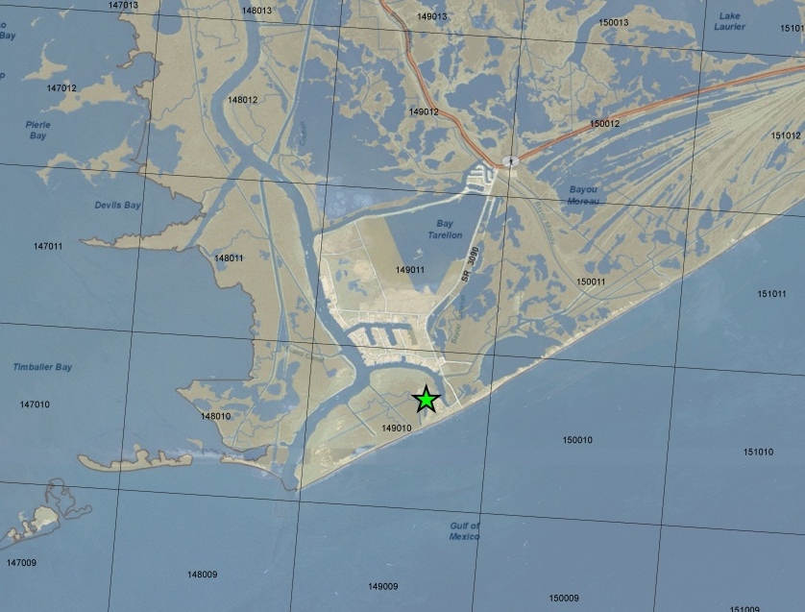
Port Fourchon with 4 km Grid Overlay

Slide 21
Gulf-Wide Sources
Commercial marine shipping and O&G platform emissions
  Acquired by sub-contractor ERG
  Latest 2008 estimates from BOEM (formerly MMS)
2008 O&G projected to 2010
  Using 2008 and 2010 production by BOEM Lease Numbers
  Assumed 2008 non-oil-related data were representative of 2010 (no projection)
Processed in EPS3 as combination of point and area sources
  CB6 speciation using default EPA cross references
  Point coordinates, lease tracts, shipping lanes for spatial allocation

Slide 22
Biogenic Emissions
MEGAN version 2.10
  Calculations driven by vegetative cover, weather
  Global land cover data at 1 km resolution
  LAI from 2008 MODIS data, 1 km/8-day resolution
  Plant Functional Type fractional (PFTf) coverage from 30-meter 2008 LANDSAT TM data
  Updated emission factors, improved US species composition data
Gridded meteorological data from WRF
  Temperature, solar radiation, wind speed
Photosynthetically Active Radiation (PAR)
  Solar radiation from WRF (this project)
    No missing data, but subject to model error (cloud cover)
Product is gridded, hourly, CB6 model-ready files
  Biogenic emissions for each hour, each day, 36/12/4 km grids

Slide 23
Wild/Agricultural Fires
Fire Inventory from NCAR (FINN) version 1
  http://bai.acd.ucar.edu/Data/fire/
  Global dataset of daily emissions from satellite (1 km)
  Species: NOx, PM2.5, CO, and VOC
    Speciated to MOZART-4
  6 fire types
    Tropical, temperate, and boreal forests, cropland, shrublands, and grasslands
Data were windowed to the 36/12/4 km modeling grids
  Fire points within 5 km of each other were combined into a single complex
Ingested into EPS3 fire module
  Mapped to CAMx CB6 speciation
  Uses WRAP methodology to temporally and vertically (by altitude) distribute daily emissions

Slide 24
September and October FINN Fire NOx

Slide 25
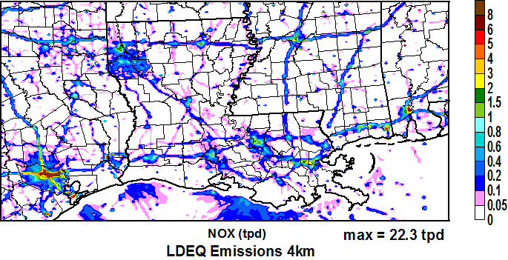
Typical Day NOx on 4 km Grid

Slide 26
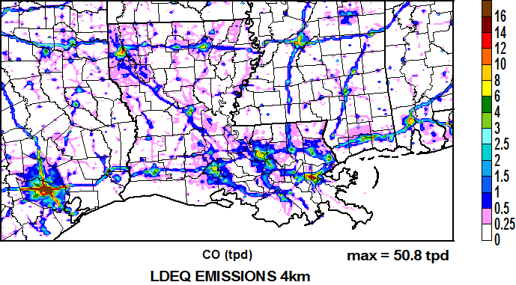
Typical Day CO on 4 km Grid

Slide 27
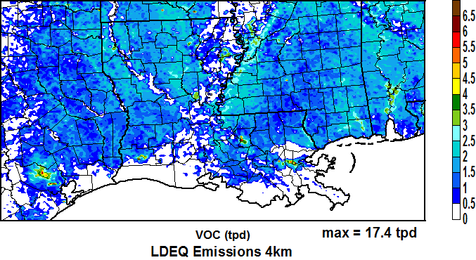
Typical Day VOC on 4 km Grid

