Slide 1

The Natural Gas Case for North America
September 30, 2010
The “New” Natural Gas

Slide 2
Challenges
9.7% unemployment (highest in 27 years)
    14.8 million people: 3.2 million higher than in 1983
Import 12.9 MMB/D of oil, 66% of consumption
  $453 billion in petroleum product imports 2008 = 70% of trade deficit
Highest CO2 emission/capita of all major nations
  130% higher than European Union, 88% higher than Japan
Source: Bureau of Labor Statistics, BP Statistical Review, Congressional Budget Office, Bureau of Economic Analysis and CDIAC.
Notes:
That’s the good news. Meantime, our country faces some real challenges.
We have the highest unemployment rate in 27 years. That’s 15 million people counted as unemployed right now.
Another challenge is our energy security. We import 66% of the oil we use. The cost of our petroleum product imports was $450BN in 2008. That was the equivalent of 70% of our trade deficit balance.
And as a nation, we are heavily in debt. The federal government will have a $1.4 trillion deficit this year, and will double its debt by 2020 if you believe the latest numbers.
And to top it all off, we face environmental issues. Now, I don’t want to go into a debate on the merits of climate change, but we do have challenges in keeping our environment in balance. The U.S. has the highest CO2 emissions per capita of any major nation
These are all big, real challenges. The important thing is that our phenomenal natural gas endowment should play a key role in helping us overcome them.

Slide 3
U.S. Energy Consumption

Slide 4
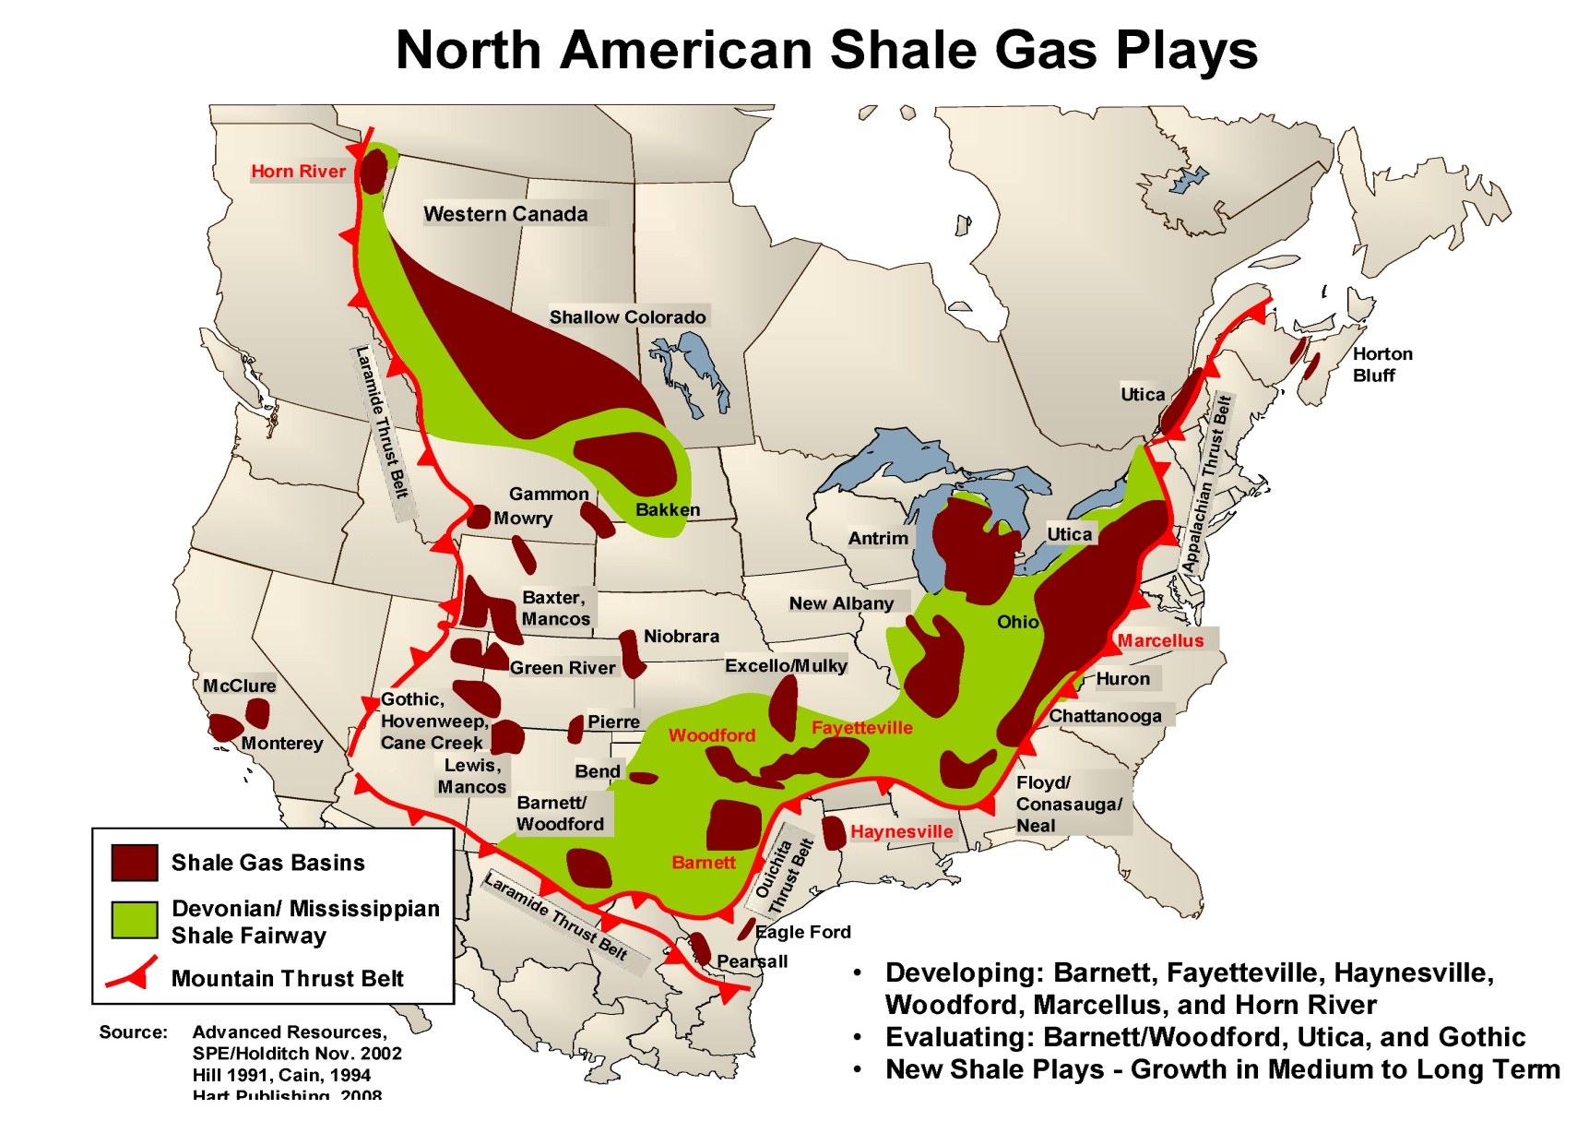
Abundance/Energy Security
- 100+ years of secure natural gas resource
- 98% of natural gas sourced from North America
Notes:
The application of horizontal drilling and multi frac technology to unconventional reservoirs has had a truly transformational impact on the resource endowment of North America.
In only about 5 years of really large scale application of these techniques, we have nearly doubled the US’s commercial natural gas reserves to over 100 years of supply.
And I say over 100 years, because the reality is that we may only be scratching the surface of what is possible as we continue to refine these technological applications.
This is great news for the country and the industry, and it is a real story about the power of innovation, technology and private enterprise.

Slide 5


Abundance
Potential for Big Impact in Near Term
BCFPD
Historical Forecast
Marcellus
Woodford
Haynesville
Fayetteville
Deep Bossier
Barnett
Source: Tristone Capital
Notes:
Moreover, the natural gas we are talking about is right here, so the potential for impact on supply available into our homes, factories and power plants is very big and very soon.
We are talking about mostly geologically uniform reservoir formations stretching for hundreds of miles at a time. We know the gas is there, and that we can get it out.
There are midstream constraints to address, but they are manageable. Unconventional gas is really a development business that really can deliver as many BCFs per day of natural gas into our economy as we want.

Slide 6

Jobs
Ranking | State | GDP ($BN)
1 | California | 1,847
2 | Texas | 1,224
3 | New York | 1,144
4 | Florida | 744
5 | Illinois | 634
6 | Pennsylvania | 553
7 | New Jersey | 475
8 | Ohio | 472
9 | North Carolina | 400
10 | Georgia | 398
11 | Virginia | 397
12 | NATURAL GAS | 385
13 | Michigan | 383
14 | Massachusetts | 365
15 | Washington | 323
Natural Gas industry:
2.8 million U.S. jobs
31 states have > 10,000 jobs related to natural gas
Source: IHS Global Insight report prepared for ANGA, BEA, U.S. Department of Commerce. All figures based on 2008 data.
Source: Regional Economics Models, Inc.
Notes:
And it starts with jobs.
IHS has conducted a study that indicates that the natural gas industry represented 2.8 million jobs in the United States as of the end of 2008. (600,000 direct jobs to explore, produce, transport, deliver and provide onsite services; 700,000 indirect jobs in other industries that supplied the natural gas industry; and 1.5 million induced jobs from direct and indirect workers spending their income)
And the jobs are all over the country. 31 different states have more than 10 thousand jobs related to natural gas.
To put it in context, if it were a state, the value added by the natural gas industry would be one of the 15 largest states by GDP. That is big.
And all of this is 2008 numbers, when we were only starting to tap the potential of the shales. The fact is that, going forward, developing our natural gas is a solid path to creating the jobs we need, getting people back to work and earning a paycheck that they can spend back in their communities.

Slide 7


Transportation
Natural Gas
Vehicles (million):
% of Vehicle Fleet
52
22
10
24
2
1
-
11
27
-
2
-
-
25
3
7
Source: Natural Gas Vehicles for America, International Association for Natural Gas Vehicles
Notes:
Other countries that have natural gas get it.
What you see on this diagram is how many millions of CNG vehicles different countries have, and the numbers on the right hand side are what percentage of their fleet that represents.
Argentina and Brazil have over 1.5 million CNG vehicles each. The United States has barely 6% of that. How can we be 6% of Brazil or Argentina with all the natural gas we have and the fact that we need to import so much of our oil?
In fact, as you can see here, in the CNG vehicle league tables, we are currently competing with the likes of Armenia or the Ukraine… that’s surely not where we belong.

Slide 8

Transportation
NGV’s utilize existing technology
CNG typically lowers fuel costs by 30 to 40 percent
NGV’s reduce carbon monoxide emissions by at least 90 percent, NOx by 50 percent and carbon dioxide by 25 percent.
25% of U.S. vehicle fleet on natural gas would:
  Reduce U.S. oil import needs by 5 MMB/D, or $140 billion per year
  Reduce U.S. GHG emissions by 8%
Notes:
So what does it take to use that natural gas?
It’s primarily about transportation and power generation, which represent most of our energy use and CO2 emissions. Let’s start with transportation.
Just about any gasoline vehicle can be easily converted to run on compressed natural gas at a very small upfront cost.
Converting just 25% of our vehicles to run on natural gas would reduce our oil imports by 37%, saving us $140BN in import bills based on current oil price benchmarks. That’s money going into our own economy instead of Saudi Arabia, Nigeria or Venezuela. The choice is ours. I think it’s a no brainer.
In addition, converting 25% of the fleet to CNG would reduce our CO2 emissions by 8%.
And we at Apache get it. We are converting our vehicle fleet to run on CNG. You can see here our Chevy Tahoe. This is not a little toy electric car, it’s a Tahoe. I drive every day a Chevy Avalanche that runs on CNG. It no big deal to convert them, and they run great.

Slide 9
Closing
Natural gas vehicles
  Uses existing technology
  Fleets ideal for centralized fueling centers
Natural gas
  Clean, abundant and American
  Economical
  Reduces dependence on foreign oil
  Reduces emissions

