Slide 1

Natural Gas Vehicles:
An American Energy, Economic, and Environmental Answer
LDEQ
September 30, 2010

Slide 2

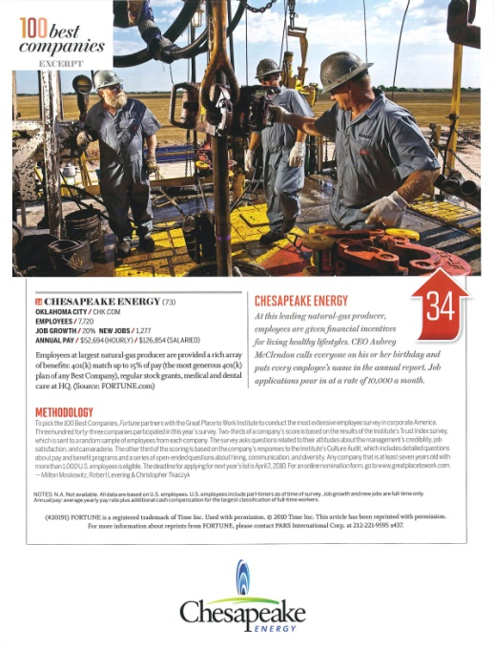
Chesapeake Energy Corporation
Industry Leader in the exploration and development of domestic deep shale gas resources
Energy Producer of the Year and Industry
Leadership Award – Platts Global Energy Awards
Program - December, 2009
Fortune 100 Best Companies to Work
For 2008, 2009 & 2010
2009 Oklahoma Governor’s Pinnacle Award
(Safety and Health)
2009 Oklahoma Compass Award (Outstanding Ethics)
2009 Natural Gas STAR Production Partner of the Year – U.S. Environmental Protection Agency
Notes:
Vast experience in unconventional shale across the US
Recognized as one of the best 100 companies in America to work for in 2008 and 2009 by Fortune 100
Were awarded the 2009 Oklahoma Governor’s Pinnacle Award by the OK Safety Council for overall excellence in Safety & Health.
Awarded the 2009 Compass Award by the OK Business Ethics Consortium for best practices in reinforcing ethical behavior.

Slide 3
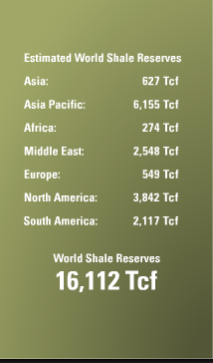
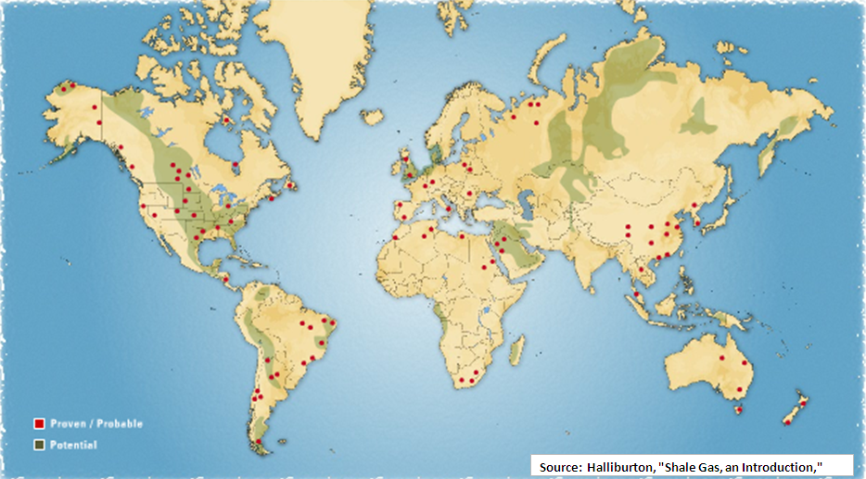
Shale Gas Deposits Around the World Could Revolutionize the Global
Supply/Demand Balance and Improve Geopolitical Relationships

Slide 4

Discoveries Are Spread Across the U.S. –
32 of 50 States Produce Natural Gas
Cody
Bakken
Gammon
Mowry
Antrim
85%
Supply from U.S.
Baxter/Mancos
Marcellus
Niobrara
Mancos
New Albany
Mulky
Lewis
Pierre
Fayetteville
97%
Supply is from
N. America
Woodford
Barnett/Woodford
Floyd-Neal
Barnett
Haynesville
Eagle Ford/Pearsall
Natural gas producing state
Non producing state
Source: EIA
U.S. natural gas deposits are far more widespread and larger than U.S. coal deposits
Notes:
4

Slide 5
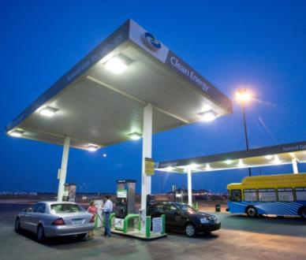
Abundant
New Discoveries:
  Barnett Shale: 44 Tcf*
  Fayetteville Shale: 42 Tcf*
  Haynesville Shale: 250 Tcf*
  Bossier Shale: 175 Tcf*
  Marcellus Shale: 490 Tcf**

Slide 6
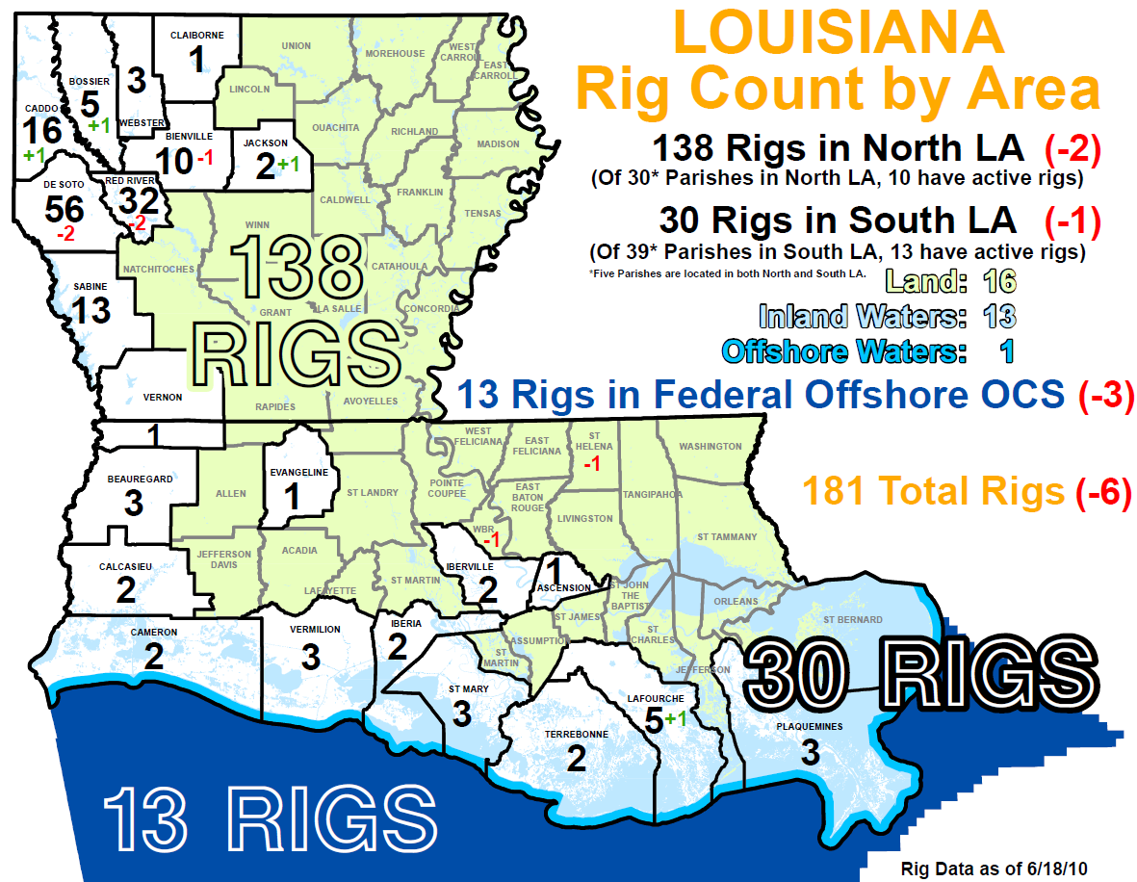

Slide 7

More Than a Coastal Issue
BATON ROUGE (June 14, 2010) - The six-month drilling moratorium in the Gulf of Mexico will cripple Louisiana's economy and leave thousands of families without income, particularly in coastal Louisiana, where one in three jobs is related to the oil and natural gas industry.
What is the overall impact of the Oil and Gas Industry in Louisiana?
Oil and gas production directly and indirectly supported $12.7 billion in household earnings in the state, representing 15.4 percent of total Louisiana household earnings in 2005;
The industry supported, directly and indirectly, more than 320,000 jobs and $70.2 billion in business sale in Louisiana in 2005;
In 2006, more than 58,000 Louisianans worked in extraction, pipeline and refining jobs

Slide 8
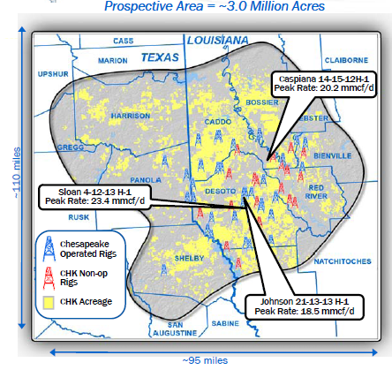
Haynesville Shale Overview
CHK discovered in 2007; the Haynesville Shale is likely to become one of the two largest natural gas fields in the U.S. (Marcellus the other)
150 million years old
Unconventional Resource Play
    Not a conventional reservoir
    Requires stimulation to produce
      Creates reservoir space
200 – 300 feet thick
2.0 – 2.5 miles below surface
CHK has the industry’s largest combined resource potential in the Haynesville and Bossier Shales

Slide 9
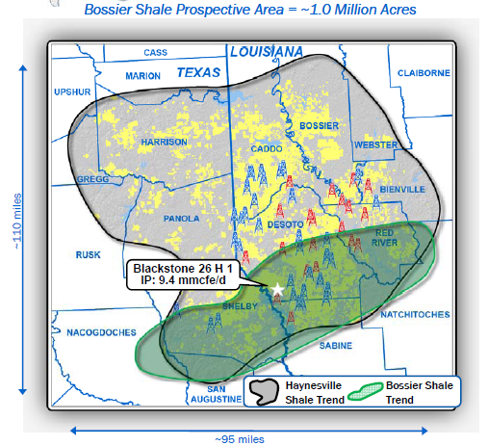
Bossier Shale Overview
500 to 800 feet above the Haynesville
Extends from the western tip of Webster and Bienville parishes in the east across to Shelby Country in the west and the eastern edge of Nacogdoches and San Augustine Counties
Estimated Ultimate Reserves (EURs) of 5.5 billion cubic feet per well, which is only 1 billion cubic feet less than a Haynesville well (HS EUR is 6.5 bcf)

Slide 10
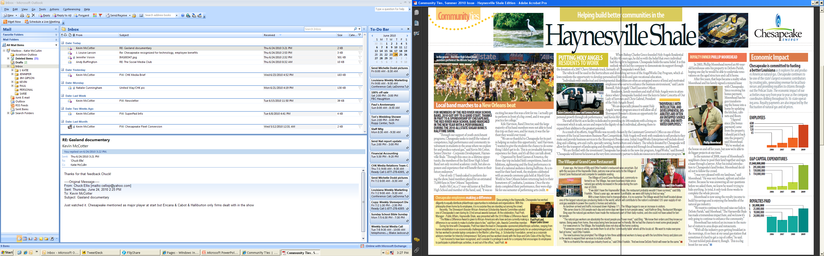
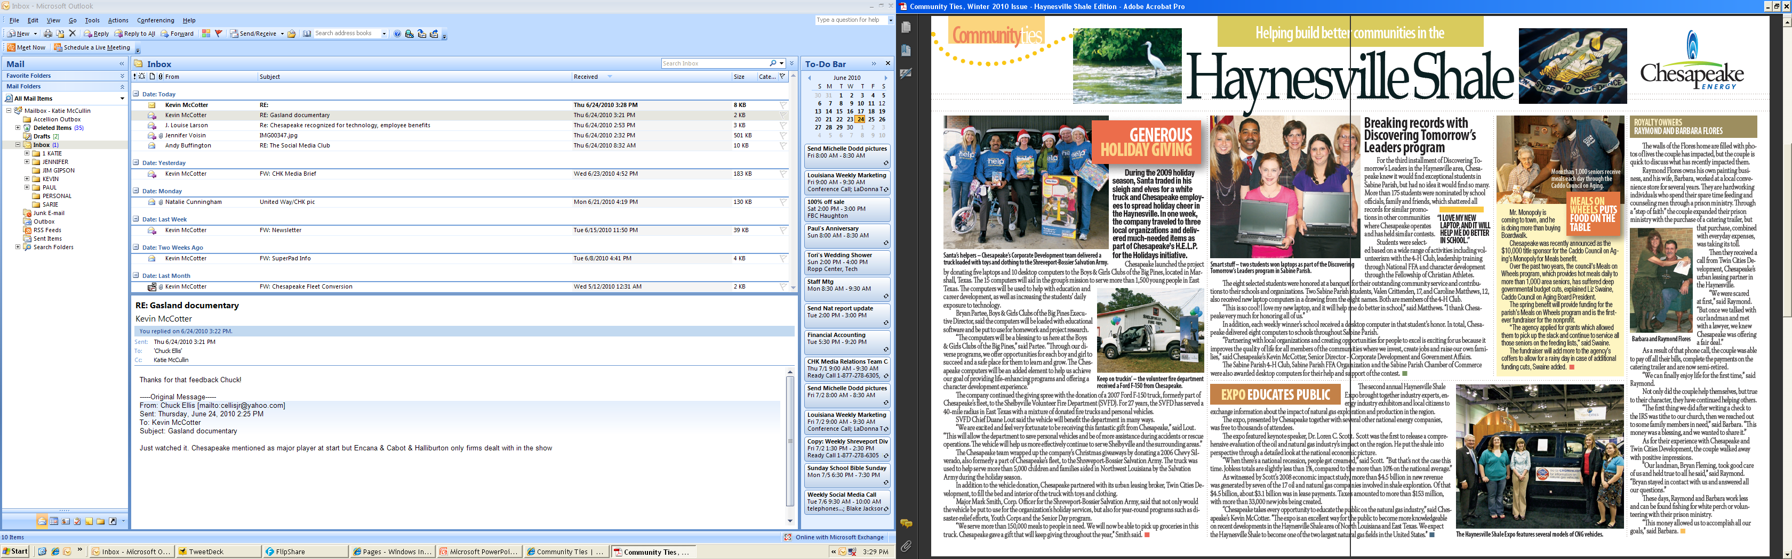
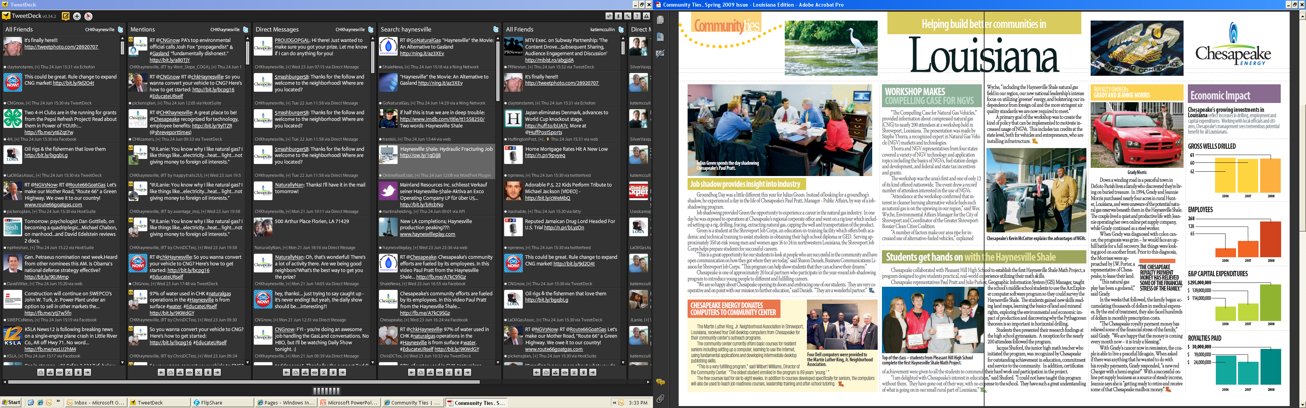
The People Behind the Economics
Chesapeake currently conducts business with over 250 local Louisiana companies for our operations in the Haynesville
Industry’s Economic Impact in 2009
  Generated approximately $10.6 billion in new business sales within the state of Louisiana ($2.4 billion in 2008).
  Created nearly $5.7 billion in household earnings ($3.9 billion in 2008).
  Accounted for 57,637 jobs within the state. Lease payments totaled $957 million in 2009; direct drilling expenditures totaled $4.4 billion and total direct spending was $7 billion (32,742 jobs in 2008).
  Increased state and local tax revenues by at least $912 million due to the extraction activities in the Haynesville Shale ($153 million in 2008).
ROYALTY OWNER
GRADY MORRIS

Slide 11
Compressed Natural Gas (CNG) -
The Energy Answer!
CLEAN
  Produces 93-95% less overall toxics and reduces greenhouse emissions by 20-30% compared to gasoline and diesel vehicles.
According to the EPA, natural gas is the cleanest-burning alternative transportation fuel commercially available today. A study performed on behalf of the California Energy Commission confirms the EPA’s findings.
71%: Share of U.S. Oil Consumption for Transportation
AMERICAN
  98% of the natural gas use is produced in North America. We purchase 70% of our oil
  from foreign nations.
ABUNDANT
  Natural gas reserves continue to be discovered and increase each year. The U.S. has enough natural gas to last for 120 years and beyond.
AFFORDABLE
  CNG costs on average are over 40% less than conventional gasoline at the pump.

Slide 12
Compressed Natural Gas (CNG) –
The Energy Answer!
NATIONAL SECURITY
The U.S. controls 4% of the world’s oil reserves yet we consume 25% of the total global production
  American producers control all of our needed natural gas reserves.
ENVIRONMENTAL
40 – 70% of emissions are from the transportation sector
  Non-attainment will adversely affect economic stability.
  Health problems created by transportation pollution will increase medical costs
  .
In 2005, the vehicle sector produced $56 billion in health and other non-climate-change damages
$36 billion from light-duty vehicles and $20 billion from heavy-duty vehicles.

Slide 13
Clean
Converting one refuse truck from diesel to natural gas is the
equivalent of taking 325 cars off the road in terms of pollution
reduction
Today’s buses have 2010-compliant, low-emission natural gas
engines, which produce only one-sixth the smog-inducing NOX that
the latest “clean diesel” buses produce.
Natural gas buses demonstrate diesel-like performance, with a
90% reduction in noise.
They emit significantly fewer pollutants than diesel---86% less particulate matter and 38% to 58% less NOX.

Slide 14










Compressed Natural Gas (CNG) –
The Energy Answer!
CNG VEHICLES
STATIONS
NGVs / STATION
1 | Argentina |  | 1,650,000 (12%) | 1,400 | 1,180
2 | Pakistan |  | 1,550,000 (54%) | 1,606 | 965
3 | Brazil |  | 1,425,513 (26%) | 1,442 | 988
4 | Italy |  | 432,900 (12%) | 558 | 775
5 | India |  | 334,820 (34%) | 321 | 1,043
6 | Iran |  | 263,662 (82%) | 179 | 1,472
7 | Colombia |  | 203,292 (65%) | 310 | 655
8 | USA |  | 146,876 (9%) | 1,340 | 109
9 | China |  | 127,120 (24%) | 355 | 358
10 | Ukraine |  | 100,000 (33%) | 147 | 680
(Annual Growth Rates 2005 -2007)
Growing Markets: Germany, Sweden, Japan

Slide 15




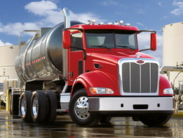
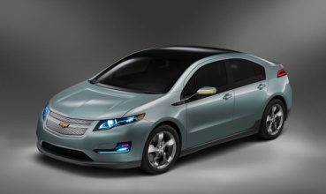
Natural Gas Vehicles Are a Clean Transportation
Solution and the Most Efficiently Scalable Answer
Natural gas vehicles, combined with Plug-In Hybrid Electric (PHEV) sedans, will support America’s economy, environment, and energy security
  Natural gas is an ideal replacement for high-fuel consumers and polluting vehicles such as:
    Transit buses
    Refuse trucks
    Commercial fleets*
    Semi-trucks
    School buses
    Delivery vans
PHEVS are only clean if powered
by clean electricity – what’s the point of replacing imported gasoline with electricity from dirty coal
All Current Natural Gas Vehicles

Slide 16
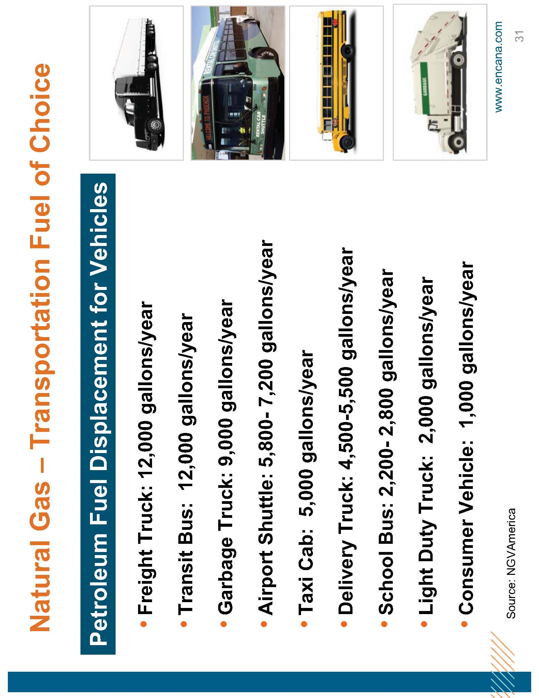
Natural Gas – Transportation
The Case for Transportation

Slide 17
Louisiana CNG Incentives
Act 469
Alternative fueled vehicles state tax credit
  50% of the incremental cost of new CNG vehicles**
    Must be billed for incremental cost on additional invoice or else is limited to $3000 or 10% of vehicle cost
  50% of the incremental cost of a conversion
Alternative fueling station state tax credit
  50% of the cost of the fueling equipment
  Act 118
  Alternative Fuels Revolving Loan Fund
    Provides for a low interest loan (~.95%) to municipalities, political subdivisions and institutions of higher learning to convert their vehicles to CNG or other Alternative Fuels

Slide 18
Federal Tax Credits Range from $2,500 to $32,000
Gross Vehicle Incremental 50% Credit 80% Credit
Weight Rating Cost Cap (ICC) At ICC 80% at ICC
Less than 8500 lbs. $5000 $2500 $4000
8501 to 14,000 lbs. $10,000 $5000 $8000
14,001 to 26,000 lbs. $25,000 $12,500 $20,000
More than 26,000 $40,000 $20,000 $32,000
Credit is set to expire on 12/31/10.
ExamplesOEM -Honda Civic GX (CARB SULEV certified) qualifies for a $4000 credit
SVM -Chevy /Ford 2500 Series pick-ups (CARB certified) -$8000 credit
M/HDV Cutaway shuttle or delivery step-van -$20,000 credit
HD trucks and buses -$32,000 credit

Slide 19
Chesapeake's Fueling the Future Initiative
FLEET: Chesapeake Fleet Transformation and Internal Market Development
  Strategic development focused on market enhancing initiatives with concentrated alignment with CHK fleet area
STATE: Chesapeake Strategic State Market Development
  Strategic initiatives and opportunity development located within CHK’s operational states in an effort to augment current NGV opportunities
NATIONAL: National Market Development and Policy Opportunities
  Market development efforts at a national perspective that can foster, support, and stimulate value-adding strategic demand for NGVs
EDUCATION: National Communication and Education
  Educational efforts focused on strategic consumer groups and particular market segments for early adoption opportunities for NGVs
MARKETING: Chesapeake Unique Marketing Applications
  Creative, sustainable, and iconic applications that provide a strategic opportunity for enhanced educational and promotional efforts for the versatility, benefits, and realities of natural gas vehicles

Slide 20
Current Fleet Stats
Company | Vehicle Count
COI | 1,545
Nomac | 650
Appalachia | 477
Midstream | 493
MidCon | 415
Great Plains | 228
Total CHK Fleet | 3,808
Est. Total Mileage 2010 | 85,386,348

Slide 21
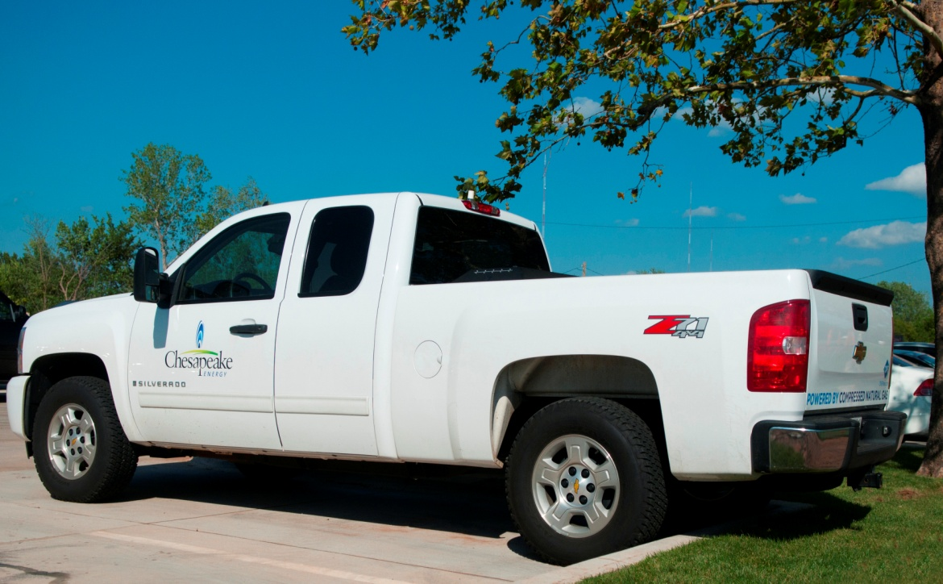

Chesapeake Fueling the Future Initiative
Entire light duty fleet transformation within 4-5 years
Current CHK Fleet
  Active Vehicles 3,925
  Current CNG Fleet 220 (130 CHK and 90 Employee Lease Program)
    575 Vehicles to be Replaced with CNG (All OK Field Offices by 12/31/2010)

Slide 22
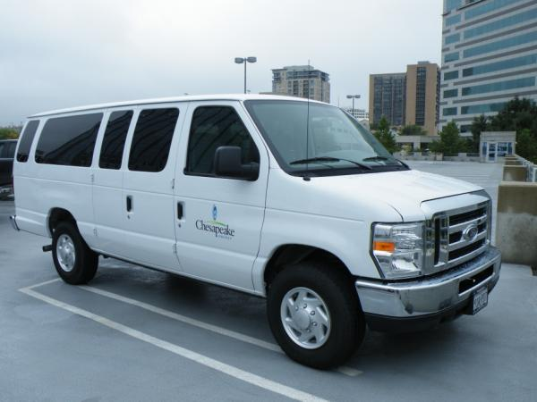
Economics -- Passenger Van for Airport Limo
GVWR: >8,500 <14,000
  Ford E-350 passenger van
  Chevy/GMC 3500 passenger van
MPG: 13/15 City/Highway
65,000 miles/year
Fuel Use: 9-12 gge/day; 4,100-4,500 gge/year
CNG Premium: $15,500 (before tax credits)
Federal Tax Credit: $8,000 (>8,500, <14,000)
Simple Payback: 1.1 – 1.3 years
  Based on $1.50/gge savings at retail station
Life-Cycle cost advantage: $18,000 – $23,000
  Depending on use and miles per day, cost differential

Slide 23
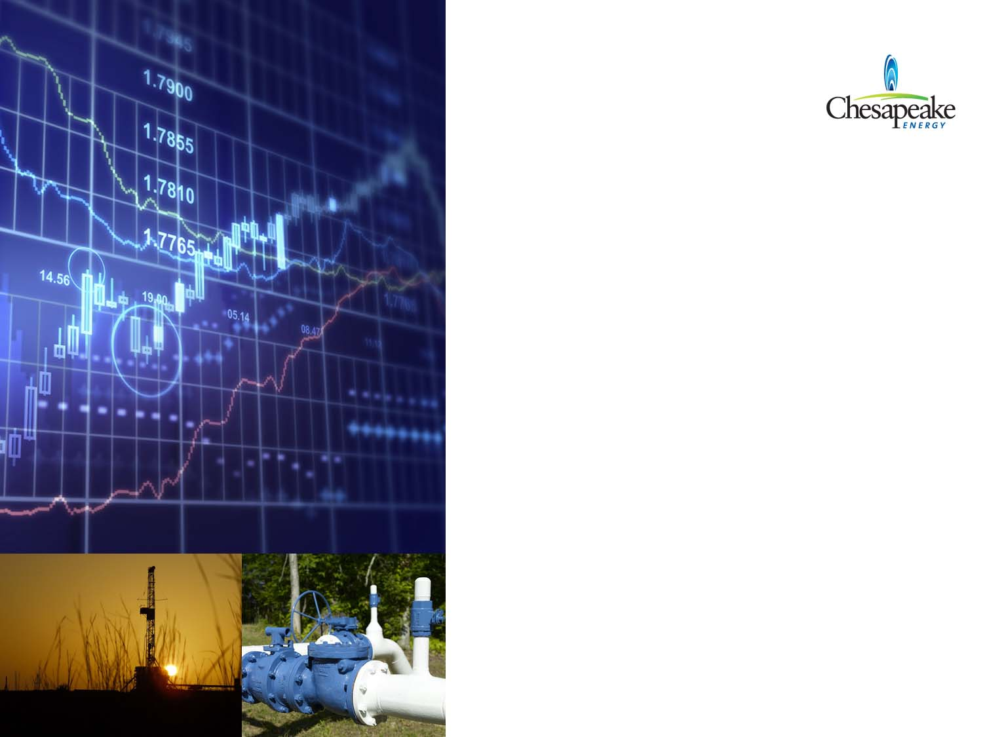
Projected Annual
Fuel Savings for Converted Fleet within next 48 Months
3,808 CNG Fleet Vehicles x $2,000 annual fuel savings=
$7,616,000!

Slide 24
CNG in the Ark-La-Tex
7 CNG fueling locations in the area with-in ~ 18 months—five of the locations applied for DNR funding and have received the final approval documents. Stations include:
Relay Station on I-49
SporTran---off of North Market
EnCana in Coushatta
Chevron Station on I-49 in Alexandria
2 stations in Bossier City
Texas St. at Benton Rd.
Hwy 71 at CenturyTel
Shreveport Trash Trucks---Kings Hwy at LSU Med Center
We are also working on locations in Mansfield, on North Market, I-20 at Greenwood Rd and the Marshall area.

Slide 25
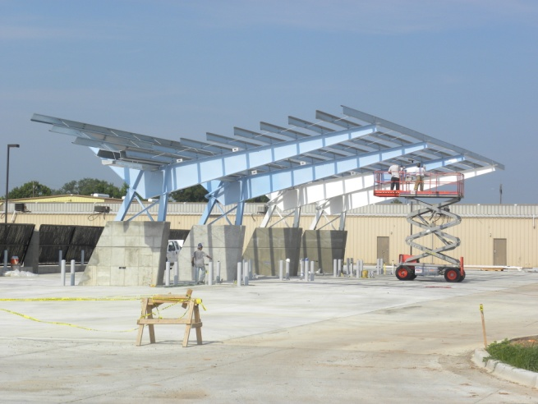
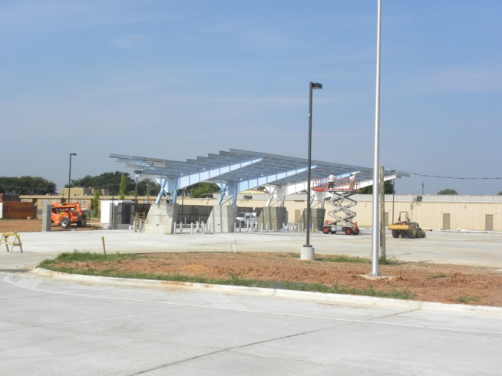
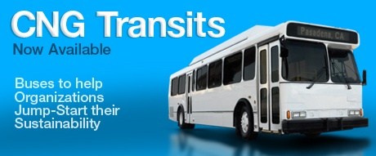
Local Progress
Future site of Bossier City CNG public fueling station
2 public fueling stations in construction phase in Bossier City
City of Shreveport SporTran buses and paratransit vehicles

Slide 26
CNG in the Ark-La-Tex
Servicing Light–Medium duty NGVs: 4 dealerships have received certifications to service NGVs:
Chevyland
Wray Ford
Mansfield Auto World
Rountree Ford

Slide 27
CNG in the Ark-La-Tex
2 NGV Conversion Centers:
Steelweld—Conversion Center for Medium and Light duty vehicles
Twin State Trucks - located on Grimmett Drive is doing repowers for heavy duty vehicles including dump trucks, refuse and School Buses.

Slide 28

Each National Fleet Using Natural Gas Is An Economic and Clean Energy Stimulant
Using AT&T’s vehicle replacement program as an example:
The impact of buying or converting 15,000 vehicles to cleaner technology over a 10-year period.
Should reduce gasoline consumption by more than 49,000,000 gallons
Trim carbon dioxide emissions by 211,000 metric tons
  the equivalent of removing more than 38,000 vehicles from the road for a year.
In addition, the AT&T replacement program will help support an average of 1,000 vehicle manufacturing related jobs each year from 2009-2013.
Source: Center for Automotive Research 2009

Slide 29
Kansas City
“We use CNG for a number of reasons. First of all, we want
vehicles that are safe and perform as well as traditional vehicles.
Secondly, we want the lowest emissions possible, and
finally, we want a secure, domestically produced fuel that will
be affordable over the long haul and offer price stability, to get
us off the roller coaster of petroleum fuels. For us, the move to
CNG has proven to be a good choice.”
– Sam Swearngin, Fleet Administrator for Kansas City

Slide 30
WHEN AMERICA NEEDS IT MOST
From 2010-2012, American cities will face a combined budget shortfall of
$56 billion, forcing 91% to make budget cuts.
Of those budget cuts, 67% of cities say they will lay off employees, 62% will delay or cancel infrastructure projects, and 14% will cut back public safety spending.
When compared to a “clean” diesel transit bus over a typical 12-year life cycle, a natural gas transit bus can save a city $228,000 more per bus.

Slide 31
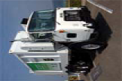
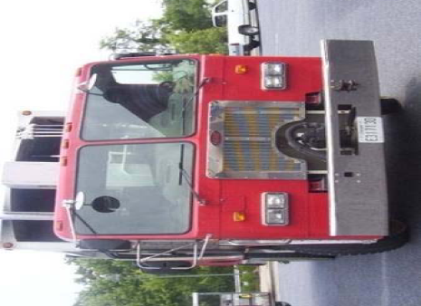
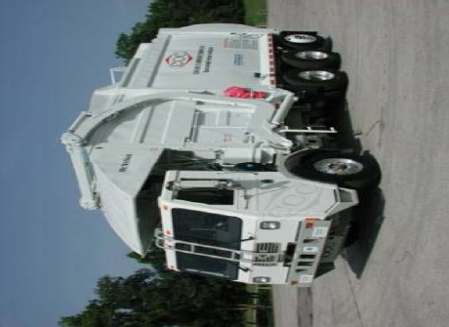
Refuse Truck
GVWR: >26,000 lbs
MPG: 2.5 –3.0 (lots of idle time)
Fuel Use: 35-40gge/day; 8500-10,000dge/yr
CNG Premium: $50,000 (before tax credits)
Fed Tax Credit: $32,000
Remaining premium (assuming no grant): $18,000
State Tax credit $9,000
Simple Payback: 9 mos
Life-cycle cost savings: 100K+! (based on 8-yrs )

Slide 32
Specific Next Steps
$ 9 million in Funding Available for Alternative Fuel Development—3 Million
Unite Anchor Fleets with Fueling Locations
An army of Fleet vehicles : Our combined Federal
agencies operate one of the world’s largest vehicle fleets, with more than 645,000 civilian and non-tactical military vehicles.
Texas Clean Transportation Triangle

Slide 33
Contact Us
Sarie Joubert
Chesapeake Energy Corporation
Manager-Public Affairs
318-674-7206

