Slide 1
State of Louisiana Briefing
LNG Vehicle
Fueling & Infrastructure
Greg Roche
Director of Business Development
(562) 493 – 2804 groche@cleanenergyfuels.com

Slide 2


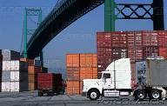


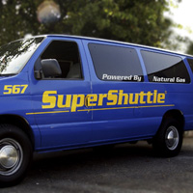
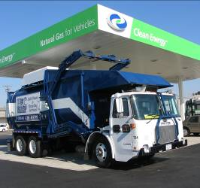
About Clean Energy
Founded by T. Boone Pickens (NASDAQ: CLNE)
Largest Alternative Transportation Fuel Provider
Leading Provider of Natural Gas
As a Transportation Fuel
430+
Fleet
Customers
20,000+
Natural Gas
Vehicles
200+
Natural Gas
Fueling Stations
Compressed Natural Gas (CNG)
Liquefied Natural Gas (LNG)
Taxis
Government
Vehicles
Regional
Trucking
Public
Transit
Airport
Transit
Refuse
Hauling
Notes:
Largest provider of natural gas transportation fuel in U.S.
Provide both CNG and LNG
Founded in 1997 as Pickens Fuel Corp - Became Clean Energy in 2002
Design, build & operate NG fueling stations
Have our own LNG production plants & delivery service for HDVs
Offer Grant writing services (over $100 million) – Vehicle financing
Target high fuel use fleets
Allow profitable expansion of infrastructure AND allow significant fuel cost savings to customer
Providing public access allows expansion of market to collateral fleets

Slide 3

Natural Gas Reduces Dependence on OPEC
Trucks Use 39 Billion Gallons of Diesel per Year
Keeps $200 million per day in USA

Slide 4
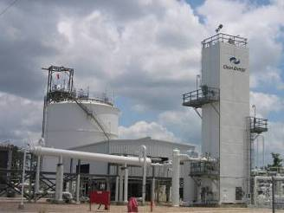
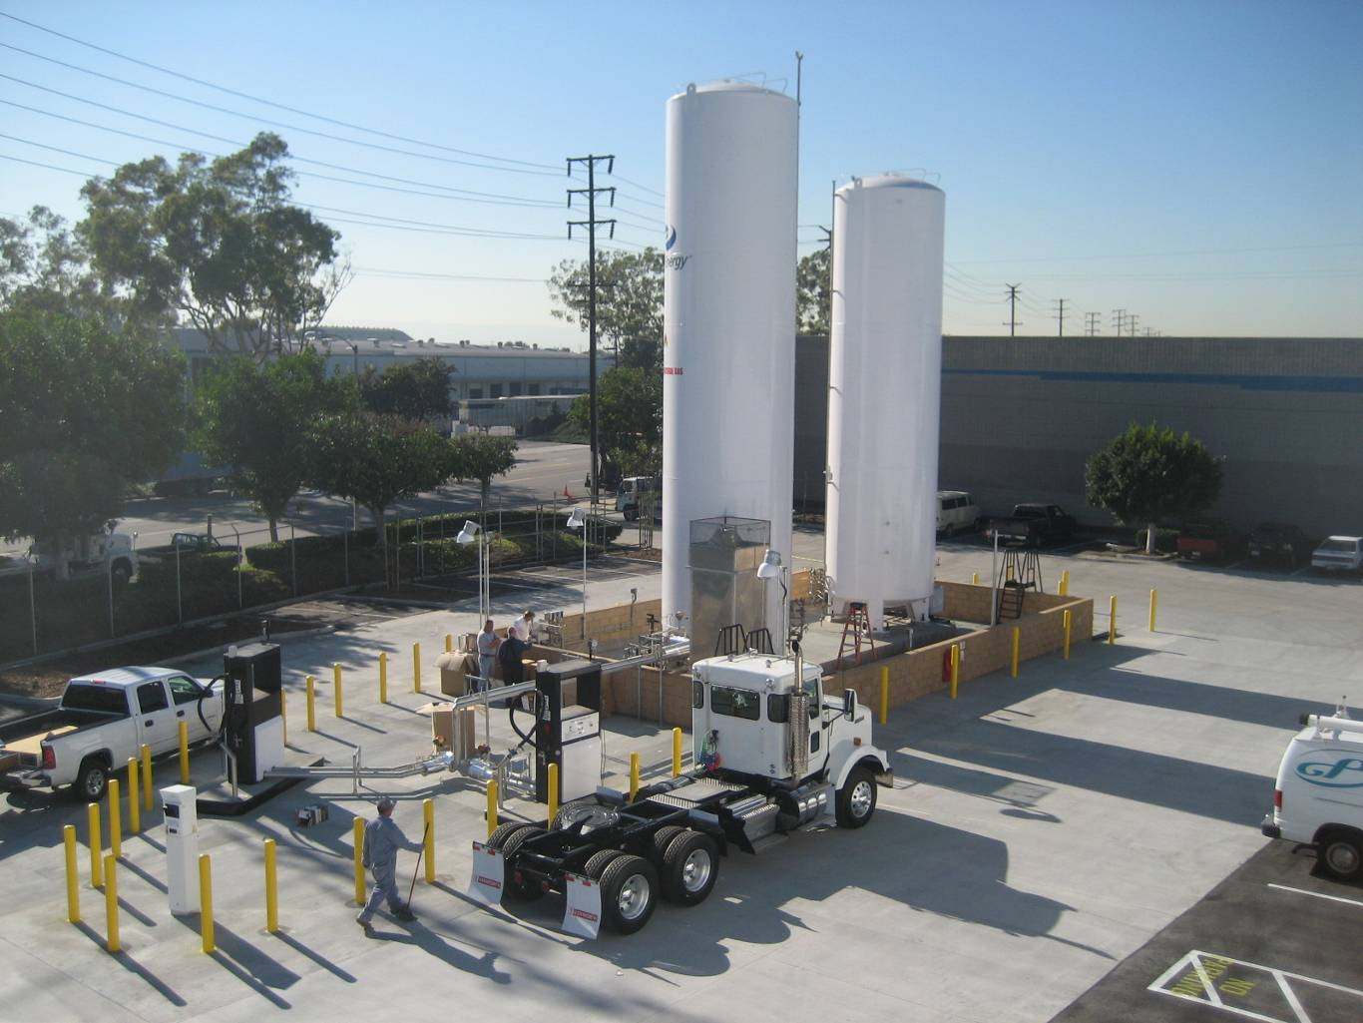
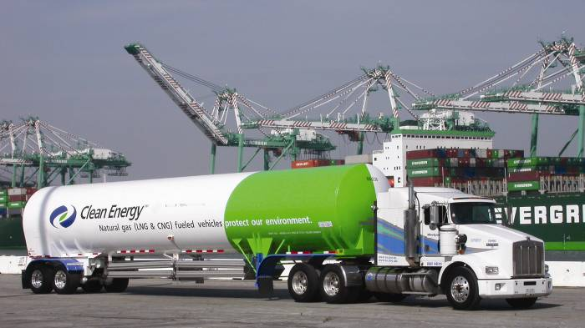
Liquid Natural Gas (LNG) Basics
Ideal for heavy duty trucking
Storage volume is half of CNG
System weight is less than CNG
Produced at LNG plants
Delivered in trailers to fuel stations
Rapid fueling in about 5 minutes

Slide 5
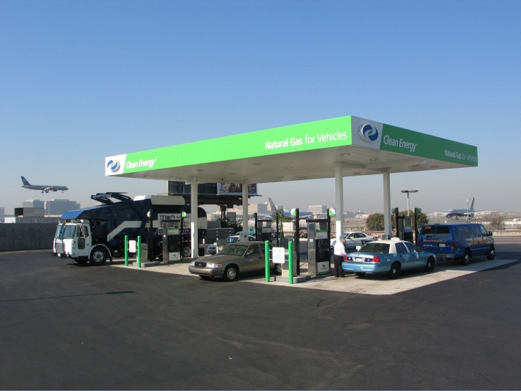
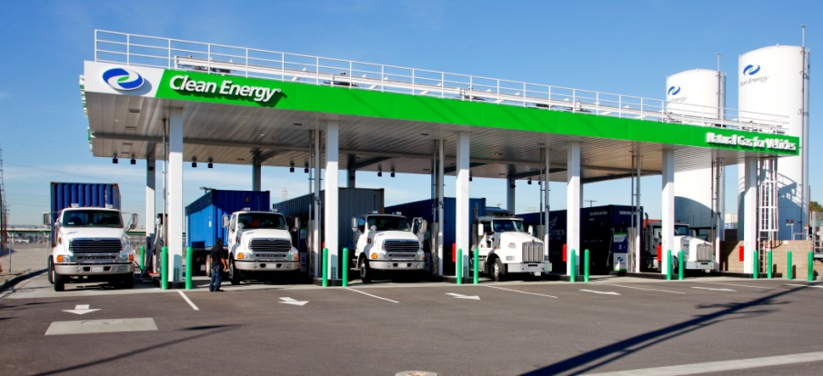
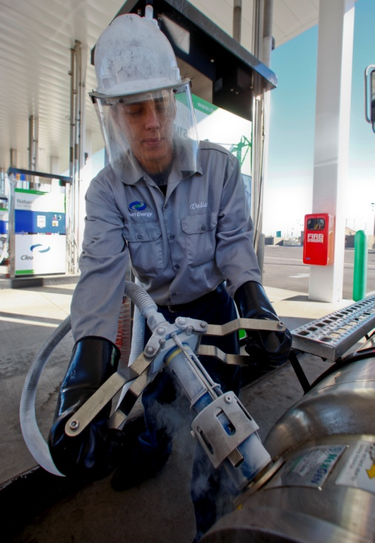
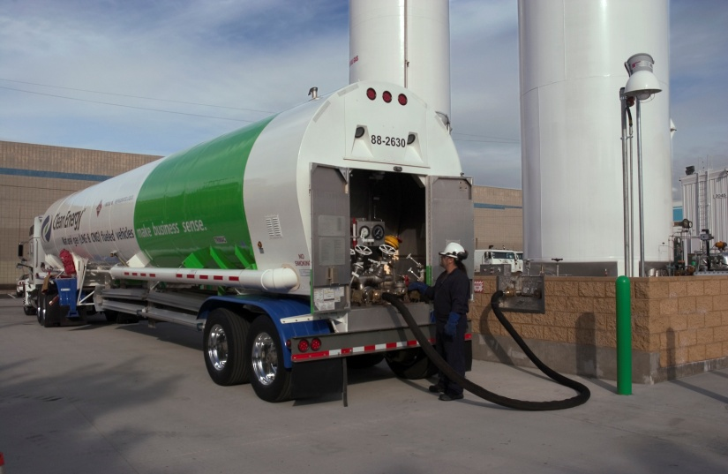
Fueling Stations

Slide 6
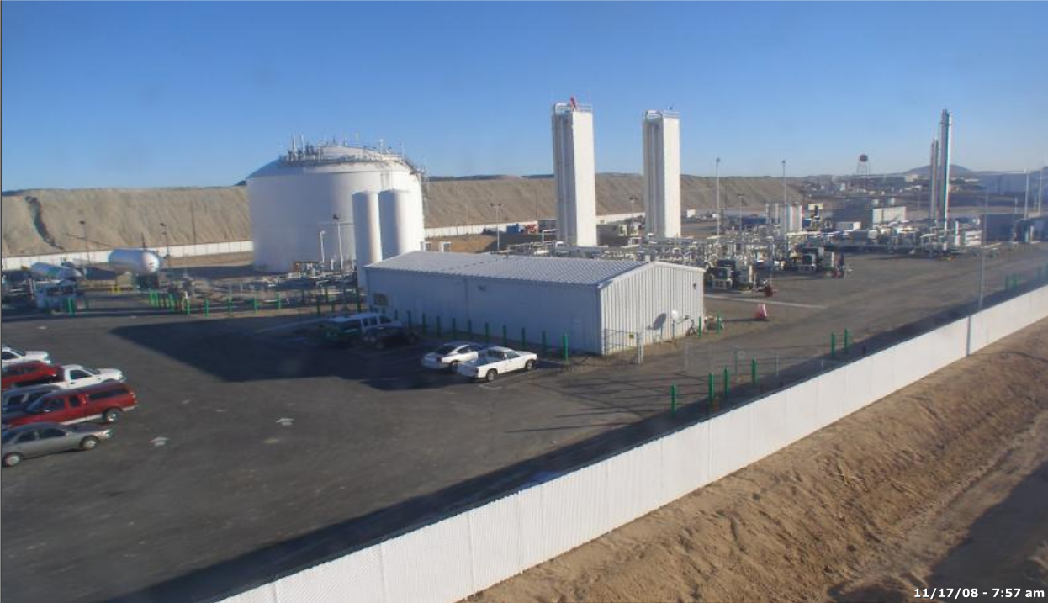
LNG Production Plants Make the Fuel
Clean Energy’s Newest LNG Plant
$80 Million Investment
160,000 gal/day
Expanding to 240,000 gal/day
1.8 Million Gallons Storage
Clean Energy currently owns two LNG plants
and draws from 7 other LNG plants

Slide 7
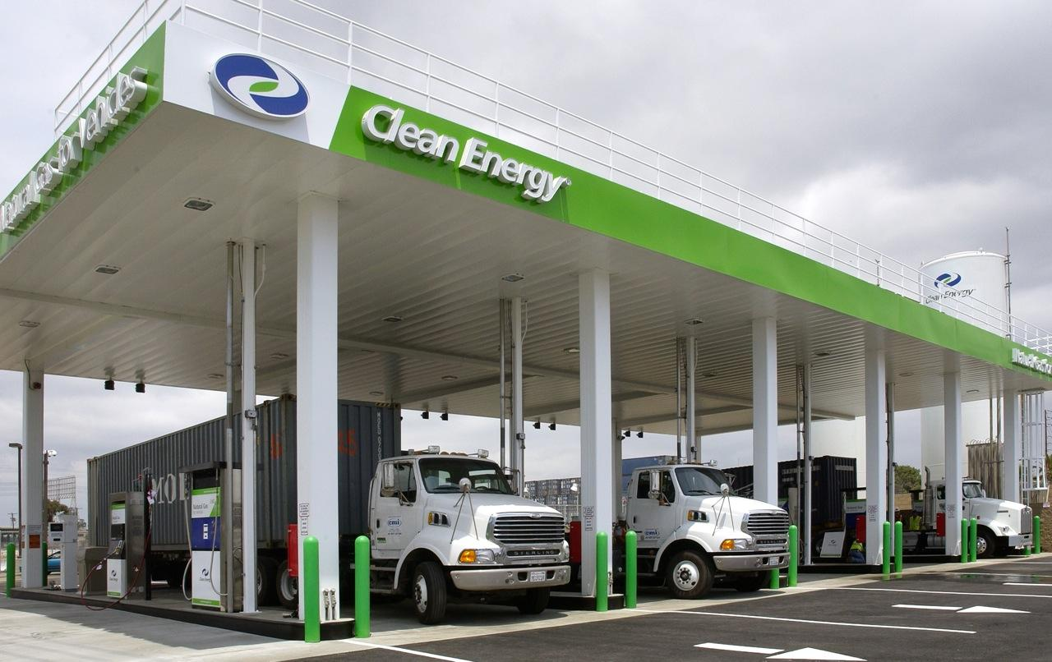
Case Study: Ports of Los Angeles & Long Beach
2009 Results – 500 Natural Gas Trucks Deployed
Displaced 2,400,000 gallons of diesel
Drivers saved $1.9 million compared to diesel fuel
Reduced NOx and PM
  Over 260 tons compared to 2006 diesel
  Over 95 tons compared to 2007 diesel
  Reduced over 6,500 tons GHG

Slide 8
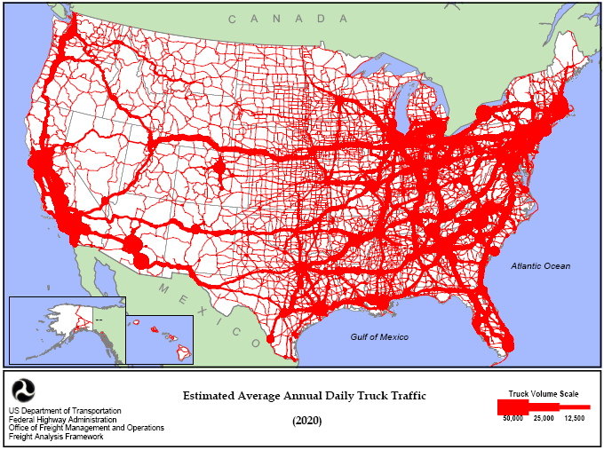
How to Deploy NG Truck Fueling Stations
Step 1:
Serve Local/Regional Trucking Hubs
Step 2:
Serve Lanes that Connect the Hubs

Slide 9
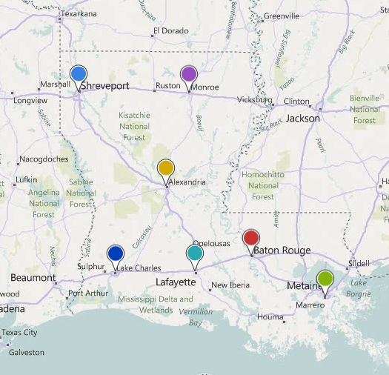
Louisiana’s Economic Development Opportunity
New Market for State’s Natural Gas
  Good for Louisiana
LNG Saves Money
  Good for shippers, fleets & citizens
Keeps US$ Money in America
  Good for Americans
Real Jobs
  Gas Producers
  Infrastructure Construction Jobs
  Operations & Maintenance Jobs
  Vehicle Technicians
  Logistics Professionals
  Support Services
How?
  Vehicle Purchase Incentives
I-10, I-20, I-49, I-55, I-59
& Throughout the State

