Slide 1
Natural Gas as a Transportation Fuel Louisiana Department of Environmental Quality CNG/LNG Policy Working Group
Sherrie Merrow
External Relations Lead Natural Gas Economy
Baton Rouge, LA | September 30, 2010

Slide 2

Natural Gas Economy Mission
Our mission is to establish natural gas as the foundation of North America’s energy portfolio
Abundant
Affordable
Clean
Reliable
Domestic Solution
2

Slide 3
U.S. & Louisiana Transportation Fuel Portfolio 2007 Consumption
America & Louisiana rely on one primary fuel for transportation – Petroleum
U.S. Gasoline Gallon Equivalents
Gasoline - 140,646,000,000
Diesel - 44,533,000,000
Alternative Fuels - 414,715,000
Louisiana Gallon Equivalents
Gasoline – 2,163,000,000
Diesel – 1,134,000,000
Alternative Fuels – 1,921,000
Excludes oxygenates
Source: Energy Information Administration (EIA)
3
Notes:
From Energy Information Agency, Alternatives to Traditional Transportation Fuels, 2007

Slide 4
U.S. & Louisiana Alternative Fuel Portfolio 2007 Consumption
America and Louisiana’s alternative fuel portfolio is dominated by natural gas products
U.S. - 414,715,000 gasoline gallon equivalents (gge)
Louisiana – 1,921,000 gasoline gallon equivalents (gge)
Excludes Biodiesel, estimate for 2007 not available
Source: EIA
4
Notes:
From Energy Information Agency, Alternatives to Traditional Transportation Fuels, 2007

Slide 5
Louisiana Alternative Portfolio 2007 Vehicles & Consumption
Fuel | Consumption (GGE/Vehicle) | Fuel Dispensed (GGE/Station)
E85 | 132 | 102,800
CNG | 457 | 34,300
LPG | 605 | 58,570
Electric |  | -
Totals
Data Source: EIA
5
Notes:
From Energy Information Agency, Alternatives to Traditional Transportation Fuels, 2007
Louisiana consumes more E-85 per station than natural gas. This, however, can suggest that the natural gas build-out is low.

Slide 6

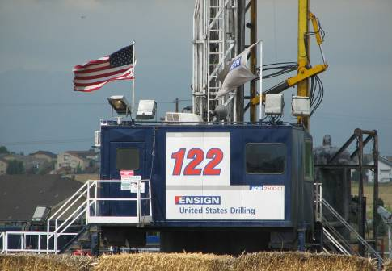
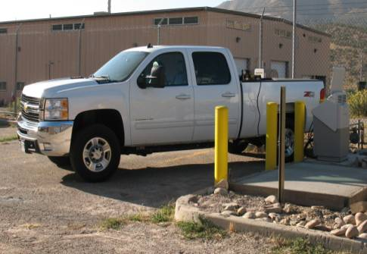
Why Natural Gas Vehicles?
Environmental
Abundant/Domestic
Economical
Up to 25% Less CO₂ than gasoline/diesel equivalents
Reduce Carbon Monoxide and emissions of particulates up to 90%
Abundant domestic supply of natural gas (100+ years)
86% of consumed natural gas produced in U.S.
98% from North America
Incentives and grants available for vehicles, infrastructure and fuel
Significant fuel price differential as compared to gasoline or diesel
Technology today
Source: Environmental Protection Agency, Naturalgas.org
6
Notes:
http://www.naturalgas.org/environment/naturalgas.asp
Natural gas can be used in the transportation sector to cut down on these high levels of pollution from gasoline and diesel powered cars, trucks, and buses. In fact, according to the EPA, compared to traditional vehicles, vehicles operating on compressed natural gas have reductions in carbon monoxide emissions of 90 to 97 percent, and reductions in carbon dioxide emissions of 25 percent. Nitrogen oxide emissions can be reduced by 35 to 60 percent, and other non-methane hydrocarbon emissions could be reduced by as much as 50 to 75 percent. In addition, because of the relatively simple makeup of natural gas in comparison to traditional vehicle fuels, there are fewer toxic and carcinogenic emissions from natural gas vehicles, and virtually no particulate emissions. Thus the environmentally friendly attributes of natural gas may be used in the transportation sector to reduce air pollution.

Slide 7

Natural Gas Vehicle Growth by Continent Great North American Opportunity
Natural Gas Vehicles by Continent
Italy as an Example
Natural Gas Vehicles (Millions)
~600,000 NGVs
37% growth since 2007
NGVs have 7% market share of all new vehicles purchased
Cost of CNG is 50% to 60% less expensive than gasoline
Government incentives
Imports 89% of natural gas
Fiat Qubo Natural Power
7
Source: IANGV, NGVA Europe, Fiat
Notes:
7
AL011V3
2010-01-25
Italy as an Analog: Slide CD 004

Slide 8






Fuel Life Cycle Emissions Natural Gas Provides a Cleaner Solution
Extraction / Farming
Processing
Distribution
Production
Transport / Distribution
Vehicle Combustion
Total Life Cycle
Landfill Gas (RNG) | 0.0 | 0.0 | 0.0 | -44.9 | 4.0 | 57.3 | 16.4
Biodiesel | 20.8 | 0.0 | 0.0 | 2.3 | 1.5 | 0.8 | 25.4
Natural Gas (CNG) | 3.5 | 3.7 | 1.0 | 2.1 | 0.6 | 57.7 | 68.6
Natural Gas (LNG) | 3.5 | 3.7 | 1.0 | 15.8 | 0.5 | 58.5 | 83.1
Corn Ethanol | 5.8 | 31.4 | 2.3 | 48.8 | 2.6 | - | 90.9
Gasoline | 6.9 | 13.8 | 1.1 | - | 0.4 | 72.9 | 95.0
Diesel | 8.8 | 10.3 | 1.1 | - | 0.2 | 74.9 | 95.3
Electric | - | - | - | 124.1 | - | - | 124.1
*Comparison of GHG emissions (gCO2e/MJ- grams of Carbon Dioxide equivalent per megajoule) using U.S. Average Generation Mix
8
Source: California Air Resources Board (California Well to Wheel Analysis), 2008
Notes:
Natural Gas contributes to a significant reduction in harmful emissions
Reformulated Gasoline Blendstock is being used for Gasoline
Production includes Liquefaction, Compression and Ethanol Production. TLC for Ethanol does not include -16.65 for co-products credits. The dry mill process generates dry distiller’s grain solubles (DDGS) which can replace feed corn as animal feed. Similarly, a wet mill generates products that can be assigned co-product credits based on their use for displacing equivalent products.
There are three key assumptions made to calculate direct energy consumption for natural gas recovery:
• Process efficiency (97.2%, CA-GREET Default)
• Fuel Shares (split of total energy consumed by fuel type, CA-GREET Default)
• Natural Gas Leak Rate (0.35%, CA-GREET Default)
The source does not indicate if the recovery is conventional or not.
Electric production emissions are based on California fuel mix of 57% NG, 22% Coal.
Direct Emissions for Electricity Production for coal is 45.0 gCO2e/MJ and Natural gas is 66.96 gCO2e/MJ.
Since landfill gas (LFG) is a renewable resource, this energy is considered renewable. When used as a vehicle fuel, compressed natural gas (CNG) produced from LFG consumes up to 185,000 Btu of fossil fuel and generates from 1.5 to 18.4 kg of carbon dioxide-equivalent (CO2e) emissions per million Btu of fuel on a “well-to-wheel” (WTW) basis. This compares with approximately 1.1 million Btu and 78.2 kg of CO2e per million Btu for CNG from fossil natural gas and 1.2 million Btu and 97.5 kg of CO2e per million Btu for petroleum gasoline. Because of the additional energy required for liquefaction, LFG-based liquefied natural gas (LNG) requires more fossil fuel (222,000–227,000 Btu/million Btu WTW) and generates more GHG emissions (approximately 22 kg CO2e /MM Btu WTW) if grid electricity is used for the liquefaction process. However, if some of the LFG is used to generate electricity for gas cleanup and liquefaction (or compression, in the case of CNG), vehicle fuel produced from LFG can have no fossil fuel input and only minimal GHG emissions (1.5–7.7 kg CO2e /MM Btu) on a WTW basis. Thus, LFG-based natural gas can be one of the lowest GHG-emitting fuels for light- or heavy-duty vehicles.
With distributed generation, landfill gas has a total life cycle of -1.0.
http://www.transportation.anl.gov/pdfs/TA/632.PDF

Slide 9
Cleaner, Healthier Air Natural Gas Emission Reductions versus Gasoline
Source: EIA
9
Notes:
Along with incentives directly to consumers pockets from fuel savings, there are numerous environmental benefits of using natural gas as a transportation fuel.
However, as you can see, mercury, SOx, particulates (Denver), NOx and CO2 emissions are greatly reduced.
This chart also covers power generation from coal versus natural gas; which is another discussion in of itself….
Virtually no mercury, sulfur dioxide and particulates, with limited nitrogen oxides, all of which cause ozone non-attainment and other emissions issues. CO2 is also significantly reduced.
From Energy Information Agency, Alternatives to Traditional Transportation Fuels, 2007
A gallon of gasoline is assumed to produce 8.8 kilograms (or 19.4 pounds) of CO2.
CO2 emissions from a gallon of diesel = 2,778 grams x 0.99 x (44/12) = 10,084 grams = 10.1 kg/gallon = 22.2 pounds/gallon

Slide 10
Water Intensity of Transportation Fuels
10
Source: Deep Shale Natural Gas: Abundant, Affordable, and Surprisingly Water Efficient, Mathew Mantell, 2009
Notes:
Figure 6 above is a logarithmic plot that shows 18 different transportation fuels and their respective water consumption reported in gallons of water per 100 miles driven. The different colors of the plots show:
• Green: Fuels that consume less water per mile than the traditional fuels
• Yellow: Traditional Fuels
• Orange: Higher water consumption than traditional fuels (200% - 525%)
• Red: Significantly higher water consumption than traditional fuels (1-3 orders of magnitude)

Slide 11
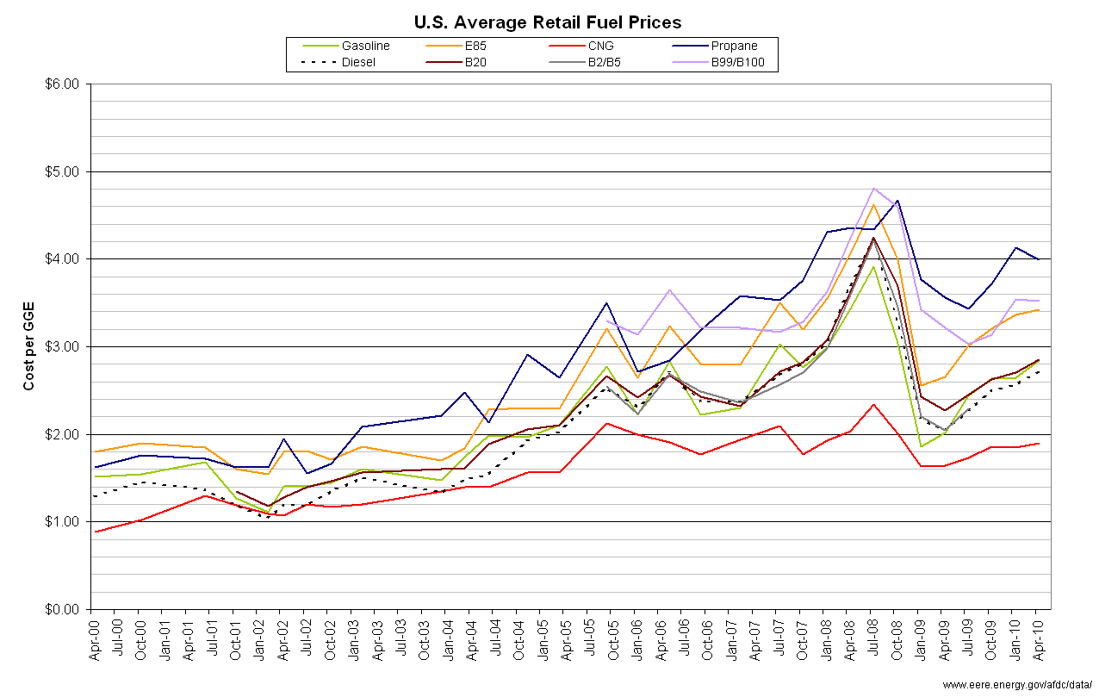
U.S. Average Retail Fuel Prices
The B’s are different blends of Bio-diesel
11
Notes:
11

Slide 12
Crude Oil Imports into the U.S. Opportunities for Displacement
Crude oil imports have historically led total U.S. imports of goods and services
Crude oil imports comprised nearly 15% of total imported goods in January 2010
Net crude imports accounted for half (49.6%) of the foreign trade deficit of $37.1 billion for the month
Imports from OPEC member countries were more than twice that of the next closest country
The transportation sector presents the biggest opportunity for imported petroleum displacement
Source: EIA, U.S. Census Bureau-Foreign Trade
12
Notes:
The U.S. Foreign Trade Deficit is defined as:
Total net exports less total net imports (by product group classification)
The U.S. has consistently ran a deficit; which is not viewed as negative from an economics/global market perspective. However, the weighting of one particular product over others could have economic/political/strategic implications.
Imports of crude oil as a percentage of total imported goods have ranged from 15% to 25%. The range is attributed to seasonality which effects the types of goods imported into the U.S though out the year.
The U.S. imported 7.9 MMbbl/d during January at an average price of $73.89 per barrel.
Early reports for February indicate 8.7 MMbbl/d of imports.
If we were to combine imports of petroleum products with crude, the U.S. spent nearly $800 million per day during January.
OPEC members in second chart are comprised of Nigeria (996 Mbbl/d), Saudi Arabia (958 Mbbl/d), Venezuela (827 Mbbl/d), Iraq (506 Mbbl/d), Algeria (327 Mbbl/d), Angola (268 Mbbl/d) and Kuwait (66 Mbbl/d).
The data provided comes from the EIA’s monthly update on the top 15 oil importers into the U.S.

Slide 13
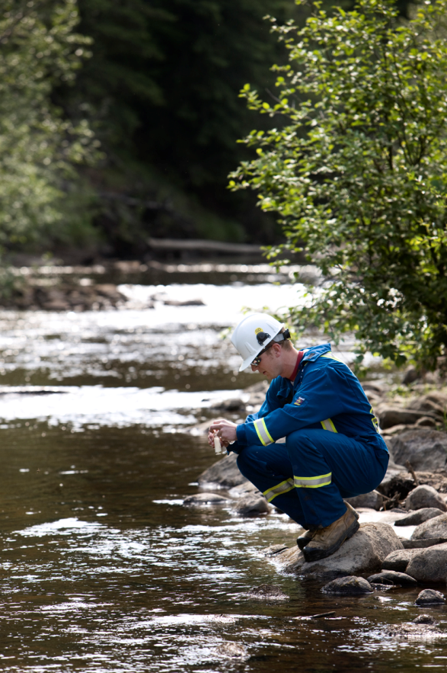
CNG and Safety
Natural gas is very safe–lighter than air… dissipates when released
High ignition temperature: 1,000°-1,100°F
Gasoline ignition temperature: 495°
Diesel ignition temperature: 410°
Limited range of air/fuel combustion ratio (5-15%)
Colorless, non-toxic substance
Does not leak into groundwater
Comprehensive fuel tank, vehicle and station design/manufacturing codes & standards
13
Notes:
Just talk to each bullet…
Questions about safety often arise when discussing NGVs..
CNG AND LNG vehicles are held to the same design/manufacturing codes and standards (DOT, etc.)
Also of note is that natural gas has a much higher ignition standard and dissipates when released….
If you have a chance, go to UTube and look up CNG safety. There are some interesting videos that are entertaining and prove the safety of CNG tanks.
Note: Air/fuel combustion ration is the ratio of air to fuel for proper combustion. It is a measurement for anti-pollution and performance. A ratio of 14.7 or above is a lean mixture which means better fuel economy. Less gives you more power.

Slide 14
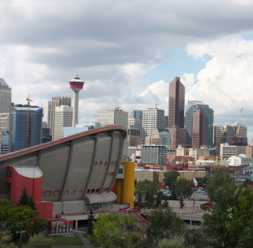

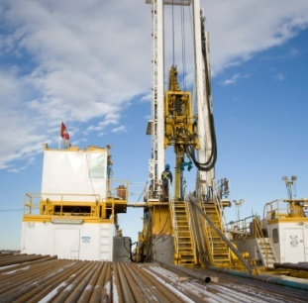
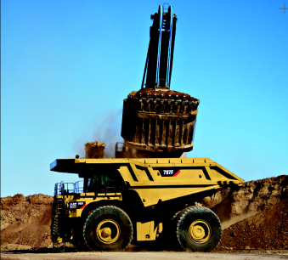
Natural Gas for Transportation Market Segmentation
GREEN CITIES
CNG
Municipal government fleets, light duty and medium duty vehicles
Commercial fleets and personal light and medium duty vehicles
Airport and port authorities
GREEN CORRIDORS
Heavy duty vehicle freight and goods transportation
Home base and mid-point fueling patterns
Transient and varied fueling patterns
LNG
GREEN GAS FACTORY
Drilling rigs and frac equipment
Service company light duty vehicle fleets
Field storage and fuel deployment solutions required
GREEN COMMERCIAL
Extra heavy duty “off-road” vehicles
Rail, mining, marine, military, and construction services
Heavy duty engine solutions required
14
Notes:
14
Green Cities initiative would include the integration of CNG.
Green Corridors, Green Gas Factories and Green Commercial Vehicles would include the integration of LNG.

Slide 15
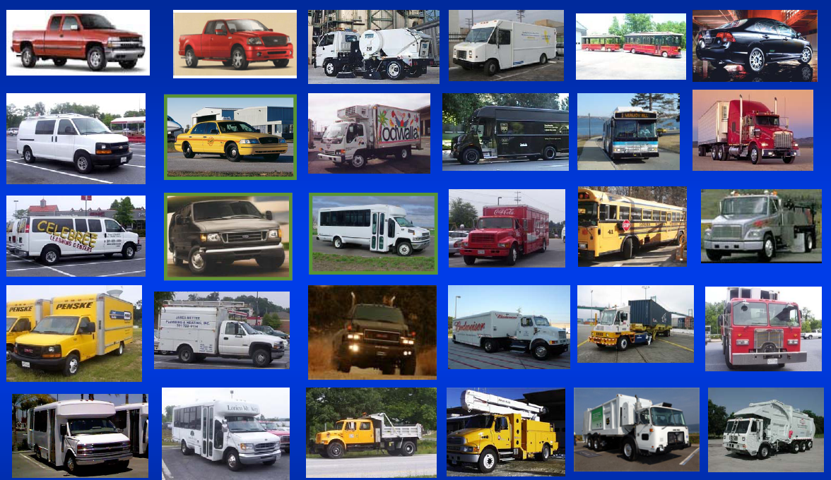
Natural Gas Vehicles
Source: Natural Gas Vehicles for America (NGVA)
15
Notes:
So what types of vehicles can run on natural gas?
Numerous types-both originally manufactured and retrofitted for natural gas use

Slide 16
Infrastructure Build Models
16

Slide 17
USA Natural Gas Refueling Infrastructure Quick Facts
As of September 18, 2010 - 919 Total
880 CNG stations
39 LNG station
CNG Stations - 880 Total
361 Public access stations (~41%)
519 Private access stations (~59%)
LNG Stations – 39 Total
12 Public access stations (~32%)
26 Private access stations (~68%)
17

Slide 18
Regional Natural Gas Refueling Infrastructure Where Are They? Active Stations by State
Active CNG Stations
18

Slide 19
Regional Natural Gas Refueling Infrastructure Where Are They? Planned Stations by State
Planned CNG Stations*
*Planned station include 12 month or less to become active – high confidence, longer range is being tracked, but not reported
19

Slide 20
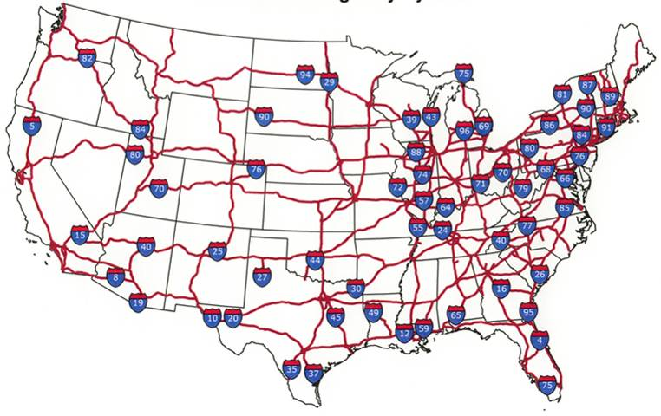
U.S. Interstate Highway System NGV Refueling Corridors
Link up regional corridors as part of expansion phase
ICTC
RMC
I-75
TT
I-75 – Interstate 75 Corridor
TT – Texas Triangle
RMC – Rocky Mountain Corridor
ICTC – Interstate Clean Transportation Corridor
20

Slide 21
Natural Gas for Transportation Infrastructure Build-out
Initial build-out – create natural gas hubs to support volume required for filling stations
Municipalities/counties
Natural gas industry fleets
Local fleets
Connecting hubs to build natural gas highways
CNG refueling stations – located every 60 – 100 miles
LNG refueling stations – located every 150 – 250 miles
Source: Encana estimates
21
Notes:
Federal Fleet Purchases–House Bill requires 50% of all new vehicles purchased or placed in service by the U.S. government by December 31, 2014, to be capable of operating on CNG or LNG
–Senate version requires that EPACT mandated purchases be dedicated (not bi-fuel)

Slide 22
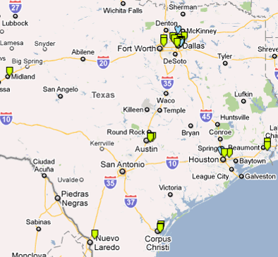
The Texas Triangle
200-250 miles between stations
LNG and CNG (LCNG)
Focus demand on heavy-duty
Fleet
Refuse
Transit
Return-to-base
Long-haul
Multi-phase approach
TX
Triangle
715 Total Miles
22

Slide 23
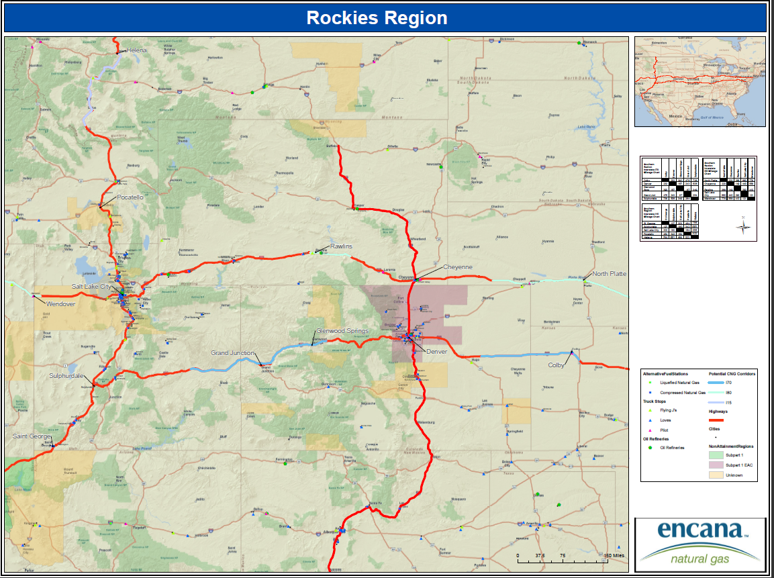
Rocky Mountain Natural Gas Corridor Sample of 100 Mile Spacing Gaps
23

Slide 24
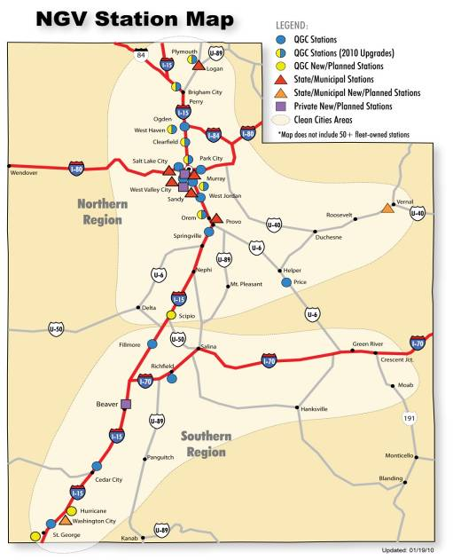
Utah NGV Update
Current Infrastructure
26 public access
60 private access
2010 new stations
Hurricane
St. George
Vernal
DOE ARRA Project
Potential for 1-3 LNG stations in UT
Utility/LDC – Government Partnership Model
24

Slide 25
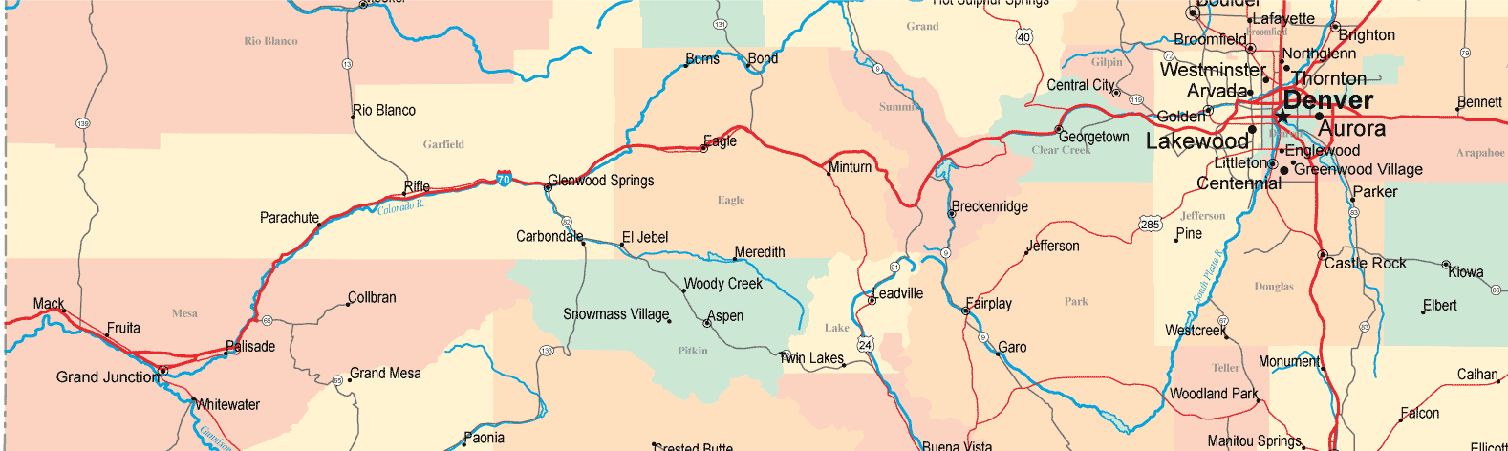
Colorado - Western Slope Update
Western Slope Collaborative
Support E&P company NGV conversions
Engage E&P service companies to convert to NGVs
Expand & connect I-70 corridor
Encourage public access stations with financial and NGV volume support
Education, outreach and awareness
Refueling stations
Rifle public access station – GEO grant, November 2010 tentative start up
City of Grand Junction – private time-fill station, desires public access option with partner, late fall 2010
Parachute public access – anticipate 2011 as CNG conversions & volume builds
Eagle – CME pilot, may consider public access if successful
25

Slide 26
Colorado – Front Range Update
Weld County Plan – County Commissioner lead effort with natural gas industry
Develop multi-year plan to demonstrate commitment and for funding opportunities
Phase I (3-5 yrs)
Develop 3-5 CNG stations
Encourage >150 new NGVs
Phase II (5-10 years)
Expand infrastructure to 7-10 CNG stations and one LNG station
NGVs to 1,000
Phase III – Program Sustainability
Infrastructure to 15-25 CNG stations and 3 LNG stations
NGVs to 10,000
Why Weld County
Oil & Gas is major industry
EPA 8-Hour non-attainment
Emission & GHG reduction
Regional corridor connectivity
Economic development - direct and indirect jobs
Petroleum displacement
26

Slide 27
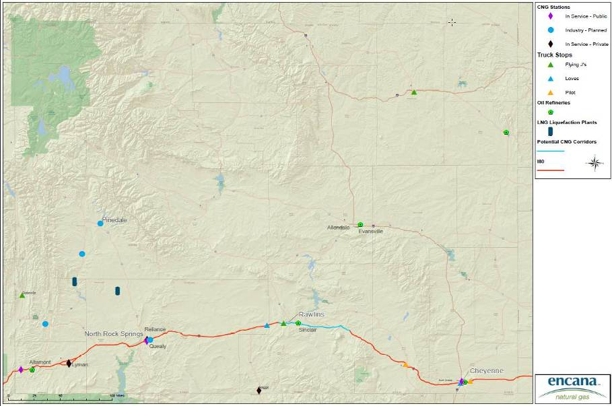
WY Natural Gas Transportation Corridor Current and Proposed Infrastructure
Wyoming Working Group
Kick off meeting held June 16th
Presentation to Minerals Committee on June 28th
Producer/LDC Meeting July 28th
Jackson, Wyoming Coalition meeting – August 31, 2010
Fleet Seminar – Jackson, Wyoming – August 31, 2010
27

Slide 28
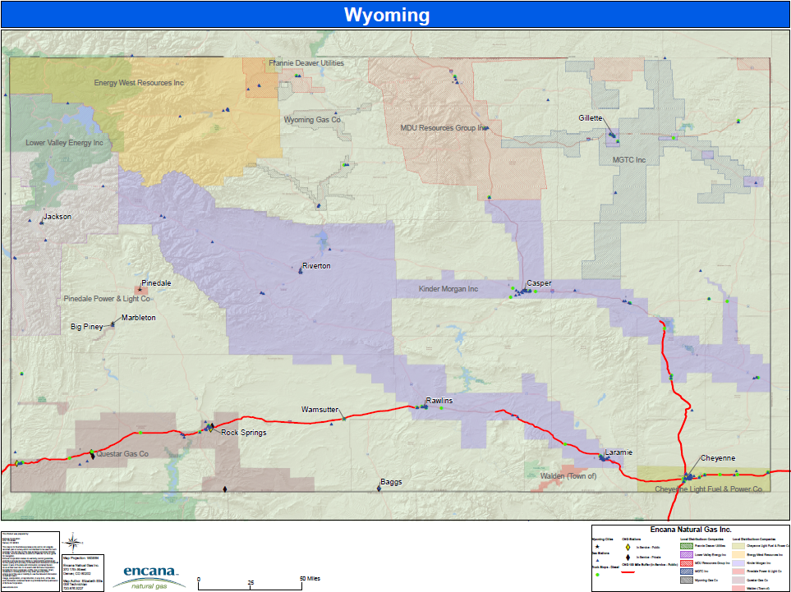
Wyoming NGV Infrastructure Coalition Regional Leadership (Producers, LDCs, Government, Organizations)
Northwest Region Leadership: Y-T Clean Energy Coalition
East/South Region Leadership: Anadarko, UW SER, WY State Motor Pool
West Leadership: Questar, QEP Resources
28
Notes:
28
Headquarters in Calgary and Denver
Second largest producer of natural gas in North America; post Cenovus split
100% of production and reserves in North America
We do have a vested interest in promoting the increased end use of natural gas in North American simply because of our asset base.
60% - U.S. 40% - Canada

Slide 29
Funding and Resources
29

Slide 30
Natural Gas Vehicle Incentive Comparisons
Louisiana is a Leader
 | Federal | California | Oklahoma | Utah | Louisiana | Colorado
Natural Gas Vehicle Count | 110,000 | 37,745 | 2,719 | 10,000 | 378 | 972
Natural Gas Station Count | 874 | 235 | 48 | 63 | 5 | 23
Infrastructure/ Home Refuel | 50% up to $50,000 cap/ $2,000 Expires: 12/31/10 | Fueling Infrastructure Grants | 75% of infrastructure Expires: 01/01/14 Fueling Infrastructure Loans | Infrastructure Grants and Loans | 50% of the cost of constructing an alternative fueling station No current expiry | 20% up to $400,000 cap/ $2,000 in-home refueling Expires: 12/31/15
Vehicle Incentives | $2,500 - $32,000 based on GVW Expires: 12/31/10 |  | 50% of the incremental cost Expires: 01/01/14 | 35% of the vehicle purchase price or $2,500 Expires: 12/31/13 | 50% of the incremental cost, or 10% of the cost of the motor vehicle or up to $3,000 No current expiry | 75% of incremental cost Rebate for tax exempt Expires: 12/31/15
Fuel Credits |  | Paid through an annual flat-fee rate |  | 3/19th of the rate of $0.0245 | Deregulation of Compressed Natural Gas (CNG) as a Motor Fuel
Mandates |  | Fleet Vehicle Procurement Requirements | Alternative Fuel Vehicle (AFV) Acquisition Requirements | Provision for Establishment of Alternative Fuel Use Mandate | Fuel Efficient Vehicle Acquisition Requirement CNG Inter-state highway with stations every 100 miles
30

Slide 31
Grant Programs
Federal Grants
DOT Congestion Mitigation and Air Quality Improvement Program (CMAQ) | Generally limited to projects in non-attainment areas
DOE State Energy Program (SEP) | Clean Cities program which supports alternative fuel vehicle and infrastructure.
EPA Supplemental Environment Project and DERA Grants Repower: 75% of cost Vehicle replacements: 25% of cost | Diesel Emissions Reduction Program (DERP): EPA program which assists government agencies, school districts and other parties to replace older diesel engines. Diesel Truck Retrofit and Fleet Modernization Program: EPA program provides grants to states to fund fleet modernization programs, with preference to be given to ports and other major hauling operations. Clean School Bus Program: EPA program provides grants to school districts and related organizations for the replacement, repower or retrofit of school buses, the purchase of alternative fuels for school buses and alternative fuel infrastructure.
Federal Transit Administration (FTA) Clean Fuels Grants | Funds transit projects such as purchasing or leasing clean fuel buses and/or constructing or leasing clean fuel bus facilities.
Federal Aviation Administration (FAA) Voluntary Airport Low Emissions (VALE) Program | National program to reduce airport ground emissions at commercial service airports located in designated air quality nonattainment and maintenance areas,
Wyoming State Grants
None available.
31

Slide 32
How do we Begin?
Seriously considering transitioning to natural gas as an alternative fuel for your fleets
Analyze our fleets
Existing vehicle types (make, model, year)
Fuel use - gallons per month, miles per gallon
Refueling behavior - when and where do we fill up currently
Analyze your refueling needs
Need for time-fill or fast-fill
Need for single or multiple CNG refueling sites
Evaluate existing public infrastructure
Identify partners to participate financially and with fleet conversions to build volume to support infrastructure
Seek additional educational and training opportunities
32

Slide 33
Upcoming Training
Natural Gas Vehicles for America (NGVAmerica)
Compelling Case Workshop with Stephe Yborra
October 14, 2010 | Bowling Green/Toledo, Ohio
November 10, 2010 | Ft. Lauderdale, FL
Natural Gas Vehicle Institute
NGV Driver and Mechanic Training
October 5, 2010 | Hayward, CA
CNG Fuel Station Design Certification
November 2-3, 2010 | Downey, CA
CNG Fuel Station Operation & Maintenance Certification
November 4-5, 2010 | Downey, CA
CNG Fuel System Inspector Training
October 6-7, 2010 | Hayward, CA
33

Slide 34
Resources
American Natural Gas Alliance (ANGA)
http://www.anga.us/
Alternative Fuel Stations and Prices
http://www.afdc.energy.gov/afdc/stations/advanced.php
http://www.altfuelprices.com/
http://www.cngprices.com/
FuelEconomy.gov
Clean Vehicle Foundation
http://www.cleanvehicle.org/index.shtml
Natural Gas Vehicle Institute
http://www.ngvi.com/
Natural Gas Vehicles for America
http://www.ngvc.org/index.html
US DOE Alternative Fuels & Advanced Vehicles Data Center
http://www.afdc.energy.gov/afdc/
Weld County Smart Energy
http://www.weldsmartenergy.org/
Yellowstone-Teton Clean Energy Coalition
http://www.ytcleanenergy.org/
34

