Slide 1
USER TRAINING Reporting Year 2012

Slide 2
Housekeeping
Restrooms
Vending Machines
Parking validation

Slide 3
Air Permits Staff
Name | Number | Email
Tegan Treadaway Administrator | 225-219-3408 | Tegan.Treadaway@la.gov
Michael Vince Senior Scientist | 225-219-3482 | Michael.Vince@la.gov
Vivian Aucoin ES Manager | 225-219-3389 | Vivian.Aucoin@la.gov
Gilberto Cuadra ES Supervisor | 225-219-3419 | Gilberto.Cuadra@la.gov
John Babin Staff Scientist | 225-219-1801 | John.Babin@la.gov
Jackie Heber Staff Scientist | 225-219-3404 | Jackie.Heber@la.gov
Maureen Fleming Environmental Scientist I | 225-219-3591 | M.Maureen.Fleming@la.gov

Slide 4
Presentation Overview
Part 1: Emissions Inventory (EI) Basics
Part 2: Revised EI Regulations
Part 3: Understanding the NEI
Part 4: Introducing ERIC
Part 5: Reporting Year 2012 Emissions in ERIC
Part 6: Helpful Hints
Part 7: Frequently Asked Questions
Part 8: Accessing ERIC

Slide 5
Emissions Inventory (EI) Basics
Part 1

Slide 6
Why an EI?
Clean Air Act (CAA) – Section 183(a)(3) requires an EI for areas of ozone nonattainment every 3 years
LAC 33:III.918 & 919 – requires point sources submit a criteria pollutant EI annually
Covers entire state
LAC 33:III.5107 – requires point sources submit a toxic air pollutant EI annually
Covers entire state

Slide 7
Why an EI?
40 CFR Part 51 Subpart A – Air Emissions Reporting Requirements (AERR) – requires annual EI for point sources of criteria pollutants and EI for nonpoint and mobile sources every 3 years for entire state
Data is submitted by LA to EPA
State data is incorporated by EPA into the National Emissions Inventory (NEI)

Slide 8
Use of the EI
Planning –
monitoring data is used to determine compliance with NAAQS
EI data is the basis for developing rules/regulations to maintain compliance & to aid in reaching compliance
Attainment demonstrations for ozone nonattainment areas - modeling
Preparation of State Implementation Plans (SIP)
Tracking of Reasonable Further Progress (RFP)

Slide 9
Use of the EI
NAAQS compliance modeling for permits – dispersion modeling
Preparation of base year inventories for nonattainment areas
Development of control strategies
Compliance & surveillance – WITH CAUTION!!

Slide 10
Revised EI Regulations
Part 2

Slide 11
AQ300 – Revised EI Regulations
ERIC became available January 2007
Advanced Notice of Rulemaking May 2009
Rule Proposed November 2009
Public Hearing December 2009
Comments Close January 2010
AQ300 became effective November 20, 2011

Slide 12
AQ300 – Revised EI Regulations
Revised LAC 33:III.918 & 919 – Criteria Pollutant Emissions Inventories
Revised LAC 33:III.5107.A – Toxic Air Pollutant Emission Inventories
Revised references to EI throughout LAC to be consistent with terminology and citations

Slide 13
AQ300 – Revised EI Regulations
LAC 33:III.918 now lists Nonattainment Areas and Adjoining Parishes by pollutant
Allows easier revision to regulations when there is a change in attainment/nonattainment designation
LAC 33:III.5107.A was revised to reflect the new EI deadline – April 30
The only change to 5107

Slide 14
AQ300 – Revised EI Regulations
LAC 33:III.919 was completely overhauled:
Revisions to applicability and when requirements no longer apply
Clarify applicability for contiguous facilities
Added transitional language for attainment/nonattainment redesignations

Slide 15
AQ300 – Revised EI Regulations
Expands definitions to be in line with ERIC
Requirements explicitly require both the EI data and the certification statement for each AI subject to EI
Includes listing of specific data elements and descriptions of each
Includes requirements for HRVOC data as well as Ozone Nonattainment Area Requirements

Slide 16
AQ300 – Revised EI Regulations
Specific requirements for changes in ownership
Portable sources reporting periods
Changes reporting deadline to April 30, clarifying that both the EI data and the certification statement are due by April 30

Slide 17
Changes in Applicability
Required to report if facility meets any of the criteria at ANY time during the reporting year
Located in nonattainment or adjoining parish and emits, has the PTE, or is permitted to emit any criteria pollutant above the threshold values in Tables 1-6 (LAC 33:III.919.A.1.a & 2)
Located in attainment parish and emits, has PTE, or is permitted to emit any criteria pollutant above the threshold values in Table 7 (LAC 33:III.919.A.1.b & 2)
Major source of HAPS or TAPS (LAC 33:III.919.A.1.c)
Holds a Title V (Part 70) permit – regardless of emissions (LAC 33:III.919.A.1.d)
Holds a portable source permit and operates at any time in a nonattainment or adjoining parish AND meets applicability criteria (LAC 33:III.919.A.1.e)
Otherwise required by rule or permit to report (LAC 33:III.919.A.1.f)
AQ300

Slide 18
“Once in, Always In”
“Once in, Always In” is in effect for criteria emissions inventories (LAC 33:III.919.D)
Once a facility no longer meets the applicability in LAC 33:III.919.A.1 for ONE FULL CALENDAR YEAR, must request approval IN WRITING to discontinue submitting an EI
While awaiting approval from LDEQ, the facility must continue to submit an EI
Facilities may stop submitting once they have received approval from LDEQ, IN WRITING
Permit modification applications do not satisfy LAC 33:III.919.D.1
Permit modifications do not satisfy LAC 33:III.919.D.1.a
Include the AI #, the Owner Name, and the Permit # in every request!
LAC 33:III.919.D.1.b lists conditions under which LDEQ will consider a facility’s request to no longer submit an EI
AQ300

Slide 19
“Once in, always in”
Currently applies to criteria EI only
If you submit a Toxic only inventory, we encourage you to check your applicability and adjust your permit as necessary if you are not a major source of TAPs
If you are a major source of TAPs, you are also subject to criteria EI, and therefore subject to “Once In, Always In”
Submit requests for approval to discontinue submission of criteria pollutant EI to:
Emissions Inventory
Office of Environmental Services
Postal Mail: For Delivery Only:
P.O. Box 4313 602 North Fifth Street
Baton Rouge, LA 70821-4313 Baton Rouge, LA 70802
Currently not accepting requests by email or fax
AQ300

Slide 20
Contiguous AIs
If your AI is contiguous to another AI, as defined in LAC 33:III.919.E, then applicability is determined by a threshold value that is the greater of (LAC 33:III.919.B):
the sum of actual emissions,
the sum of the potentials to emit; or
the sum of permitted emissions for ALL contiguous AIs
Each AI shall report an EI separately
AQ300

Slide 21
Attainment Redesignations
If your AI is in an area that was nonattainment and EPA designates as Attainment, the AI shall continue to be subject to reporting until otherwise directed (LAC 33:III.919.C)
For example, the 5 parish Baton Rouge area was designated as attainment for Ozone on December 30, 2011, for the 1997 8-hour standard
The 5 parish Baton Rouge area was designated as nonattainment for Ozone on May 21, 2012, effective July 20, 2012 for the 2008 8-hour standard
Facilities in the 5 parish Baton Rouge area and its adjoining parishes shall continue to be subject to LAC 33:III.919.A.1.a
Long story short – nonattainment to attainment - Keep reporting to EI until Agency says otherwise!
AQ300

Slide 22
Attainment Redesignations
If your AI is in an area that changes from attainment to nonattainment following designation by EPA, you will be required to report after the first full year of designation (LAC 33:III.919.F.1.d.i & ii)
For example, St. Bernard Parish is likely to be designated nonattainment for SO2 in July 2013
Facilities in St. Bernard Parish and its adjoining parishes would not be required to report until 2015 when they will report their 2014 emissions
Long story short – attainment to nonattainment – don’t report until after the first full year following the nonattainment designation
AQ300

Slide 23
New Definitions & Requirements
Definitions in LAC 33:III.919.E have been expanded and revised to be more consistent with ERIC
Requirements in LAC 33:III.919.F.1 explicitly require:
Both the EI data and the certification statement for each AI subject to LAC 33:III.919
Require data for all air pollutants for which a NAAQS has been issued and for all NAAQS precursor pollutants
Submit the data in a format specified by LDEQ – ERIC
Emissions for criteria pollutants are in tons
AQ300

Slide 24
Supporting Information
LAC 33:III.919.F.1.a.ii lists the information to be included in the EI data
Includes data elements from ERIC along with descriptions and whether it is required or optional
List in the regulations is included for reference only and may not be complete.
AQ300

Slide 25
HRVOC and Ozone Requirements
In addition to criteria pollutants, facilities located in the following parishes are also required to submit HRVOC data for ethylene and propylene (LAC 33:III.919.F.1.a.i)
Ascension, East Baton Rouge, Iberville, Livingston, St. Charles, St. James, St. John the Baptist, and West Baton Rouge
LAC 33:III.919.F.1.a.iii has additional requirements for facilities in ozone nonattainment areas:
Ozone season average daily emissions of CO, NOx, VOC, ethylene, & propylene
Average ozone season throughput
Ozone season average heat content
Ozone season estimation method for CO, NOx, VOC, ethylene, & propylene
AQ300

Slide 26
Change in Ownership
When there is a change in facility ownership, each owner is responsible to submit and certify their own EI for the period of ownership (LAC 33:III.919.F.2)
Each owner will get their own ERIC account
Contact your LDEQ staff contact if you would like the previous inventory submitted by the previous owner
The start and end dates of the inventory in ERIC must coincide with the ownership dates in TEMPO
Ownership dates in TEMPO are determined by the N/O change paperwork submitted in accordance with LAC 33:III.517.G
If you have not submitted the N/O change paperwork as required, the changes will not be reflected in TEMPO and therefore, you will not be able to submit an EI in ERIC until we receive and process the paperwork in TEMPO
AQ300

Slide 27
Portable Sources
If a portable source operates in a nonattainment or adjoining parish at any time during the reporting year and meets the applicability of LAC 33:III.919.A.1.a, then they must report to EI (LAC 33:III.919.A.1.e)
Refers to portable sources with permits issued in accordance with LAC 33:III.513, permit number usually begins with 7777
Does not apply to portable equipment located at a stationary source
If a portable incinerator with a permit number beginning with 7777 operates in East Baton Rouge parish for one day, then they are subject to EI reporting for the entire year
AQ300

Slide 28
Portable Sources
If a portable source must report to EI, then they must report for the entire period of ownership during the reporting year (LAC 33:III.919.F.1.d.iii)
For example, a portable incinerator with a permit number beginning with 7777 operates in East Baton Rouge parish for one day in 2012, then they must report to EI for the entire year of 2012 (assuming there was just one owner for 2012)
If the portable source changed ownership on Sept 16, 2012, then the owner that operated the facility in East Baton Rouge parish during 2012 will report for the period of ownership (01/01/2012-09/15/2012)
AQ300

Slide 29
MSOGs
Per Section X of the Minor Source Air General Permit for Crude Oil and Natural Gas Production (MSOG), facilities in a nonattainment area for ozone or an adjoining parish with an MSOG shall submit an EI per LAC 33:III.919
Everyone with an MSOG in the following parishes has to report to EI, regardless of emissions:
Ascension St. Helena
Assumption St. James
East Baton Rouge St. John the Baptist
East Feliciana St. Martin
Iberia Tangipahoa
Iberville West Baton Rouge
Livingston West Feliciana
Pointe Coupee
AQ300

Slide 30
Reporting Deadlines
April 30 is the deadline for submitting your EI and certification statements
Applies to both criteria EI (LAC 33:III.919.F.1.d) and toxic EI (LAC 33:III.5107.A.1)
Both the certification statement and the data in ERIC are due by April 30 (LAC 33:III.919.F.1.d)
Certification statements must be postmarked by April 30
If using a delivery service, the shipped date must be on or before April 30
If hand-delivering, the certification statement must be stamped on or before April 30 with the stamp at the drop off box
If the certification statement comes to us without a date, we will use the date it lands on our desk – that’s risky! Mail takes time to makes it way to us.
We will do all we can to find a verifiable date!
AQ300

Slide 31
Continuations
The certification statement still requires an original signature by the Responsible Official (LAC 33:III.919.F.1.c)
Please do not sign in black ink – sign in blue or red or green or another color that we can verify as an original. Anything but black!
The EI must include all emissions from the facility (LAC 33:III.919.F.1.b)
The only emissions that are exempt are Insignificant Activities on Lists B & C in LAC 33:III.501.B.5
There are no facility classes or categories exempt from EI reporting (LAC 33:III.919.D.2)
Special Inventories – LAC 33:III.919.F.3
Calculations – LAC 33:III.919.G
Fees – LAC 33:III.919.I – have not increased but we will still collect them
AQ300

Slide 32
AQ332 – Revised Toxic regulations
Final on November 20, 2012
Sources subject to a NESHAP are no longer subject to LAC 33:III.Chapter 51, except 5107.A, 5109.B, and applicable toxic fees in LAC 33:III.Chapter 2 (LAC 33:III.5101.D.1)
5107.A requires emissions inventory reporting of toxic emissions
5109.B requires compliance with Ambient Air Standards in Ch. 51
If an affected source emits a TAP that is not a HAP (section 112(b) of the CAA), the source is subject to Ch. 51 for that pollutant
Emissions inventory reporting of ALL toxic emissions is still required
Fees are still applicable
Discharge report per LAC 33:III.5107.B.5 is no longer required
AQ332

Slide 33
Understanding the NEI
Part 3

Slide 34
NEI – National Emissions Inventory
40 CFR Part 51, Subpart A and Clean Air Act Section 182.A.3.a
LDEQ must submit point source inventory data annually to EPA by December 31 for the preceding calendar year, i.e., 2012 emissions are due to EPA by December 31, 2013
The Department must take into account the information required to satisfy the EPA and its National Emissions Inventory System (EIS), as well as the needs of the department for accurate data to support:
-Permit modeling -Measuring emissions reduction progress
-NAAQS attainment demonstration modeling -Development of pollutant control strategies
States meet requirements of the National Emissions Inventory System (EIS) by following EPA guidance documents, implementation manuals and other tools
The EPA can add, change or delete data elements as they deem necessary to administer the program to meet national objectives. States must make similar adjustments to their systems in order to be able to report data to the EPA and meet the national consistency goals while striving to maintain the facilities certified emissions inventory

Slide 35
Normal Schedule
January 1 – ERIC officially open for reporting
April 30 – Inventories due in ERIC
May – June – certify inventories
June – QA/QC certification statement data entry
July – migrate inventories to TEMPO
July – December 31 – prepare and submit to NEI
NEI

Slide 36
Coordination
Year round – receive review packages from EPA and make corrections to the submitted inventory in the NEI
Sometimes we can fix these problems without the facility resubmitting and certifying a revision in ERIC and sometimes we cannot
Sometimes the flagged data does not need correcting and we inform EPA that the data is accurate as is
NEI

Slide 37
Process
Two Part Process – Facility Inventory and Emissions Inventory
Facility inventory is due first and contains the bulk of the inventory information. We add any facilities that have not been in the NEI previously and then we update the facility status on existing facilities when needed.
NEI works like ERIC - We package the facility inventory from ERIC into the NEI format and send that package to QA to check for errors. We make any necessary changes to our data file and keep bouncing the package off EPA’s QA servers until we do not have any more errors.
NEI

Slide 38
Process
When necessary, we may contact the facility and have them resubmit and certify an inventory in ERIC before sending it to the NEI or making the changes in our NEI data file ourselves.
Once we have passed all validations, we then submit the facility inventory package to the production server on the NEI and if we receive any errors, we fix them in our data file or contact the facility to resubmit and certify in ERIC. If no errors, the data is “officially” submitted to the NEI.
Next is the Emissions Inventory. We follow the same QA process as with the Facility Inventory
A very important note – any changes or fixes we make to the data we are submitting to EPA is not done in ERIC unless the facility makes the corrections and certifies the data. Our corrections are made in a separate MS Access database or in the NEI itself.
NEI

Slide 39
Introducing ERIC - Data Elements and Hierarchy
Part 4

Slide 40
What is ERIC?
Online emissions inventory reporting system for LDEQ
Provides online interactive access
Provides flexible and enhanced user options
Drop down menus
Reduces redundant reporting
Intuitive report format
Multiple input options
Real time validation checks
Online reports are now available

Slide 41
Account Home
Page displays current list of inventories
Inventory Status
“Editing” status means the inventory is in progress and is only on the ERIC site (not submitted to the department)
“Submitted” means the inventory can only be viewed or brought forward for creating a revised inventory
“Revised” status means a more recent revision has been submitted for a particular inventory (only the most current version can be revised)
“Certified” means the department has received the signed certification statement and updated ERIC to reflect the certified date
Certified date is the postmark or ship date of the certification statement
Only one “Editing” inventory active per year at any given time
ERIC

Slide 42
Data Entry Options
Online data entry – can enter data directly into web-based application
Data upload – accepts formatted data submittals using Microsoft Excel via downloadable template
Online QA checks performed prior to certification, helps reduce revisions and updates
ERIC

Slide 43
Data Element Terminology
Facility – Location at which business is conducted – Agency Interest. ERIC reporting is by the AI!
Contacts – EI Contact and EI Billing Party are required
Source – Equipment or unit that generates emissions. This is the operating equipment, not the control equipment or the stack/vent;
Note that piping components, valves, flanges, PRVs, etc. should not be included as individual sources in the inventory
ERIC

Slide 44
Data Element Terminology
Process – Description of the operational mode and material throughput of a source generating emissions;
Includes an SCC and material throughput
An emission factor, if used, is related to a Process
Insignificant Activities, GC XVII, & Fugitive sources do not require a Process
Emission Factor – Report only if Estimation Method using “Emission Factor” is selected on the Emissions Record
Emissions = Activity * EF
ERIC

Slide 45
Data Element Terminology
Control System – Equipment through which emissions are routed for control
e.g., flare, scrubber, thermal oxidizer
Report a control system if you used an associated control efficiency in your emissions calculation
Control Efficiencies – Required for each control system reported
ERIC

Slide 46
Data Element Terminology
Release Point – Physical location of release of pollutants to atmosphere
UTM or lat/long coordinates
Stack or area source dimensions
Portable Source Locations – Only used to indicate alternate locations at which a portable facility operated and permitted under LAC 33:III.513
Typically have permit numbers beginning with 7777
Not such items as rental generators that are brought onsite and moved around to different locations in the plant
e.g., portable concrete batch plant that can be moved around the state
ERIC

Slide 47
Data Element Terminology
Emissions Record – An emissions record includes
the emissions path
the pollutant
the emissions type
tons or pounds emitted
Emissions Path – Combination of a source, a process, and a release point; may also include a control system
Emissions Type – i.e., routine, startup/shutdown, variance, etc.
ERIC

Slide 48
Data Element Terminology
Emission Estimation Methodology –
Method to calculate emissions for each pollutant emitted by a particular process
CEMS, emission factor, stack test data, engineering judgment
ERIC

Slide 49
Data Elements Primary Identifiers
Facility-generated IDs
Up to 6 alpha-numeric characters
For Source, Process, Control System, and Release Point, and Portable Source Location
Must be unique across time for the entire inventory for each ID type
Must remain the same for an item over time
ERIC

Slide 50
Data Hierarchy
Inventory Information – Exactly one record
Identifies the reporting period and type of report
Facility Information – Exactly one record
Includes identifying information for the facility
Contact Information – At least two records
EI Facility Contact and
EI Billing Party
EI Consultant, optional
ERIC

Slide 51
Data Hierarchy
Source Information – 1 or more records
One for each source at the facility
Process Information – 1 or more records per source
One for each mode that the source operated in during the reporting period
Emission Factor Information – 0 or more records for each Process
One for each pollutant for which an emission factor is used to estimate emissions
ERIC

Slide 52
Data Hierarchy
Control System Information – 0 or more records
Not tied to a specific source
Associated with a source on the emissions record
May be included in one or more emissions paths
Control Efficiency – 1 or more records for each Control System record
Specified for each pollutant controlled
ERIC

Slide 53
Data Hierarchy
Release Point Information – 1 or more records
Not tied to a specific source
Associated with a source on the emissions record
Portable Source Location – 0 or more records for each release point record
Only used to indicate alternate locations at which a portable facility operated
Permitted under LAC 33:III.513
Not to be used for portable sources at a major source such as diesel generators
ERIC

Slide 54
Data Hierarchy
Emissions Records – One of each:
Emissions path,
source, process, control equipment, and release point
Pollutant,
Emissions type
Tons or pounds emitted, and
Estimation method
ERIC

Slide 55
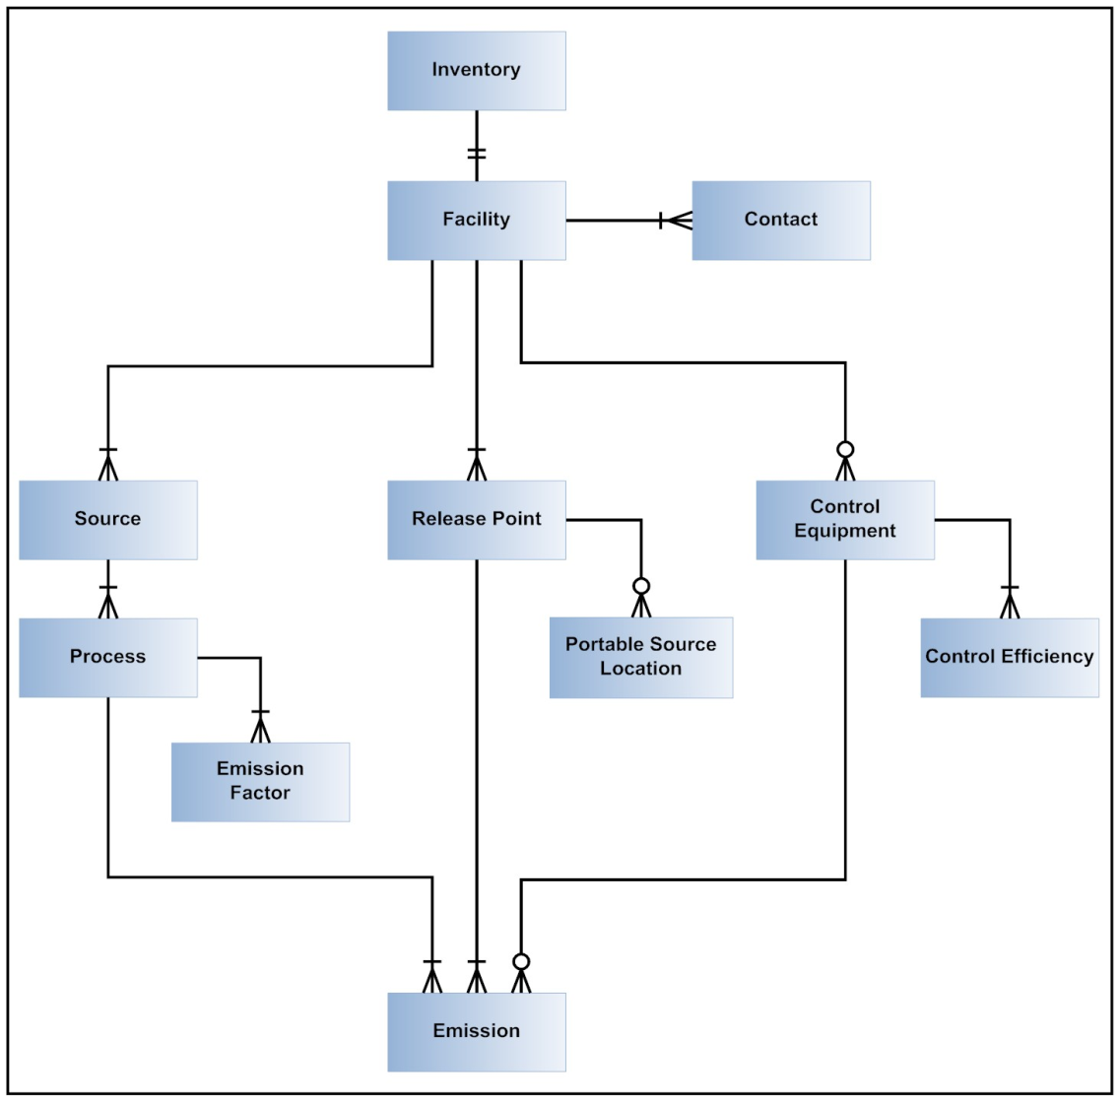
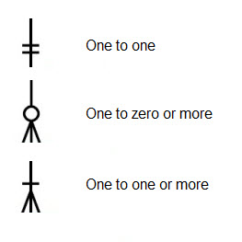
Key:

Slide 56
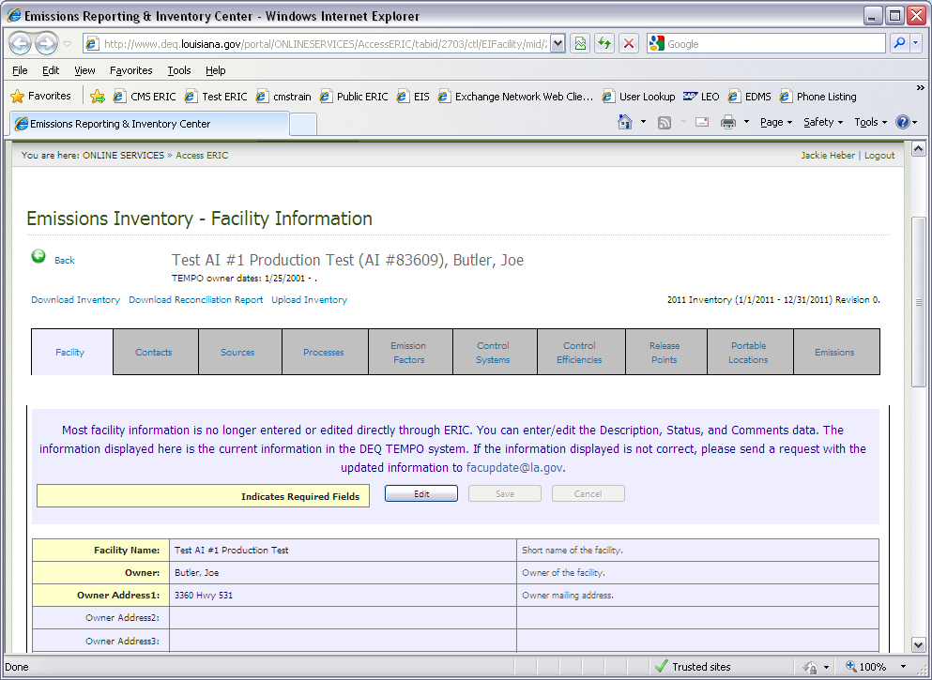

Slide 57
Minimum Decimal Places And Reporting Thresholds
Criteria and HRVOC pollutants reported in tons
Two decimal places minimum, recommended
Not required to report emissions < 0.005 tons (potential & actual) for an emissions path, unless VOC TAPs are > 0.005 pounds
Toxics reported in pounds
Two decimal places minimum, recommended
3 decimal places if MER < 50 lbs/yr, and
6 decimal places for dioxins and furans
Not required to report emissions < 0.005 pounds (potential & actual) for an emissions path
ERIC

Slide 58
Grouping Similar Sources
May group similar sources/process if, in aggregate, emissions (potential & actual) are
< 5 tons Criteria Pollutants
< MER for Toxic Air Pollutants
Create an emissions path for the group
Source, process, release point
ERIC

Slide 59
Insignificant Activities
May aggregate IA
By Permit (not facility-wide)
Do not combine with GC XVII or Fugitives
Report as source type of Insignificant Activities
Report as release point type of Area with dimensions of area where activity occurs
Does not require a process record
Report Insignificant Activity Lists A and D
Do not report Insignificant Activity Lists B or C
ERIC

Slide 60
GC XVII Emissions
May aggregate GC XVII
By Permit (not facility-wide)
Do not combine with IA or Fugitives
Report as source type of GC XVII Emissions
Report as release point type of Area with dimensions of area where activity occurs
Does not require a process record
ERIC

Slide 61
Fugitives
May aggregate Fugitives
By Permit (not facility-wide)
Do not combine with IA or GC XVII
Report as source type of Fugitive Emissions
Report as release point type of Fugitive with dimensions of area where activity occurs
Does not require a process record
ERIC

Slide 62
Validation
QA Checks
Basic checks done on each screen (data type, range of values, etc.)
Required fields NOT checked until you submit, but data validation is checked upon data entry
You can run validation checks at any time
Printable list of items to address
ERIC

Slide 63
Asking for Help
Keep in mind that there are only 2 staff members who handle the work
They answer your questions and help with your revisions
They analyze the data to make sure we are submitting good data to EPA
They also help permits, engineering, enforcement, surveillance, planning, the public, and other state/federal agencies
ERIC

Slide 64
Asking for Help
LDEQ staff are assigned parishes
Call or send an email to the staff person that is assigned the parish where your facility is located
A list of parishes and assigned staff is listed on the left sidebar on the ERIC homepage
Please do not call other LDEQ staff asking for help, even if they have helped in the past
Call those on the list only, please
LDEQ staff that are not on the list may not be kept up to date with the most recent changes to EI and/or ERIC
ERIC

Slide 65
Asking for Help
ALWAYS, ALWAYS have your AI # ready
ALWAYS!
Put the AI # in every email, EVERY TIME!
ERIC

Slide 66
Asking for Help
Send us an email first
Calling your staff contact is always good, however, we will more than likely ask you to email us
When emailing your staff contact:
Send the AI #
Send a screen shot of the error(s) you need help with
If having problems with the spreadsheet or uploading a spreadsheet, send the spreadsheet
ERIC

Slide 67
Asking for Help
ALWAYS, ALWAYS have your AI # ready
ALWAYS!
Put the AI # in every email, EVERY TIME!
ERIC

Slide 68
Reporting Year 2012 Emissions in ERIC
Part 5

Slide 69
Deadlines
AQ300 permanently extended the deadline for reporting both criteria and toxic emission inventories and the accompanying certification statement to April 30
Reporting Year 2012 data for criteria and toxic emission inventories, as well as the certification statement are be due by April 30, 2013
A 2012 inventory will be considered late if not submitted in ERIC on or before April 30, 2013
A 2012 certification statement will be considered late if not postmarked or delivered by April 30, 2013
Requests for extensions to the deadline must be submitted to Air Permits as a variance
Contact your permit writer for assistance
RY2012
Changes

Slide 70
ERIC Enhancements
Version 8 of the spreadsheet – dated 11/22/2011 – Start using it
Break ERIC from TEMPO, mostly
Updated/additional validations
Release points are locked and users can not edit them
Revised how validations are applied to prior year inventories
Public Reports online for actual and permitted emissions
RY2012 Changes

Slide 71
ERIC/TEMPO Break
Most of the links between ERIC and TEMPO have been broken
When starting a new inventory, most of the information will be pulled from ERIC from the inventory you selected as your base year
Coming from TEMPO:
Facility, except Facility Description, Facility Status, & Comments
Contacts, except EI Consultant & Other
Coming from ERIC:
Facility Description, Facility Status & Comments
Contact types EI Consultant & Other
Source
Process
Emission Factor
Control Systems
Control Efficiencies
Release Points
Portable Locations
Emissions
RY2012 Changes

Slide 72
ERIC/TEMPO Break
When revising an inventory, all ERIC information is still copied from the inventory being revised
Sources with the following statuses will no longer be brought forward into a new inventory, nor will these statuses be valid:
Duplicate
Not required to report
Permitted and never to be built
Permitted but not built
Reported under another source
Valid source statuses:
Active
Idle
Permanently Shutdown
RY2012 Changes

Slide 73
Reconciliation Report
Added a Reconciliation Report for downloading
Available inside each inventory
Compares the data in the selected inventory with data in TEMPO’s master file
The data in the report pulled from TEMPO was the data we would have populated your inventory with had we pulled it from TEMPO, as in years past
Removed the Additional Items tab
Use the report as you see fit:
Ignore the report (we hope that you don’t)
Correct the data in the inventory in ERIC to correspond to TEMPO
Contact us to have data in TEMPO corrected
RY2012 Changes

Slide 74
Reconciliation Report

Slide 75
Additional Validations
“Permanently Shutdown” is now an option for Facility Status.
Emissions must equal 0.
Sources must have a status of Idle or Permanently Shutdown
If emissions are greater than 0, then facility status must be Active
If Facility Status is Permanently Shutdown, then ERIC will ignore validations on everything but Facility and Contact tabs.
RY2012 Changes

Slide 76
Additional Validations
If inventory type is Criteria and emissions are reported for toxic pollutants (excluding ammonia), you will receive an error.
If inventory type is Toxic and emissions are reported for criteria pollutant (excluding ammonia), you will receive an error.
Inventory type can now be changed on an inventory in Editing status.
RY2012 Changes

Slide 77
Additional Validations

Slide 79
Updated Validations
Toxic VOCs emissions must be within 25 pounds of Total VOC emissions
Facility wide emissions
Emissions by path
HRVOCs will receive a warning
Toxic VOCs will receive an error
Ozone season validations now only require ozone season emissions for CO, NOx, VOC, propylene, and ethylene.
RY2012 Changes

Slide 80
Locked Coordinates
RY 2011, release point coordinates were limited to a distance of 500 meters from the facility coordinates
Distance limit increased upon request and review
Specific distance limits are carried over every year
If an ERIC account does not have a specific distance limit, the default limit is 500 meters (~0.25 mile)
New ERIC accounts have a distance limit of 500 meters
Send email with AI # requesting a distance limit increase
RY2012 Changes

Slide 81
Locked Coordinates
If they are outside 500 meters, users will get an ERROR
If they are legitimately outside 500 meters, users must provide verification of such and request that the limit be increased
Once the request is received and the distance is verified, LDEQ will adjust the limit for that facility
Most inventories will receive this error on their first pass – DO NOT PANIC!
We need for your coordinates to be reviewed and confirmed
PLEASE, PLEASE, PLEASE do NOT change your release point coordinates to your facility coordinates just to pass validation
We need accurate release point coordinates
REVIEW ALL COORDINATES – INCLUDING FACILITY COORDINATES!!!!
GET STARTED EARLY!!!!
RY2012 Changes

Slide 82
Locked Coordinates
Beginning with RY 2012, release point coordinates are LOCKED!
Users are no longer be able to edit release point coordinates freely
LDEQ will review and approve or deny the changes
REVIEW YOUR COORDINATES NOW!!!
RY2012 Changes

Slide 83
Locked Coordinates
Beginning with RY 2012, release point coordinates are LOCKED!
Users are no longer be able to edit or add release point coordinates without approval from LDEQ
Request form within ERIC that sends an email to the AI’s assigned LDEQ staff
Spreadsheet upload with changes will automatically send an email to LDEQ
LDEQ will review and approve or deny the additions/changes
Step by step instructions are in Section 6.9 of the ERIC User Manual
REVIEW YOUR COORDINATES NOW!!!
RY2012 Changes

Slide 85
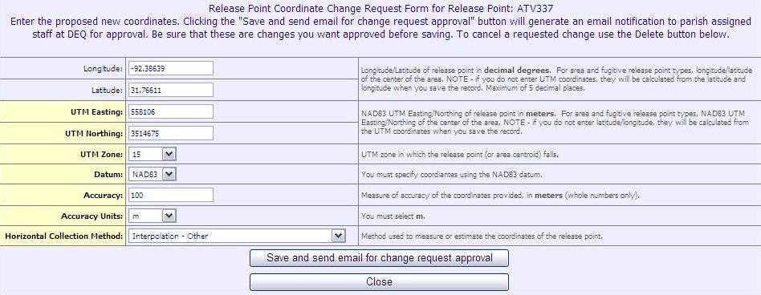

Slide 86
Locked Coordinates
If you are changing longitude/latitude, delete the UTM coordinates first.
Change the longitude/latitude and upon clicking the Save and send email for change request approval button, the UTM coordinates will be calculated and populated.
If you are changing UTM coordinates, delete the longitude/latitude coordinates first.
Change the UTM coordinates and upon clicking the Save and send email for change request approval button, longitude/latitude will be calculated and populated.
RY2012 Changes

Slide 87
Locked Coordinates
Adding a new release point in ERIC:
Create the release point in ERIC.
Save the new release point.
Edit the release point
Request Changes link will be available
If you try to submit before changes have been approved or denied, you can still submit, however, all changes will be lost.
If you have added a new release point with coordinates and try to submit, upon validation, you will receive errors for missing the required release point coordinate data.
RY2012 Changes

Slide 88
Locked Coordinates
After approval, download the inventory
Or, add the approved coordinates to your spreadsheet.
Be sure to login with your own portal account.
If you are using someone else’s portal account login, the response from LDEQ staff will be sent to the email address of the portal account making the request.
RY2012 Changes

Slide 89
Prior Year Validations
LDEQ modified how validations are applied to prior year revisions
Submitting prior year inventories or revisions will be easier
Section 3.11 and Appendix A of the ERIC User Manual
Tiered approach to prior year inventory validations
Current Reporting Year
Up To Four Years Prior
More Than Four Years Prior
RY2012 Changes

Slide 90
Prior Year Validations
Current Reporting Year: advances on October 1st of each calendar year.
Jan 1 – Sept 30 = current calendar year -1
Oct 1 – December 31 = current calendar year
So from October 1, 2012 through September 30, 2013, the Current Reporting Year is 2012.
Starting October 1, 2013, the Current Reporting Year will change to 2013.
New Inventory - ALL validations applied to ALL data fields
Revision - ALL validations applied to ALL data fields
RY2012 Changes

Slide 91
Prior Year Validations
Up To Four Years Prior
New Inventory - ALL validations applied to ALL data fields
Revision - ALL validations applied to CHANGED data fields
Current reporting year = 2012, therefore, this validation tier applies to 2011, 2010, 2009, & 2008
RY2012 Changes

Slide 92
Prior Year Validations
More Than Four Years Prior
New Inventory - PARTIAL validations applied to ALL data fields
Revision - PARTIAL validations applied to CHANGED data fields
Current reporting year = 2012, therefore, this validation tier applies to 2007 and earlier
List of partial validations in ERIC User Manual Appendix A
RY2012 Changes

Slide 93
Prior Year Validations
Inventory Year | Submittal Type | Full Validation List | Partial Validation List | All Inventory Data | Changed Fields Only
Current | New | X |  | X
Current | Revision | X |  | X
Up to 4 years prior | New | X |  | X
Up to 4 years prior | Revision | X |  |  | X
>4 years | New |  | X | X
>4 years | Revision |  | X |  | X
RY2012 Changes

Slide 94
Public Reports
Public Reports page is available
Do not need a portal account nor an ERIC account to access the Public Reports page
http://www.deq.louisiana.gov/portal/tabid/2703/Default.aspx
Three options:
Radius Search (actual emissions and permitted emissions)
Data used in modeling
Replaces the need for public records requests by AI or Parish
Emissions by Parish
Prior year data sets
RY2012 Changes

Slide 97
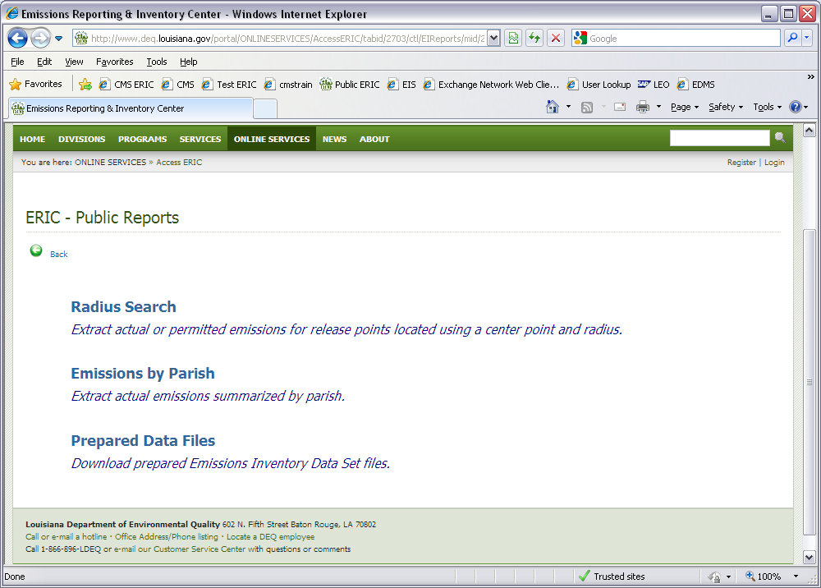

Slide 98
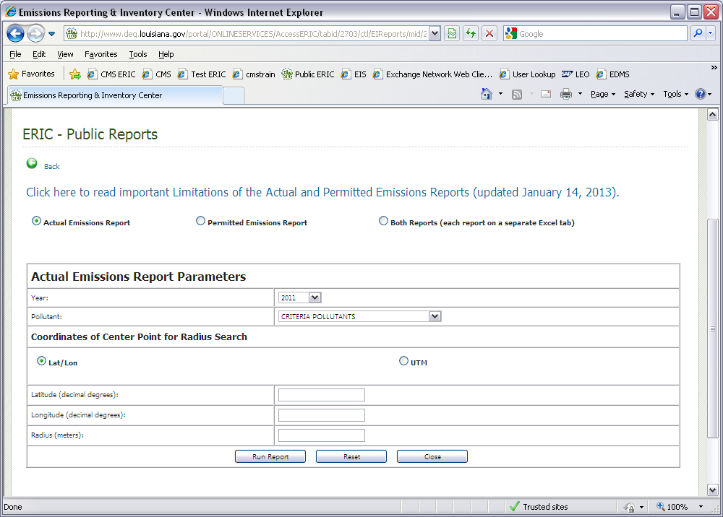

Slide 99
Public Reports
Actual emissions radius search:
Certified emissions data from ERIC
Last 5 years plus Baseline data
If you need a year not on the dropdown, submit a public records request: http://www.deq.louisiana.gov/portal/SERVICES/InformationRecords.aspx
Permitted emissions radius search:
Permitting data from TEMPO
Current operating permits only (not pending permit applications)
RY2012 Changes

Slide 100
New User Manual
New ERIC Users Manual is available
Version 2.1
Comprehensive & detailed
Will be updated as needed, so check website frequently
Replaces all documentation except current reporting year guidance and lookup lists
201 pages!
Let us know if something is missing or incorrect!
RY2012 Changes

Slide 102
Affecting Change to ERIC
What would you like to see us change in or about ERIC?
Suggestions or comments on how to improve ERIC should be emailed to Jackie Heber at jackie.heber@la.gov
If a value is missing from a dropdown list or a reference sheet, please email Jackie and request that it be added
Until it is added, you can select “Other”, “Not Applicable”, “Unknown”, if available, or the next best option

Slide 103
Helpful Hints
Part 6

Slide 104
Helpful Hints
Guidance documents are updated frequently and posted on the ERIC home page
http://www.deq.louisiana.gov/portal/tabid/109/Default.aspx
Helpful Hints have been incorporated throughout the new User Manual and the Helpful Hints document has been taken down from the website
Helpful Hints

Slide 105
Assistance with ERIC
Check ERIC home page frequently for updated guidance materials
Check the help text in the web application
Call or send an email to the LDEQ staff person that is assigned to the parish where your facility is located
A list of parishes and assigned staff is listed on the left sidebar on the ERIC homepage
When emailing the staff about an error, include:
a screen shot of the error you are seeing
AI #
Description of what you were doing
Helpful Hints

Slide 106
Access to ERIC
If your AI # is not available in ERIC, send us an email with the AI #, owner company, owner address, and permit number, and ask that an ERIC account be created for the AI #
Pre-registration codes are given to the account’s company representative(s) only
Code gives administrator access to an ERIC account, therefore:
LDEQ does not give pre-registration codes to consultants
LDEQ does not recommend giving the pre-registration code to consultants or users outside the company
Helpful Hints

Slide 107
Permits & ERIC
EI is not intended to “duplicate” the permit
Inventory data in ERIC is designed in such a way as to give LDEQ the best possible data, in the best possible way, for use of the inventory data
Not necessary to represent information from your permit exactly as it is in the permit
Where possible, we have provided data elements intended to help crosswalk the inventory data to the permit
When preparing an EI, how your facility is permitted should be given little consideration
Helpful Hints

Slide 108
Permits & ERIC
CAPs are a function of permits and should not be represented in the inventory as a CAP
All the equipment in the CAP should be reported individually as sources, processes, release points, and/or control systems
Do not represent CAPs as area sources or release points
Rule of thumb – how you calculate your data is how you should represent it in the inventory
Helpful Hints

Slide 109
Data Quality
Routine – emissions emitted under normal operating conditions
Routine does not necessarily mean permitted
Variance – emissions emitted through the operations approved by a variance
Startup/Shutdown – emissions emitted during the startup/shutdown of the emissions path
Helpful Hints

Slide 110
Data Quality
Unauthorized Discharge – all other emissions that are not routine, variance, startup/shutdown
Not intended to duplicate or replace any other unauthorized emissions report at LDEQ
It is just a catch all for emissions that do not meet one of the other three emission types
Helpful Hints

Slide 111
Data Quality
If you only report “Routine” emission types in your inventory, then you are indicating that you facility:
Had NO variances for the ENTIRE reporting year
Had NO startup/shutdown emissions for the ENTIRE reporting year
Had NO unauthorized emissions for the ENTIRE reporting year and
the facility operated under routine operations for the ENTIRE reporting year
Helpful Hints

Slide 112
Data Quality
Provide informative descriptions in any of the description fields
Descriptions created from the migration of the 2005 data are not descriptive or useful
Change any description that says "NEDS point ##" or "TEDI Emissions for SIC ####" as these are not very helpful
Helpful Hints

Slide 113
Data Quality
The data should be in a state that you are willing to certify
Certification statement can hold you criminally liable for information in the inventory
LAC 33:III.919.G requires emissions to be reported using CEMS data or approved stack testing data.
Only in the absence of CEMS or stack test data are you allowed to use emissions factors.
Emission factors must be those as of December 31 of the reporting year
Used for the entire reporting year
Do not use the same calculation methods in your permit unless they meet LAC 33:III.919.G
Helpful Hints

Slide 114
Data Quality
Validations are intended to give us the best data that is accurate
Do not use blanks, spaces, or 0s to bypass an error
Correct the data receiving the error so that it is accurate
Do not change the data just to pass the validation error or warning
Helpful Hints

Slide 115
Certification Statement
In order for an inventory to be deemed complete and in compliance, we must receive the certification statement with an original, wet ink signature by the Responsible Official, and on or before the reporting deadline
LDEQ only uses certified data – data in ERIC for which we have received a certification statement
If the data is submitted but not certified, we do not use it
If you revise your inventory in ERIC and you want it to be deemed complete – you MUST submit the accompanying certification statement
The certification statement submitted for Revision 0 does not certify Revision 1 – no matter why you revised the inventory
Helpful Hints

Slide 116
Certification Statement
Do not use previous versions of the certification statement
We will only accept the ERIC generated certification statement
Must be an original, wet ink signature signed by a Responsible Official per LAC 33:III.502
LDEQ can not accept copies, faxed, or stamped signatures
Postmark or ship date determines compliance with the reporting deadline
Do not use black ink to sign the certification statement
Use blue, green, red, pink, purple
Any color but black
We must be able to verify that the signature is an original, wet ink signature by the Responsible Official
Helpful Hints

Slide 117
Certification Statement
The certification statement will be available for downloading on the Summary page of an inventory submitted in ERIC
If any information is incorrect on the certification statement, you must revise the inventory in ERIC and correct the information
Do not mark up the certification statement with the correct information before sending to LDEQ
Handwritten markups do not change the data in ERIC
Helpful Hints

Slide 118
Certification Statement
Unless specifically directed, do not send copies to EPA, the regional office, Enforcement, Compliance, your Permit Writer, etc.
Only need to send the original to EI
Send to the address on the certification statement
Check your cover letters – many have outdated addresses and addressees
Helpful Hints

Slide 119
Certification Statement
Check to make sure the inventory IDs are the same on page 1 and page 2
Only need to send in one original – requirement to send an original and a copy has been removed from the regulations
Unless specifically directed, do not need to send us the calculations
We only need the certification statement and the discharge report, if required
Helpful Hints

Slide 120
Am I required to Report?
If requirement to report per 919 or 5107 is in your permit, you are now expected to report
If requirement in permit is in error, continue to report until permit is modified and you are released from reporting per LAC 33:III.919.D
Otherwise, you risk being out of compliance with your permit
Ch. 51 applies to major sources only
Once in, always in no longer
However, if you are a minor source of toxics and Ch. 51 does not apply but requirement is in permit, continue to report or risk enforcement action for non-compliance with permit
Helpful Hints

Slide 121
Asking for Help
ALWAYS, ALWAYS have your AI # ready
ALWAYS!
Put the AI # in every email, EVERY TIME!
Helpful Hints

Slide 122
Frequently Asked Questions
Part 7

Slide 123
Frequently Asked Questions
If your facility meets the applicability in LAC 33:III.919 or Ch. 51, you must report even if your facility was not constructed or is not operating
The facility’s permit was modified mid-year to either subject the facility to emission inventory reporting or to remove the requirement to report. Are the emissions reported just for the time the facility was subject to reporting?
No. Emissions in the inventory are annualized and if the facility was subject to reporting at any time during the reporting year, then the emissions should be for 1/1 to 12/31.
Exceptions:
change of ownerships
Initial permit issued and ownership begins mid-year

Slide 124
Frequently Asked Questions
Include Toxic VOC emissions in the Total VOC emissions
ERIC does not automatically include VOC TAPs in the Total VOC. It must be done manually, but VOC TAPs in a “toxic” or “criteria and toxic” inventory will be subtracted from Total VOC for invoicing purposes.
ERIC has a validation that checks to see if VOC TAPs are greater than Total VOC on the emissions path as well as facility wide. If VOC TAPs are greater than Total VOC, within a tolerance of 25 pounds, users will get an error.
You must include your VOC TAPs in your Total VOC
Do not create a separate Source ID for those emissions sources of toxics. Include criteria and toxics under the same Source ID.

Slide 125
Frequently Asked Questions
I’ve requested access to a facility, but still can not get into the ERIC account.
Access requests are processed by the account administrator
The account administrator does not receive notification
Contact the account administrator and have them grant/deny and then edit your access to the level they wish
How do I find out who the account administrator is?
Email or call your staff contact and ask who the administrator is for an AI and owner

Slide 126
Frequently Asked Questions
What does this error mean?
Error inserting process information: Exception of type DEQ.EmissionsInventory.DAO.DAOException' was thrown.; DAO Exception Type UniqueIndexViolation
This is caused by a duplicate Process ID in the spreadsheet. The same applies to other categories of information where the ID value used by the Facility must be unique across the inventory.

Slide 127
Frequently Asked Questions
DO not generate a Subject Item ID #s.
The subject item ID is assigned through TEMPO. It can be found in the permit, if generated through TEMPO, or on the list of valid Subject Items in the help text in ERIC.
The subject item ID field is required. If you do not know it or do not have one assigned, you may enter “Not Listed”.
If a facility is subject to LAC 33:III.919 reporting but is NOT subject to toxic reporting, do we need to include TAP emissions in ERIC?
No, you do not need to report individual TAP emissions in ERIC if the facility is not required to report to per Ch. 51. However, VOCs that are also TAPS should be included in Total VOCs.

Slide 128
Frequently Asked Questions
How are change in ownerships handled?
Each owner will have their own account in ERIC for the AI
Access to these accounts is the same as any other account
Each account’s inventory start and end dates should correspond to the dates of ownership in TEMPO
i.e., if Jackie sold her oil and gas plant to Heather on March 1, 2012:
Jackie’s inventory will be 1/1/2012 – 2/28/2012
Heather’s inventory will be 3/1/2012 – 12/31/2012
If the dates are not correct in TEMPO, they will be required to be corrected before submitting the inventory
Ownership dates in TEMPO are dependent upon the change of ownership forms submitted to the department in accordance with LAC 33:III.517.G
Emissions should be for the period of ownership during the reporting year
The new owner cannot report for the entire year as it was done in the past
Each owner’s inventory will be invoiced according to the emissions reported in the inventory.

Slide 129
Frequently Asked Questions
Can Insignificant Activities and GCXVII be aggregated together?
No
Please visit LDEQ’s website for full document.
http://www.deq.louisiana.gov/portal/tabid/109/Default.aspx

Slide 130
Questions?

Slide 131
Accessing ERIC
Part 8

Slide 132
Portal Accounts
Before you are able to access the facility’s data in ERIC, you must have an LDEQ Portal Account
Portal accounts are specific to each person
Portal accounts give access to restricted information on the LDEQ website and passage into ERIC
We strongly discourage more than one person using a portal account
Each person at a firm should have their own portal account
Register for a Portal Account at the LDEQ ERIC homepage: http:///www.deq.louisiana.gov/eric
Upon completion of registration, you will receive a screen message and a confirmation email. The email will contain instructions on how to activate your account, along with your username and password.
Accessing ERIC

Slide 133
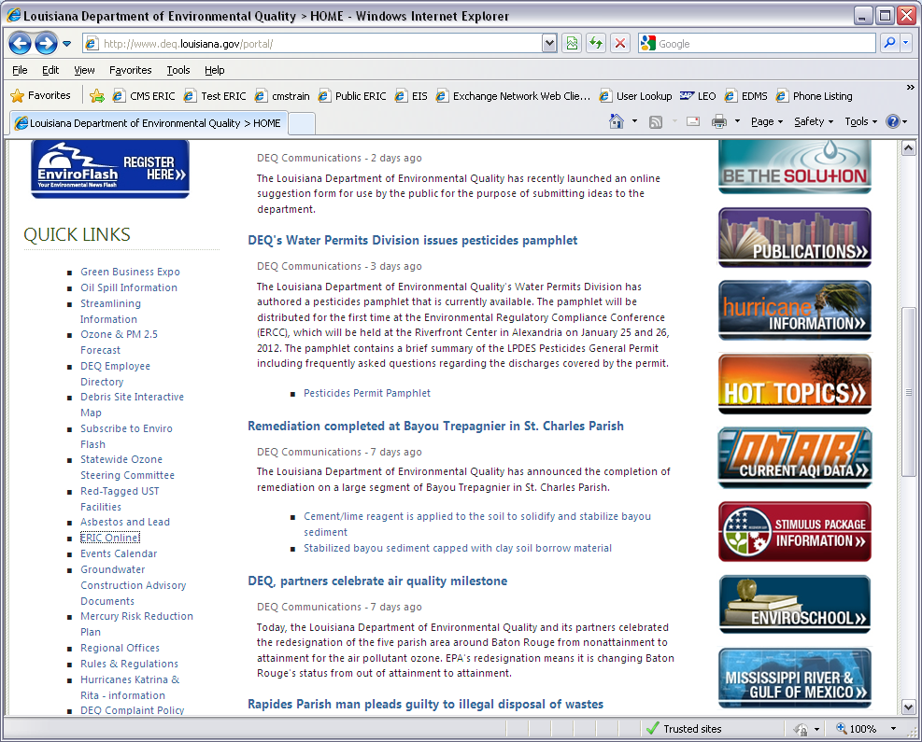

Slide 135
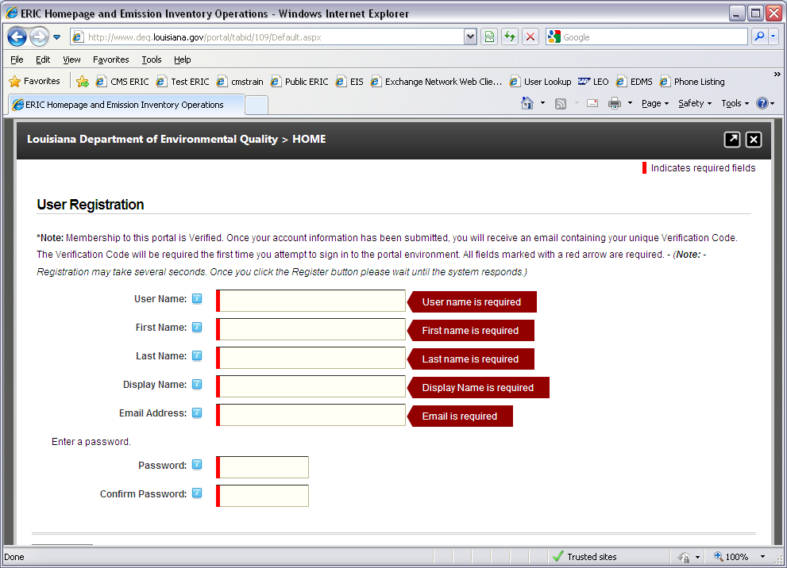

Slide 136
ERIC Accounts
ERIC Account
Access is granted to ERIC via a pre-registration code
For new ERIC accounts, or if facility ownership has changed, this code is issued by LDEQ to the Emissions Inventory contact upon request
Once the ERIC Account Administrator is identified, ALL future access is granted by this ERIC Account Administrator, NOT by LDEQ
Each owner has a separate account
Pre-Registration Process
Log in to portal, enter AI, and pre-registration code. After activating your access, it is necessary for you to logout and then log back in for access permissions to be applied
Accessing ERIC

Slide 137
Accessing ERIC Accounts
New facilities that do not have an ERIC account
Email request to LDEQ staff contact being sure to include:
AI#, Owner Name, Owner Address, & Permit Number
LDEQ will create account and pre-registration code
Pre-registration codes must be sent to a company employee – cannot be sent to a consultant
Request Access: Others who need access must request it
ERIC Account Administrator grants or rejects requests
(NOT LDEQ)
ERIC Account Administrators manage access to all accounts
Instructions for granting access and roles can be found on the User Administration page
Password Resets – can be found in the User Profile
Accessing ERIC

Slide 138
Requesting Access from the Facility ERIC Administrator
After obtaining the LDEQ portal account, request access to the facility from the link on the ERIC homepage
Select the option: I am an employee of the facility owner or a designated consultant
Enter the AI # and click “submit”
A prompt will ask to confirm the request; if the information is correct, click “confirm”
Once the request has been made, contact your ERIC Account Administrator to let them know of the request
Accessing ERIC

Slide 139
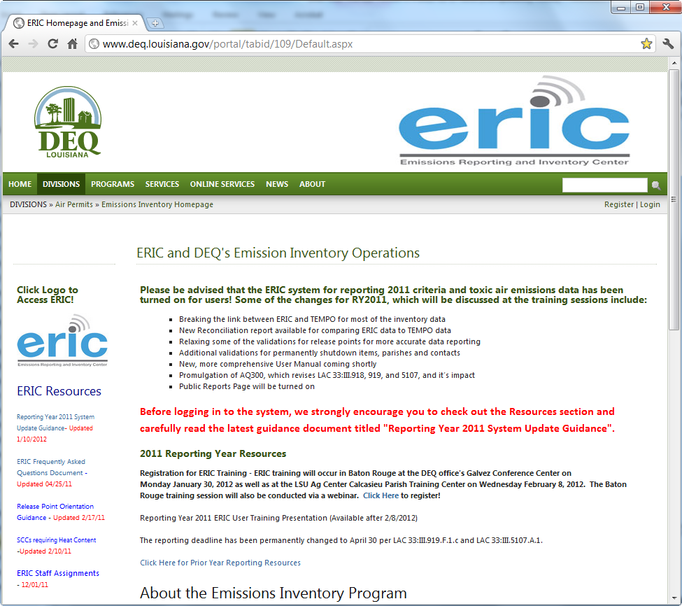

Slide 140
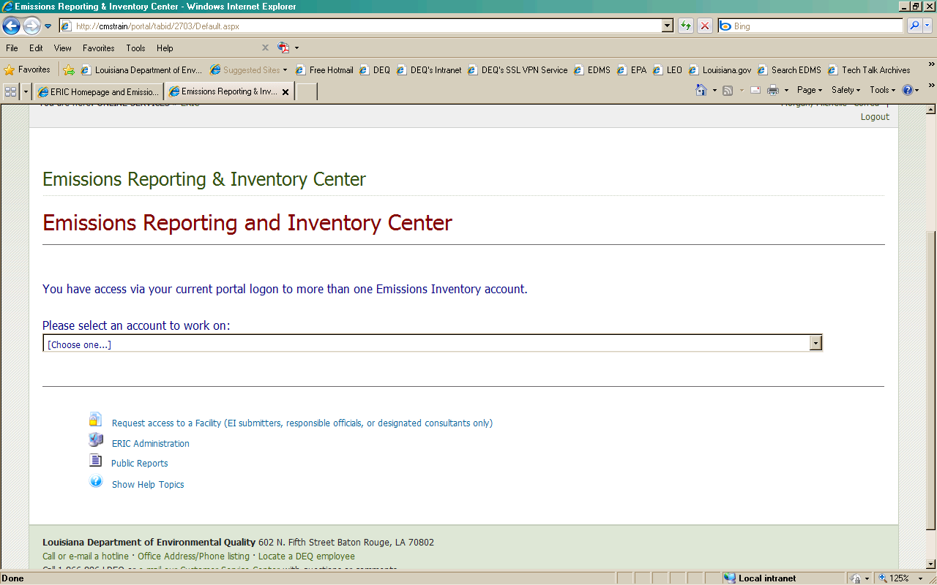

Slide 141
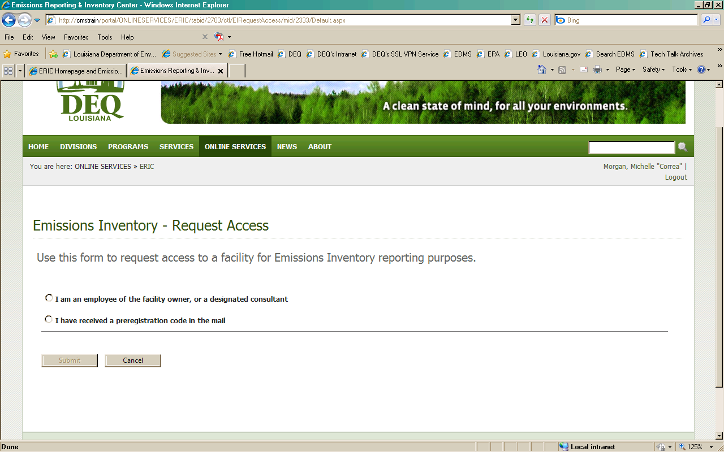

Slide 142
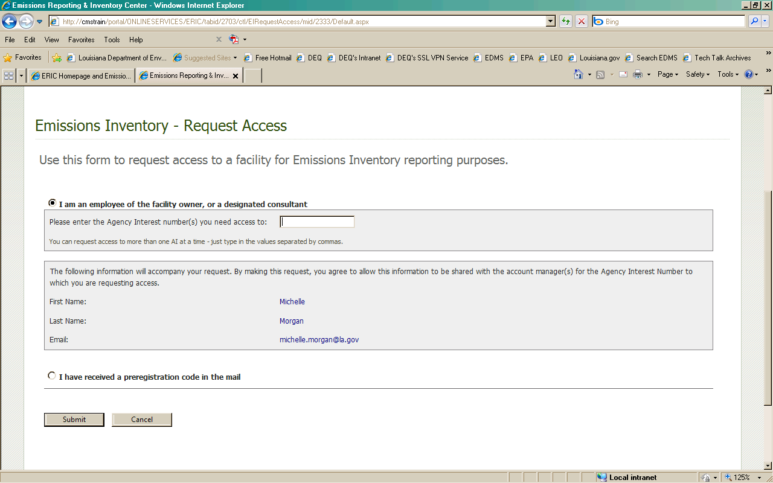

Slide 143
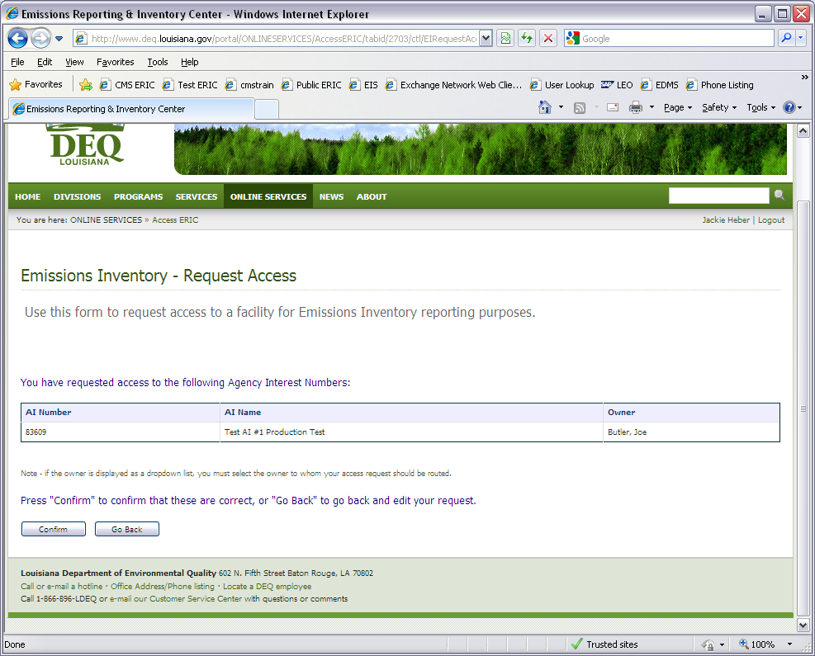

Slide 144
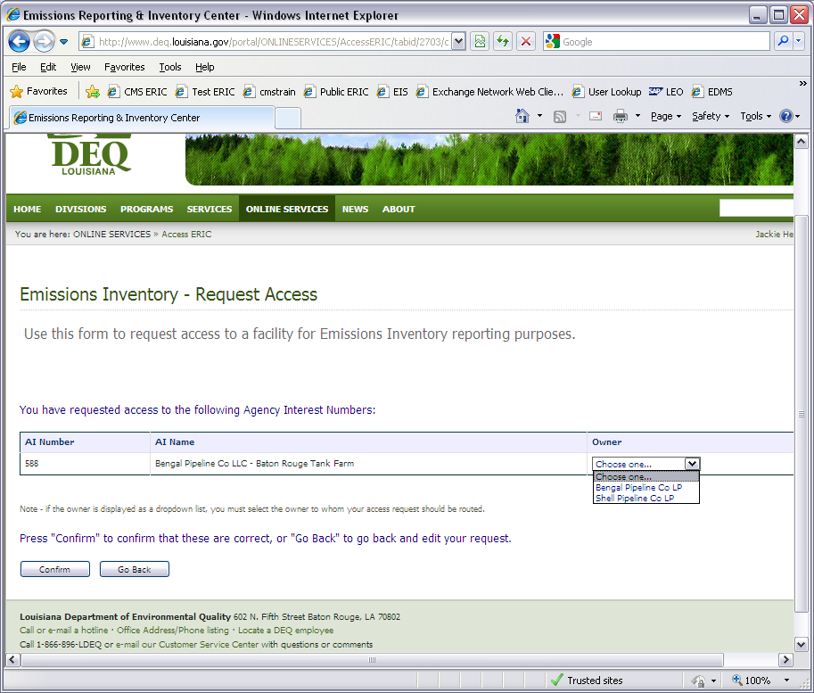

Slide 145
Important Note
Only facility owners or confirmed employees will be given a pre-registration code
LDEQ recommends a facility employee act as the ERIC Account Administrator
Consultants are asked to create a portal account first, then request access to their assigned facilities
The Administrator will then grant/deny access to the account and designate the consultant's role
If a consultant is the only administrator, the facility does not have control of their account!
If the ERIC Account Administrator is no longer with the company and there is no other administrator, please contact your ERIC contact at LDEQ for further instructions
Accessing ERIC

Slide 146
User Roles
Administrator –
Authority to grant or reject access requests and, if granted, what level of access/role is allowed
Editing privileges to upload inventory data into Excel format, create new inventories, edit existing inventories and revise old inventories
Can submit inventories
Manager – Provides editing privileges for ERIC data
can edit data, upload inventory data in Excel format, create new inventories, edit existing inventories, and revise old inventories
can submit an inventory
cannot grant user access or modify user roles
Reader –Provides read-only access to your ERIC data
Users with this role can view your inventories, download the data to a spreadsheet, but they cannot edit any data or upload new inventory data
Accessing ERIC

Slide 147
All of the necessary information is located:
LDEQ Website: http://deq.la.gov
Instructions on the ERIC Home Page
ERIC User Manual tab or
“How Do I” Guides
Create Portal Account
Request Access to ERIC
Accessing ERIC

Slide 148
Questions?

