Slide 1
IIJA / BIL Funding for Wastewater Infrastructure
By
Scott J. Templet, P.E.

Slide 2
Definitions
IIJA – Infrastructure Investment and Jobs Act
BIL – Bipartisan Infrastructure Law
CWSRF – Clean Water State Revolving Fund
Disadvantaged Communities (CWSRF) – community that meets Affordability Criteria
Affordability Criteria – meets one of the following:
  MHI < state average
  Population growth (2-year) < state average
  Unemployment > state average
BABA – Build American, Buy American
QBS – Qualification Based Selection (A/E Contract)

Slide 3
IIJA/BIL Funding Details
Louisiana CWSRF projected supplemental
  ~ $20-$25M per year (2022-2026)
49% of funds provided as subsidy (i.e. grant, forgivable loan)
  Disadvantage Community, or
  Benefits area, or
  Address water or energy efficiency, mitigates stormwater impact, sustainable planning, design, and construction
Allows for 2% of funds to be used for Technical Assistance
1-yr to close loan agreement
  Build Project Pipeline

Slide 4
2% Technical Assistance Targets
Rural, Small, tribal POTW
  Treat up to 1 MGD
  Serves < 10,000 population (and/or serve hospital, school, restaurant, etc.)
Non-compliant systems
Disadvantaged Communities
Impaired Waterbodies
Tech. Assistance to Include
System Assessment
  How to get system back into compliance
  Operational Changes, Upgrades, Consolidation, etc.
Rate Study
Technical Training

Slide 5
CWSRF Eligibilities
Construction of publically owned treatment works;
Implementation of a non-point source pollution management program;
Implementation of an estuary improvement program;
Decentralized Wastewater Treatment Systems;
Measures to manage, reduce, treat, or recapture stormwater;
Water conservation, efficiency, or reuse;
Watershed Pilot Projects;
Energy Efficiency;
Reusing or recycling wastewater, stormwater, or drainage water;
Increase security of POTW; and
Technical Assistance to owners/operators of small POTW

Slide 6
LDEQ CWSRF Approach to BIL
Starting Technical Assistance Efforts ~ September 2022
  Build Project Pipelines
  Ongoing throughout 5-year BIL period
Apply for FY22 BIL funds ~ March/April 2023
  Project List = 1-year to close
Apply for Base Program funding ~ May/June 2023
Apply for FY23 BIL funds ~ August/September 2023
  Project List = 1-year to close
Accept pre-applications at any time

Slide 7
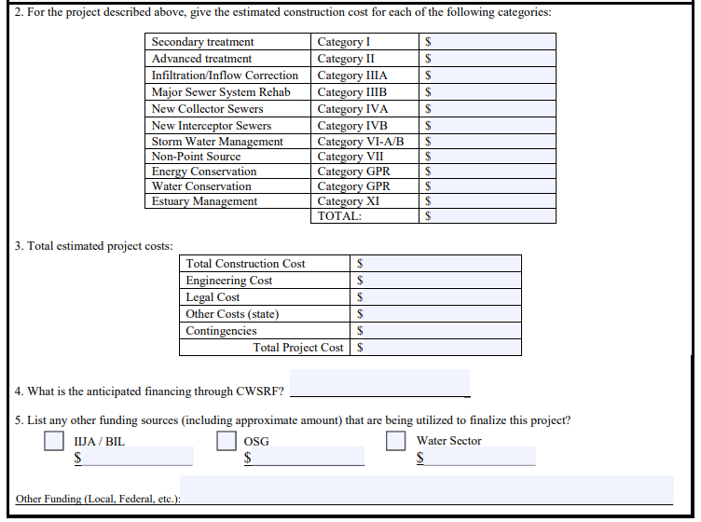
CWSRF Pre-application
https://deq.louisiana.gov/page/clean-water-state-revolving-fund-application

Slide 8

Questions

Slide 9
Scott J. Templet, P.E.
LDEQ, CWSRF
https://deq.louisiana.gov/page/clean-water-state-revolving-fund
(225) 219-3463
Scott.Templet@La.Gov

