Slide 1
CWSRF / IIJA / BIL Funding for Wastewater Infrastructure
By
Scott J. Templet, P.E.
LRWA Conference (October 19, 2022)

Slide 2
Definitions / Acronyms
CWSRF – Clean Water State Revolving Fund
IIJA – Infrastructure Investment and Jobs Act
BIL – Bipartisan Infrastructure Law
Disadvantaged Communities (CWSRF) – community that meets Affordability Criteria
Affordability Criteria – meets one of the following:
MHI < state average
Population growth (2-year) < state average
Unemployment > state average
AIS – American Iron & Steel
BABA – Build American, Buy American
QBS – Qualification Based Selection (A/E Contract)

Slide 3
CWSRF Background
Clean Water State Revolving Fund (CWSRF)
Created in 1987 by addition of Title VI to Clean Water Act (CWA)
Regulations (1990) per 40 CFR 35.31
Water Resources Reform and Development Act (WRRDA), 2014
Infrastructure Investment and Jobs Act (IIJA), 2021

Slide 4
CWSRF Program Purpose
Below market interest loans for projects necessary to
Comply with requirements of Clean Water Act
Protect public health
CWSRF Program Terms
Effective interest rate 0.95%
Interest rate: 0.45%
Administrative fee: 0.5%
Construction period: 2 years
Repayment period: 20 years

Slide 5
CWSRF Process
EPA
State
CAP Grant
State Match
Loan Agreement
Project Payments
Entity
Principal & Interest

Slide 6
CWSRF Eligibilities
Construction of publically owned treatment works;
Implementation of a non-point source pollution management program;
Implementation of an estuary improvement program;
Decentralized Wastewater Treatment Systems;
Measures to manage, reduce, treat, or recapture stormwater;
Water conservation, efficiency, or reuse;
Watershed Pilot Projects;
Energy Efficiency;
Reusing or recycling wastewater, stormwater, or drainage water;
Increase security of POTW; and
Technical Assistance to owners/operators of small POTW

Slide 7
Green Project Reserve (GPR)
4 basic categories for GPR
Water efficiency improvements
Wastewater Reuse; Water Meters (automatic, smart)
Energy efficiency improvements
Renewable Energy (i.e. Solar Panels), Energy efficient lighting
Green infrastructure
Permeable pavement, bioretention, green roofs, cisterns
Environmentally innovative activities
Climate Change adaptation, GHG mitigation

Slide 8
Eligible Project Examples
Rehabilitation, Upgrades, Expansion
Wastewater Treatment & Collection System
Any treatment process, including backup power (generators)
Lift stations, force mains, manholes, gravity collection
Nonpoint Source
Stormwater Management
green buffer zones, drainage swales, green roof, cisterns, permeable pavement, etc.
Decentralized Treatment
Upgrades from Septic Tank to ATUs

Slide 9
Eligible Costs
Costs for engineering, design, construction, legal & monitoring fees
Costs incurred prior to loan closing are reimbursable
O&M costs are not eligible
Real estate transactions are usually not eligible

Slide 10
Pre-Construction Requirements
Planning & Environmental
Categorical Exclusion, or
Full NEPA-like (FONSI)
Requires Preliminary Engineering Report (PER) &
Environmental Information Document (EID)
Design
Plans & Specifications
Include CWSRF requirements (i.e. DB, AIS/BABAA, DBE, etc.)
Engineering Contracts (if funded via CWSRF)
QBS for IIJA/BIL funded projects
Financial Review
Local Funding Ordinance (if applicable)
State Bond Commission Approval
Full Application & Attachments

Slide 11
Average Timeline

Slide 12
Average Timeline (Different tracks)
Engineering
Plans and Specifications
Advertising and Bidding
Cat Ex or
Financial
State Bond Commission
Local funding ordinance
Financial review
3 months
1 month
6 - 12 months
3 - 9 months
1 - 2 months
3 months
2-3 months
PER/EID

Slide 13
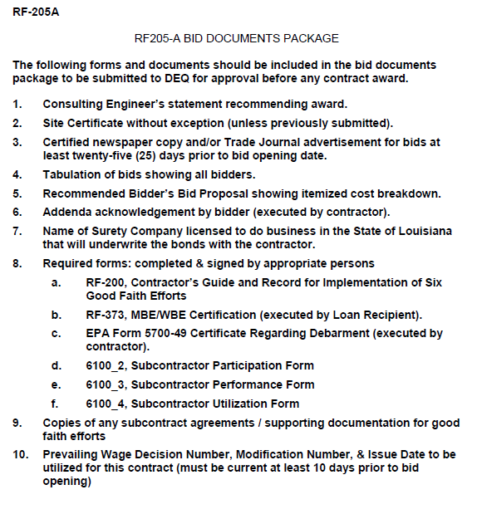
Bidding Requirements
Follow State Bid Law for Public Works

Slide 14
Construction Requirements
Periodic Inspections
Document Review
Certified Payrolls
American Material Certifications (i.e. AIS or BABA)
Change Orders
Payment Requests

Slide 15
Project Closeout
Substantial Completion
Final Inspection
Clear Lien Certificate
Final Acceptance (from Loan Recipient)

Slide 16
CWSRF Loan Amounts

Slide 17
Population Served by Projects

Slide 18
IIJA/BIL Funding Details
Louisiana CWSRF projected supplemental
~ $20-$25M per year (2022-2026)
49% of funds provided as subsidy (i.e. grant, forgivable loan)
Disadvantage Community, or
Benefits area, or
Address water or energy efficiency, mitigates stormwater impact, sustainable planning, design, and construction
Allows for 2% of funds to be used for Technical Assistance
1-yr to close loan agreement
Build Project Pipeline
Emerging Contaminant Funds

Slide 19
2% Technical Assistance Targets
Rural, Small, tribal POTW
Treat up to 1 MGD
Serves < 10,000 population (and/or serve hospital, school, restaurant, etc.)
Non-compliant systems
Disadvantaged Communities
Impaired Waterbodies
Tech. Assistance to Include
System Assessment
How to get system back into compliance
Operational Changes, Upgrades, Consolidation, etc.
Rate Study
Managerial, Technical, Financial Assistance

Slide 20
LDEQ CWSRF Approach to BIL
Starting Technical Assistance Efforts ~ January 2023
Contracted through LRWA
~10-15 assessments / funding cycle
Build Project Pipelines
Ongoing throughout 5-year BIL period
Apply for FY22 BIL funds ~ March/April 2023
Project List = 1-year to close
Apply for CWSRF Base Program funding ~ May/June 2023
Apply for FY23 BIL funds ~ October/November 2023
Project List = 1-year to close
Accept pre-applications at any time

Slide 21
How to Apply?
Website: www.deq.Louisiana.gov/cwsrf
Google: Louisiana CWSRF
Click Apply Now
Pre-application
Resolution
Planning Area Map

Slide 22
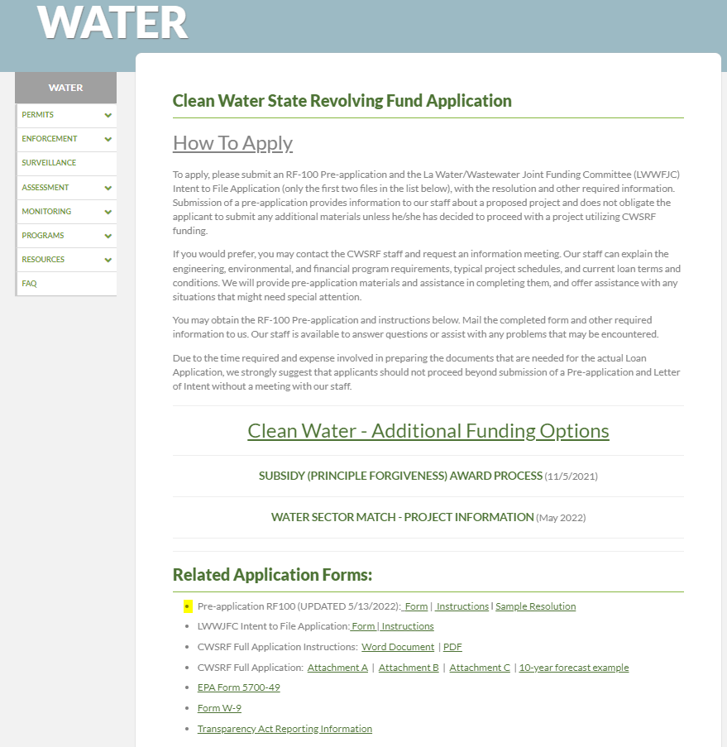
CWSRF Applications

Slide 23
CWSRF Pre-application
https://deq.louisiana.gov/page/clean-water-state-revolving-fund-application

Slide 24
Applied – Now What?
www.deq.louisiana.gov/cwsrf
Pre-application Evaluated / Scored
Project is placed on Priority List

Slide 25
Application Evaluation
Disadvantaged/Affordability Criteria
Median Household Income (MHI) < State Average MHI
Unemployment > State Average
Population Growth < State Average
(two year period)
Scoring
Population
Waterbody Impairment
(Designated Use & Degree of Support)
Treatment Type & Age
Collection Age (i.e. project area)
Level of Treatment

Slide 26
Funding Commitment
Projects selected for funding
Commitment meeting
Applicant must complete pre-construction requirements
Must close loan within 1 year of commitment

Slide 27
Loan Closing
Technical
Environmental Complete
Engineering Contract
Plans & Specs Submitted
Financial
Bond Commission Approval
Local Funding Ordinance (if necessary)
Financial Approval
1st Payment Request Received

Slide 28
Questions

Slide 29
Scott J. Templet, P.E. LDEQ, CWSRF (225) 219-3463 Scott.Templet@La.Gov
www.deq.louisiana.gov/CWSRF

