Slide 1
Mercury for Local Governments
Chris Piehler, John Rogers
LDEQ Staff
Notes:
. What is mercury?
Mercury is a naturally occurring metal which has several forms. The metallic mercury is a shiny, silver-white, odorless liquid. If heated, it is a colorless, odorless gas.
Mercury combines with other elements, such as chlorine, sulfur, or oxygen, to form inorganic mercury compounds or “salts,” which are usually white powders or crystals. Mercury also combines with carbon to make organic mercury compounds. The most common one, methylmercury, is produced mainly by microscopic organisms in the water and soil. More mercury in the environment can increase the amounts of methylmercury that these small organisms make. Metallic mercury is used to produce chlorine gas and caustic soda, and is also used in thermometers, dental fillings, and batteries. Mercury salts are sometimes used in skin lightening

Slide 2

Acknowledgement
This program has been made possible by a generous grant from the Environmental Protection Agency’s Persistent, Bioaccumulative, and Toxic Pollutants (PBT) Program.
Region VI staff: Ruben R. Casso, PBT/Toxics Coordinator, Donna Cooper, Project Manager

Slide 3
What is mercury
Naturally occurring
Metallic mercury is a shiny, silver-white, odorless liquid
If heated, it is a colorless, odorless gas.
Notes:
Mercury is a basic chemical element of which there is a fixed amount on earth It is an element that does not break down
It is a heavy, silvery-white liquid that vaporizes quickly at ambient temperatures It exists in three states: Organic (methylmercury), elemental and mercury salt Most mercury occurring in the atmosphere is in the form of elemental vapor
Most mercury in water, soil, sediments or biota is in the form of inorganic salts or organic (methylmercury) forms

Slide 4
Mercury combines with other elements
Notes:
Human Health Effects and Ecological Impacts of Mercury
Exposure of the general public to mercury's toxic effects occurs primarily by the ingestion of fish that have been contaminated with mercury. Approximately 95% of the mercury found in fish is in the form of methylmercury, a neurotoxin and a particularly toxic form of mercury. Because methylmercury is a neurotoxin (particularly toxic to the developing nervous system), unborn fetuses and young children are especially susceptible to mercury's toxic effects

Slide 5
Mercury is pervasive
Naturally occurring
Garbage and coal combustion
Industrial processes
In products
Notes:
The natural release and cycling of geologically bound mercury
1/3 of total mercury in the atmosphere
Volcanoes
Forest Fires
Decomposition of soil
Erosion of rock
Oceans
Anthropogenic releases
2/3 of total mercury in the environment
Combustion (Coal, oil, wood, natural gas)
Incineration
Mining of gold and mercury
Alkali and metal processing
The re-emission of mercury to the atmosphere from that deposited to earth’s surface in the past by the other two sources

Slide 6
Mercury is in the home
Thermostats 46.7%
Dental Amalgams 21.0%
Light Switches 14.1%
Auto switches 4.7%
Thermometers 4.7%
Appliances switches 2.4%
Batteries 0.6%
Fluorescent Lights 0.5%

Slide 7
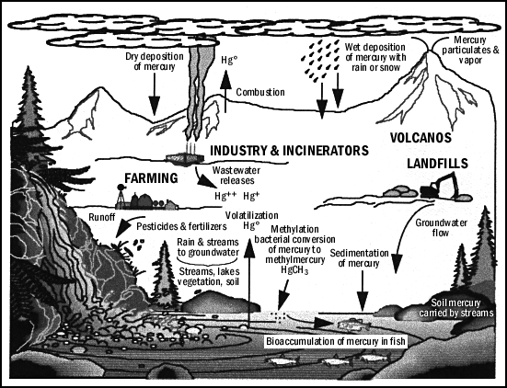
Notes:
Exposure can also occur by inhalation of or bodily contact with elemental mercury from a broken product (e.g., mercury fever thermometer) or from a manufacturing process. In these cases, mercury can be in its elemental form or combined with an inorganic element or compound.

Slide 8
Health Effects
Inorganic and Elemental Mercury
Renal toxicity
Skeletal muscle degeneration
Gastrointestinal irritation
Pulmonary edema - fluid in the lungs
Elevated blood pressure
Low grade/intermittent fevers
Flushing of palms and soles
Notes:
Health Effects
Inorganic and Elemental Mercury
Renal toxicity
Skeletal muscle degeneration
Gastrointestinal irritation
Pulmonary edema - fluid in the lungs
Elevated blood pressure
Low grade/intermittent fevers
Flushing of palms and soles

Slide 9
Health Effects
Methylmercury
Neonatal brain damage
Nephritis - inflammation of the kidney
Paresthesia - tingling skin sensation
Muscle fasciculation - twitching muscles
Abnormal heart rhythms
Chromosomal aberrations
Dermatitis - skin inflammation
Notes:
Health Effects
Methylmercury
Neonatal brain damage
Nephritis - inflammation of the kidney
Paresthesia - tingling skin sensation
Muscle fasciculation - twitching muscles
Abnormal heart rhythms
Chromosomal aberrations
Dermatitis - skin inflammation

Slide 10
The Agency for Toxic Substances and Disease Registry & the Environmental Protection Agency
Issued a Warning About Continuing Patterns of Metallic Mercury Exposure!

Slide 11

Notes:
Why were Hatters MAD ?
In Alice in Wonderland (1865), Lewis Carroll selected a hat maker as the demented host for the tea party. Hatters of the time commonly exhibited slurred speech, tremors, irritability, shyness, depression and other neurological symptoms; hence the expression "mad as a hatter". Carroll was probably unaware that the hatter's disabilities were symptoms of mercury poisoning. In the mid-1800s hat makers used hot solutions of mercuric nitrate to shape wool felt hats. They typically worked in poorly ventilated rooms leading to chronic occupational exposure to mercury and neurological damage that followed.

Slide 12
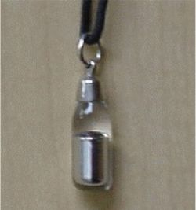
Context of Poisoning
There is a continuing pattern of metallic mercury exposure in:
1.children and teenagers,
2.persons using certain folk medicines, or
3 participating in certain ethnic or religious practices

Slide 13
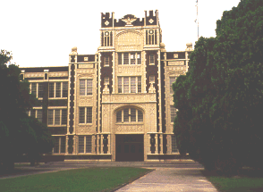
Children and teenagers
Increasing numbers of metallic mercury spills and contamination involving schoolchildren have been reported:
  Florida Atlantic University in Boca Raton, Florida
  A middle school in St. Joseph, Missouri
  A high school in Oskaloosa, Kansas
  A convalescent home in Johnson County, Kansas,;
  A high school and a home in Dallas, TX
  Wilkes-Barre. Montgomery County, Pennsylvania.
Notes:
In August 1994, more than 500 students in Belle Glade, Florida, were contaminated with metallic mercury after three children found 4 jars (totaling 55 pounds) of metallic-mercury in an abandoned van. The local hazardous waste materials team decontaminated the children (removed contaminated clothing and washed the metallic mercury from their skin). More than 20 families had to be evacuated while their homes were decontaminated.
In November 1994, college students at Florida Atlantic University in Boca Raton, Florida, removed metallic mercury from one of the school's laboratories. Students living in the dormitory were evacuated and housed in a local hotel while the dormitory was decontaminated.
In June 1996, metallic mercury was taken from a middle school in St. Joseph, Missouri, and used in and outside of school by a group of teenagers. Approximately 200 children were tested for mercury exposure; one child was hospitalized and another five underwent outpatient treatment to remove the mercury from their systems; 20 other children had mildly elevated mercury levels. Two homes and a car required extensive decontamination.
In October 1996, a high school in Oskaloosa, Kansas and a convalescent home in Johnson County, Kansas, were contaminated with metallic mercury; 52 students and an unknown number of residents of the home were tested. On the basis of ATSDR recommendations, the school was closed for a week until indoor air levels were safe. A month later, sampling at the school identified an increase in air mercury concentrations. The school was re-evaluated and additional clean-up was done as recommended by ATSDR.
In November 1996, ATSDR again assisted state health officials and EPA in evaluating contamination at a high school and a home in Dallas, Pennsylvania, near Wilkes-Barre. Four areas in the school had levels of metallic mercury contamination that required cleanup.
In March 1997, a middle school student on his way to school found metallic mercury on the street in front of his home in Montgomery County, Pennsylvania. The student took the metallic mercury to school and shared it with three to four classmates. Also, in March 1997 a broken mercury thermometer was discovered after school on the floor of a bathroom stall in the boys bathroom. One thermometer was confirmed missing from the science department's inventory. The school was found to be clear of contamination with the exception of one science laboratory and the carpet in a classroom. Two homes required decontamination.
Incidents involving religious practices
Persons who use metallic mercury in ethnic folk medicine and for religious practices are at risk. Metallic mercury is sold under the name "azogue" in stores (sometimes called botanicas), which specialize in religious items used in Esperitismo (a spiritual belief system native to Puerto Rico), Santeria (a Cuban-based religion that venerates both African deities and Catholic saints), and voodoo.
The use of azogue in religious practices is recommended in some Hispanic communities by family members, spiritualists, card readers, and santeros. Typically, azogue is carried on one's person in a sealed pouch prepared by a spiritual leader or sprinkled in the home or automobile. Some botanica owners suggest mixing it in bath water or perfume and placing it in devotional candles.

Slide 14
LDEQ/LDHH Fish Consumption Advisory Areas for Mercury
Louisiana Water Bodies

Slide 15
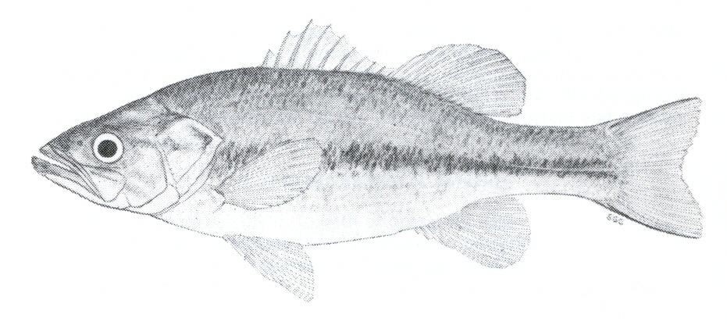
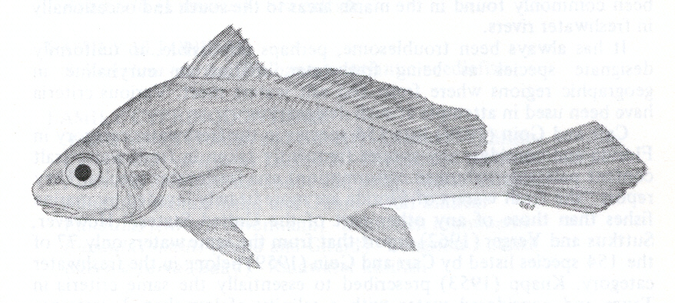
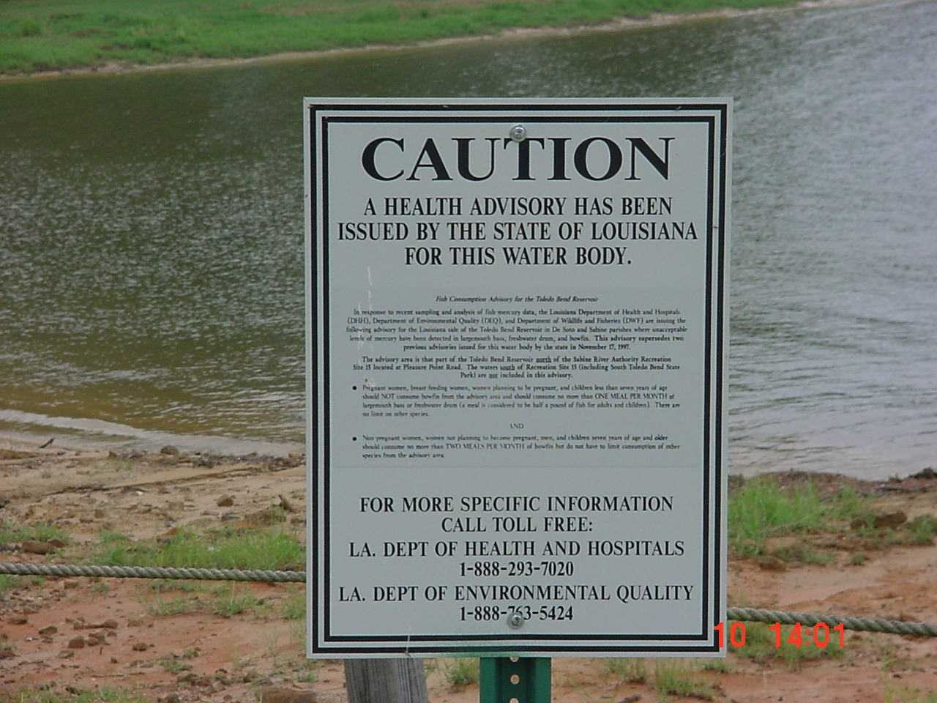
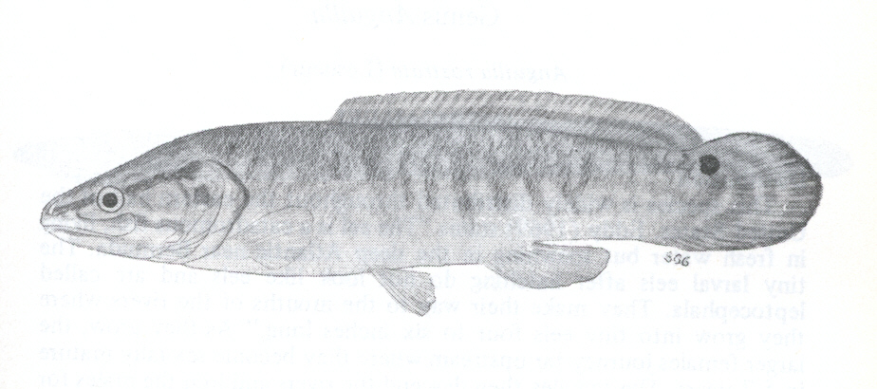
The LDEQ Mercury Program

Slide 16
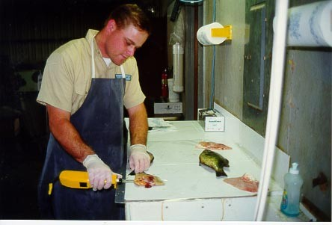
Mercury Program Components
Sampling – biota, water, sediment
Data Management
Risk Assessment
Risk Communication
Recycling
Remediation
Pollution Control
Research

Slide 17
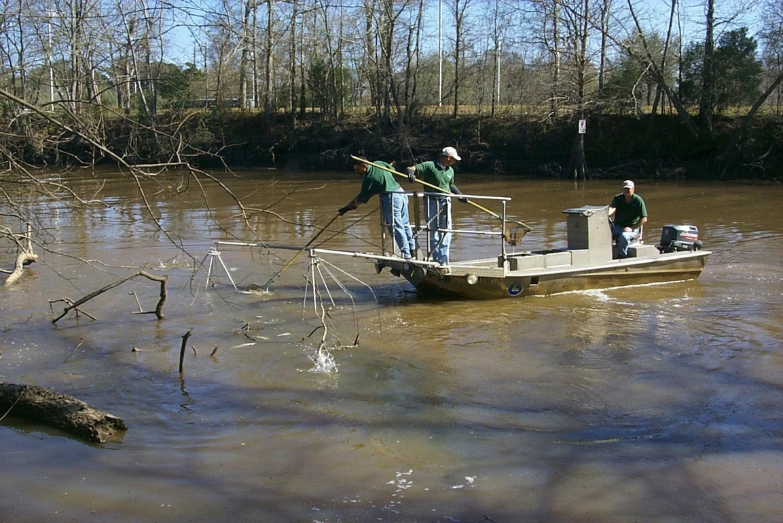

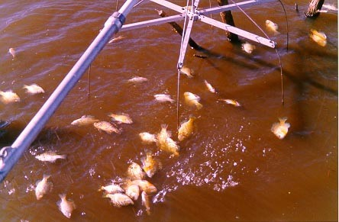
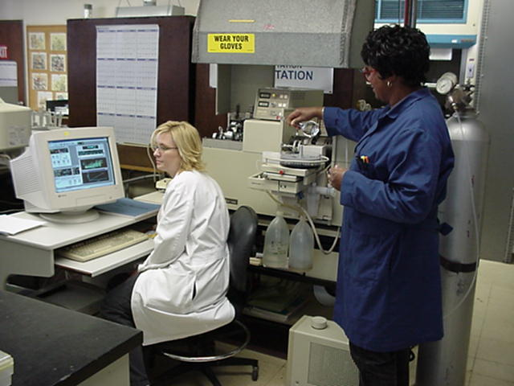

Slide 18
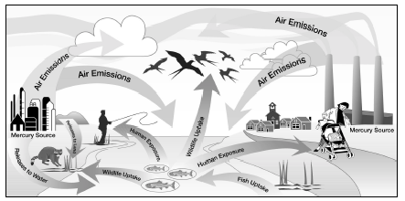
Mercury Cycle

Slide 19
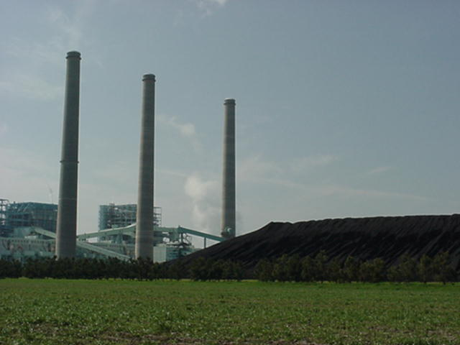
Mercury is pervasive
One-half occurring due to natural processes (~0.5ppm in earth’s crust)
Garbage and coal combustion
Industrial processes
Household products

Slide 21
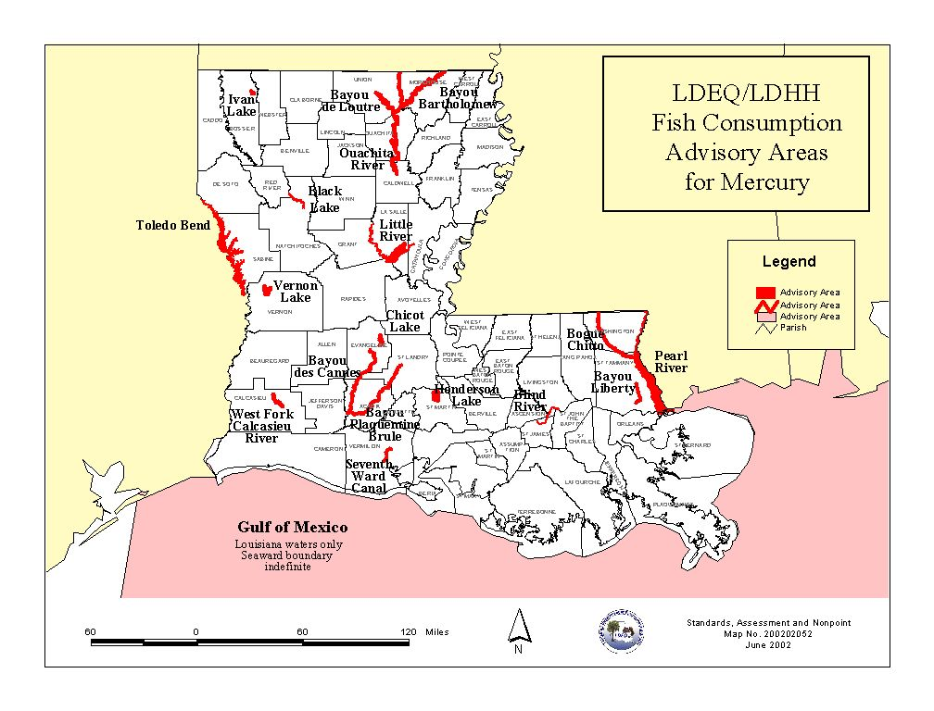
Fish Consumption Advisories due to Methyl Mercury

Slide 24
Statewide Mercury Sweep
A voluntary statewide collection program.
Universities & colleges, medical facilities, laboratories, maintenance facilities
Auto salvage yard operators
A voluntary dental mercury reduction program
Notes:
A voluntary statewide collection program aimed at local schools, public entities and homeowners. Only elemental mercury is targeted.
A voluntary program for Universities & Colleges, Medical Facilities, Laboratories, Maintenance Facilities to identify, properly handle, and eventually replace with a non-mercury device. Devices , such as, Manometers, Pumps/Valves/Gauges, Switches, Thermometers, Thermostats.
Develop a Best Management Practice Manual for Auto Salvage Yard Operators designed to keep mercury out of steel recycling facilities.
Dialogue with the Louisiana Dental Association on a voluntary Dental Mercury Reduction Program

Slide 25
Focus on Hospitals & Schools
Fever thermometers
Laboratory thermometers
Sphygmomanometers
Gastroenterology instruments (Cantor and Miller Abbot tubes)
Non-clinical barometers, repair kits, switches.
Other (thermostats, manometers, lamps)

Slide 26
Eight Local Government Projects
Make mercury a priority
Identify sources
Choose a specific sector
Enact protective laws
Capitalize on existing programs
Publicize
Properly collect, handle and recycle
Utilize existing resources
Notes:
Two recent independent studies10, 11 have found
significant accuracy problems associated with
mercury thermometers:
• 25% of new mercury thermometers were
inaccurate by at least ± 0.2 degrees C
• 28% of mercury thermometers were inaccurate
by at least ± 0.1 degree C
[The ASTM standard for glass/mercury medical
thermometers specifies a maximum allowable
error of ± 0.1 C in the cited range.]
Leick-Rude, M.K. and Bloom, L.F. 1998. A Comparison of Temperature-Taking Methods in Neonates. Neonatal Network. Volume 17. Number 5. Pages 21-37.
11 Mayfield, S. R. et al. 1984. Temperature Measurements in Term and Preterm Neonates. Journal of Pediatrics. Volume 104. Number 2. Pages 271-275 as cited in Leick-Rude,
M.K. and Bloom, L.F. 1998.

Slide 27
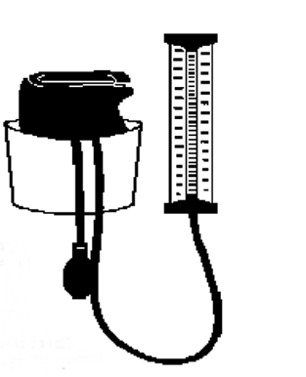
Make Mercury a Priority
You’re the first line of information
Mercury is toxic
Exposure typically though fumes or fish
Implement a municipal purchasing policy that chooses non-mercury products
over those that contain mercury
Notes:
Mercury is toxic. It affects the brain, liver and kidneys and can cause developmental disorders in
children. Young children and developing fetuses are especially at risk. Exposure most commonly occurs by eating fish
contaminated with mercury or by breathing mercury fumes. One pound (approximately two tablespoons) of mercury is
enough to contaminate almost two million pounds of fish.
One broken thermometer, if not properly cleaned up, can lead to indoor air mercury levels that exceed guidelines for safety from the U. S.
Saltwater fish impacted are swordfish, king mackerel, tuna.
DHH has also issued fish consumption advisories for the general public on many water bodies in the state.

Slide 28
Goals
Continual reduction in the use and release of anthropogenic (man-made) mercury in Louisiana
Minimize human exposure to mercury though better mercury collection, disposal, and management options

Slide 29
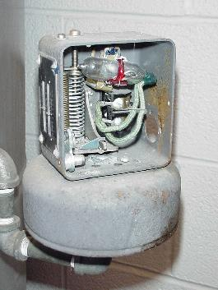
Identify Sources of Mercury In Your Community
Familiarize yourself with the items that contain mercury
Perform an audit of mercury device in municipal buildings
Largest waste contributors are:
  Fluorescent lamps
  Mercury fever thermometers
  Hg thermostats and switches
Notes:
Mercury is found in a variety of consumer products
and building equipment. Familiarize yourself with
the items that contain mercury. Common examples
include: mercury blood pressure devices, mercury
thermometers, mercury thermostat probes and flame
sensors in appliances, mercury thermostats, mercury
barometers, mercury manometers,
mercury switches (e.g., in some
fire alarms, sump pumps, water
heaters), fluorescent and high
intensity discharge lamps (commonly
used in gymnasiums and
parking lots), button cell batteries,
elemental mercury, dental amalgam,
and some chemistry sets.
Some pharmaceuticals, detergents
and disinfectants may contain
mercury compounds.
Project Idea – Perform an inventory
of mercury materials in municipal
buildings and implement a plan for
proper handling and recycling
once these materials become waste.
The largest contributors of mercury
in the municipal solid waste stream
are as follows:
• fluorescent lights
• mercury fever thermometers
• mercury thermostats and switches
Some common places where
significant quantities of these materials are found
include the following:
• manufacturing facilities
• schools
• municipal buildings
• households
• health care and long-term care facilities
• plumbing and electrical supply stores
• educational institutions and laboratories
• dental offices

Slide 30
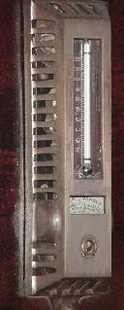
Choose a Specific Sector
Volume of Hg is overwhelming
Work with one sector, then move to the next
Option: work on a target mercury containing product
Notes:
Because it is so pervasive, addressing the mercury
issue can be overwhelming at first.
Start by working with one sector, such as hospitals
and clinics, dentists, schools or scrap metal recyclers.
Partner with these organizations to identify, collect
and recycle mercury products and replace them with
non-mercury alternatives.
Alternatively, start your program by focusing on one
product, such as fluorescent lights, mercury fever
thermometers or mercury thermostats.
Project Idea (sector approach) - Work with your
schools. Almost all schools have mercury materials.
A recent mercury inventory in a Massachusetts high
school uncovered nearly forty pounds of elemental
mercury, mercury-containing lab thermometers,
barometers, molecular vibration tubes, and various
mercury compounds. The school was already recycling
their fluorescent bulbs. The nurse’s office and
maintenance areas may also have mercury devices.
See http://www.newmoa.org/prevention/mercury/
schools/checklist.cfm for a list of many possible
mercury devices found in schools.
Project Idea (sector approach) – Franklin County
Solid Waste Management District worked on a project
to identify and remove mercury switches and
thermostat probes from white goods prior to recycling
(http://www.epa.gov/region5/air/mercury/
appliancereport.html). This prevents the mercury
from being released to the environment during
recycling.
Project Idea (product approach) - Work with local
heating and plumbing contractors to collect and
recycle mercury thermostats. The Thermostat
Recycling Corporation (TRC) has a free take-back
program for the customers of participating wholesalers
(not households). Check their website to see if any
of your local wholesalers are participating in the
program (http://www.nema.org/index_nema.cfm/
664/). If they are, they may need some assistance
promoting the program and if they aren’t, convince
them to join in!
Project Idea (product approach) – Organize
mercury product collections for local businesses, for
example, fluorescent lights. The municipality can
arrange for the time, location, drop-off and pick up,
and the businesses can pay a fee based on how many
items they bring. The Burlington Board of Health has
arranged such a program (http://208.58.133.9/
health/Mercury.

Slide 31
Enact Protective Laws
Focus on children
Focus on prevention
Use existing laws
Notes:
Some communities have found it useful to enact
local bylaws in order to reduce mercury pollution.
Example: Since January 1998, the Burlington Board
of Health has required that all local businesses
develop a written policy outlining how they will
manage their universal waste. In addition, prior to
initiating any site renovation or demolition, a property
owner must indicate in their re-development proposal
how they will properly handle mercury materials, in
addition to other hazardous components.

Slide 32
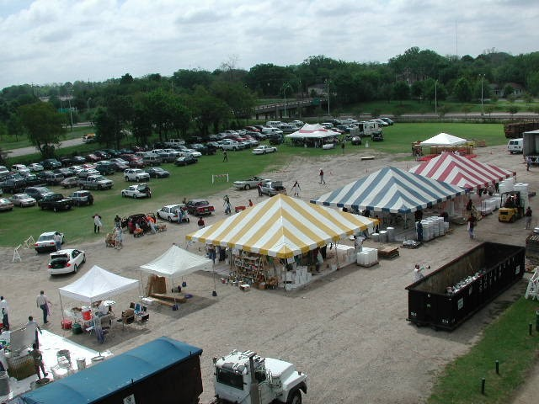
Capitalize on Existing Programs
Add mercury devices to your next HHMD
Encourage pharmacies
To accept mercury fever thermometers
Organize your own mercury fever thermometer collection

Slide 33
Conduct a mercury inventory
Utilize your materials management staff
Computerize the inventory by location
Mercury inventory tools are widely available on internet. We have included an Excel inventory tool* on the mercury CD for Louisiana Hospitals along with EPA’s Mercury in Hospitals, and this presentation.
* California Department of Health Services, Medical Waste Management Program

Slide 34
Where is mercury found in hospitals?
Sphygmomanometers and Gastroenterology instruments instruments can be as high as 90% of the elemental mercury
Notes:
Fixatives and Stains 0.04%
Gastroenterology 42.30%
Barostats 0.04%
Sphys 46.50%
x-ray tubes 0.06%
Non-clinincal 8.17%
Thermometers 0.66%
Engineering 1.43%
Fluorescent 0.07%
Switches 0.12%

Slide 35
Evaluate Alternatives
Context of your hospitals operations
  Performance comparisons
  Purchase cost
  Offsets for lower handling, disposal, maintenance
Notes:
A study 12 of 444 mercury sphygs found:
• 55% showed zero level between
10 and 20 mm Hg
• 38% had dirty columns that
obscured readings
• 20% of the columns were not vertical
• 5% had blocked air filters
• 3 units had visible mercury
droplets outside the mercury tube
N.K. Markandu, F. Whitcher; A. Arnold and C. Carney. “The Mercury Sphygmomanometer Should Be abandoned Before it is Proscribed.” Journal of Human Hypertension.
Volume 14, pages 31 through 36. 2000.

Slide 36
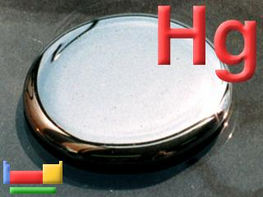
Institute Best Management Practices
Educate staff on hazards, handling and recovery
Eliminate mercury equipment and products
Establish and monitor mercury-free purchasing

Slide 37

Measure Success
Use your inventory to chart your progress
Identify your successes
Communicate your successes to your staff

Slide 38
Keep the Mercury Out
Purchasing agents to act as gatekeepers
Require vendors disclose mercury content
Develop a mercury free purchasing policy
Notes:
Copies on the disk

Slide 39

Mercury Spills
Decide on your policy
  Specify amount of spill to evacuate. In all cases evacuate children, infirmed, and pregnant women.
  Allow small spill cleanup by trained staff person
  Call in a spill team
Put it in writing

Slide 40
Contacts
Enforcement – Chris Piehler
  225.219.3609
  chris.piehler@la.gov
Recycling – John Rogers
  225.219.3266
  800.305.6621
  john.rogers@la.gov

Slide 41
Websites
DEQ www.deq.louisiana.gov
EPA www.epa.gov/pbt
Sustainable Hospitals www.sustainablehospitals.org
Hospitals for a Healthy Environment http://www.h2e-online.org/
Health Care Without Harm http://www.noharm.org
Northeast Waste Management Officials' Association http://www.newmoa.org/Newmoa/htdocs/about/AboutUs.cfm

Slide 42
Questions

