Slide 1
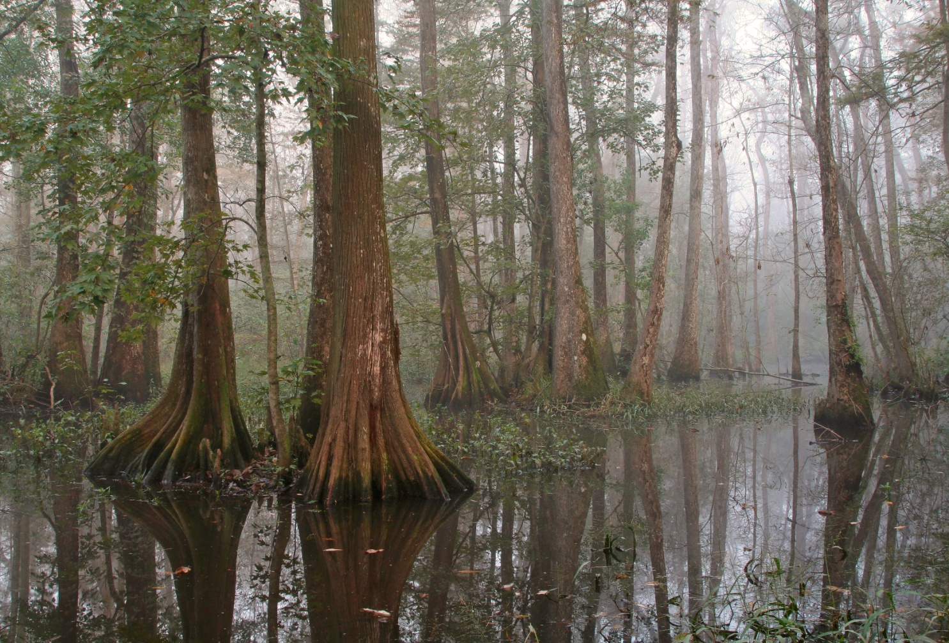
Welcome to the Annual NPS Project Review Meeting

Slide 2
APPROVED November 21, 2012
Louisiana’s Nonpoint Source Management Plan

Slide 3
40 PRIORITY WATER BODIES

Slide 4
FFY2012 Section 319 Work Plan
Eight (8) Monitoring Projects
Big Creek (Lake Pontchartrain Basin)
Bayou Queue de Tortue (Mermentau River Basin)
Grand Bayou/Little Grand Bayou (Terrebonne Basin)
Bayou Louis/Lake Louis (Ouachita River Basin)
Lake St. Joseph (Ouachita River Basin)
Bayou Lafourche (Ouachita River Basin)
Upper Bayou Terrebonne (Terrebonne Basin)
Middle Bayou Terrebonne (Terrebonne Basin)
Six Mile Creek (Calcasieu River Basin)

Slide 5
FFY2012 Section 319 Work Plan
National Water Quality Initiative (NWQI)
Big Creek
(Lake Pontchartrain Basin)
Bayou Louis & Lake Louis (Ouachita River Basin)

Slide 6
FFY2012 Section 319 Work Plan
Gulf of Mexico Initiative (GoMI)
Bayou Queue de Tortue
(Mermentau River Basin)
Grand Bayou & Little Grand Bayou
(Terrebonne Basin)

Slide 7
FFY2012 Section 319 Work Plan
Big Creek
(Lake Pontchartrain Basin)
Bayou Queue de Tortue
(Mermentau River Basin)
Bayou Louis & Lake Louis
(Ouachita River)

Slide 8
Louisiana Nutrient Management Strategy
Rick Raynie, CPRA

