Slide 1
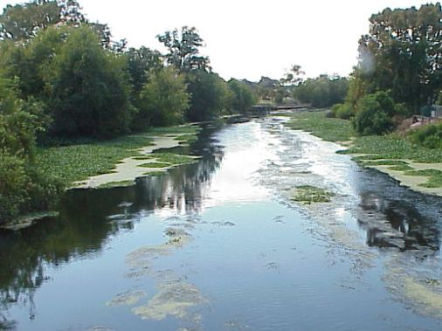


Louisiana Department of Environmental Quality
Bayou Lafourche Fecal Coliform Project
Presented by Jesse Means

Slide 2
Today’s Presentation
Fecal coliform problem
Action taken
Nicholls State University fecal coliform sampling project
Response to project findings
Future actions/possible solutions

Slide 3
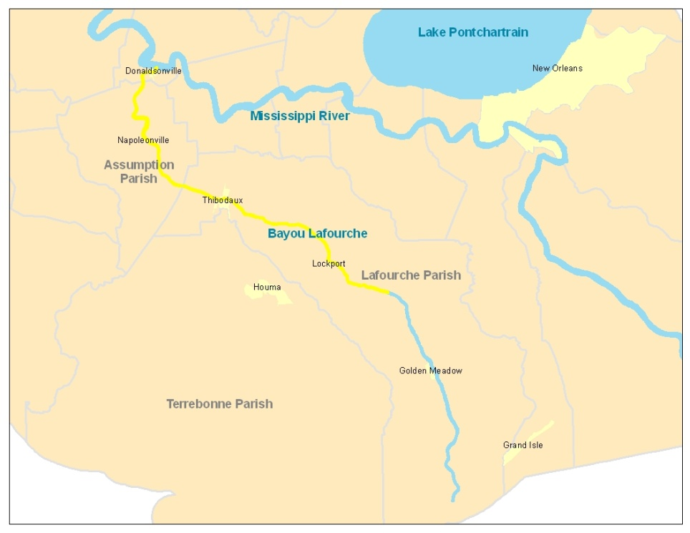
Fecal Coliform Issue
Bacteria found in warm-blooded organisms
Donaldsonville to Larose (same portion intakes use)
Consistently not meeting swimming standard for fecal coliform of 400 colonies/100 ml
Spikes in data over boating/fishing standard and the drinking water supply standard (both 2000 colonies/100 ml)
Total maximum daily pollutant load requires reduction in fecal coliform loading
Data from Mississippi River doesn’t show the same fecal coliform levels

Slide 5
Fecal Coliform Issue
What do the numbers mean?
Can indicate of the presence of sewage
Health effects
  Wide variety of illnesses including diarrhea and infections from pathogens ( bacteria, parasites, and viruses) and from algal blooms
  Pharmaceuticals
  Mostly short-term with no lasting effects, but can be violent and unpleasant
  Some long-term illnesses and deaths (especially children, elderly, and those with weakened immune systems), example: cryptosporidium – diarrhea, immunocompromised

Slide 6
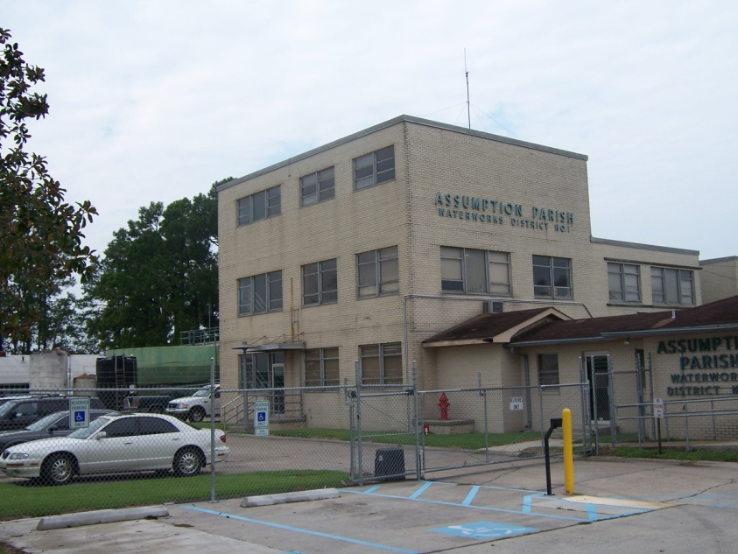
Fecal Coliform Issue
What do the numbers mean?
Potable water supply
  Water is treated by the public water systems and potable water is constantly tested to assure it is safe for consumption
  Additional treatment required
  Chlorine by-products
  Increased cost

Slide 7
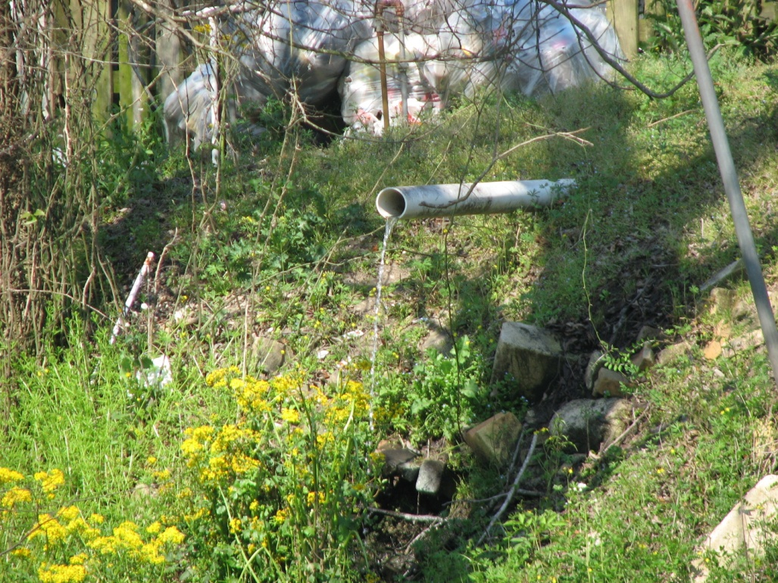
Fecal Coliform Issue
Many areas without community sewage service
Population growth in these areas

Slide 8
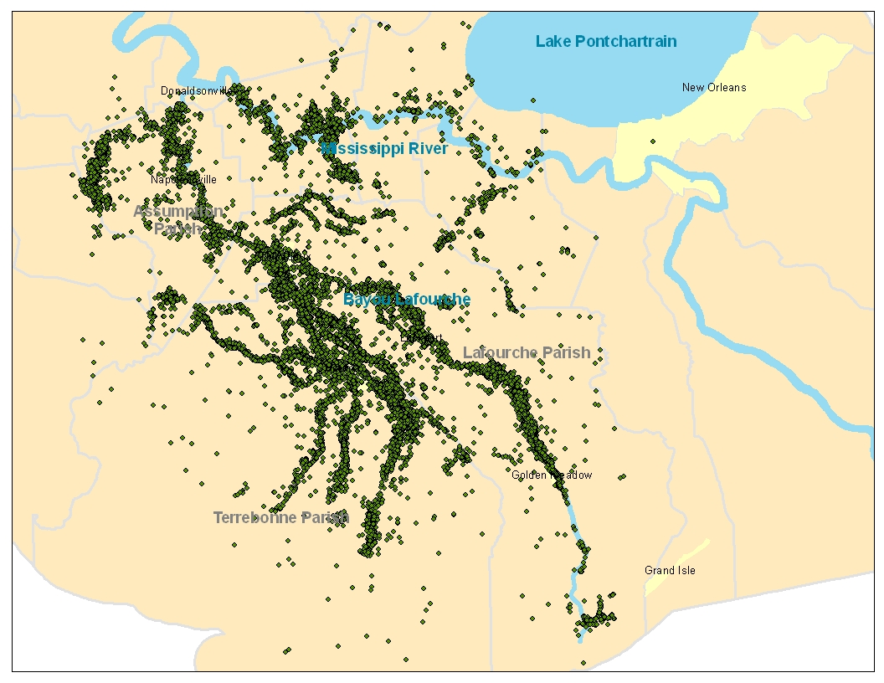
Louisiana Department of Health and Hospitals (DHH) Permitted Sewage Plants

Slide 9
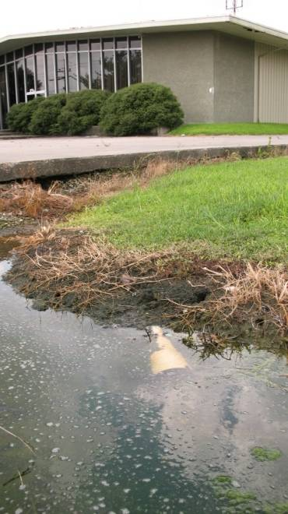
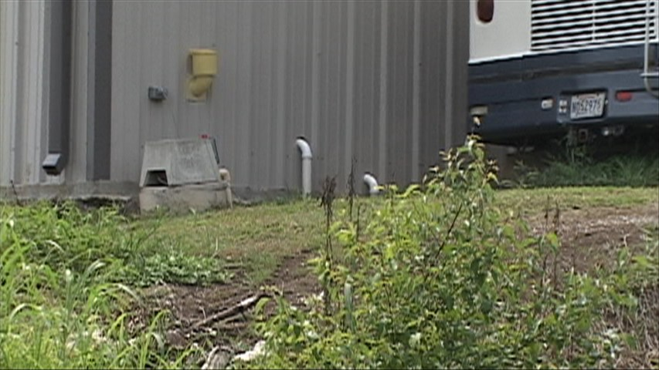
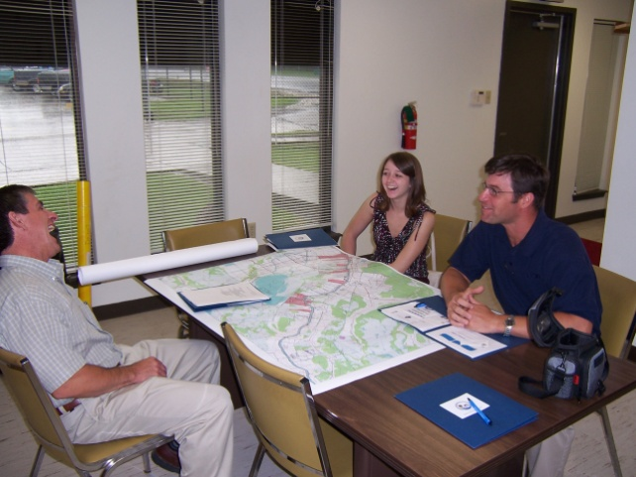
Action Taken
Sought opinions (citizens, local government, state agencies, various organizations, etc.)
  Malfunctioning individual home sewage systems
Louisiana Department of Environmental Quality (DEQ) regulatory inspections
  Multimedia inspections of 780 facilities, including sewage treatment systems (anything other than a home)
  Follow up to assure compliance

Slide 10
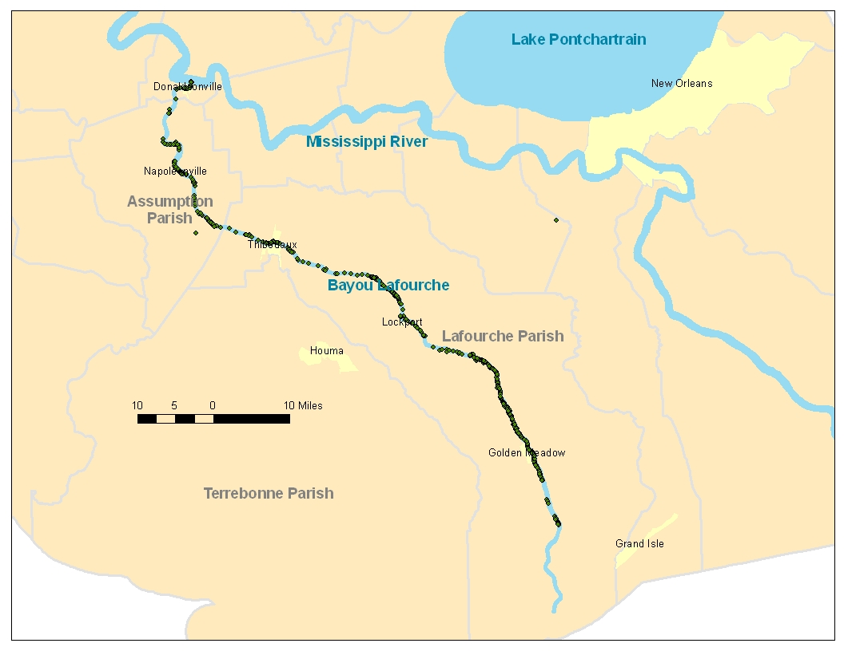
DEQ Regulatory Inspections

Slide 11
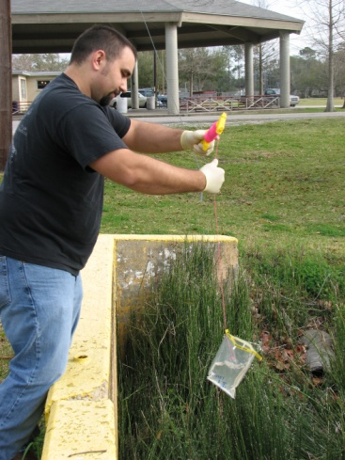
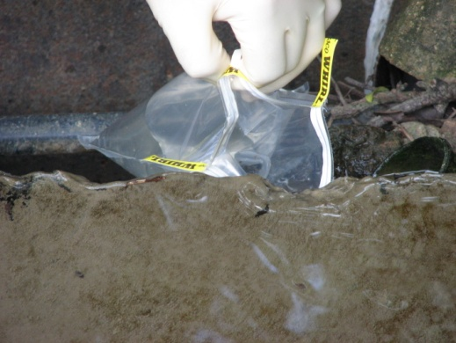
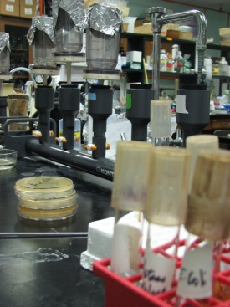
Action Taken
Nicholls State University fecal coliform studies
  Identified areas that drain to the bayou within two study areas
  Monitored conduits of this drainage in addition to sampling directly in the bayou for fecal coliform and optical brighteners on a rotating schedule
  High fecal coliform and high optical brighteners = human origin

Slide 12
Action Taken
Nicholls State University 2nd fecal coliform study – Differences from previous study
  LDEQ field staff collected samples
  Additional parameters – in-situ data, human molecular markers
    Human Papilloma Virus-BK, archaeon Methanobrevibacter smithii, and Eubacterium Human Bacteroides HF-183 bacterium
    Absence of any marker means no human input or source was too diluted for methods to detect
    Did confirm 1st study’s “hot spots” with these markers

Slide 13
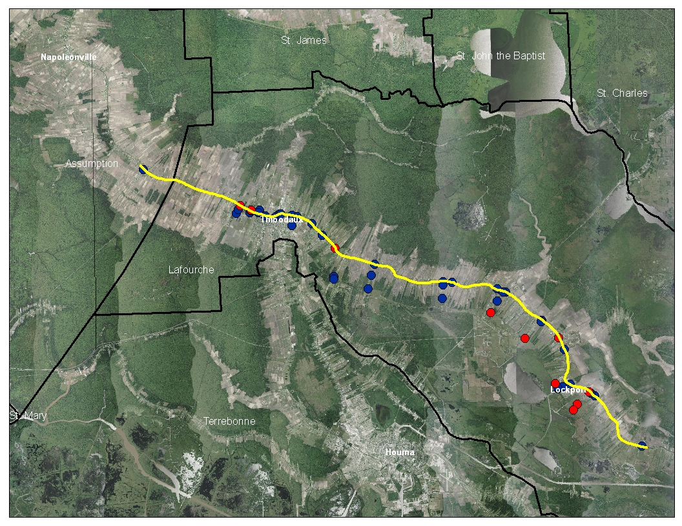
Action Taken
Nicholls State University 1st fecal coliform study
-Study area = Labadieville to below Lockport
-Dots = 54 sample locations
-Red dots = 11sample sites identified as “hot spots” that contribute sewage to the bayou

Slide 14
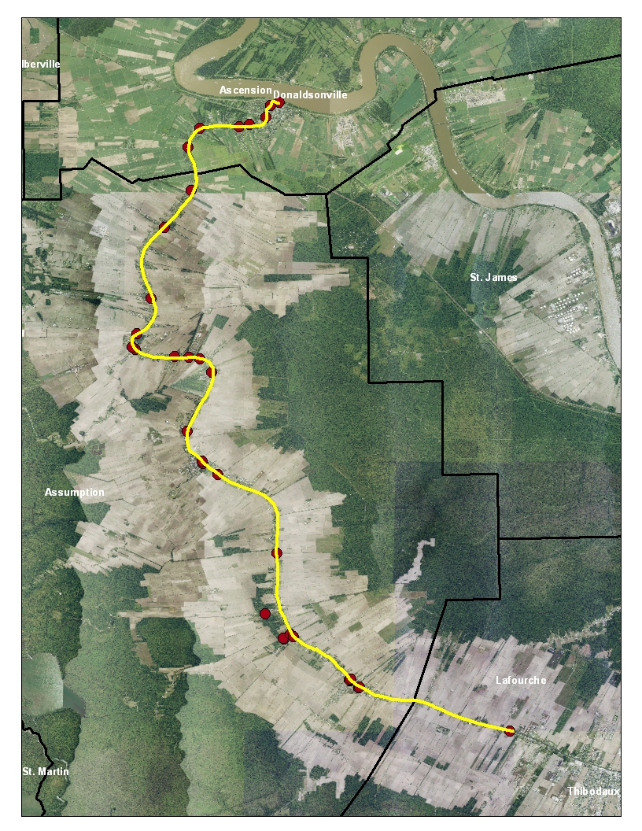
Action Taken
Nicholls State University 2nd fecal coliform study
-Study area = Donaldsonville/Miss. River to Supreme
-Dots = 34 sample locations
-13 possible hot spots

Slide 15
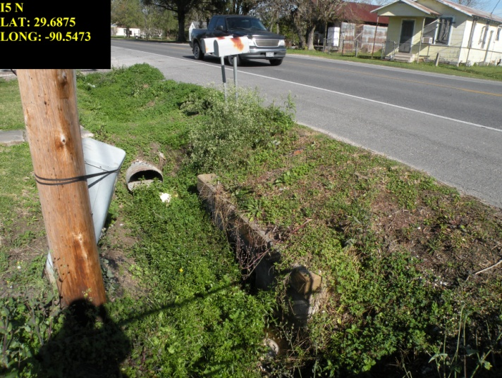
Example Hotspot
Culvert at 4926 Hwy 1, Mathews
-Three of seven samples exceeded drinking water fecal coliform standard of 2,000 colonies/100 ml (97,272 to 16,000 FC/100 ml)
-Two of seven samples exceeded swimming fecal coliform standard of 400 colonies/100 ml only (700 to 550 FC/100ml)
-All optical brightener readings for the seven samples were > 5.00 (11.18 to 6.98)
-No water in ditch for six sampling periods

Slide 16
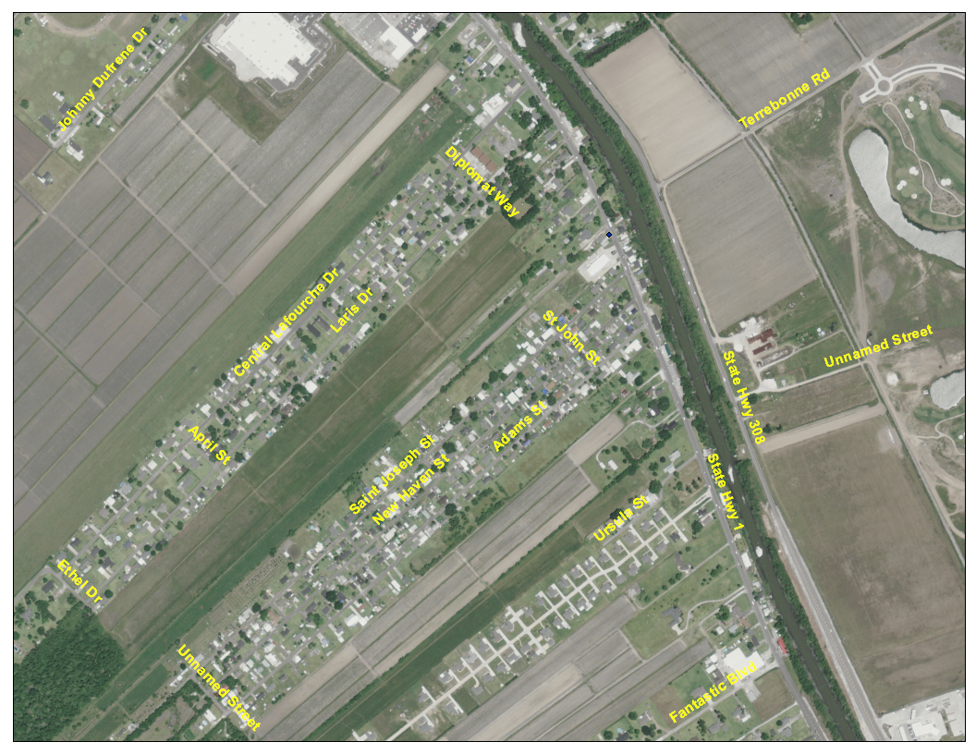
Example Hotspot
I5
Culvert at 4926 Hwy 1, Mathews
-Drainage from buildings along Hwy 1 and nearby neighborhoods flows here
-Neighborhoods have individual sewage treatment systems
-Open ditches with discharge pipes in neighborhoods and along Hwy 1 ditch
-Possible Solutions
DEQ regional office checking non-residential sewage discharges
DHH sanitary sweep
Establishment of community sewage system for neighborhoods

Slide 17
Response to Nicholls Project Findings Thus Far
Visual inspection of areas near “hot spots”
Reported findings to DHH
Reported findings to local officials/identified solutions and garnered support for future action
Looking for possible funding sources
LDEQ compliance inspections for areas that drain to hot spots/compliance follow-up with previously inspected facilities

Slide 18
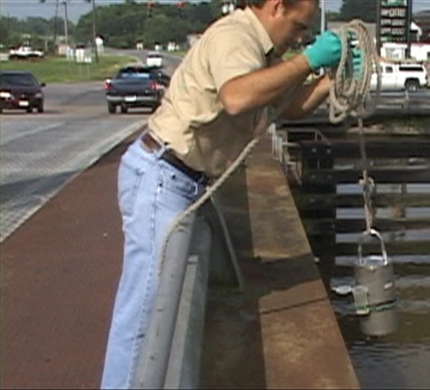
Future Actions/Possible Solutions
Further sampling
  Track routine DEQ fecal sampling
  Additional in-stream sampling to ascertain if efforts to address fecal coliform are working
Address through DEQ & DHH regulations
  Continue DEQ compliance follow up
  DHH regulations for individual homes
    May provide quicker fix but is it a long-term fix
    If a system was approved without disinfection by DHH it will still contribute fecal coliform

Slide 19
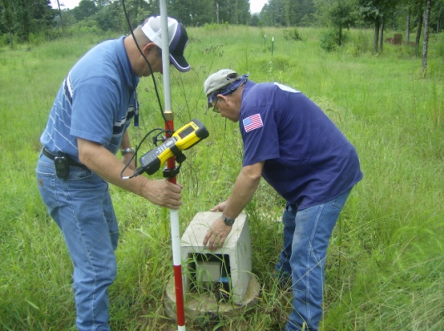
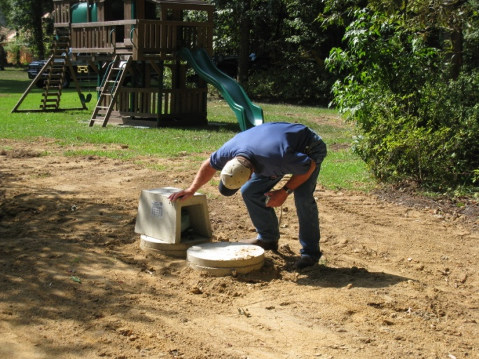
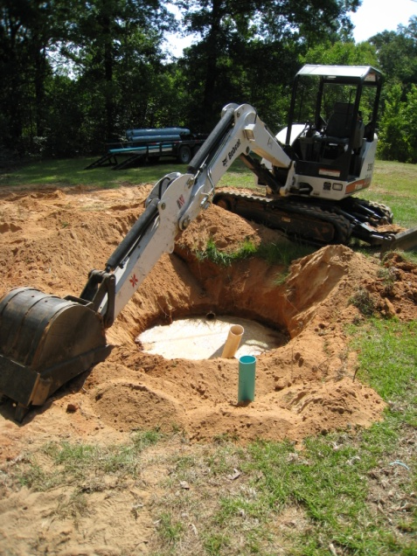
Future Actions/Possible Solutions
Local Ordinance
  Lafourche Parish Council has adopted State Sanitary Code
  Inspections/enforcement on a local level
  Must have personnel available
Project to repair/replace malfunctioning individual sewage systems
  319 funded projects
  Barataria Terrebonne National Estuary Program project

Slide 20
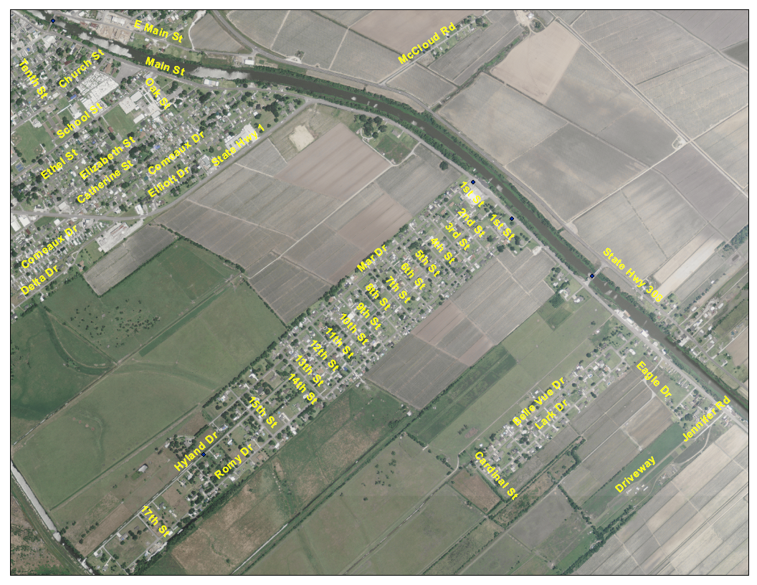
Future Actions/Possible Solutions
Community systems
  Connect unsewered communities to existing community systems or create new community systems for them

Slide 21
Future Actions/Possible Solutions
Community systems
  Would remove sewage from public drainage, improving quality of life in neighborhoods, and to a centralized treatment facility (easier target for compliance and would provide for disinfection)
  Would direct discharge from central sewage treatment facility away from Bayou Lafourche toward wetlands
    Would remove sewage from bayou
    Would remove nutrients from bayou (assisting the Gulf of Mexico)
    Would add nutrients to the wetlands, encouraging plant growth and mitigating wetlands loss
  A more final solution

Slide 22
Future Actions/Possible Solutions
Public Education
  Proper maintenance of individual sewage treatment systems
Combination of all solutions, depending on location, layout, income level, local buy-in
Funding sources
  Community development block grants
  Gulf of Mexico Program
  319 nonpoint source pollution prevention grants
Local government acceptance

Slide 23
Benefits of Action
Better environmental conditions benefitting both fish and wildlife and human health
Decreased treatment requirements, associated costs, and chlorine by-products
Removal of sewage from ditches, increasing property values and quality of life
For homes and businesses that tie on to a community-based sewage treatment system
  No more maintenance requirements.
  Monthly sewer user fee would be incurred, offset by the removal of maintenance costs for individual sewage systems.

Slide 24
Questions?
Other possible solutions?

Slide 25
Contact Information
Jesse Means
Louisiana Department of Environmental Quality
Drinking Water Protection Program
P. O. Box 4301
Baton Rouge, LA 70821
(225) 219-1827
http://www.deq.louisiana.gov/portal/PROGRAMS/DrinkingWaterProtectionProgram.aspx

