Slide 1
Water Quality Monitoring of Lake St. Joseph Watershed
Principal Investigator: Beatrix Haggard, Ph.D.
Co-Principal Investigators:
James Hendrix
Donnie Miller, Ph.D.

Slide 2
Background

Slide 3
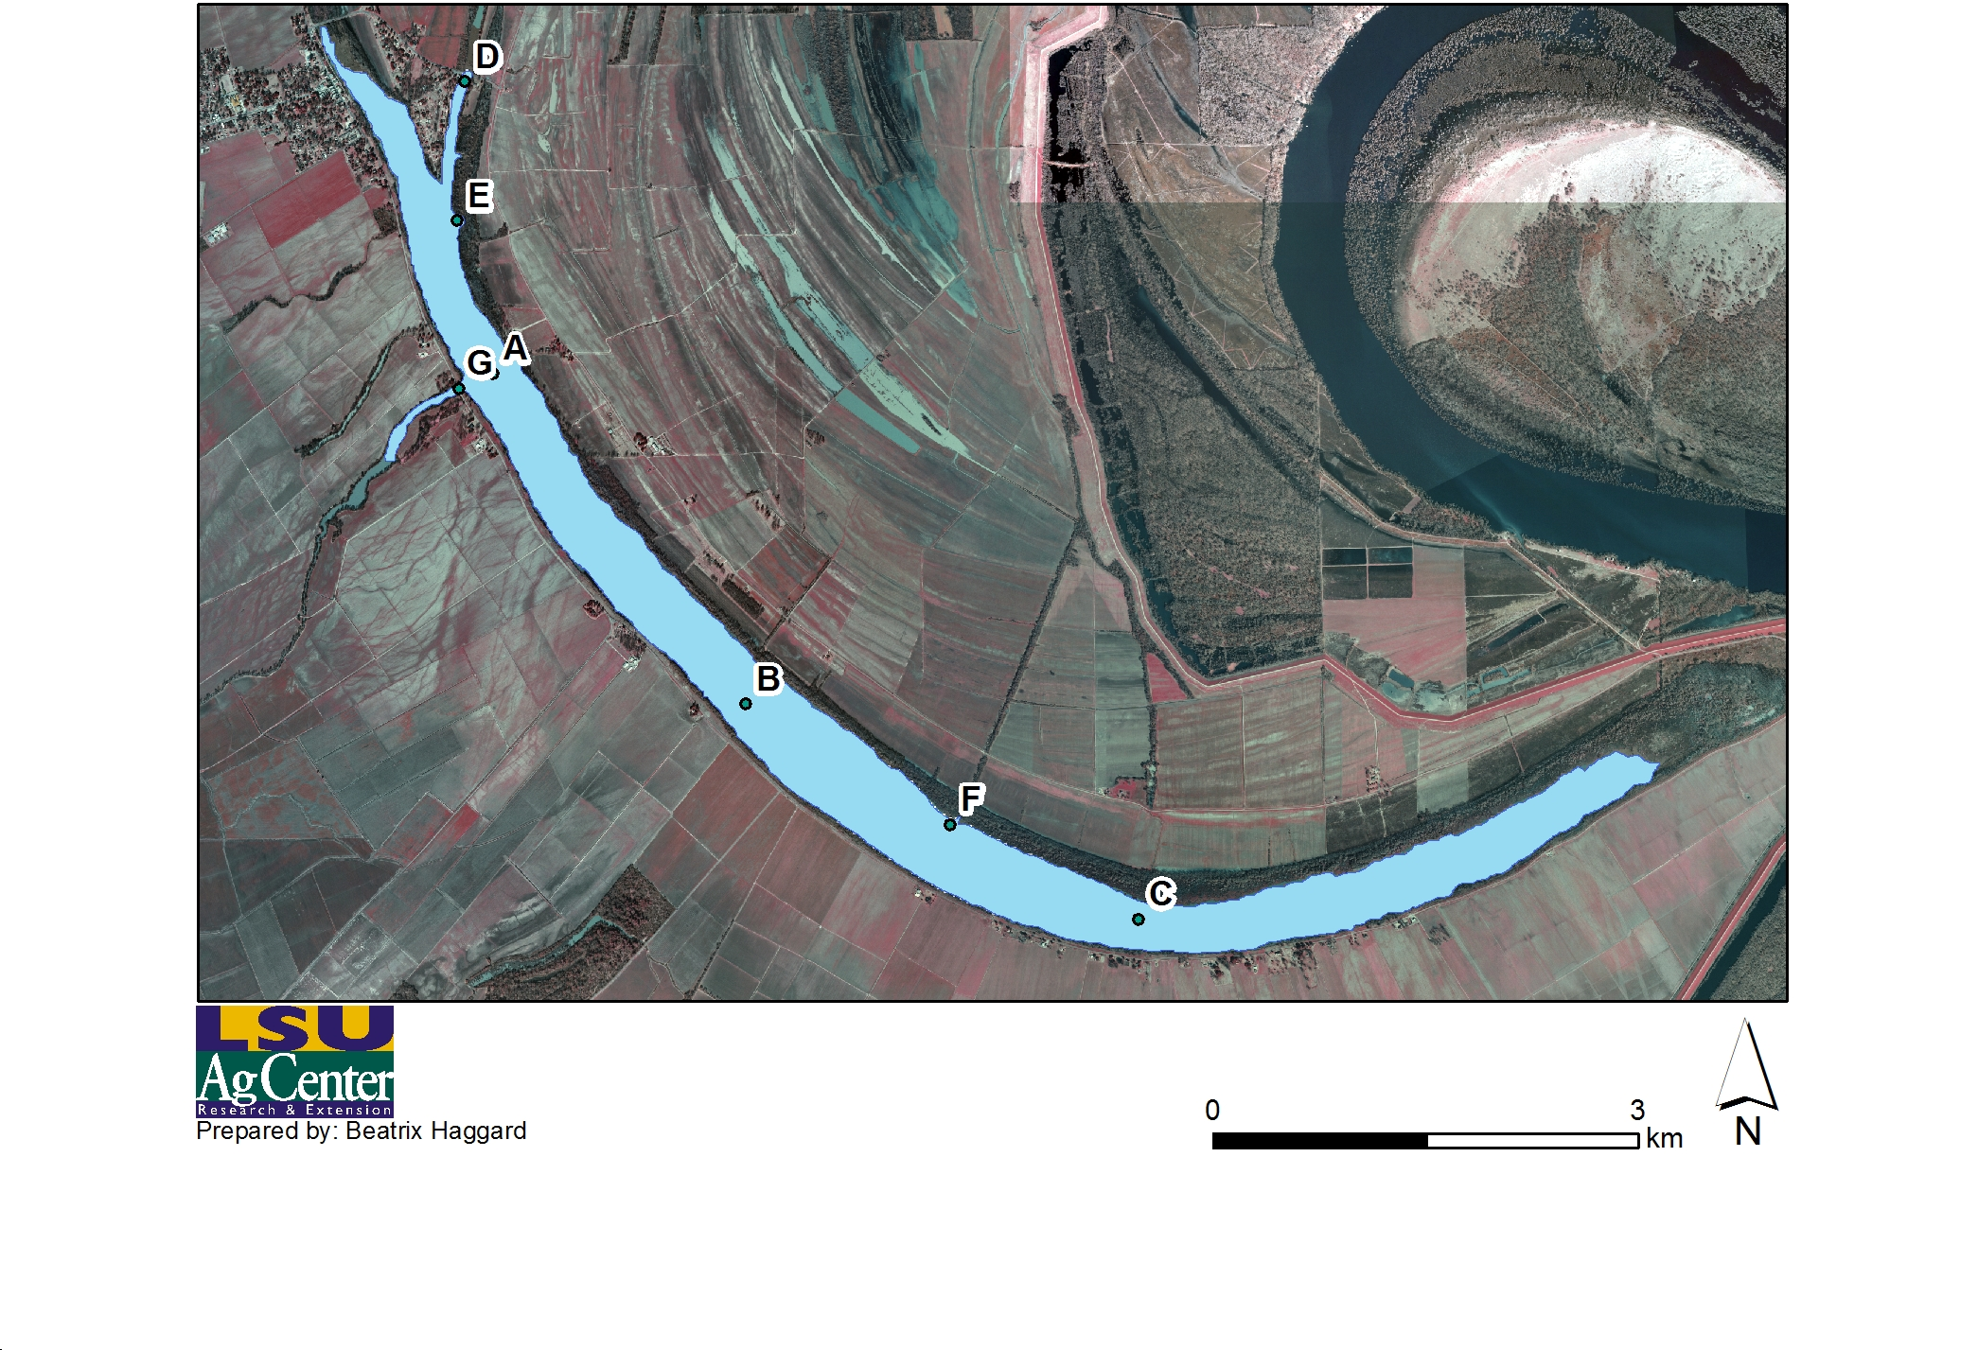
Lake St. Joseph (081202)

Slide 4
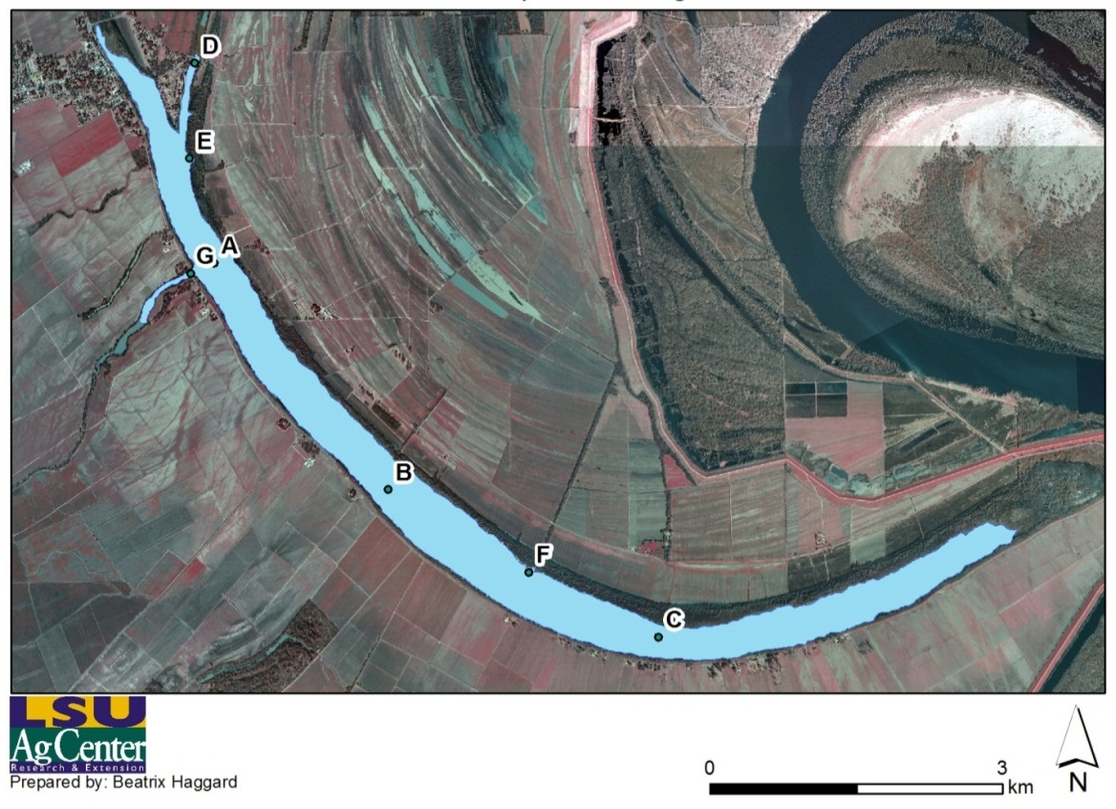
Lake St. Joseph (081202)

Slide 5
Lake St. Joseph (081202)
Listed in the 2000 303 (d) for not supporting:
Primary contact recreation
Secondary contact recreation
Propagation of fish
Impairments
Low DO
Nutrients (N and P)
Suspended solids
Pesticides

Slide 6
Objectives

Slide 7
Objectives
Monitor the water quality of Lake St. Joseph
Identify important inflow/outflow ditches that are substantial pathways of non-point source pollutants, examine likely contributing land uses, and identify rainfall events and period of the year associated with high inflow/outflow concentrations

Slide 8
Objectives
Generate updated baseline water quality data for Lake St. Joseph

Slide 9
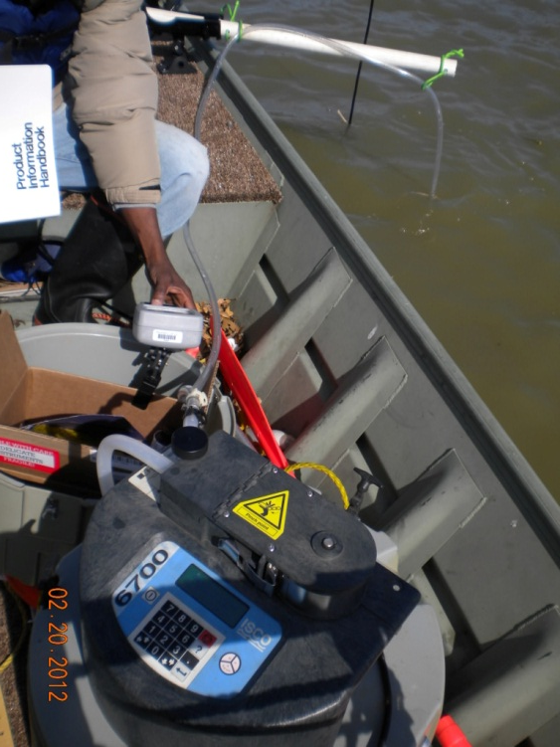
Instrumentation
Water sampling
  ISCO 6700
  YSI 556 MPS

Slide 10
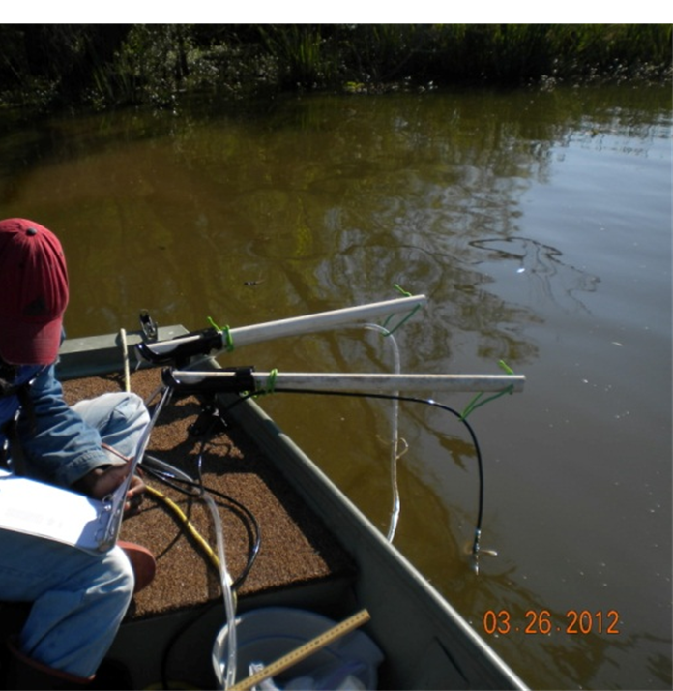
Instrumentation

Slide 11
Methods
Samples at A, B, and C
  Two depths
    Deeper portions of the lake
Samples at D, E, F, and G
  One depth
    Inflows and outflows

Slide 12
Methods

Slide 13
Objective 1
Monitor the water quality of Lake St. Joseph

Slide 14
Objective 1
Monthly monitoring began at 7 stations February 2012 (Ongoing)
Measuring
  DO
  pH
  TDS
  P
  BOD₅
  TKN
  EC
  Temperature
  TSS
  NO₃⁻
  NO₂⁻
  Turbidity

Slide 15
Objective 2
Identify important inflow/outflow ditches that are substantial pathways of non-point source pollutants, examine likely contributing land uses, and identify rainfall events and period of the year associated with high inflow/outflow concentrations

Slide 16
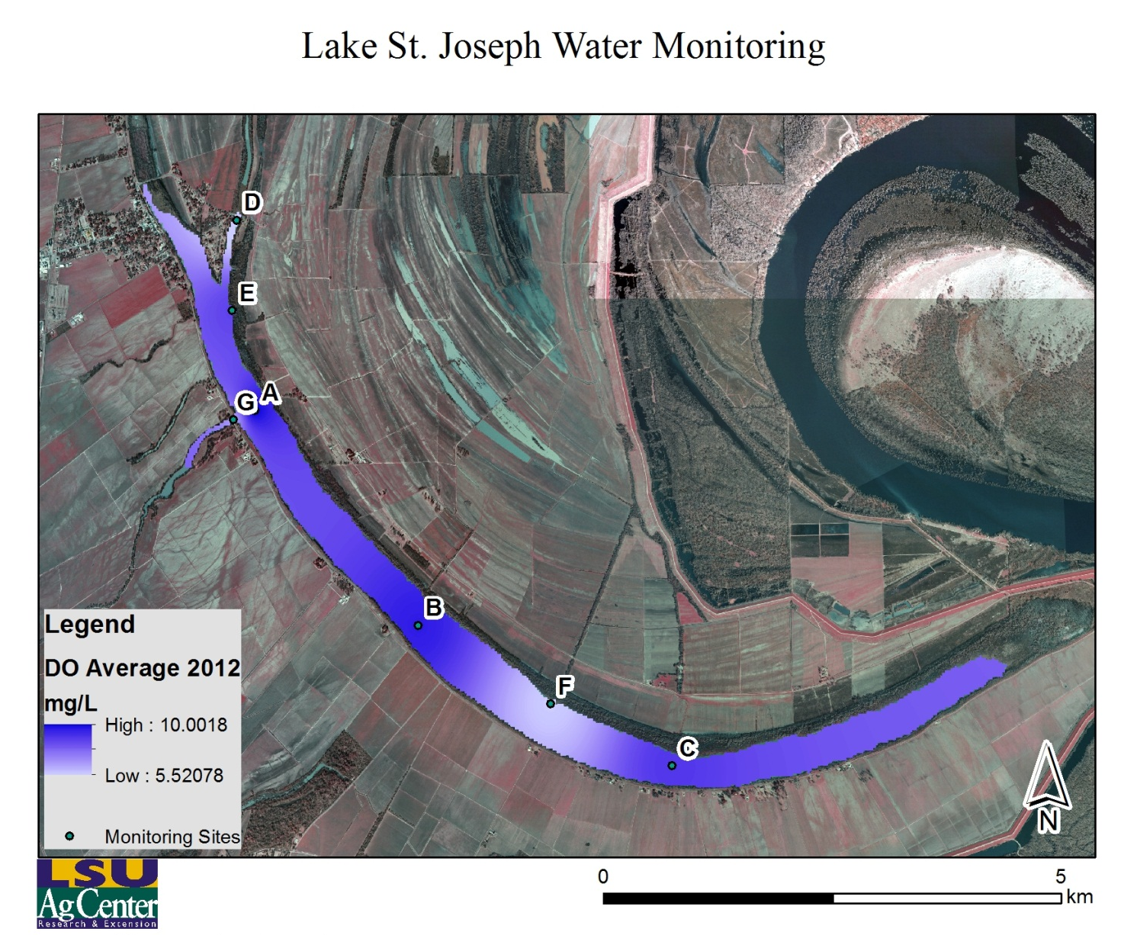
Objective 2

Slide 17
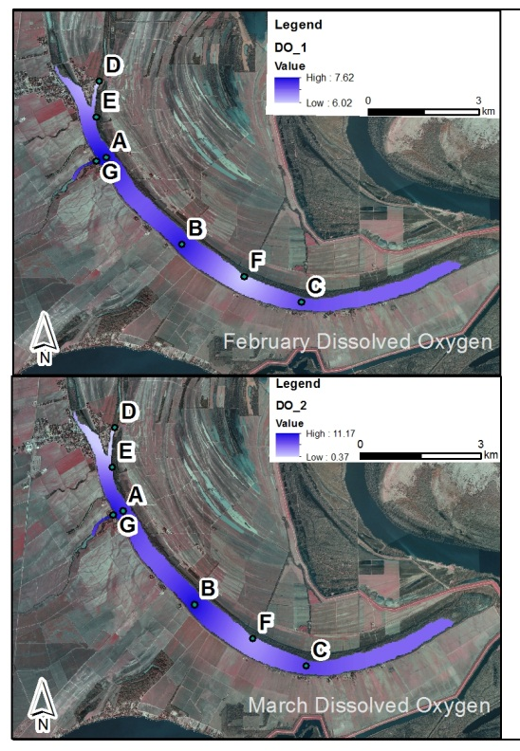
Dissolved Oxygen
Slightly lowered values at inflow sites
  D
  E
  F

Slide 18

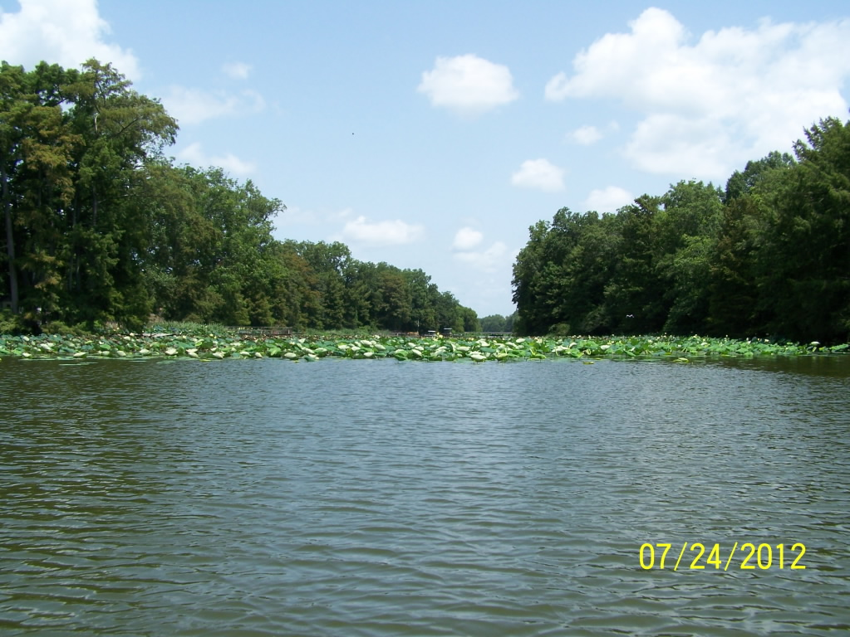


Slide 19
Objective 3
Generate updated baseline water quality data for Lake St. Joseph

Slide 20
Objective 3
Station ID | DO | EC | Temperature | pH | TDS
 | mg/L | µs/cm | ˚C |  | mg/L
A1 | 10.01 | 186 | 25.27 | 9.17 | 162
A2 | 7.84 | 186 | 24.85 | 9.02 | 158
B1 | 9.63 | 185 | 24.98 | 9.03 | 157
B2 | 8.44 | 186 | 24.54 | 8.96 | 144
C1 | 9.03 | 194 | 24.79 | 8.29 | 150
C2 | 7.56 | 197 | 24.42 | 8.08 | 160
D | 5.52 | 170 | 23.85 | 7.60 | 156
E | 8.76 | 184 | 25.58 | 8.71 | 155
F | 6.10 | 207 | 23.05 | 7.43 | 191
G† | 7.04 | 195 | 24.93 | 8.38 | 143

Slide 21
Objective 3
Station ID | DO | EC | Temperature | pH | TDS
 | mg/L | µs/cm | ˚C |  | mg/L
A1 | 10.01 | 186 | 25.27 | 9.17 | 162
A2 | 7.84 | 186 | 24.85 | 9.02 | 158
B1 | 9.63 | 185 | 24.98 | 9.03 | 157
B2 | 8.44 | 186 | 24.54 | 8.96 | 144
C1 | 9.03 | 194 | 24.79 | 8.29 | 150
C2 | 7.56 | 197 | 24.42 | 8.08 | 160
D | 5.52 | 170 | 23.85 | 7.60 | 156
E | 8.76 | 184 | 25.58 | 8.71 | 155
F | 6.10 | 207 | 23.05 | 7.43 | 191
G† | 7.04 | 195 | 24.93 | 8.38 | 143

Slide 22
Objective 3

Slide 23
Objective 3

Slide 24
Objective 3

Slide 25
Objective 3

Slide 26
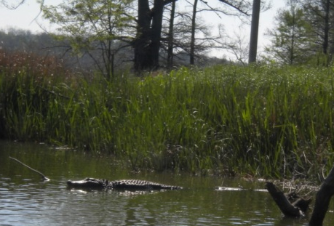
Obstacles

Slide 27
Obstacles
Accounting for influence of weather

Slide 28
Future work
3 Year Extension
Implementation of BMPs with selected landowners surrounding Lake St. Joseph
Continuation of water monitoring at the 7 sites
Addition of TOC

Slide 29
Questions?

