Slide 1
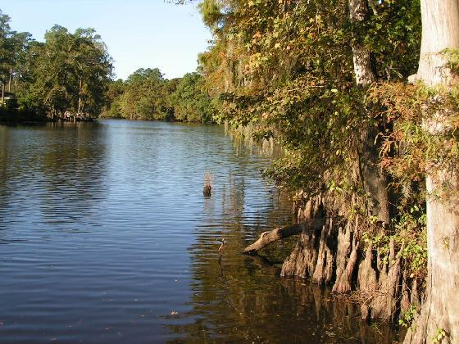
Nonpoint Source Pollution Reduction through Enhancement of the On-Site Wastewater Disposal System inspection and Education Outreach
Nonpoint Source Pollution Reduction through Enhancement of the On-Site Wastewater Disposal System Inspection and Educational Outreach
Calcasieu Parish, Louisiana

Slide 2
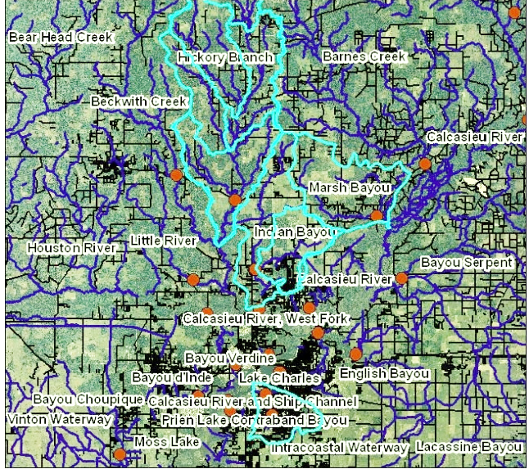
Introduction
Intent: Address Clean waters goal of removing 25% of impaired water bodies from 303(D) list by 2012
Goal: enhance existing parish mechanical sewer inspection program
Focus: Target four water bodies in Calcasieu river basin impaired for fecal coliform bacteria
Notes:
Impaired waterbody is
A waterbody with chronic or recurring monitored violations of the water quality criteria.
The four target water bodies are Marsh Bayou, Hickory Branch, Contraband Bayou and Indian Bayou.
Historic water quality monitoring has demonstrated exceedances of pathogenic organisms beyond acceptable standards. Failing or poorly managed individually owned on-site sewage systems are the suspected cause of the presence of the microbial contamination.

Slide 3

Program Structure
Inspect all home mechanical sewer systems in the unincorporated areas of Calcasieu Parish
Develop public awareness program to inform residents of importance of proper sewer system maintenance
Notes:
Prior to the inspector entering an area a letter is sent out to inform the residence that the inspectors will be in the areas soon to conduct an inspection of the sewer system.
Prior to the initiation of the inspections, a public education and awareness campaign has been carried out to inform the public of the planned program. The public awareness program is projected to continue throughout the duration of the three year grant period and beyond. Public Service Announcements through the C-Gov, Calcasieu Parish's government channel, parish website information, flyers.

Slide 4
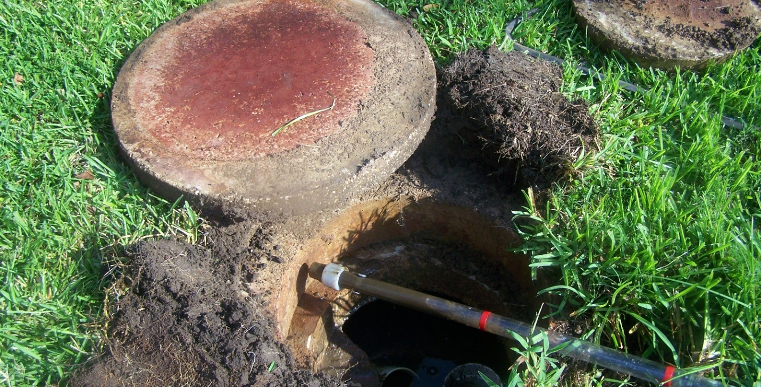
Inspections

Slide 5
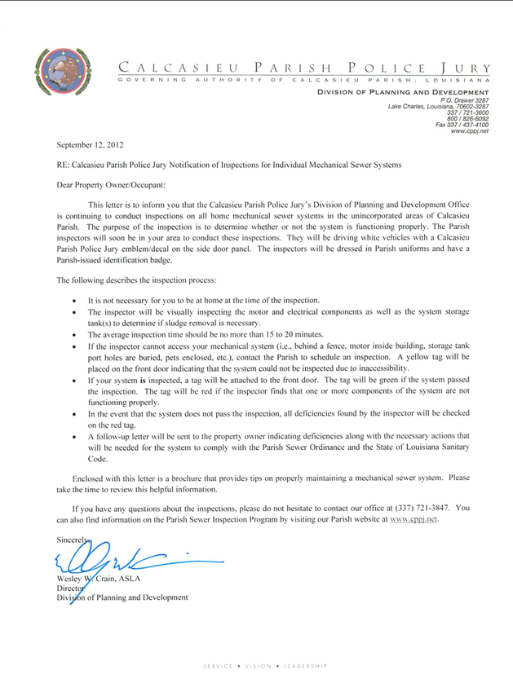
Notes:
Before an inspection occurs, a letter is sent out informing the property owner that the inspectors will be in the area soon to conduct an inspection of their sewer system.
The letter goes on to describe the inspection process
It is not necessary for you to be at home at the time of the inspection.
The inspector will be visually inspecting the motor and electrical components as well as the system storage tanks to determine if sludge removal is necessary.
The average inspection time should be no more than 15 to 20 minutes.
If the inspector cannot access your mechanical system (i.e., behind a fence, motor inside building, storage tank port holes are buried, pets enclosed, etc.), contact the Parish to schedule an inspection. A yellow tag will be placed on the front door indicating that the system could not be inspected due to inaccessibility.
If your system is inspected, a tag will be attached to the front door. The tag will be green if the system passed the inspection. The tag will be red if the inspector finds that one or more components of the system are not functioning properly.
In the event that the system does not pass the inspection, all deficiencies found by the inspector will be checked on the red tag.
A follow-up letter will be sent to the property owner indicating deficiencies along with the necessary actions that will be needed for the system to comply with the Parish Sewer Ordinance and the State of Louisiana Sanitary Code.
Enclosed with this letter is a brochure that provides tips on properly maintaining a mechanical sewer system. Please take the time to review this helpful information.

Slide 6
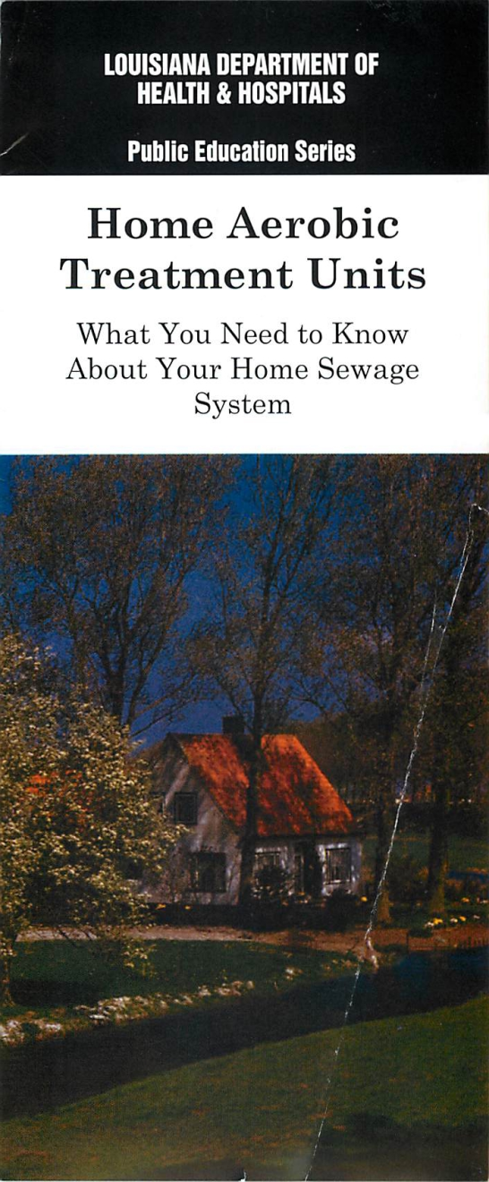
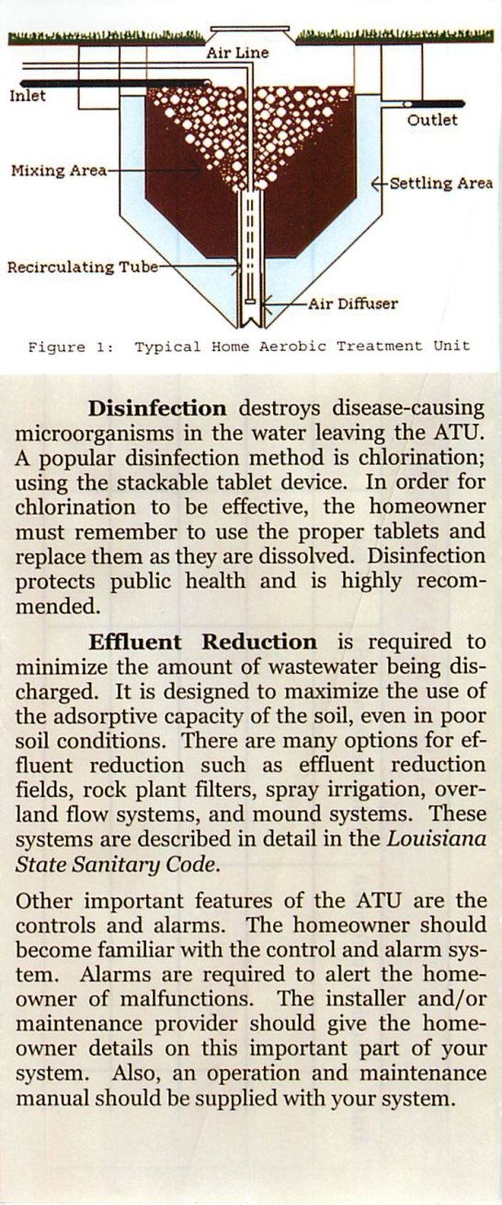
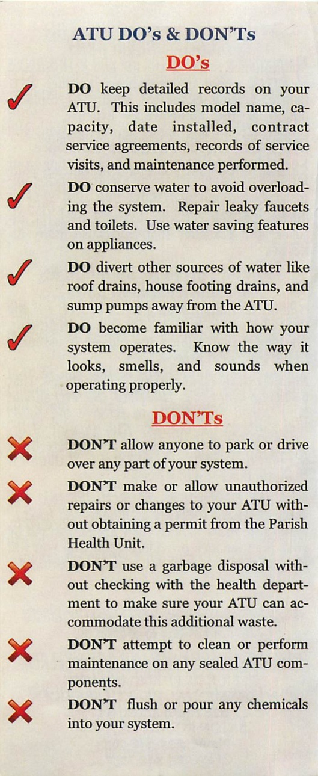
Notes:
A pamphlet, regarding the importance of inspection and maintenance of the sewage systems is included with the letter.

Slide 7
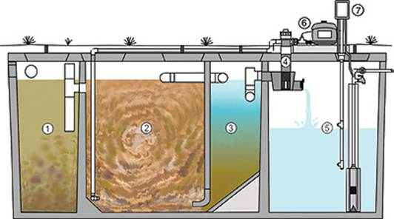
1. Pretreatment tank
2. Aeration chamber
3. Clarifier chamber
4. Chlorinator
5. Holding tank.
6. Aerator and pump.
7. Control Center monitors
Notes:
1. Pretreatment tank where influent enters.
2. Aeration chamber where oxygen is pumped into the waste water
3. Clarifier chamber where the clear, odorless effluent rises.
4. Chlorinator the clear effluent passes through for disinfection. *
5. Chlorine Contact Chamber or Holding tank for disinfected effluent ready for discharge.
6. aerator and pump.
7. Control Panel that operates the entire system

Slide 8
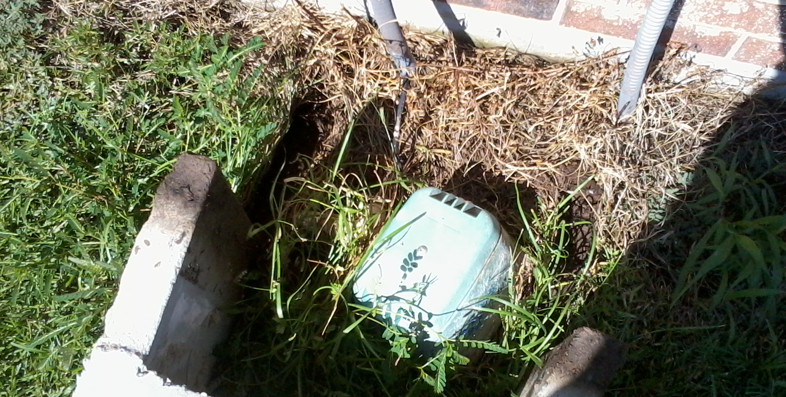
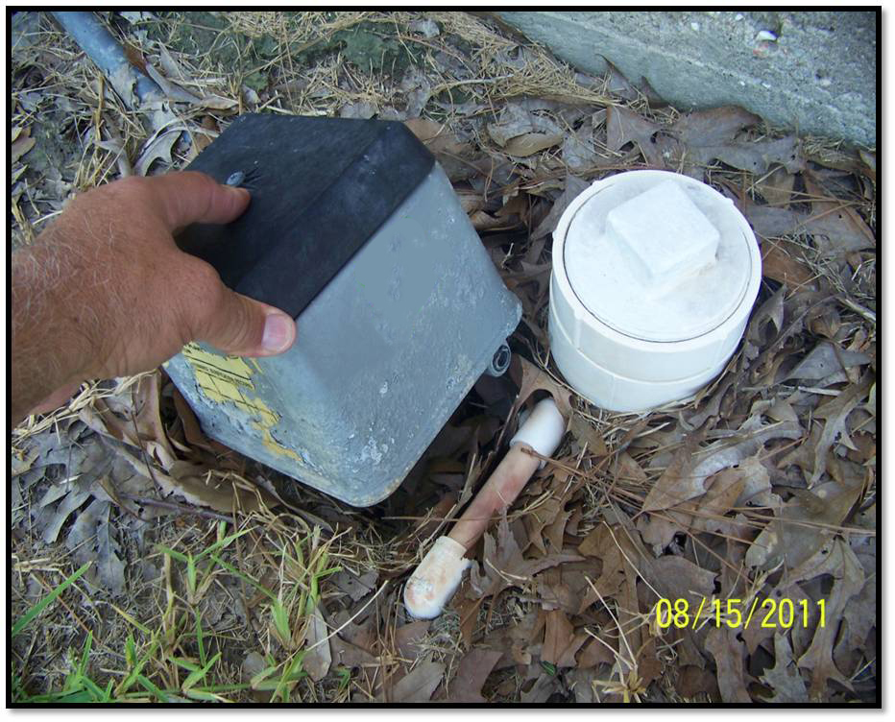
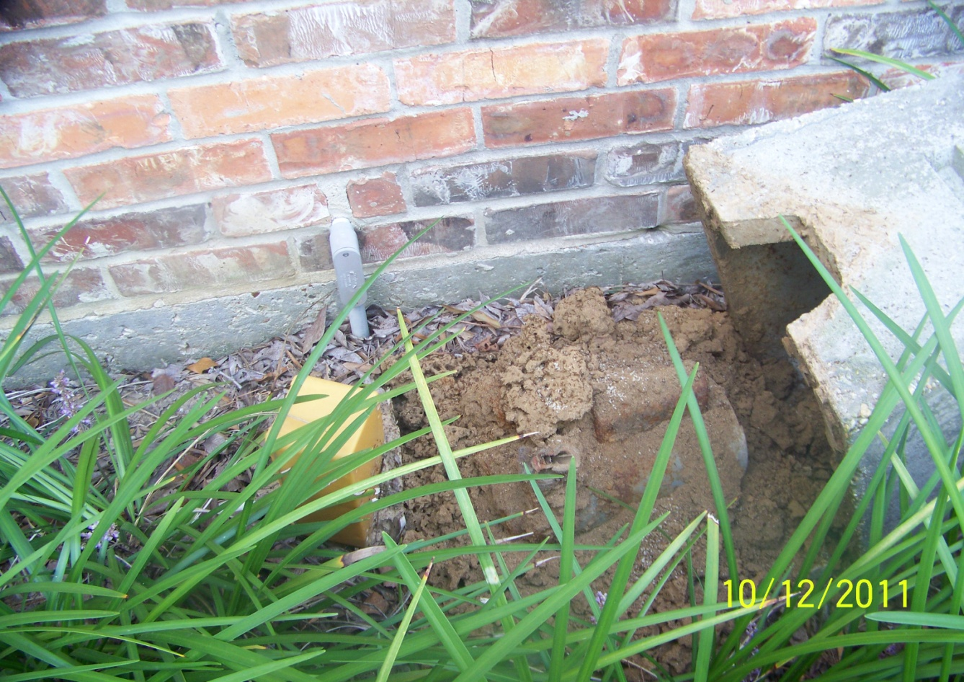
Motor
Air Line
Ants
Notes:
Look for evidence of a functioning motor.
i.e. is it have an electrical supply? is it running, it is inundated with grass or ants ect.

Slide 9
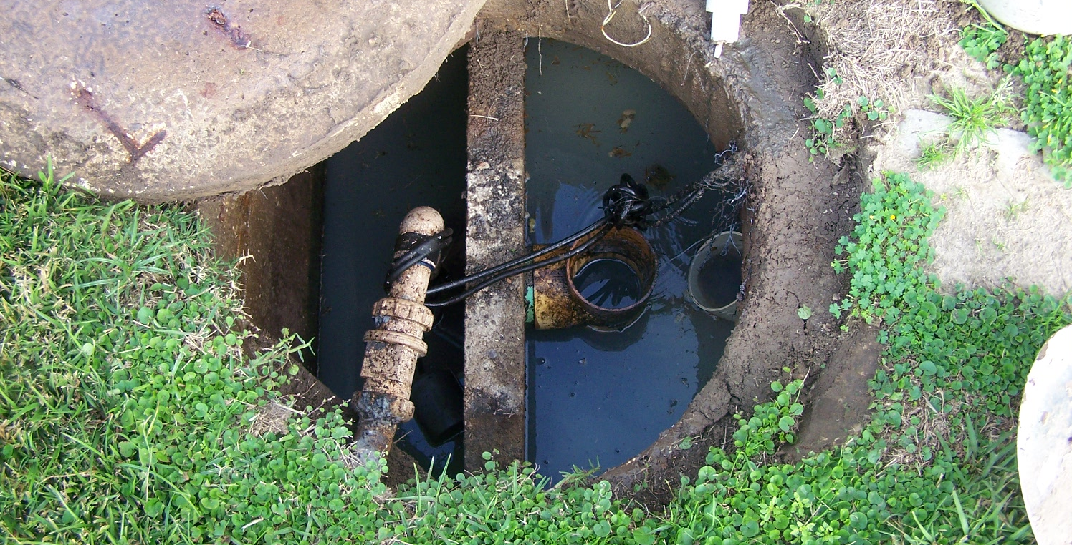
Tank
Notes:
They perform a visual inspection to ensure air from the motor is being introduced into the tank
They then visually inspect for sludge.
Is there excessive sludge build up? If so they perform a Sludge test with an instrument called a Sludge Judge

Slide 10
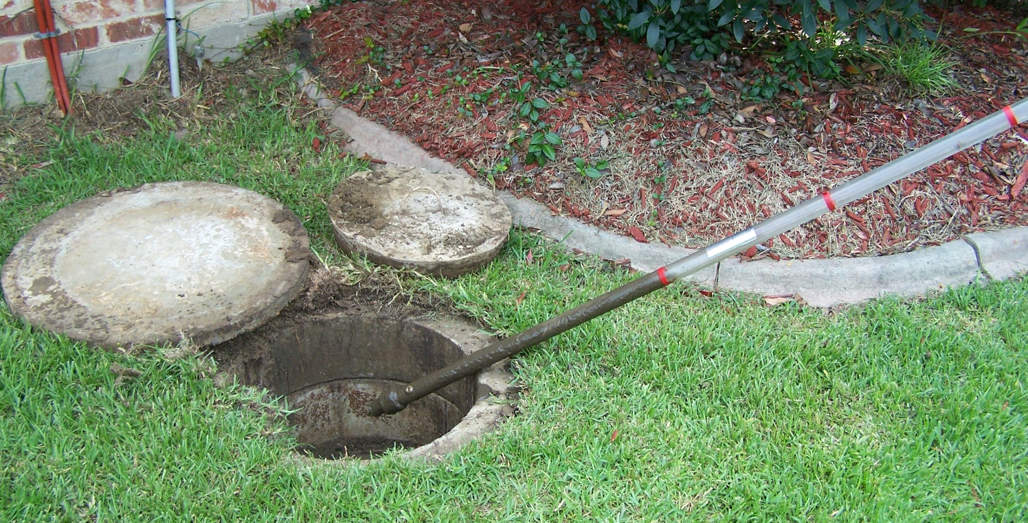
Sludge Judge
Notes:
Sewage sludge is a thick sludge of solid materials which settle out from wastewater during the treatment process.
Under normal conditions, sewage sludge will rapidly undergo anaerobic fermentation, with bacteria which thrive in an oxygen-free environment breaking down the sludge.
A system will fail an inspection if there is 50% sludge.

Slide 11
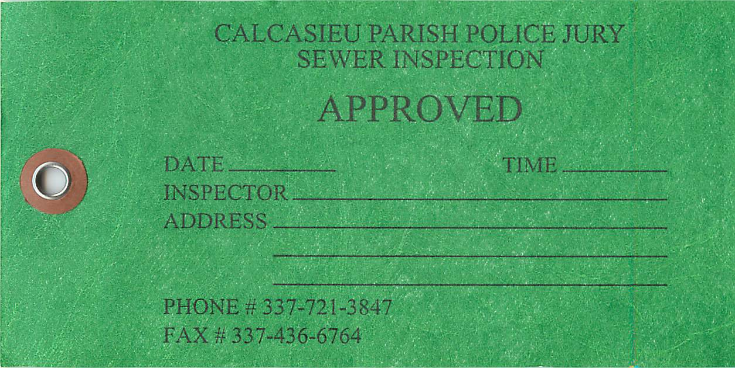
Inspection Tags
Notes:
If a system is approved it is issued a green tag and no further actions is required

Slide 12
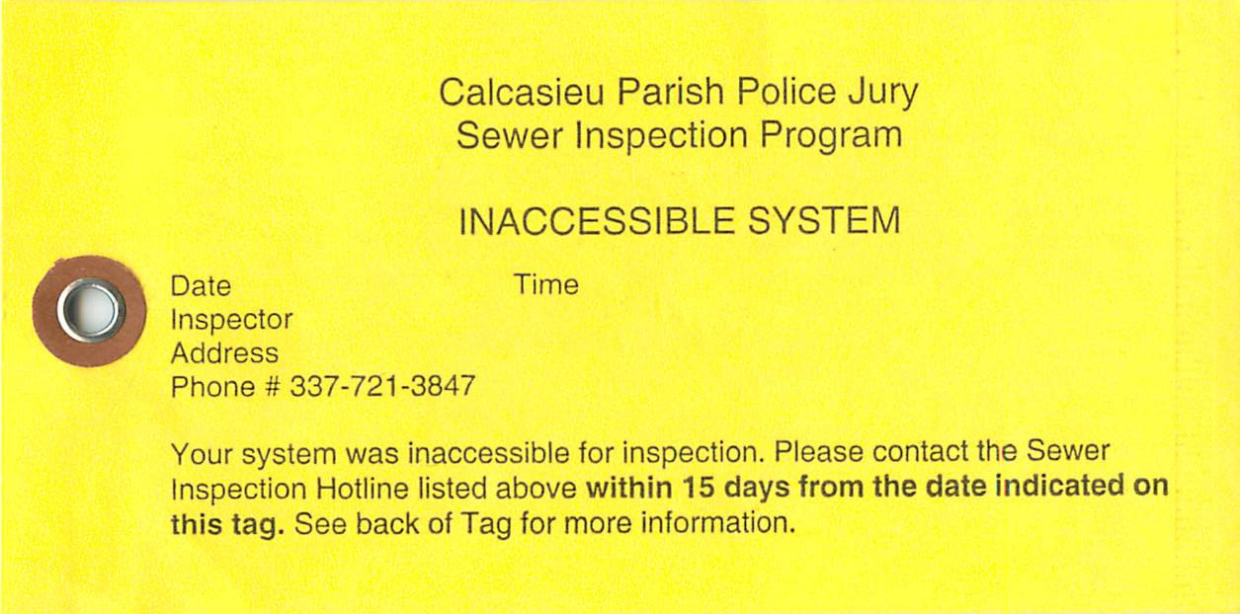
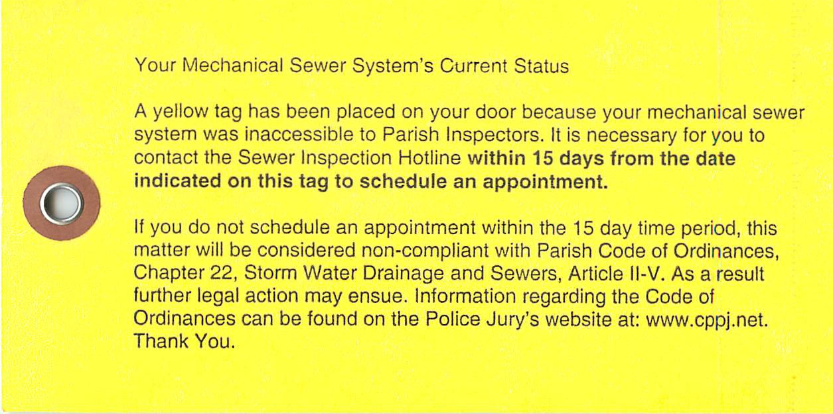
Notes:
If the system is inaccessible to the inspector, they are issued a yellow tag . A system may be inaccessible because of its location or as a result of a property owner restricting the parish access to his or her property. In the case of inaccessibility, a property owner is required to schedule an appointment with an inspector within 15 days. If the owner fails to do so, it will be considered non-complaint and can be issued a civil penalty.

Slide 13
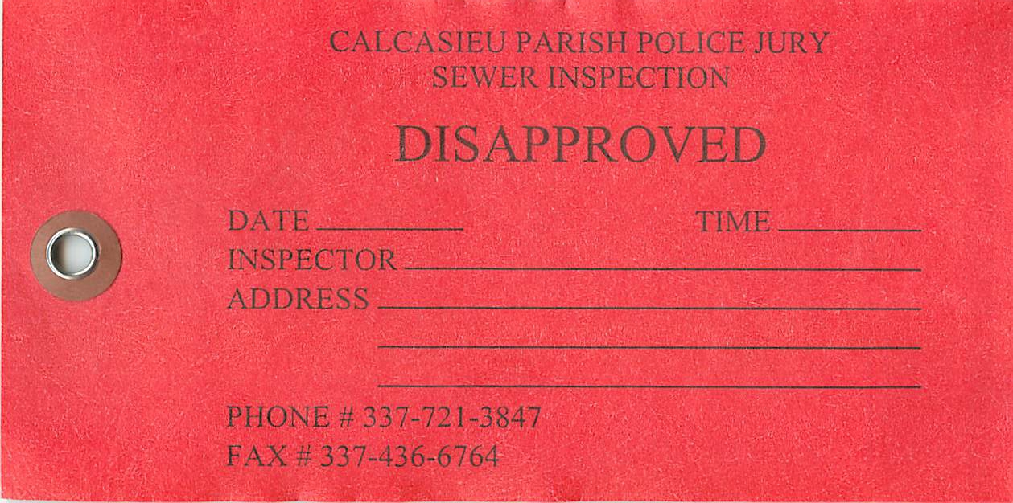
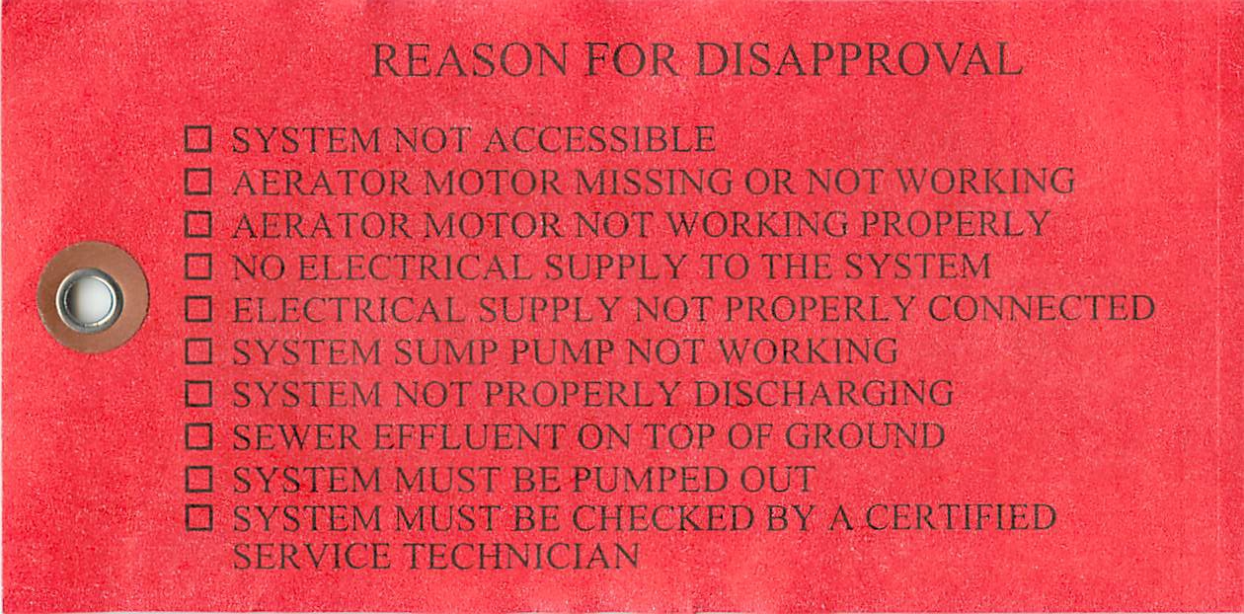
Notes:
If a system is found to be out of compliance a red tag noting the reason for disapproval. The tag is followed up by a letter citing the violation and the owner of the property is given 30 to bring the system into compliance. After the 30 they are subject to civil penalties. The owner is required to submit proof of repairs and or proof of a pumpout.

Slide 14
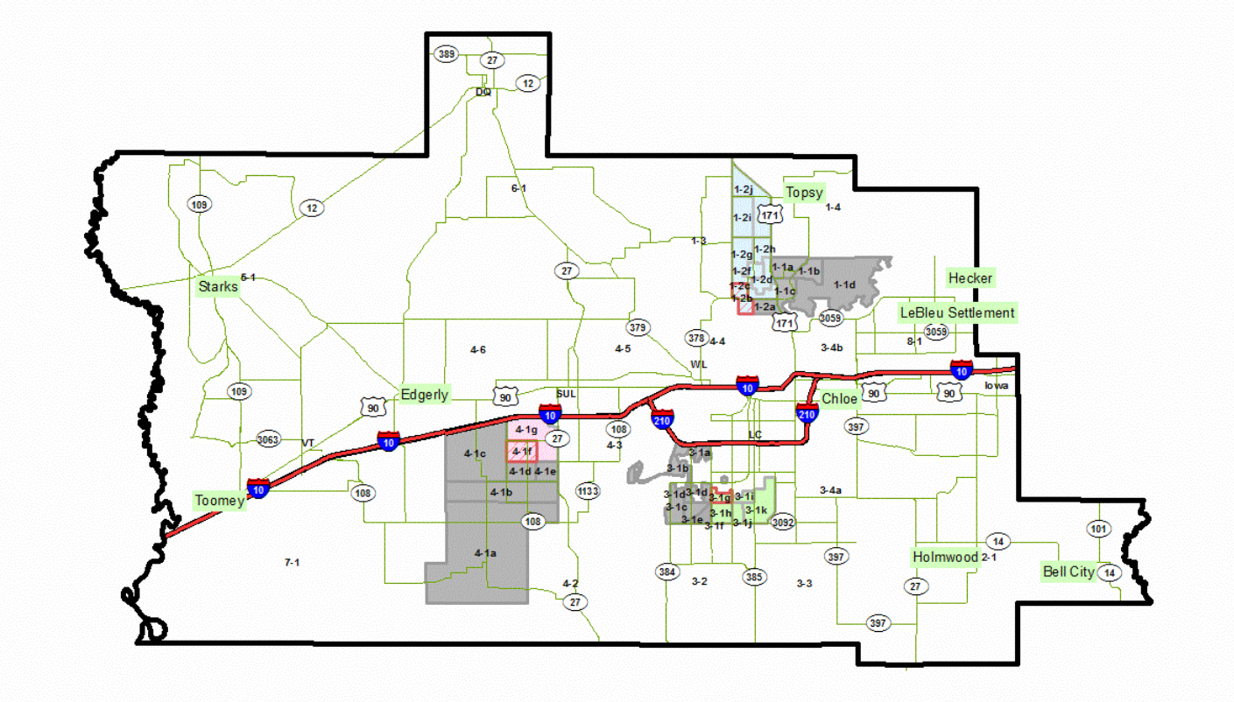
Parish Map
Notes:
The parish is divided into 8 wards. We are currently inspecting 3 wards.

Slide 15
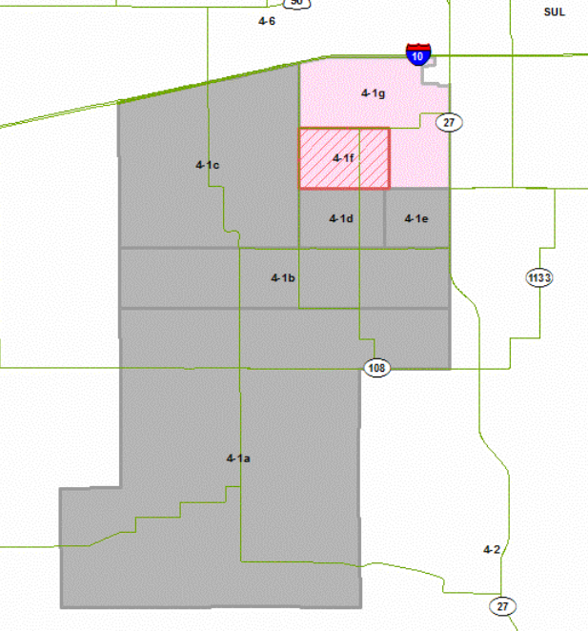
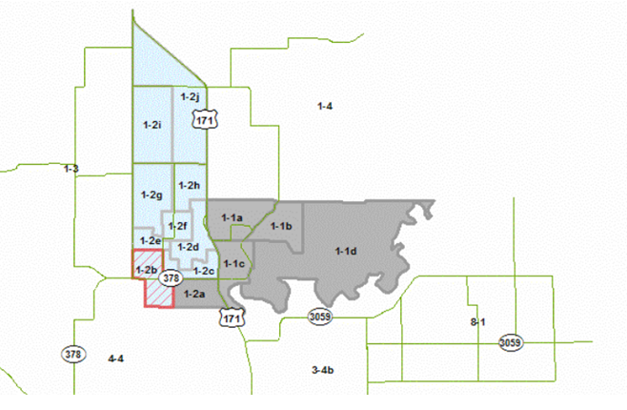
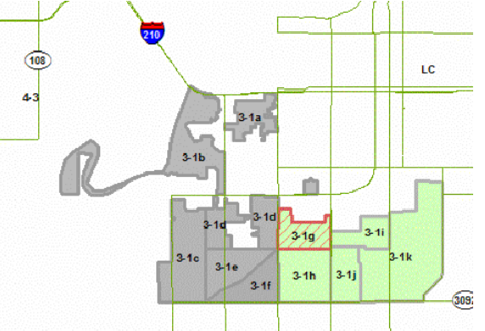
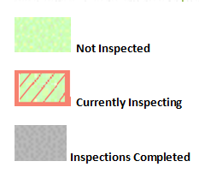
Notes:
Colored areas indicate areas that are yet to be inspected
Hatched areas indicate areas that are currently being inspected
And Grayed areas indicate areas where inspection have been completed

Slide 16
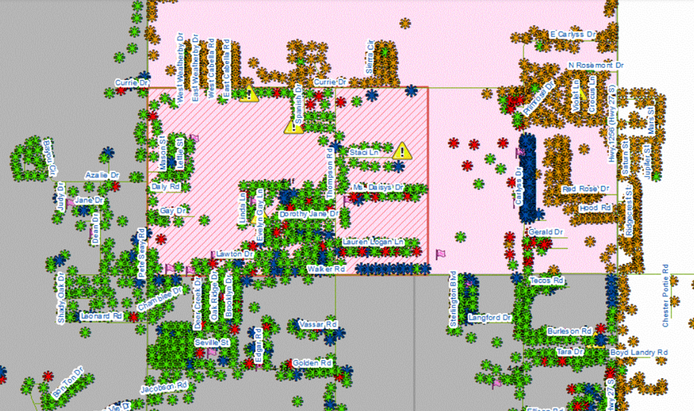
GIS tracking system
Notes:
GIS is used to track inspections.
Green System is approved
Red System is not in compliance
Yellow System has not been inspected
Blue
Yield Owner has scheduled an
Stop sign Owner has indicated we aren’t allowed on their property

Slide 17
Progress Report
Overall Inspections
Total Mechanical Plant Inspections:-------4,192 (12.7%)
Total Mechanical Plant Approved:-------- 2,942 (70%)
Total Mechanical Plant Disapproved:------1,250 (30%)
Total Other Systems Inspections:---------- 733
Total Other Systems Approved:------------600
Total Other Systems Disapproved:--------- 133
Notes:
Overall Inspections
Total Mechanical Plant Inspections:-------4,192 (12.7%)
Total Mechanical Plant Approved:-------- 2,942 (70%)
Total Mechanical Plant Disapproved:------1,250 (30%)
Total Other Systems Inspections:---------- 733
Total Other Systems Approved:------------600
Total Other Systems Disapproved:--------- 133

Slide 18
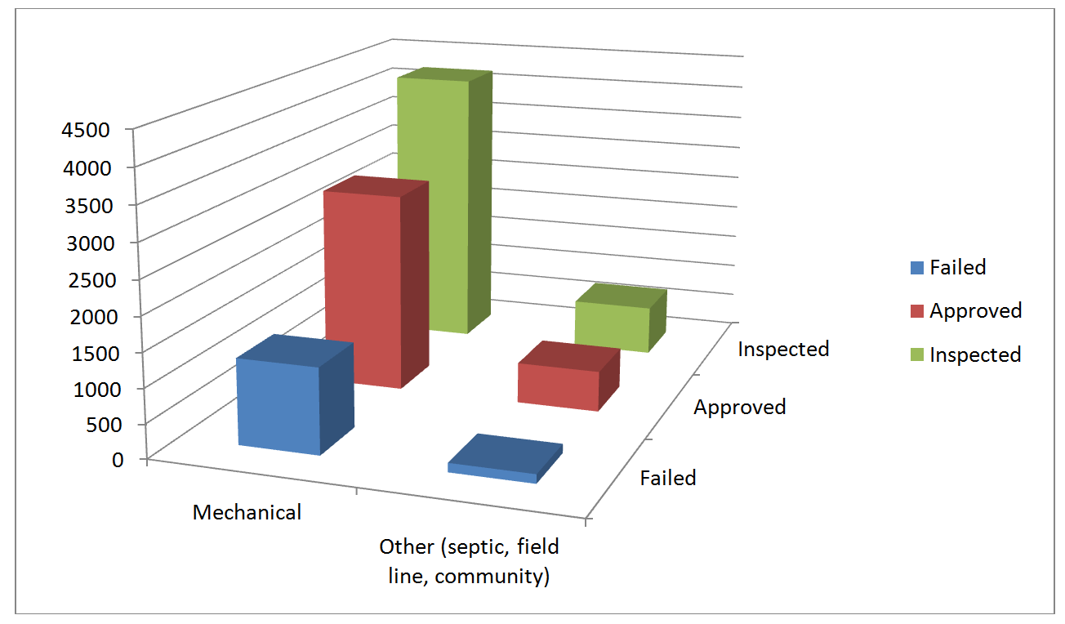
Sewer Inspections
January 23, 2012 – October 31, 2012
Notes:
A total of 1,383 systems (including mechanical plants, septic, field line and community systems) were initially determined to be malfunctioning. A total of 1,064 systems have had the proper maintenance or enhancements and have been deemed functional upon re-inspection. On average, 300 gallons of water are treated by these systems daily. Given that, the water quality of an estimated 319,200 gallons per day has improved.

