Slide 1
Nonpoint Source Pollutant Reduction in Tensas River Watershed Using a Vegetated Filter Strip - Retention Pond System
Principal Investigator: Beatrix Haggard, Ph.D.
Co-Principal Investigators:
James Hendrix
Donnie Miller, Ph.D.

Slide 2
Background

Slide 3
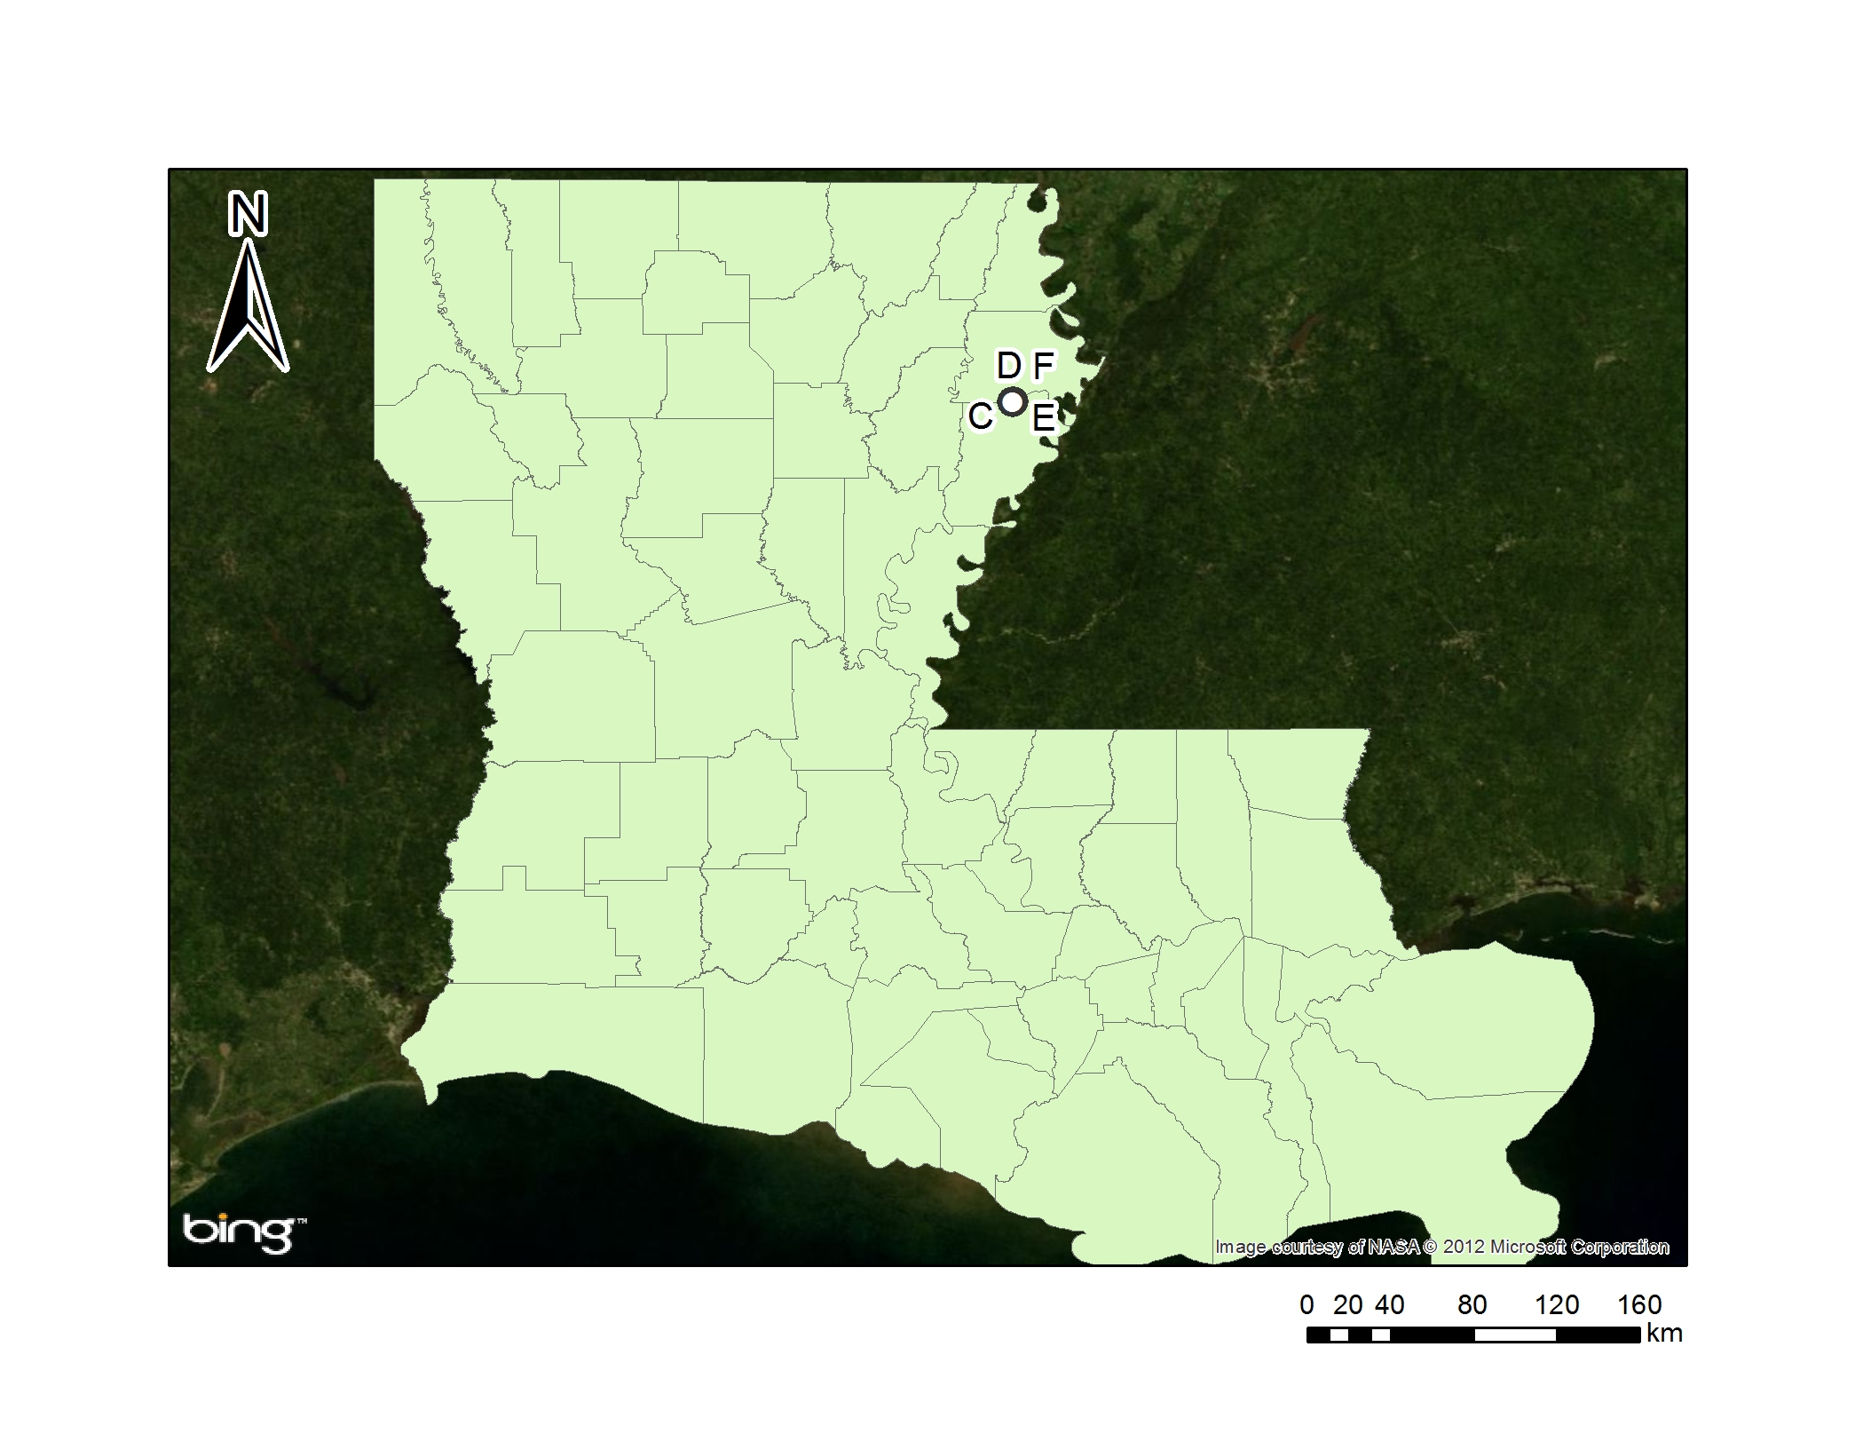
Tensas River (081201)

Slide 4
Tensas River (081201)

Slide 5
Tensas River
Added to 305(b) list in 2005 for not supporting wildlife propagation
Impairments
Pesticides
Nutrients
Total suspended solids (TSS)
Turbidity

Slide 6
Objectives

Slide 7
Objectives
Construct modifications to retention pond and vegetated filter strip
Collect water samples
Analyze water data

Slide 8
Instrumentation
Water sampling
ISCO 6700 & 3700, equipped with 350 mL glass bottles
YSI 556 MPS

Slide 9
Methods
Sample Collection at sites A, B, C, and D
Fixed samples were collected using ISCO 3700

Slide 10
Methods
Sample collection at sites E and F
Pull samples were collected using ISCO 6700
In-situ analysis via YSI 556 MPS

Slide 11
Objective 1
Construct modifications to retention pond and vegetated filter strip, install samplers

Slide 12
Objective 1
Install vegetated filter strip to reduce particulates
Originally bermuda, a poor stand was achieved
Wheat was used successfully
Provided surface residue for extended filtering

Slide 13
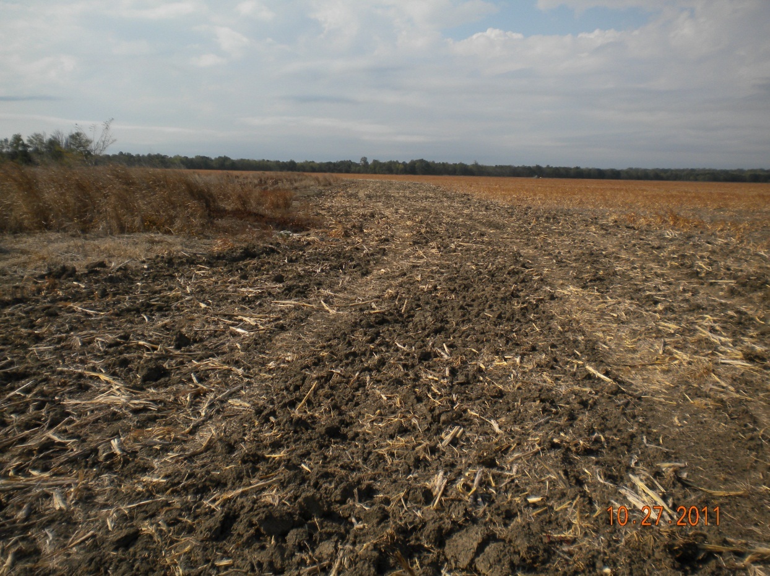
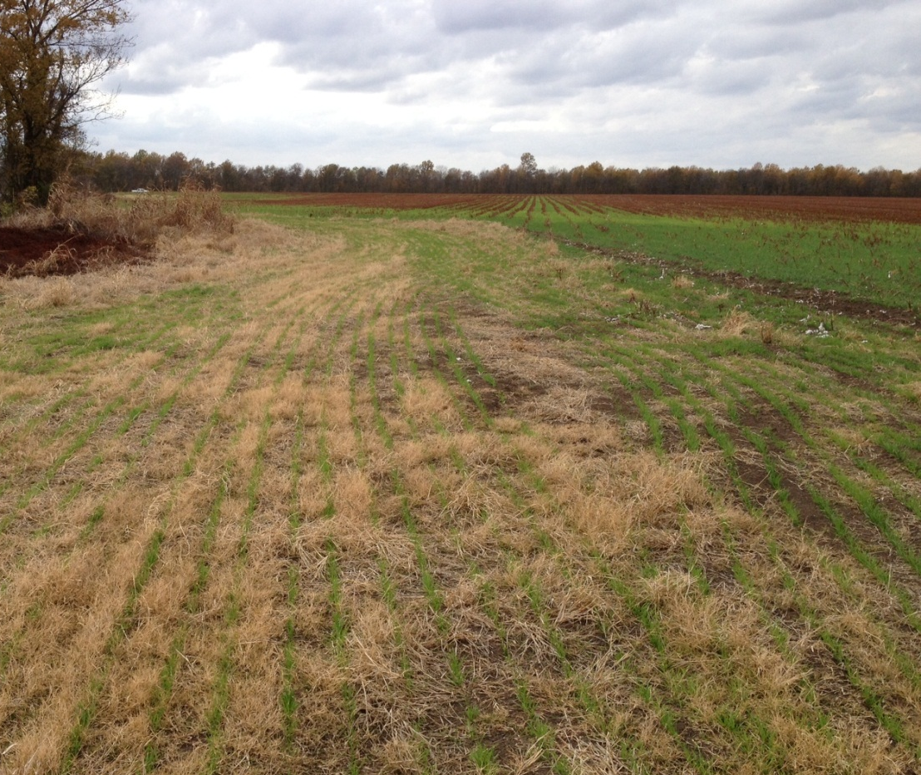
Filter strip
Before 2011
After 2012

Slide 14
Sampler installation

Slide 15
Water control
Water control structures are meant to control agricultural runoff from 570 acres in production
Located at the outlet locations
E (higher)
F (lower) – Flows into Bayou du Rosset
4.9 km to Bayou du Rosset
8.64 km to Tensas River

Slide 16
Tensas River Filter Strip

Slide 17
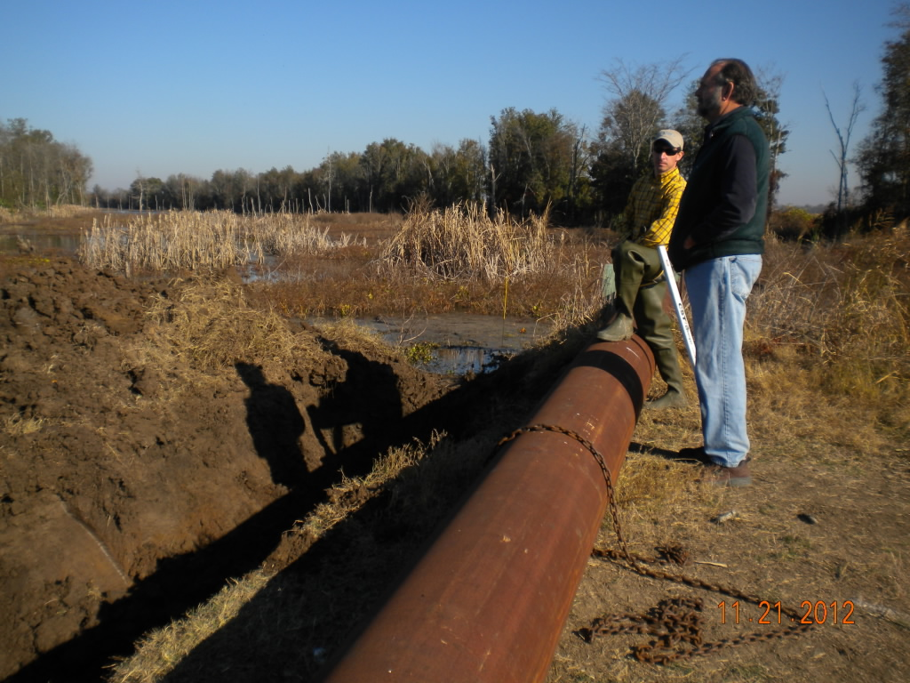
Pipe installation
Pipe drop

Slide 18
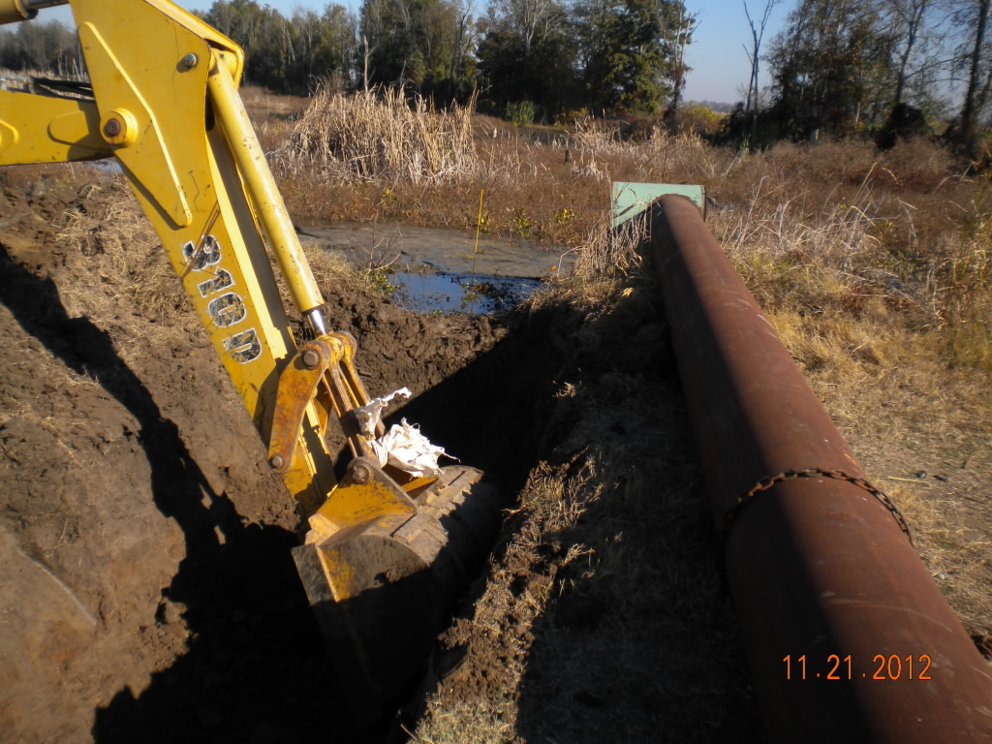
Pipe installation
Pipe drop

Slide 19
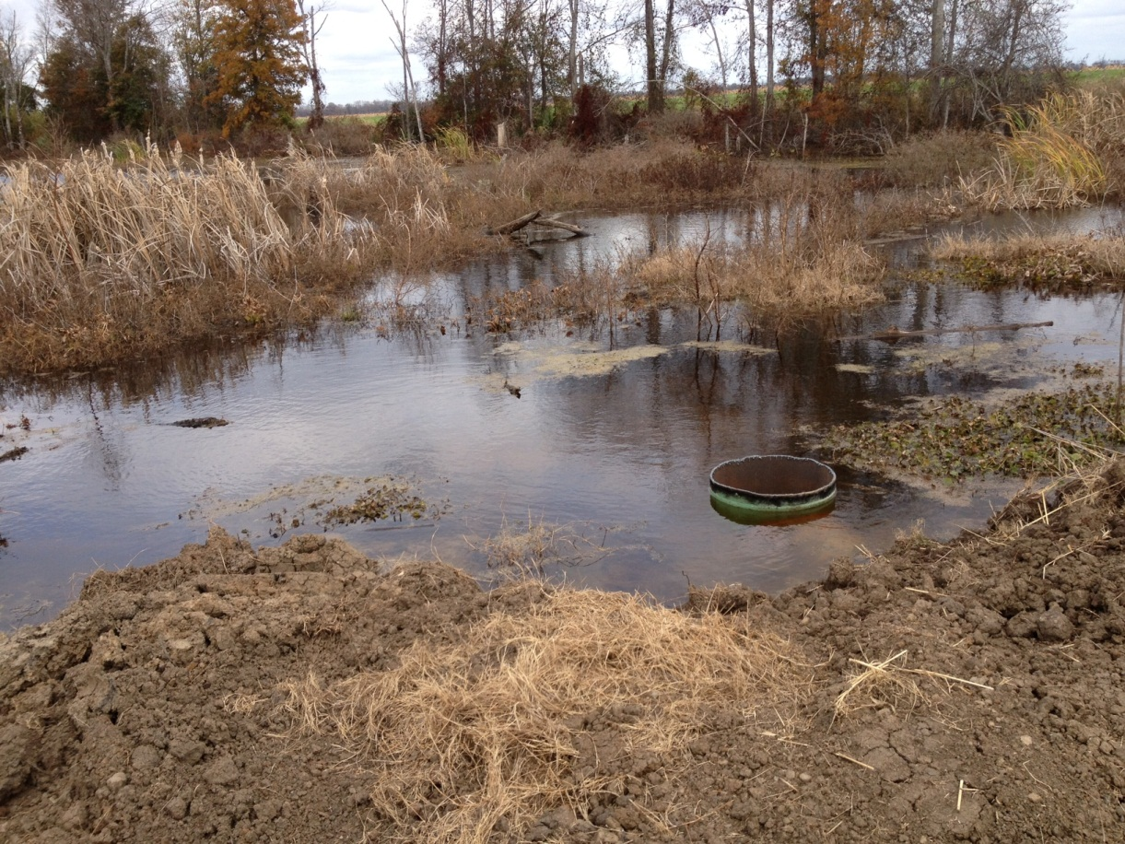
Pipe installation
Pipe drop

Slide 20
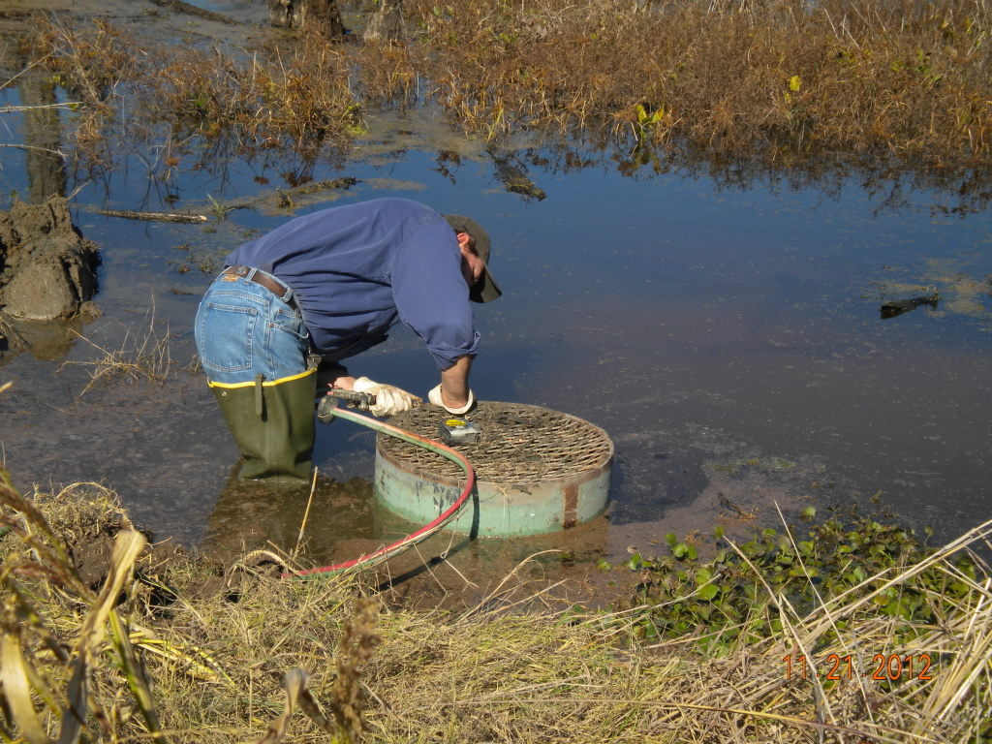
Pipe installation
Pipe drop

Slide 21
Objective 2
Collect water samples

Slide 22
Sample collection
Sites A, B, C, D
Samples are fixed using H₂SO₄
Allows for multiple days to access sample sites

Slide 23
Sample collection
Sites E and F
Pulled from the retention pond

Slide 24
Objective 3
Analyze Water Data

Slide 25
In-situ water parameters
Site | DO | EC | pH | Temperature
September
E | .21 | 153 | 6.31 | 22.67
F | 1.27 | 118 | 6.27 | 23.13
October
E | 2.33 | 158 | 5.26 | 21.31
F | .20 | 148 | 5.88 | 20.63
November
E | 6.51 | 171 | 6.83 | 12.04
F | ---- | ---- | ---- | ----

Slide 26
Obstacles
Sites A, B, C, and D
Samplers actuating before enough water has collected
Waiting for roads to dry out enough to become passable
Need to account for disturbance in sediment caused by installing the drop pipe
Alligators eating tubing

Slide 27
Complete
Filter strip has been put into place
Wheat and bermuda combination is working well
Installation of drainage system for the retention pond
Sampling commenced in September 2012

Slide 28
Future work
Continue sampling after rainfall events
Installing a new site at the inflow from the crop field

Slide 29
New Site

Slide 30
Questions?

