Slide 1
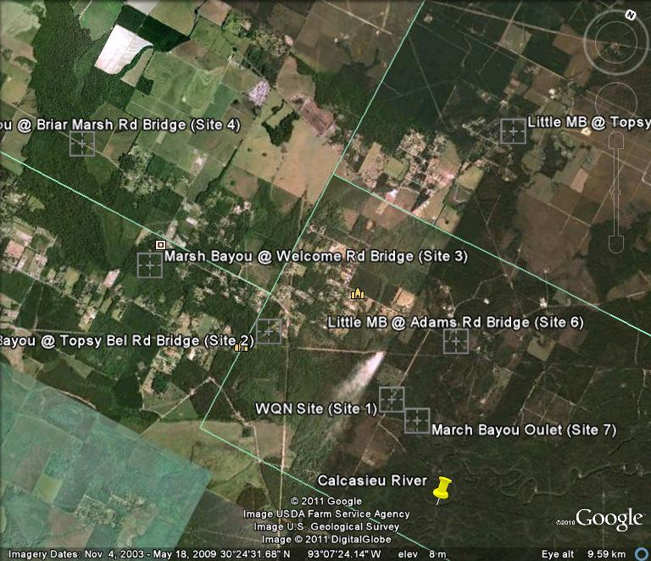
Watershed Monitoring for Marsh Bayou (030603)
LDEQ NPS Program

Slide 2
Goals
To investigate water conditions at loading sites identified by the AnnAGNPS model and at other points in the watershed to identify potential NPS pollution loading points
To identify potential sources of NPS loading coming into the watershed
To monitor attainment for water quality criteria
To identify where potential BMPs are needed within the watershed

Slide 3
Recon Work
Met with Surveys group to go out and recon potential sites
Evaluated sites for potential flow and tape down measurements
Evaluated AnnAGNPS model outputs for loading to the stream
Gained access to stream below ambient site for data comparison

Slide 22
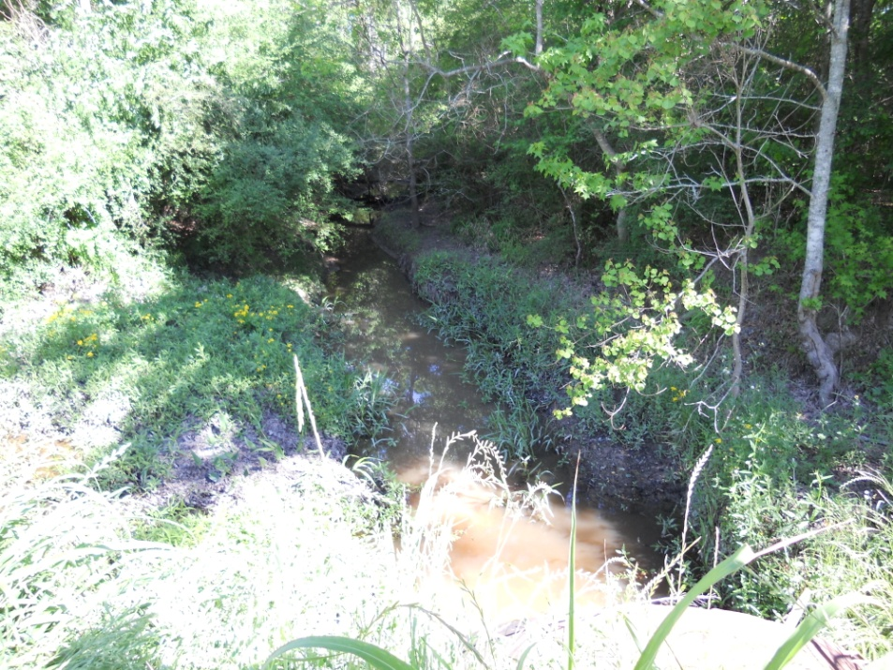
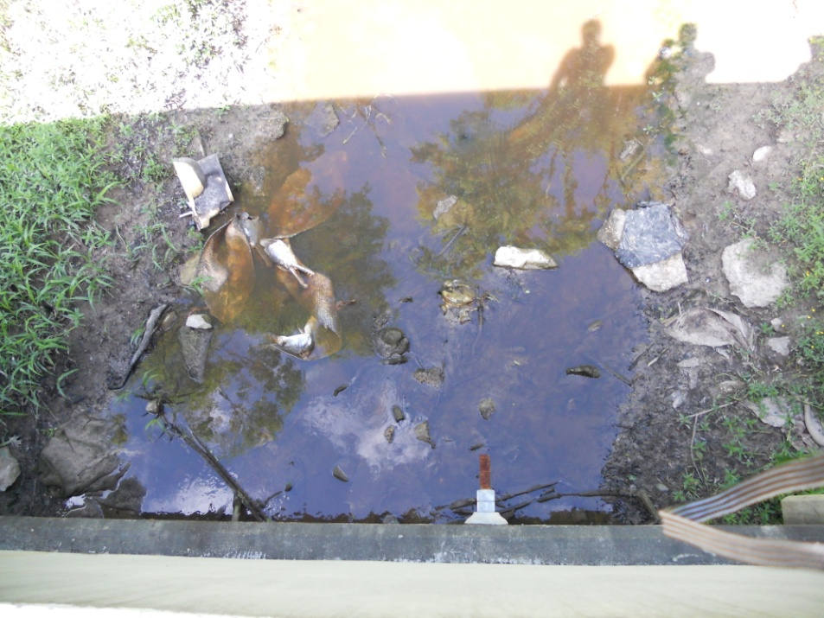
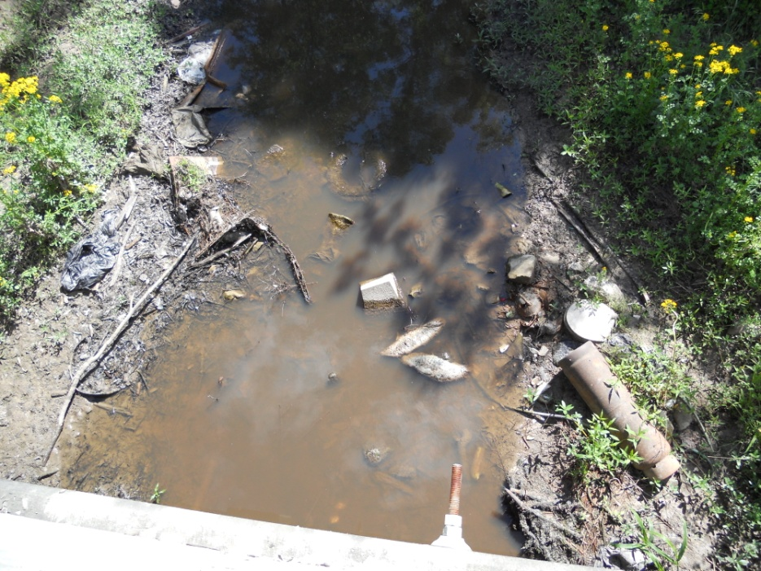
Site 4017
Site 4016

Slide 23
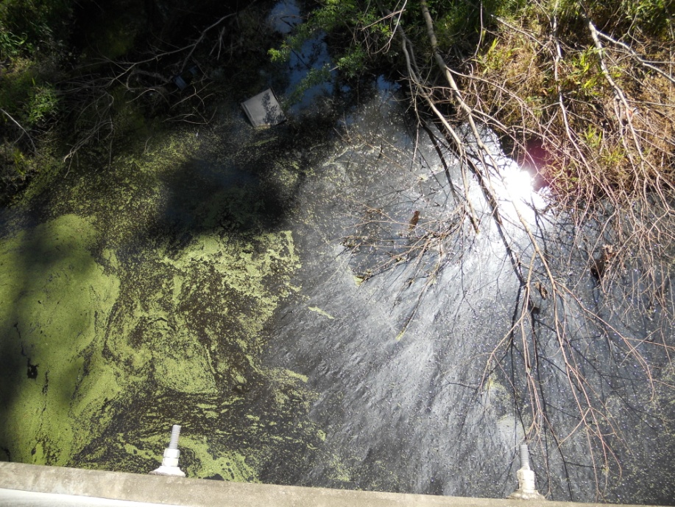
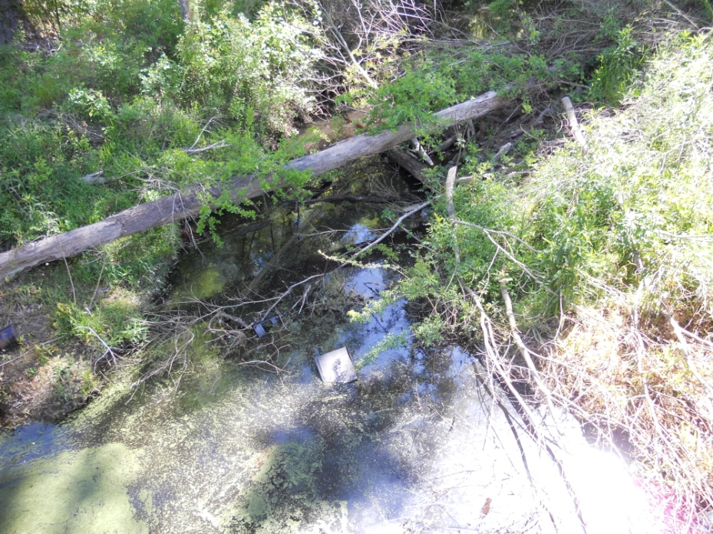
Site 4015
Site 4018

Slide 24
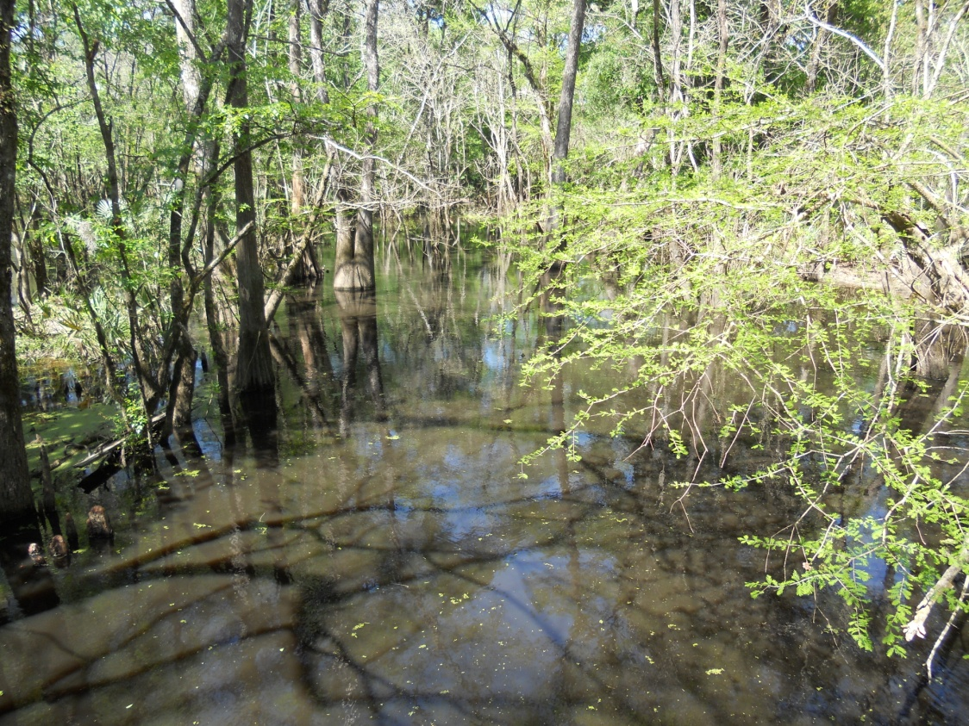
Site 4019
WQN Ambient Site

Slide 25
Conclusions
Bacteria problem seems to exist throughout the waterbody, however the source was not determine.
Lack of flow through out the year during ambient conditions.
DO problem may be more flow than pollutant related.
Current ambient site may not be representative of the stream, at least, in the case of DO.

